Slide 1
Illuminating Our Power, Unveiling Our Truth! 2019 Black Issues Conference University of Tennessee Stand up and be COUNTED!
KIMBERLY SMITH, MBA
EAST TN PARTNERSHIP SPECIALIST
US CENSUS BUREAU

Slide 2
Agenda
US Census Bureau
Customized for UTK 14th Annual Black Issues Conference
January 2019
U.S. Census Bureau Overview
History of the Census Bureau
Unveiling Our Truth: Understanding Census Data
* Minority communities by the numbers
* Minority communities on the map
Illuminating Our Power: 2020 Census
* Census Obstacles
* Live “Census”
* Proposed Solutions
Questions

Slide 3
U.S. Census Bureau Overview

Slide 4
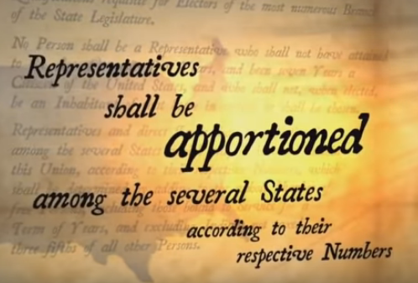
U.S. Census Bureau
Mission:
Serve as the leading source of the nation’s data. We honor privacy, protect confidentiality, share our expertise globally, and conduct our work openly.
Mandated by Article 1, Section 2 of the U.S. Constitution
Largest peacetime mobilization
Conducted every 10 years
Counts every resident in the United States
Records are kept confidential for 72 years until released by the National Archives.
1.4 million workers in 2010

Slide 5
U.S. Census Bureau Data Uses
Drawing federal, state, and local legislative districts.
Attracting new businesses to state and local areas.
Forecasting future transportation needs
for all segments of the population.
Planning for hospitals, nursing
homes, clinics, and the location
of other health services.
Analyzing local trends.
Development of rural areas.
Decision making at all levels of government.
Estimating people displaced by natural disasters.
Developing American Indians/Alaska Natives programs
Creating maps to speed emergency services to
households in need of assistance.
Planning future government services.
Distributing medical research.
Establishing fair market rents and enforcing fair lending
Drawing school district boundaries.
Planning budgets for government
at all levels.
Spotting trends in the economic well-
being of the nation.
Planning health and educational services
for people with disabilities.
Planning for public transportation services.
Reapportioning seats in the House of Representatives.
Determining areas eligible for housing assistance and rehabilitation loans.
Distributing annually
$675 billion+
federal funds

Slide 6
Census Bureau Programs & Survey
The U.S. Census Bureau conducts more than 100 surveys of households and business across the nation each year including:
Economic Census
Decennial Census
Census of Governments
Statistics of US Businesses
American Community Survey
American Housing Survey
Current Population Survey
Survey of Income and Program Participation

Slide 7
American Community Survey
72 questions cover over 35 topics
The ACS is our only source of detailed data about communities across the nation.

Slide 8
U.S. Census Bureau History

Slide 9
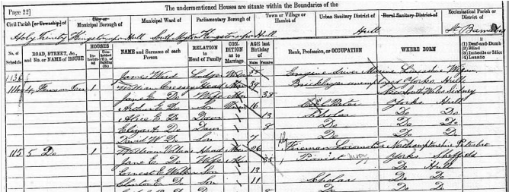
U.S. Census Bureau History Cont.
1790-1800
The first census in 1790 was managed under the direction of Thomas Jefferson, the Secretary of State.
Congress assigned responsibility for the 1790 Census to the marshals of the U.S. judicial districts.
The pay allowed for the 1790 "enumerators" was very small, and did not exceed $1 for 50 people properly recorded.
Marshals took the census, by horseback, in the original 13 states plus the districts of Kentucky, Maine, Vermont, and the Southwest Territory .

Slide 10
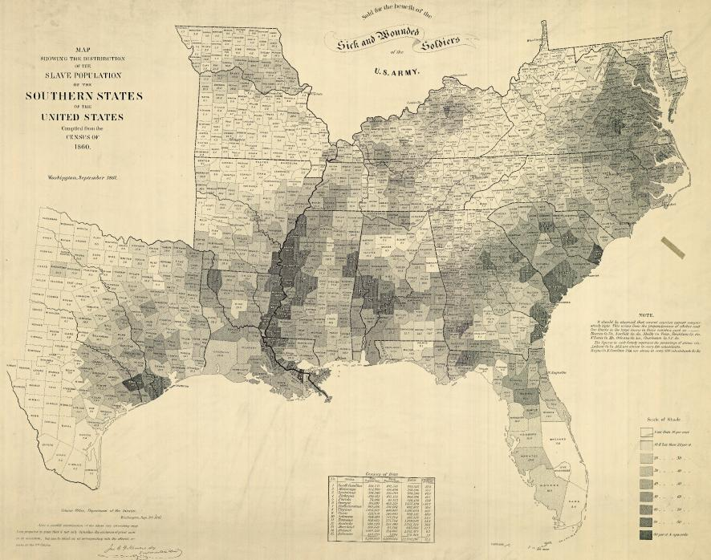
U.S. Census Bureau History Cont.
1810-1910
In addition to population inquiries, the 1810 census was the first to collect data about the nation's manufactures.
The 1850 saw two questionnaires: one for free inhabitants and one for slaves.
Beginning with the 1880 census, specially hired and trained census-takers replaced the U.S. marshals.
The U.S. Census Bureau was established as a permanent agency within the Department of the Interior in 1902.

Slide 11
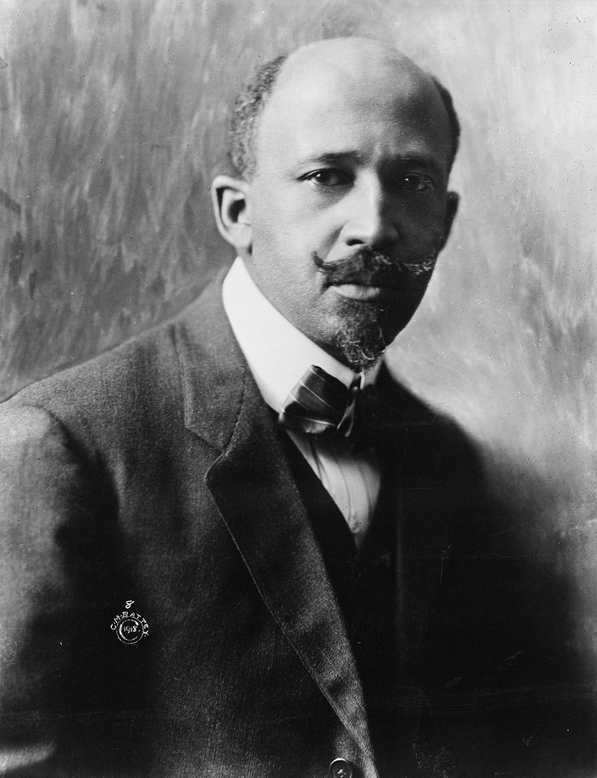
U.S. Census Bureau History Cont.
Remarkable Census Staff
W.E.B. Du Bois
W.E.B. Du Bois (1868–1963) used his gifts as a social scientist and writer to fight for equal rights for black Americans throughout his life. In 1904, for part of Census Bulletin #8, Du Bois wrote an analysis of black farmers in the southern United States. Du Bois' analysis used statistics to counter the racist narrative of the day and showed how black farmers used their land and agricultural skills to make a better life for themselves and their families

Slide 12
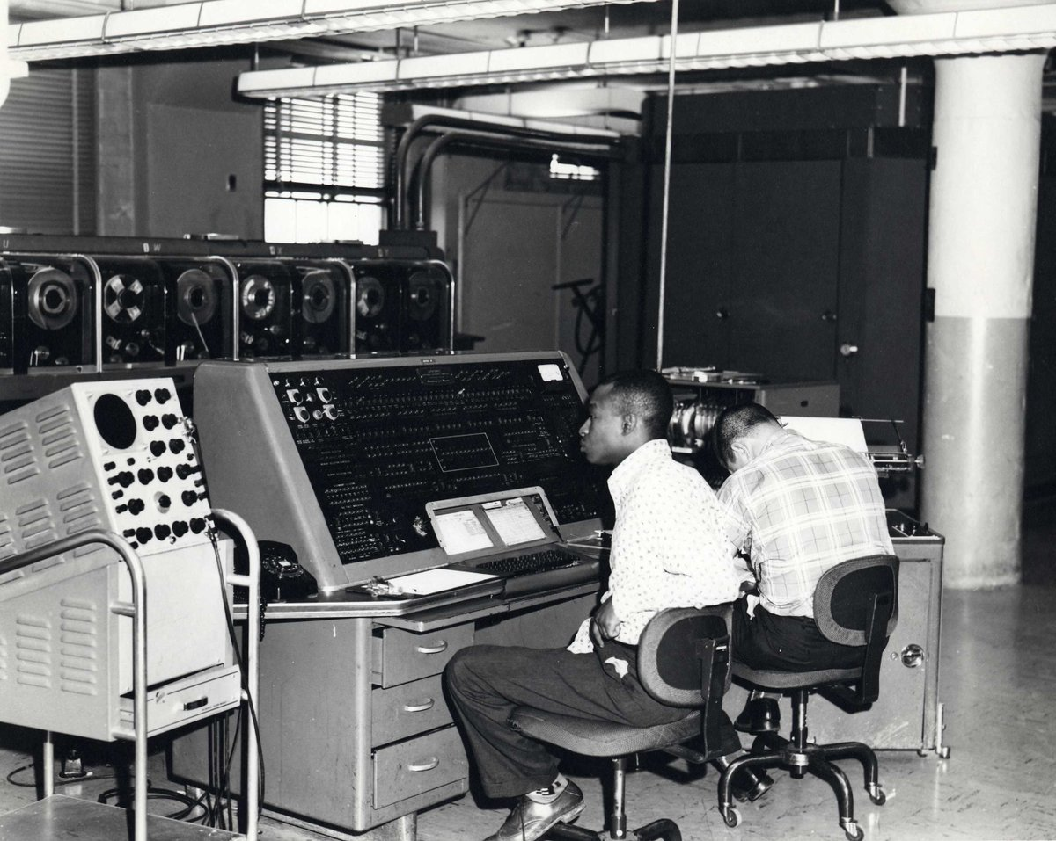
U.S. Census Bureau History Cont.
1920-1950
The 1920 census saw no separate forms for American Indians.
1930 was the first and only time, "Mexican" was listed as a race.
Computers and magnetic computer tape were introduced in the 1950s.

Slide 13
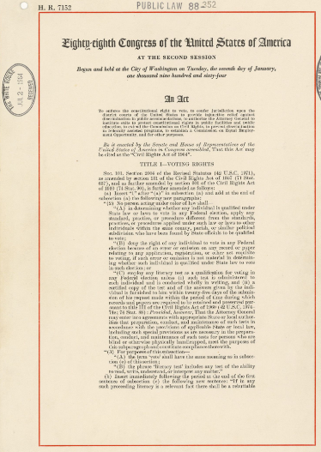
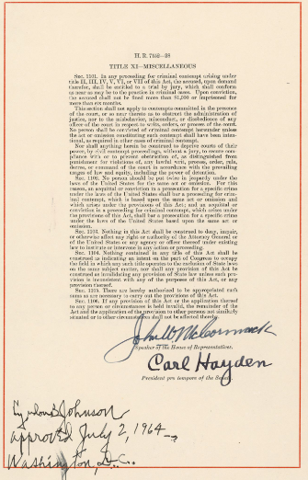
U.S. Census Bureau History Cont.
1960-1970
1962 Baker v. Carr decision ruled all elected legislative bodies must represent equal population size geographic districts.
Civil Rights Act of 1964 and Voting Rights Act of 1965 established census data as basis for implementing civil rights programs.
1960-1970s civil rights organizations saw census undercounting diminished political representation of African-Americans areas.
1970 saw the first mail-out, mail-back census procedure.

Slide 14
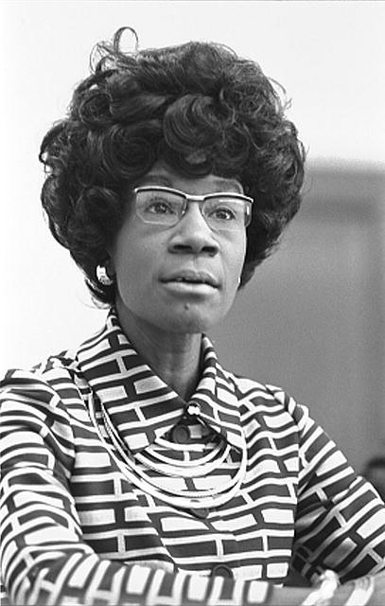
U.S. Census Bureau History Cont.
Remarkable Census Staff
Shirley A. Chisholm
Shirley A. Chisholm (1924–2005) broke conventions and wrote history as the first black woman elected to the United States Congress in 1968. Throughout her long career in public service, including 14 years in the U.S. House of Representatives, Congresswoman Chisholm looked out for those whom the government traditionally overlooked and neglected. In 1970, Congresswoman Chisholm worried about minorities being under-represented in the census and pinned on an enumerator's badge to help enumerate parts of Brooklyn, showing that the census could benefit communities simply by counting them.

Slide 15
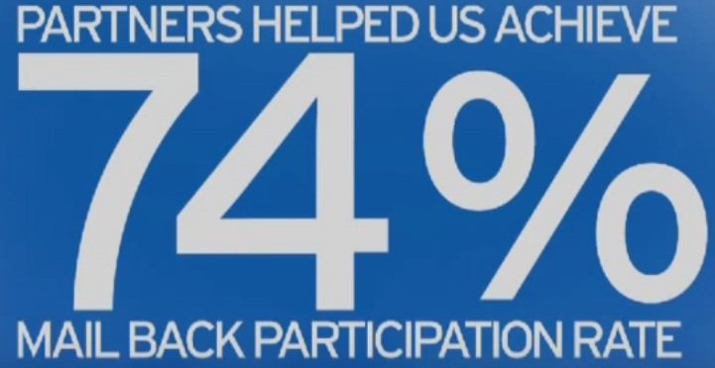
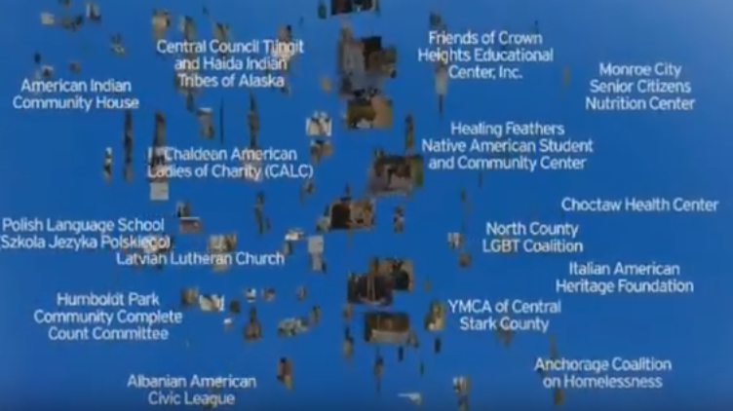
U.S. Census Bureau History Cont.
1980-2010
1970/1980 mayors recognized census undercount diminished large cities political representation and federal revenue.
2010 census removed the long form used from 1940 to 2000 replacing it with 10 questions.
2010 Census created a annual American Community Survey from the long-form
2010 saw the establishment of the Community Partnership Program, intended to improve the census participation rate.

Slide 16
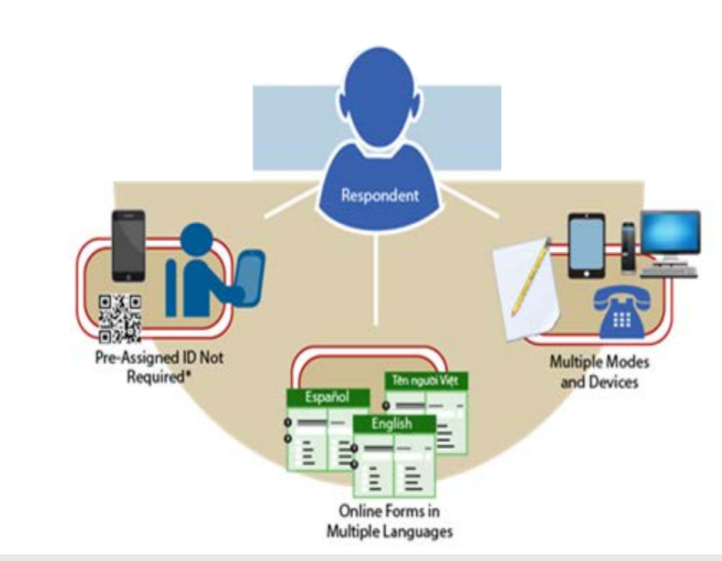
Decennial Census 2020
April 1, 2020
It’s Easy, Safe, & Important!
Purpose:
Count everyone once, only once and in the right place.
Historic Moments:
Transition to digital operations, Employees must be natural born citizens, Citizenship Status Question added to Census
May 2020
December 2020
Non-Response Follow-up Starts
Counts Delivered to President
Fall 2019
Early 2020
Address Canvassing
Group Quarters Start

Slide 17
Decennial Census 2020 Questions

Slide 18
Unveiling Our Truth: Understanding U.S. Census Bureau Data

Slide 19
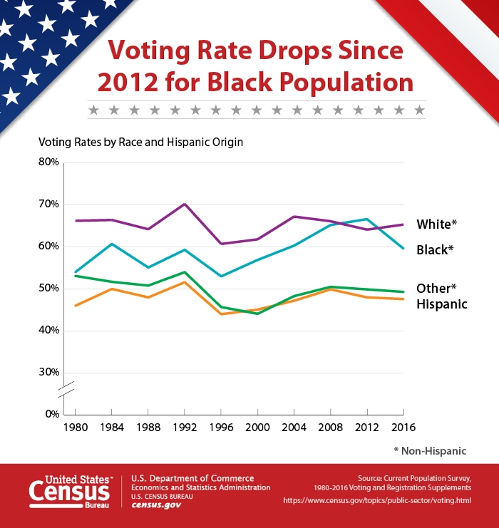
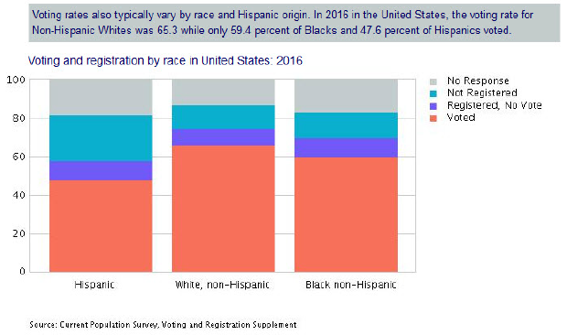
Minority Community Voting Statistics
*Source: Current Population Survey, Voter and Registration Supplement

Slide 20
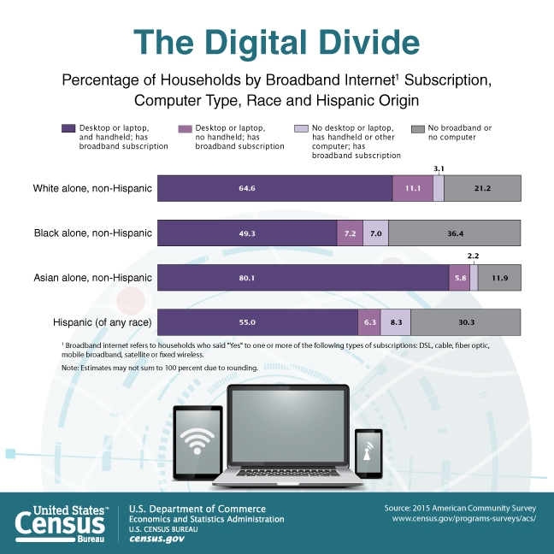
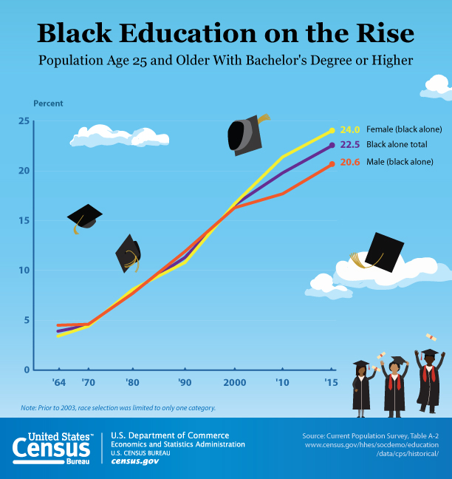

Slide 21
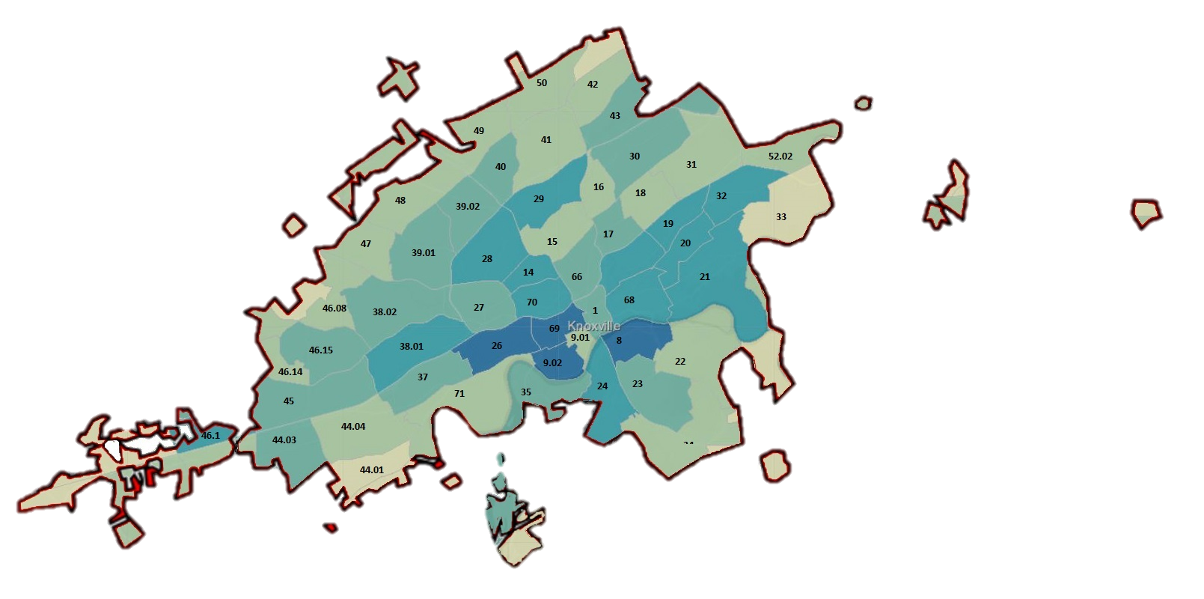
Response Outreach Area Map Low Response

Slide 22
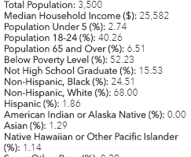
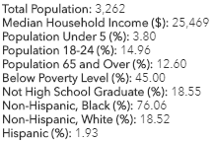
Response Outreach Area Map Low Response
Census Tract 8
Response Score: 30.2%
Census Tract 20
Response Score: 27.7%

Slide 23
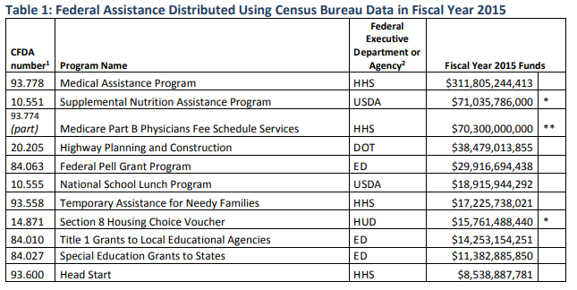
Census-based Federal Funding Allocations
Cost to Tennessee
$1,091/person in missed federal funding to Tennessee
For every 1% of Tennesseans missed in 2010 Census the state of Tennessee lost $69,205,364/year
Sources: census.gov/library/working-papers/2017/decennial/census-data-federal-funds.htm
gwipp.gwu.edu/counting-dollars-2020-role-decennial-census-geographic-distribution-federal-fundsl

Slide 24
14th Annual Black Issues Conference
Live Mock Census
Please visit the link below on your smartphones or tablets to complete your Census

Slide 25
Illuminating Our Power: 2020 Census

Slide 26
Decennial Census 2020 Obstacles
Low-income
Rapid changing use of technology
Constrained fiscal environment
2020 Census
Declining response rates
Increasingly diverse population
Informal, complex living arrangements
Distrust in Government
Children Under 5
Transitory Locations
HTC
Immigrants
Group Quarters

Slide 27
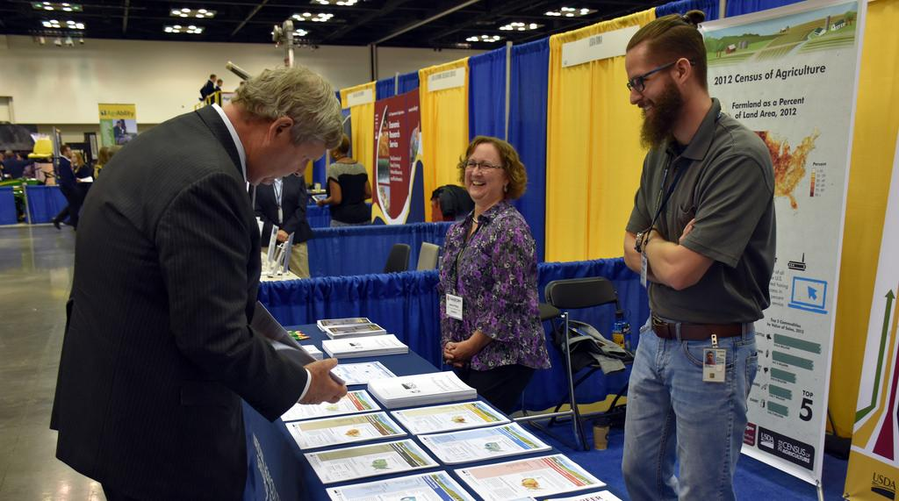
Educate, Encourage, Engage!

Slide 28
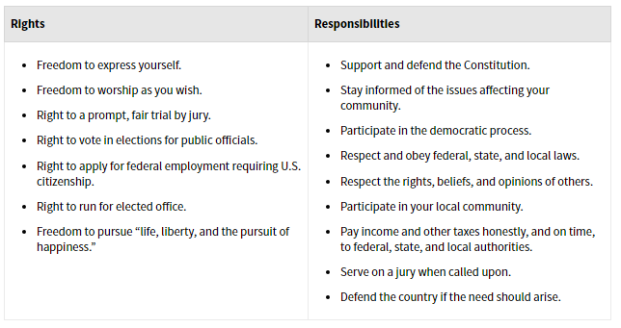
Know your part!
Title 13 of the U.S. Code. Title 13 calls for a $100 fine for refusing to answer a census question and a $500 fine for answering questions falsely. However, the Sentencing Reform Act of 1984 effectively increased these minimum fines to $5,000, codified under Title 18 of the U.S. Code.
*Source: www.uscis.gov/citizenship/learners/citizenship-rights-and-responsibilities

Slide 29
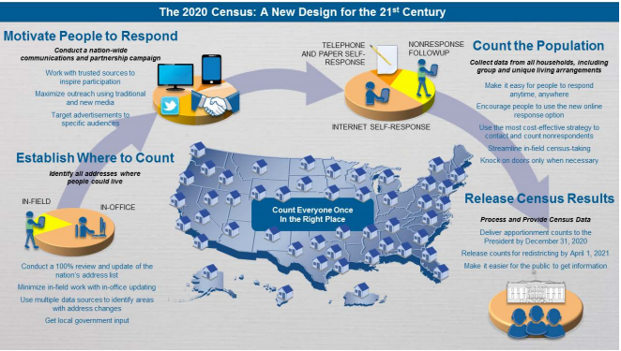
Decennial Census 2020 Process

Slide 30
Work for the Census Bureau

Slide 31
Questions?

Slide 32
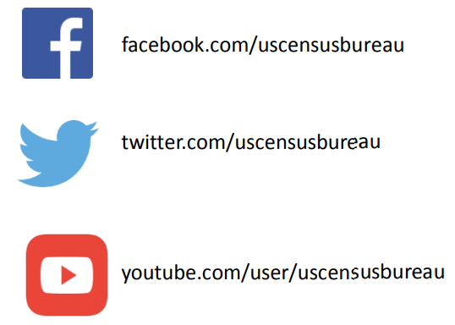
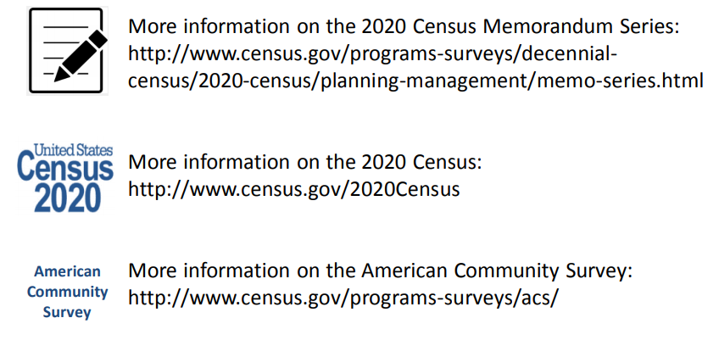
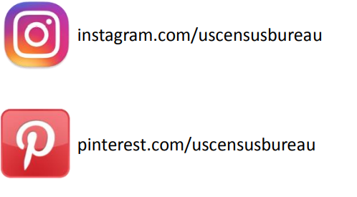
Connect with Us!
Kimberly Smith, MBA East Tennessee Partnership Specialist
Kimberly.smith@2020census.gov
865-936-1592

