Slide 1

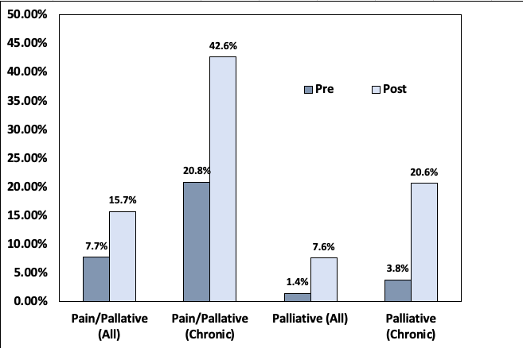
Implementation of Pediatric Palliative Care Training to Advance Nursing Knowledge and Increase Palliative Care Referrals
Whitney Stone, BSN, RN, CPN; Lisa Merritt, DNP, APRN, CPNP-PC/AC, PMHS, Faculty Mentor
University of Tennessee-Knoxville, College of Nursing
Background
Palliative care improves the quality of life of patients and families (Kaye et al., 2016)
Children are disproportionately underserved compared to adults (ICPCN, n.d.).
Shown to (1) improve assessment and management of symptoms (2) decrease number of invasive procedures, and (3) increase use of integrative and complementary therapies (Kaye et al., 2016)
Caregivers have improved quality of life, decreased self-perceived burdens, more preparedness, and less emotional stress (Groh et al., 2013)
Palliative care can reduce health care costs (Connor, 2014)
Inadequate healthcare provider education has been identified as a barrier to the use of palliative care services (WHO, 2018)
Purpose:
Implement an evidence-based educational initiative to improve pediatric palliative and end-of-life care at the project site. The goal of the proposed project is to improve patient outcomes by increasing registered nurses’ knowledge regarding palliative and end-of-life care and increasing the amount of patient referrals made to the palliative care service.
Pre-test
Online Presentation
Methods:
Theoretical Framework: IOWA Model
Participants: 46 Registered Nurses
Setting: Children’s Hospital (PICU)
Data Collection: De-identified test scores, palliative care referrals pre- and post-intervention
Data Analysis: SPSS
Immediate Post-test
In-person training
Knowledge Assessments:
Significant increase from pre-test to immediate post-test (p<.05)
Significant increase from pre-test to four-week follow-up (p<.05)
Changes across time did not differ by shift or years of experience
Pre-test | Post-test | Four-week follow-up
73.2 | 91.7 | 86.4
Four-week follow-up test
PICOT:
“In acute care pediatric nurses, how does participation in an evidence-based pediatric palliative care training program compared to no palliative care training, affect nurses’ knowledge and number of referrals over three months.”
Implications:
Coinciding with the literature, this project:
  1. Increased participant knowledge
  2. Increased number of palliative care referrals
  3. Increased usage of complementary therapies
Limitations:
Time constraints of the academic calendar
Pre and post assessments were not proctored
Literature Evidence:
12 articles total
5 ELNEC articles
Palliative care training can:
Increase registered nurse knowledge regarding palliative and end-of-life care
2) Lead to more and earlier palliative care referrals and ultimately improve patient care
References:
Connor, S. R. (2014). The Global Atlas of Palliative Care at the End of Life: an advocacy tool. European Journal of Palliative Care, 21(4), 180–183. Retrieved from https://searchebscohost.com.proxy.lib.utk.edu/login.aspx?direct=true&db=ccm&AN=97236593&scope=site
Groh, G., Vyhnalek, B., Feddersen, B., Führer, M., & Borasio, G. D. (2013). Effectiveness of a Specialized Outpatient Palliative Care Service as Experienced by Patients and Caregivers. Journal of Palliative Medicine, 16(8), 848–856. https://doi-org.proxy.lib.utk.edu/10.1089/jpm.2012.0491
Kaye, E. C., Friebert, S., & Baker, J. N. (2016). Early Integration of Palliative Care for Children with High-Risk Cancer and Their Families. Pediatric Blood & Cancer, 63(4), 593–597. https://doi-org.proxy.lib.utk.edu/10.1002/pbc.25848
The International Children’s Palliative Care Network (ICPCN) (n.d.). Scale of the need. http://www.icpcn.org/information/the-need-for-childrens-palliative-care/
World Health Organization. (2018). Palliative Care. https://www.who.int/news-room/fact-sheets/detail/palliative-care
Notes:
Pain and Palliative Care:
Pain/palliative care consults increased from 7.7% (11 patients) to 15.7% (29 patients) for all PICU admissions
Significant increase in the number of referrals (p=.028)
With only chronic conditions, 1 out of 53 (20.8%) increased to 29 out of 68 (42.6%)
Significant increase in the number of referrals (p=.011)
Palliative care:
Palliative care consults increased for 2 out of 143 (1.4%) received palliative care referrals to 14 out of 185 (7.6%) for all PICU admissions
Significant increase in the number of referrals (p=.010)
With only chronic diagnosis, 2 out of 53 (3.8%) increased to 14 out of 54 (20.6%)
Significant increase in the number of referrals (p=.007)

