Slide 1

DataONE and USGS
Mike Frame,
USGS Core Science Systems
Core Science Analytics & Synthesis
USGS DataONE Workshop
April 17-18, 2012

Slide 2
Brief Agenda Review
Day 1 Highlights:
  What is DataONE & Why should I care?
  How can I become involved?
  What tools, services, and/or training capabilities are available that could benefit my activities?
Day 2 Highlights:
  Who do I install, configure, and setup DataONE tools?
  What services are available and what are their capabilities?

Slide 3
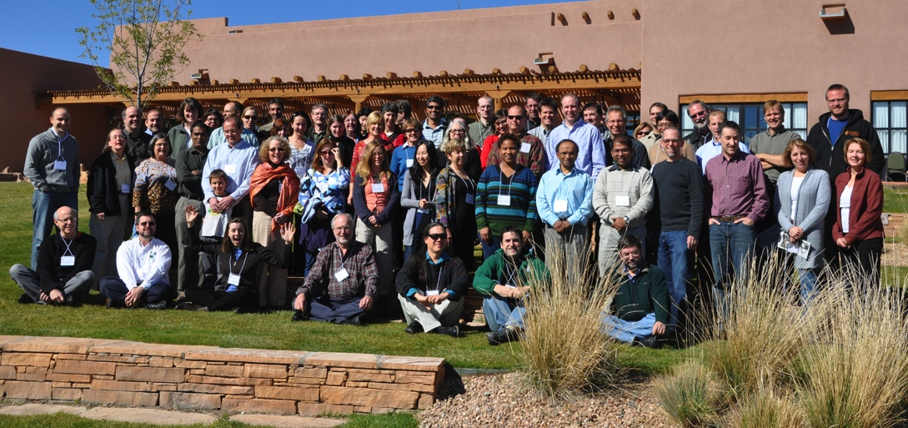

Workshop Leaders
Matt Jones, UCSB
Vivian Hutchison, USGS
Giri Palanismy, ORNL
Dave Vieglais, KU/UNM
Mike Frame, USGS

Slide 4
Logistics
Ask Questions as we go through the presentations
Webex Participants
  Use Chat Log for Questions, Comments, or to Break-in
Break ~ 10:30ish (12:30 ET)
Anticipate presentations going until ~ 4pm MT / 6pm ET
All presentations will be available in MyUSGS DataONE area

Slide 5
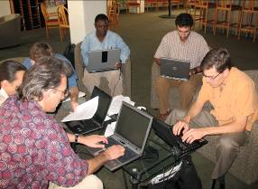
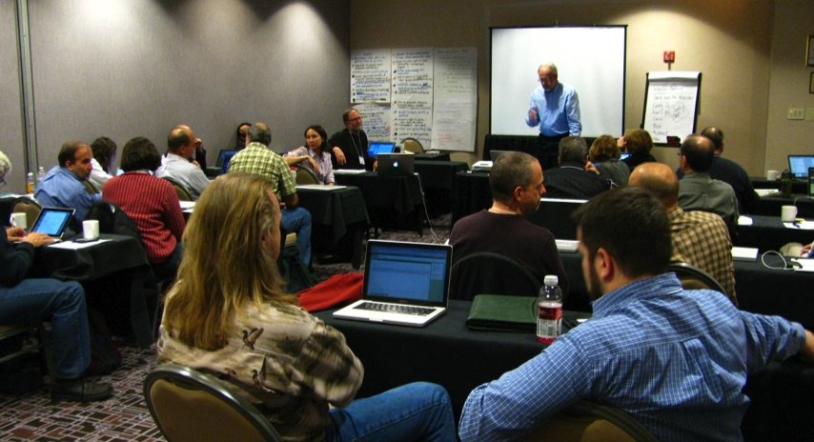
DataONE Overview
Dave:
Cyberinfrastructure, Tools, & Services - Dave
Viv:
Community Engagement
Outreach Activities

Slide 6
DataONE and USGS
Mike Frame,
USGS Core Science Systems
Core Science Analytics & Synthesis
Member Node Overview, Current Status
USGS DataONE Workshop
April 17-18, 2012

Slide 7
Topics
Member Node Overview
Characteristics of Member Nodes
Why Become a Member Node
Typical Member Nodes
Resource Required
Steps in becoming a Member Node
Potential USGS Member Nodes

Slide 8














Cyberinfrastructure
Three major components for a flexible, scalable, sustainable network
Member Nodes
diverse institutions
serve local community
provide resources for managing their data
retain copies of data
Coordinating Nodes
retain complete metadata catalog
indexing for search
network-wide services
ensure content availability (preservation)
replication services
Investigator Toolkit
Notes:
DataONE is a federated data network built to improve access to Earth science data, and to support science by:
engaging the relevant science, data, and policy communities;
facilitating easy, secure, and persistent storage of data; and
disseminating integrated and user-friendly tools for data discovery, analysis, visualization, and decision-making.
There are three principal components:
Member Nodes which include a diverse array of data centers and repositories that are associated with national and international agencies and research networks, universities, libraries, etc.
Coordinating Nodes which support data replication across Member Nodes (i.e., data centers) as well as network wide services like 24/7 access to metadata at the CNs, indexing and rapid search and discovery, etc.
Am Investigator Toolkit that includes tools that are widely used by scientists, The tools are coupled with the DataONE resources so that it is, for example, possible to seamlessly and transparently access data at Member Nodes through the tool of your choice.

Slide 9
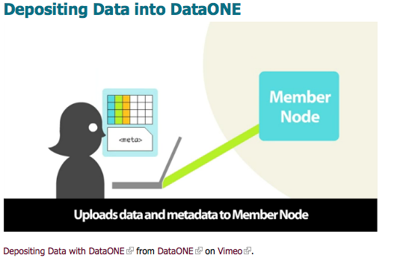
Member Node – High level overview
http://vimeo.com/36383735

Slide 10
Member Node Functions
Data storage
Data access
Access control
Metadata quality
Primary user interaction
If needed
Replication
Investigator Toolkit
Member Nodes
Coordinating Nodes
Service Interfaces
Bridge to non-DataONE Services
Data Repository

Slide 11
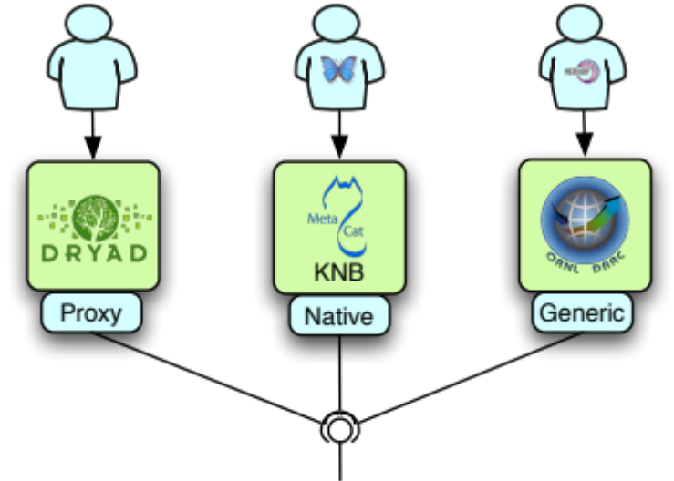
Metadata for discovery and access
Science metadata
EML, FGDC, DC, ISO, DIF, …
System metadata
Globally unique IDs for data &
metadata (DOI, GUID, Hdl, …)
Checksums of objects
Object policies
Three original member nodes:
demonstrate different ways of integration
diverse range of technical and business processes.
Notes:
KNB – knowledge network for biocomplexity. Dryad – Dspace.
Foreshadow other member nodes, including work with Fedora Commons, CUAHSI, NBII (leads into Matt’s discussion), Merritt Repository,
Dave will talk about the different ways member nodes have been implemented. Part of the reasons these three member nodes were chosen is to demonstrate the different ways of doing integration and to work across a very broad range of technical and business processes. Talk about this in terms of building on existing cyberinfrastructure. In system metadata, comment on object policies. Will talk about this further in replication. MN’s control who gets access, both for end users and for replication. At a data object level. Also enables things like temporary embargo while publications are being prepared, as well as some levels of restricted access (like T&E)
Picked these three as member nodes because of diversity. Refer back to Bill’s slides.
Value from a MN perspective.
Mention MN from a technology adaptation/robustness perspective.

Slide 12
Implementation Tiers
Tier 1 Supports publicly readable content without authentication or more specific access control rules
Tier 2 Tier 1 plus access control support
Tier 3 Tier 2 plus ability to add content through the DataONE service interfaces and provides full support for interaction with DataONE Investigator Toolkit
Tier 4 Support the full set of DataONE APIs and can operate as replication targets, accepting content from compatible (technical and policy) Member Nodes and fully supporting the DataONE content access control rules
Member Node API Definitions are available:
http://mule1.dataone.org/ArchitectureDocs-current/apis/MN_APIs.html
Notes:
Tier 1: Public read, no authentication or access control of content. No content can be created through the DataONE service interfaces. The node can not act as a replication target.
Tier 2: Read and resolve with access control support.
Tier 3: Write (create, update, delete), possibly limited support for data types
Tier 4: Replication target. The types of content supported by the node may be limited to a subset of object formats.

Slide 13
Characteristics of potential Member Nodes
Existing Data Centers within the earth science domain;
Long-term projects and research activities wishing to share, access, and preserve data;
Organizations/Institutions establishing data infrastructures to manage research data;
Organizations with computing and storage capabilities to augment the DataONE cyberinfrastructure;
Organizations/Institutions with expertise in enviro- informatics research and applications.

Slide 14
Why become a Member Node
Common methods of access to our data, as well as wider access to and exposure of those data;
Leverage of existing investment in cyberinfrastructure and related data management practices;
Potential cost-effective preservation of data and metadata
Access to a larger community with expertise and best practice adoption in science data life cycle management;
Provide visibility as a community leader in supporting open and rapid access to scientific data;

Slide 15
Why become a Member Node – Cont.
Facilitate recognition and credit for our data and services through data citations in published literature;
Provide opportunities for collaborative research;
A Principle Investigator Toolkit for analysis, visualization and modeling your data
Enhance public understanding of the value of a common model for sharing science data across organizations.

Slide 16
Initial DataONE Member Nodes
 | ORNL-DAAC | Dryad | KNB | USGS Metadata CH
Community | Agency repository | Journal consortium | Research network | Agency – State & Federal
Data | Ecology and biogeochemical dynamics | Biosciences | Biodiversity, ecology, environment | Biology, ecology, environment
Size | ~ 1,000 data products, ~ 1 TB | ~ 1,000 data products, ~ 5 GB | 20,000 data products, 100s GBs | 100,000 metadata; distributed datasets, 100s GBs
Services | Tools for data preservation, replication, discovery, access, subsetting, and visualization | Tools for data preservation, replication, discovery and access | Tools for data preservation, replication, discovery, access, management, and visualization | Tools for data harvesting, creation, QA/QC, search, visualization, and services.
Metadata stds. | FGDC subset | Dublin Core application profile | EML, FGDC | FGDC BDP
Degree of curation | High | Medium | Low | Medium
Data submission | Staff-assisted submission and curation of final data product | Web-based data submission at time of journal article submission | Self-submission via desktop tool at any time | Staff-assisted submission and curation by distributed data providers
Sponsor | NASA | NSF/JISC, societies, publisher | NSF | USGS
Notes:
DataONE is poised for public release in December 2011. Presently, the prototype infrastructure supports three Member Nodes that were chosen because of their differences in: (1) the community supported; (2) the types of data hosted by the data center; (3) the size of the holdings; (4) the services supported by the data center; (5) the metadata standards and tools employed and supported; (6) the degree of curation ranging from intensively managed and peer-reviewed data products to minimally curated and reviewed; (7) the procedures used for data submission; and (8) the sponsoring agency.

Slide 17
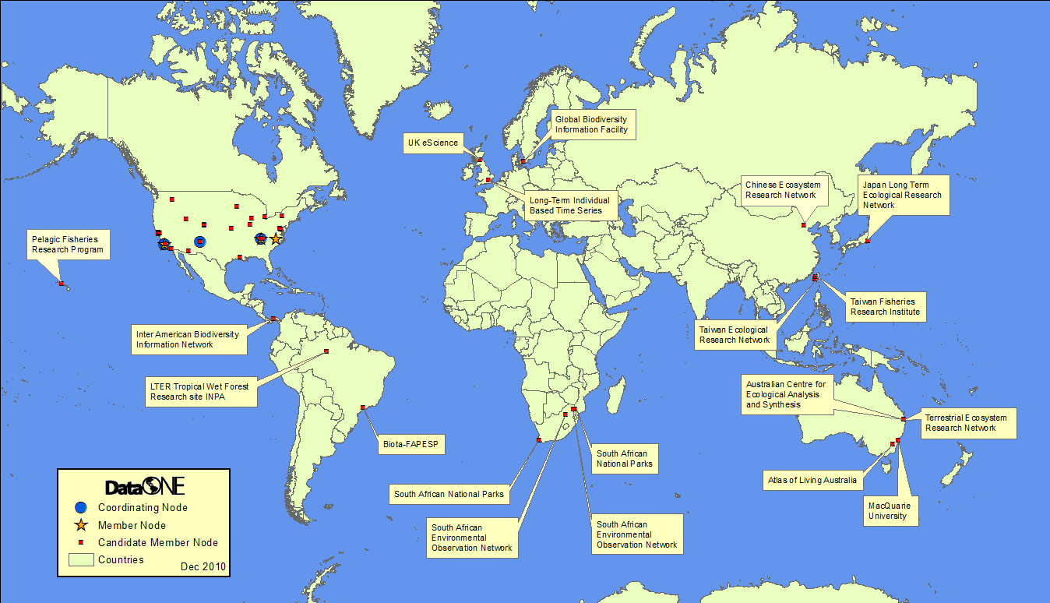
The DataONE Federation
Notes:
There are many opportunities for collaboration with DataONE and there are many benefits to doing so; the next few slides highlight the benefit and opps for research scientists, Member Nodes, and funding agencies. This map highlights many of the international partners that have expressed interest in establishing Member Nodes, many of which are active members of the DataONE Users Group.

Slide 18
Projected Growth of Member Nodes
Notes:
Expanding from 6 to 10 to 20 to 40
how do we do this?
manage expectation

Slide 19
Resources required for Member Node participation
Provide reliable access to actively managed data
Provide descriptive metadata to DataONE Coordinating Nodes to facilitate data discovery, access and usability
Engage with the larger DataONE community to advance DataONE services, support, emerging Member Nodes, tools, and promote best practices in data management.
Deploy an implementation of DataONE APIs (Application Programming Interfaces)
Utilize a unique identifier for each dataset by participating in DataONE user identity federation
Support Member Node Partnership Agreement (Governance)
Allow replication of data for preservation and increased access (Tier 4)

Slide 20
Member Node Partnership Agreement
In order to participate as a MN, MN's and DataONE will execute a short Partnership Agreement describing;
  Roles and activities,
  Duration of the agreement,
  Data to be provided, the access to and protections of (authorization, authentication, replication, integrity) to be given data collections and metadata,
  How data will be retained or discarded if/when the agreement ends

Slide 21
Steps to become a Member Node*
Step 1: Expression of interest
  Complete Member Node Description document and sign letter of interest
  Join DataONE Users Group (at any time)
Step 2: Technical and strategic review
  “Criteria for Evaluating / Priortizing DataONE Member Node”
Step 3: DataONE Response
Affirmative: Next slide
Not at this time:
Link up with appropriate Member Node
Obtain advice about becoming a Member Node in the future.
*Additional information available on-line:
http://www.dataone.org/content/dataone-users-group
Notes:
Based on material from 1st DUG meeting

Slide 22
Implementation Steps
Agree to DataONE service guidelines and partnership agreement
Operational implementation by DataONE and Member Node
Participate in the following:
  DataONE User Group
  Development of:
    Overall MN strategic plan
    5-yr plan for MNs
    Roles, responsibilities, value proposition

Slide 23
Discussion
Vision for USGS Member Node(S)
What is required to setup a MN in USGS?

Slide 24
DataONE Approaches for choosing next Member Nodes
Why prioritize?
    sustainable, technological, strategic
Solicit your ideas for a prioritization approach in USGS
Notes:
Outline the reasoning behind the need to prioritize (sustainable scaling) and the reasons for prioritization (attaining good mix of nodes with technological contributions and strategic partners)
D1 engagement with MN candidates needs to be prioritized since leadership, administrative, and technical resources will be required to engage each MN,
Share the rubric: Present as the likely process, looking for feedback to fine-tune. This would include gaining insight about how ot present this so it encourages participation, contains expectations, and provides transparency.
Solicit ideas on indicators that can be applied to the rubric and on key technological or strategic partners.

Slide 25
Key Characteristics when prioritizing
Data
Quality assurance
Scientific value
Extent of collection
Risk
Strategic Partnerships
Community
Funding
Technical expertise
Data management expertise
Synergy
Diversity
Geographic
Underrepresented groups
Linguistic or cultural diversity
Institution type
Leadership/Management
Technical
Human resources
Technical resources
Technical compatibility
Technical stability
Notes:
These dimensions assume a candidate MN already meets the minimal, required
criteria. These dimensions serve to prioritize engagement of a candidate MN.

Slide 26





USGS “initial” Member Nodes
  Continued to build on USGS Metadata Clearinghouse as DataONE Member Node
  Establish ScienceBase as a DataONE Member Node
  Establish pilot DataONE MN within CSC Network with Northwest Knowledge Network
  Others?
ScienceBase
Notes:
Development continues on the project as a whole. The most significant work will be integration with the DataONE project. DataONE is working to provide a full data management workflow to researchers, centered around linked desktop tools. DataONE and ScienceBase will work cooperatively to share components, ensuring that datasets feeding one system are usable across all systems.

Slide 27
USGS Member Node piloting
Day 2:
  Review available MN Toolkits
  Install & Configure USGS data with MN APIs
  Perform basic DataONE Operations
  Retrieve USGS pilot data holdings via DataONE ONEMercury

Slide 28




























DataONE Team and Sponsors
Amber Budden, Roger Dahl, Rebecca Koskela, Bill Michener, Robert Nahf, Mark Servilla
Ewa Deelman
Dave Vieglais
Peter Honeyman
Suzie Allard, Carol Tenopir, Maribeth Manoff, Robert Waltz, Bruce Wilson
Jeff Horsburgh
John Cobb, Bob Cook, Giri Palanismy, Line Pouchard
Robert Sandusky
Patricia Cruse, John Kunze
Bertram Ludaescher
Sky Bristol, Mike Frame, Richard Huffine, Viv Hutchison, Jeff Morisette, Jake Weltzin, Lisa Zolly
Peter Buneman
Chad Berkley, Stephanie Hampton, Matt Jones
Cliff Duke
Paul Allen, Rick Bonney, Steve Kelling
Carole Goble
Ryan Scherle, Todd Vision
Donald Hobern
Randy Butler
David DeRoure
LEON LEVY
FOUNDATION

Slide 29
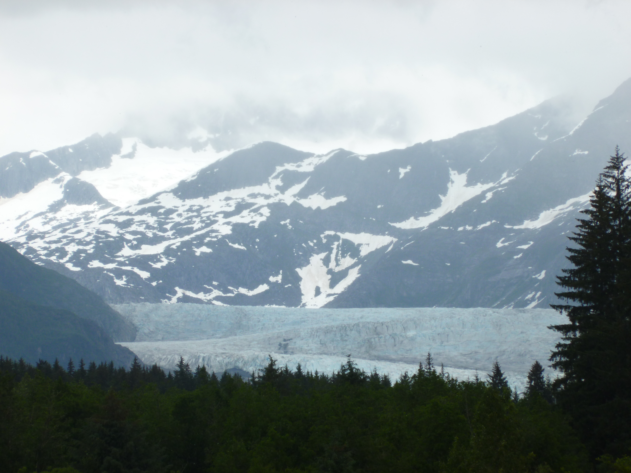
Questions, Discussion?
Questions, Comments, Ideas

