Slide 1
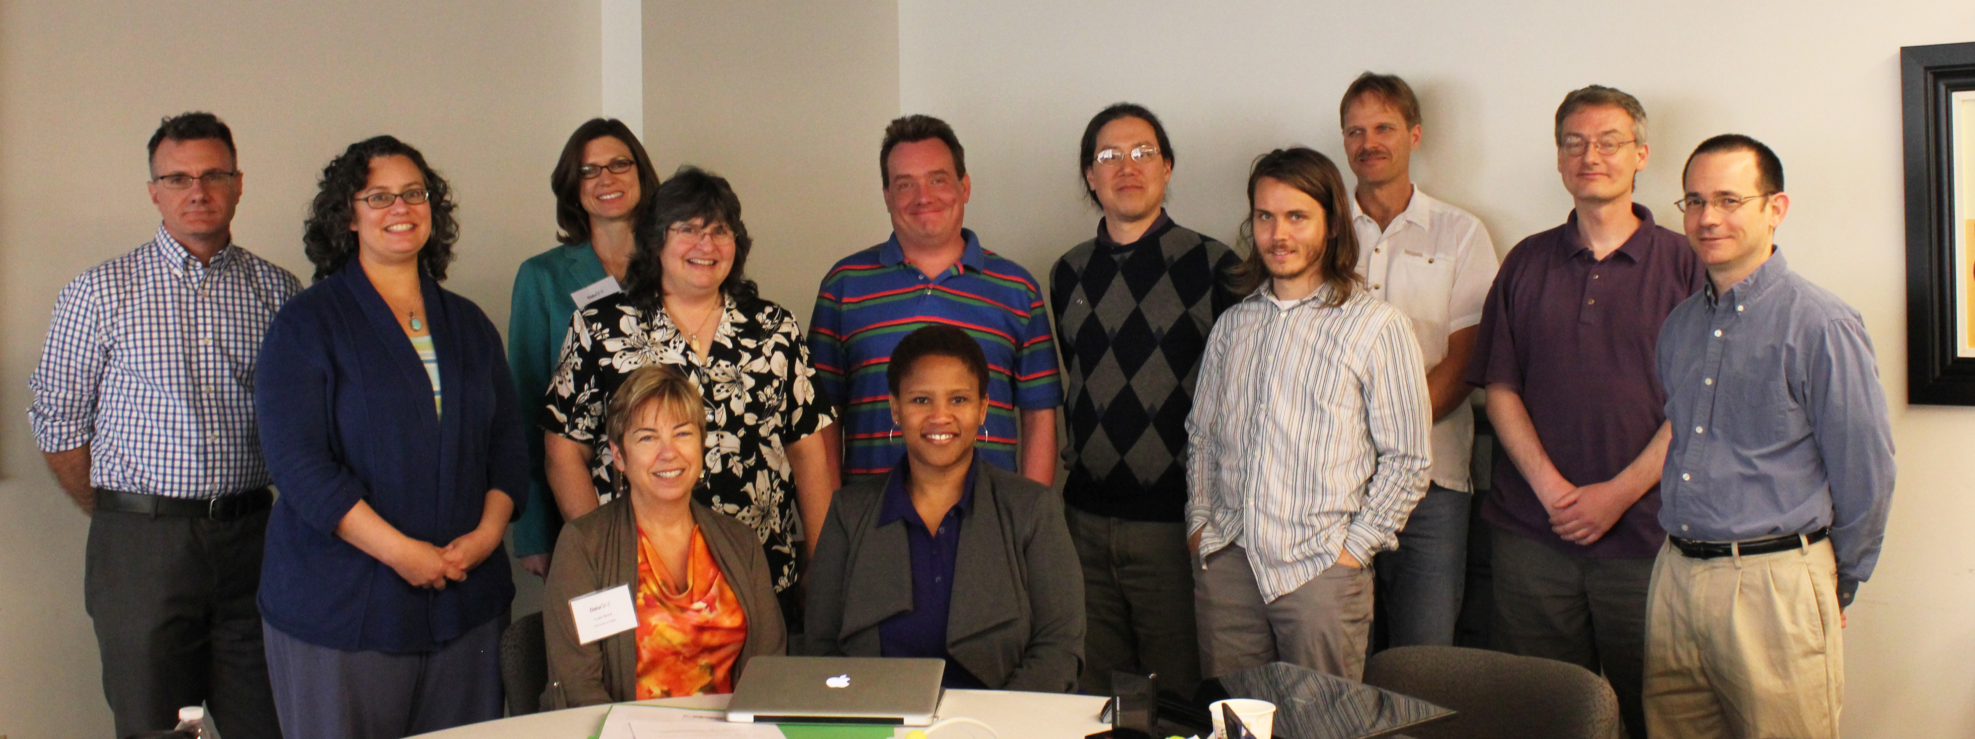
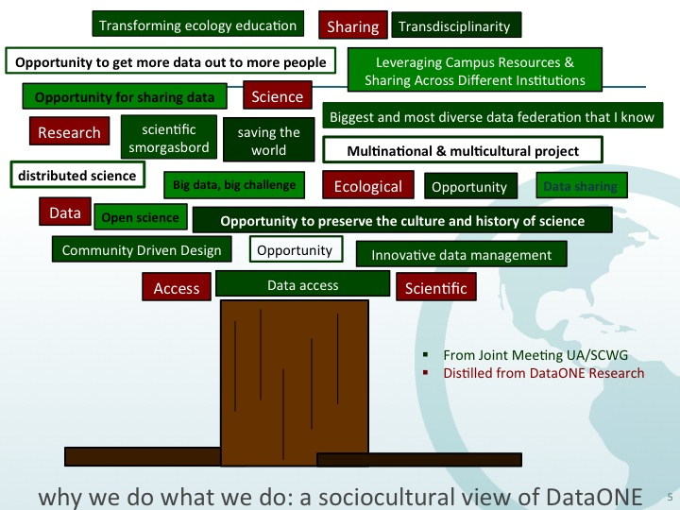
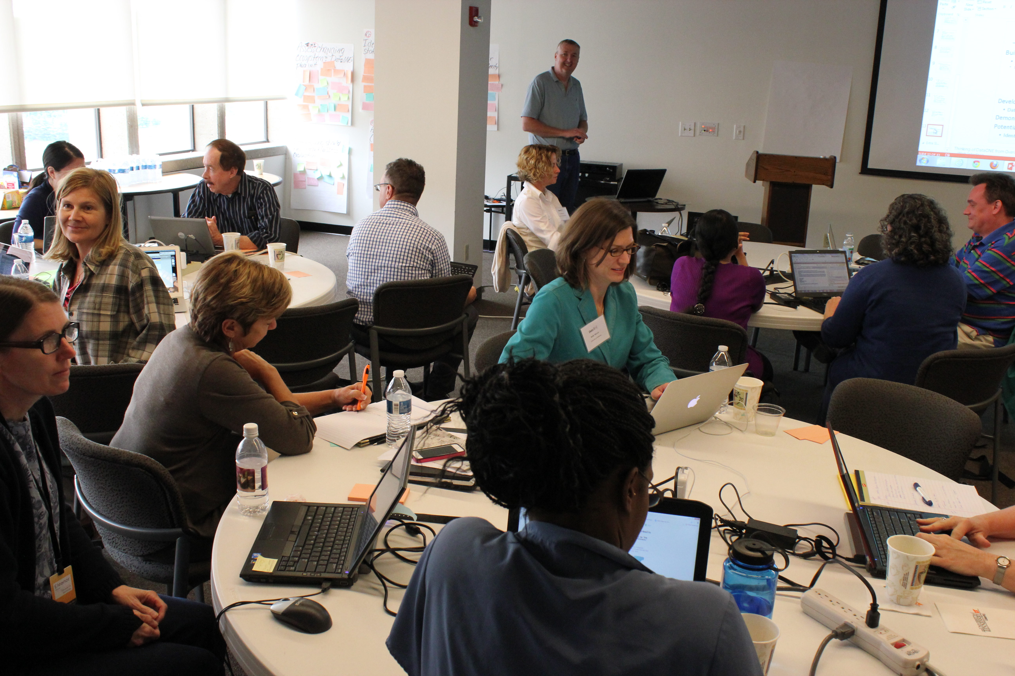
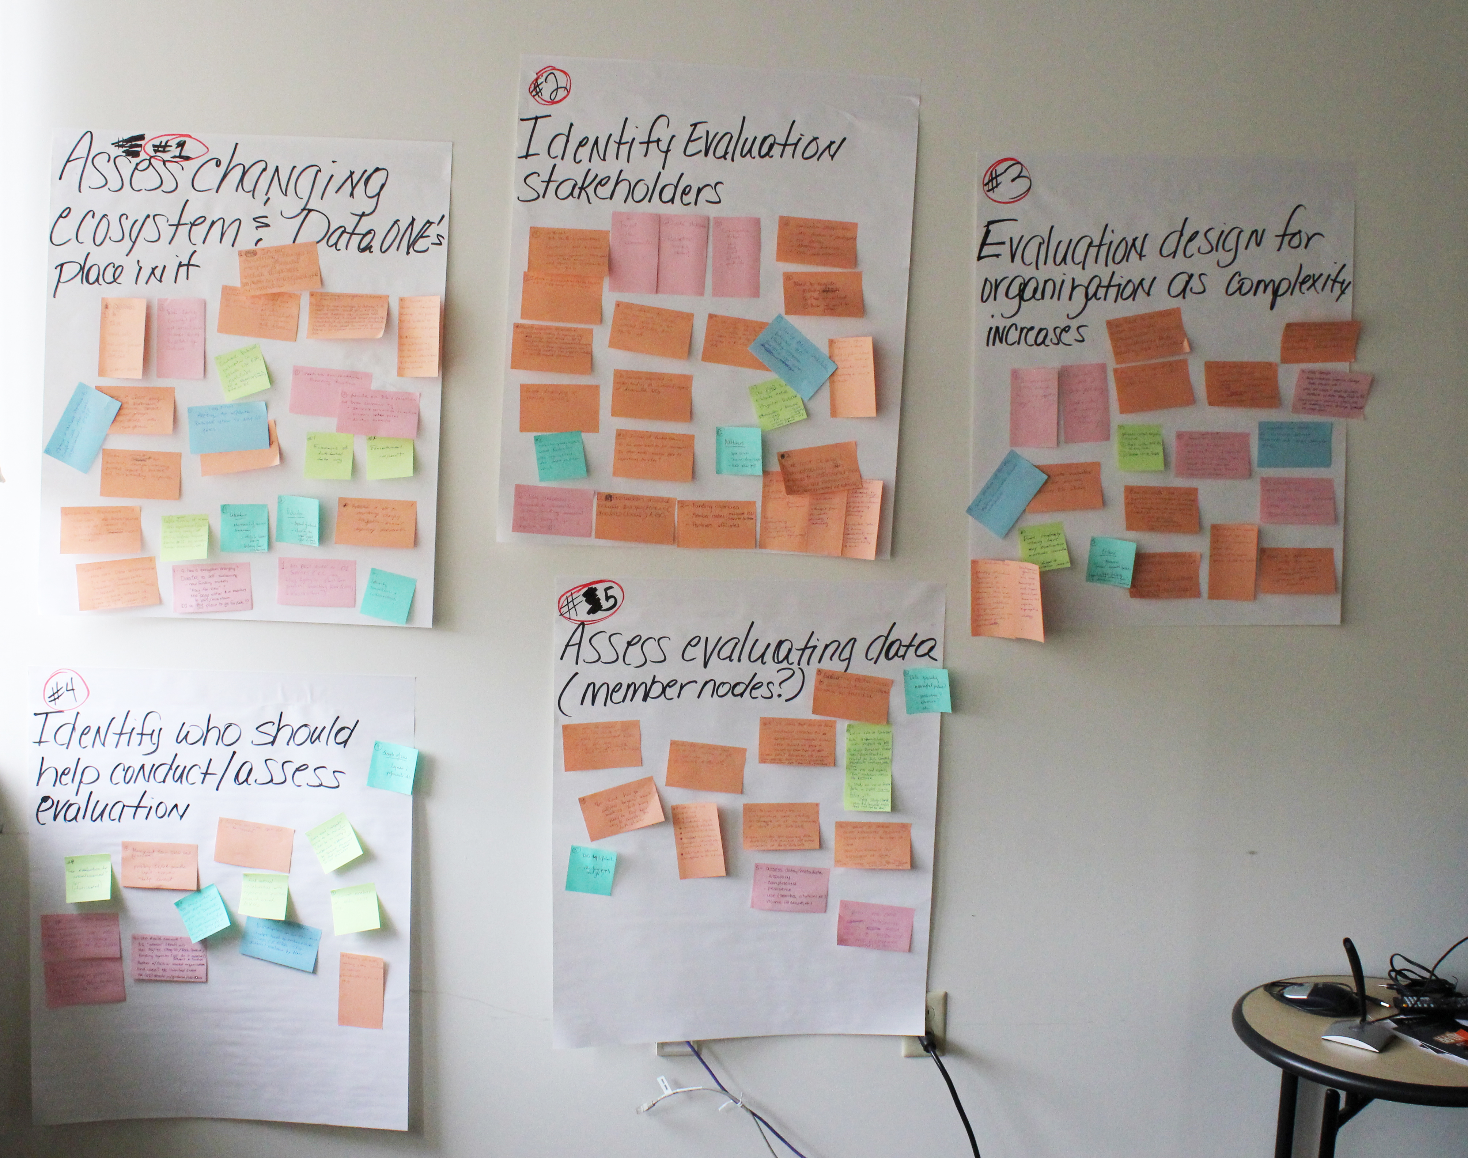
Sociocultural WG
Past Activities (6 mos) | Focus for this Meeting
Joint WG w/ UA in Knoxville, 2013 | Planning for Joint UA/SC 2014 Meeting
FAQs: Vetted answers to existing FAQs, identified and created new FAQs, reviewed Ask.DataONE.org and posted FAQs | Environmental scan : assess the changing data intensive ecosystem and identify DataONE’s place in it
Member Nodes: reviewed the MN web presence. Provided suggestions for MN metrics | Framing for the future: populate the framework that analyzes successes and failures to inform strategic activities
Notes:
The Tree: review of DataONE research and input from SC/UA WG members in answer to question of what word or phrase describes DataONE?
Evaluation: identified components of self-evaluation program for internal project management

Slide 2
Milestones Next 9 Months
White paper on environmental scan
Journal article from environmental scan white paper
Paper on the level of hands-on data management activities undertaken by scientists at different points in their career
Network analysis of DataONE
Communication Strategy for Years 6-10

