Slide 1

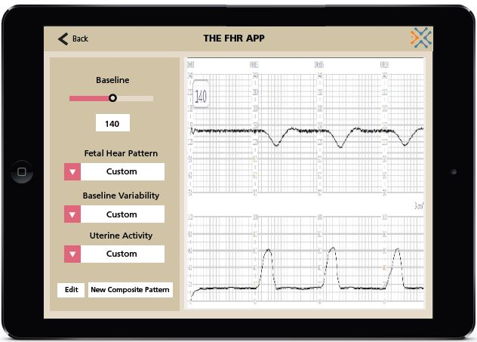
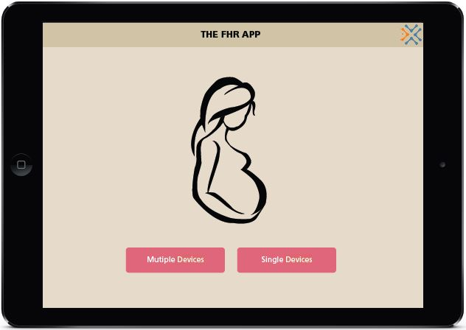

Exploring Nursing Students’ Perceptions of Electronic Fetal Monitoring App
Rachael Wyatt, Isaac Moore, Michelle Miller, Valerie White, & Callie Heitzman
Background
Methods
A growing number of electronic applications are intended to assist with education of health care professionals. Previously, nursing curriculum has taught electronic fetal monitoring (EFM) through the use of paper fetal heart rate (FHR) strips. New nurses struggle to read real-time FHR monitors & respond appropriately. A team from the UTK HITS lab has developed a new application to assist with the teaching of EFM in simulation. Before this new application can be incorporated into obstetric curriculum, data regarding its use needs to be collected, specifically nursing student perceptions.
Design: Qualitative descriptive
Sample
  Undergraduate & graduate nursing students at UTK exposed to hands-on lab simulation
  Inclusion Criteria: Exposure to the EFM application in simulation
  Exclusion Criteria: Graduate nursing students with more than 5 years of experience in the field
Setting
  The UTK College of Nursing over the span of 2 consecutive semesters
  A comfortable room with seating for 10-15, windows, easy access to restroom facilities, and minimal distractions
Instruments
  Focus Groups: 6-8 participants per group, 5 groups total
  Interviews: 10 interviews total
  First researcher questions, second researcher takes field notes and controls audio &/or video recordings
Data Collection
  Students participate in focus groups or interviews in the same semester they were exposed to the EFM app
  Collect informed consents at the beginning of focus groups & interviews
  First Semester: at least 2 focus groups and 5 interviews
  Second Semester: at least 3 focus groups and 5 interviews
  Collect audio &/or video recordings
Analysis Plan: Data collection & qualitative content analysis occur concurrently
Discussion
Purpose
Contribution to Evidence Based Practice
Presented is a qualitative study that paves the way for further research regarding UTK's newly developed application. This theoretical research serves as a pilot study for a larger spectrum of applied research, which will analyze the effectiveness of the application in nursing curriculum, while also studying the learning experience gained while using the app. The future use of this app will increase nursing self-efficacy, & positively effect patient outcomes.
Summary
Since the knowledge base surrounding the new electronic fetal monitoring (EFM) app is minimal, student perceptions regarding the utility and usability of the application in nursing curriculum is critical.​ Themes that emerge from this pilot study will be analyzed and incorporated into further EFM simulations in nursing curriculum.
The purpose of this qualitative descriptive study is to explore nursing students’ learning experiences, attitudes, perceptions, and opinions regarding a fluid, dynamic, instructor-manipulated EFM application developed at the University of Tennessee, Knoxville HITS Lab.

