Slide 1

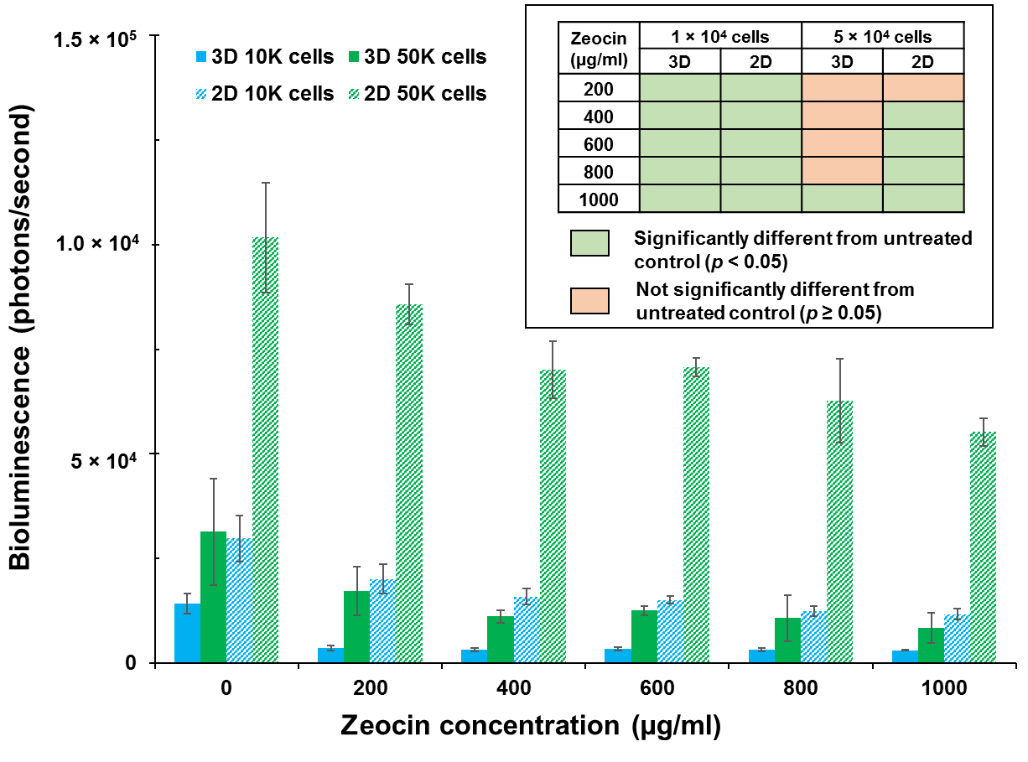
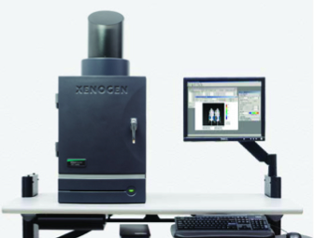
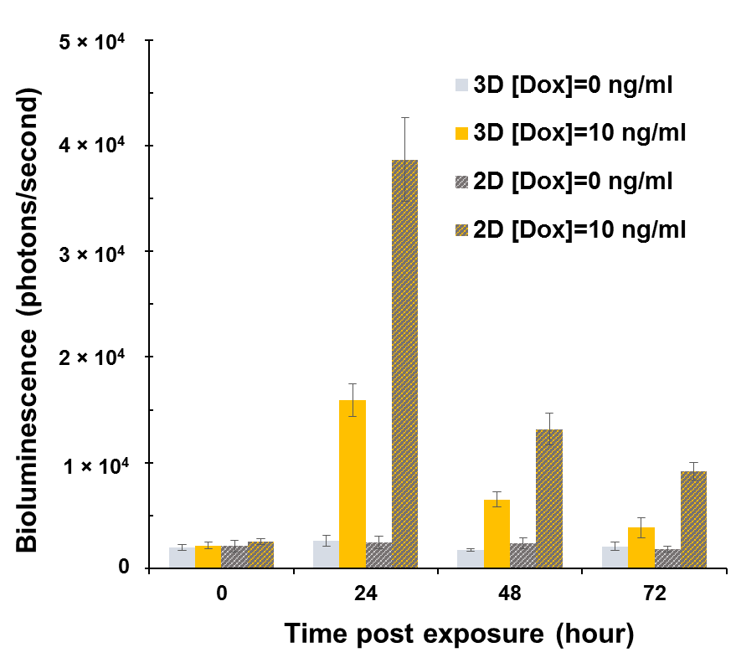
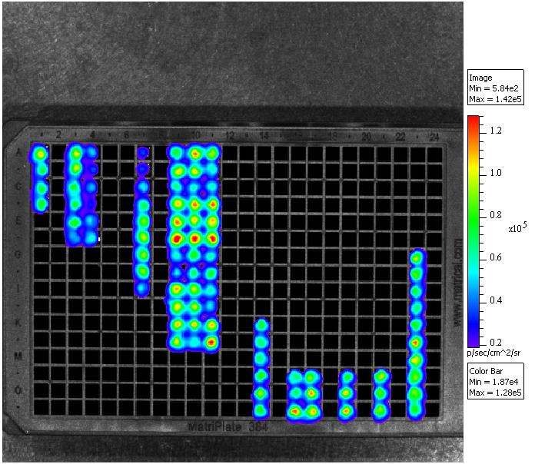
Real-Time Biomonitoring of Cytotoxicity in 3D Autobioluminescent Human Tissue Culture Models
Haylie Lam
Chemical Engineering and Biochemistry and Cellular and Molecular Biology
Introduction
Experimental Design
Results
Current optimal imaging technologies (e.g., fluorescence and firefly luciferase-based bioluminescence) require an external stimulation be applied prior to signal generation.
To overcome this limitation, a ‘humanized’ bacterial luciferase reporter operon (lux) has been developed for expression in eukaryotic organisms, resulting in human cell lines capable of self-producing bioluminescent output without external stimulation.
These cells can be programmed to continuously produce an autobioluminescent signal with declining intensity correlating with exposure to toxicants detrimental to cellular health or to auto-initiate bioluminescent production only in response to the detection of specific target agents.
This study compares the ‘lights-off’ and ‘lights-on’ reporter functions of these cells when deployed in collagen-encapsulated 3D matrix mimicking typical organs-on-a-chip platform technologies relative to their function under traditional 2D growth conditions.
‘Lights-off’ bioreporter for detecting cytotoxicity
Constitutively autobioluminescent HEK293 cells
(CMV promoter)
Encapsulated in collagen hydrogel in 96-well plates
(3D)
Plated as monolayers in 96-well plates
(2D)
Treated with various concentrations of Zeocin
(0 to 1000 µg/ml)
Zeocin-triggered bioluminescent response in collagen encapsulated (3D) and monolayer (2D) autobioluminescent HEK293 cells was measured in the IVIS imaging system
Significant decreases in bioluminescence (‘lights-off’) were observed after 48 hours of treatment with 1000 µg/ml and 400 µg/ml Zeocin concentrations in 3D and 2D conditions, respectively.
Background
Synthetic six gene (luxCDABEfrp) bioluminescent reporter system
Based on the bacterial luciferase gene cassette
Allows for endogenous synthesis and regeneration of the substrates required for signal production
Eliminates the need for exogenous substrate addition
Permits continuous and/or repetitive monitoring of the same sample
Bioluminescence imaged using the IVIS Lumina imaging system
Peak bioluminescence occurred 24 hour post-treatment in both 2D and 3D conditions
A higher fold of induction was observed in 2D conditions (16-fold) than that of 3D conditions (6-fold).
‘Lights-on’ bioreporter for detecting target compounds
Tet-On inducible autobioluminescent HEK293 cells
(doxycycline inducible Tet-On promoter)
Encapsulated in collagen hydrogel in 96-well plates
(3D)
Plated as monolayers in 96-well plates
(2D)
Conclusions
These results demonstrate the utility of a reagent-free autobioluminescent cellular system for continuous, real-time toxicity monitoring in 3D tissue culture models.
Collagen encapsulated cells are more resistant to toxicants than cells grown as monolayers, possibly due to their increased cell-to-cell interactions and the extracellular scaffold support facilitated by the collagen matrix.
Exposed to doxycycline for 3 days
Acknowledgements
Bioluminescence imaged using the IVIS Lumina imaging system every 24 hours
Advisors: Dr. Gary Sayler, Dr. Steven Ripp, and Dr.Tingting Xu
Funding support: NSF Science, Technology, Engineering and Mathematics Talent Expansion Program (STEP) grant and Chemical, Bioengineering, Environmental, and Transportation program.

