Slide 1




Libraries in an Age of Data Science:
Research Data Management Services
Carol Tenopir
University of Tennessee
ctenopir@utk.edu

Slide 2



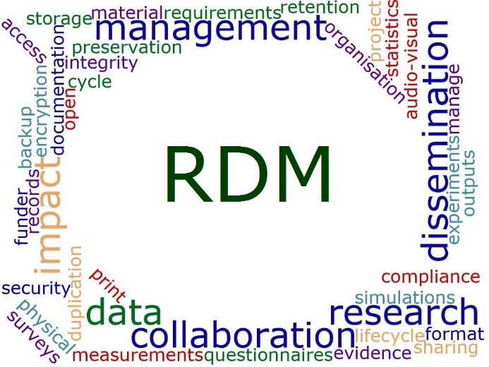

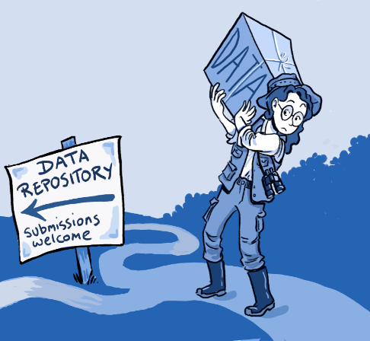




Image attribution: Roche DG, Lanfear R, Binning SA, Haff TM, Schwanz LE, et al. (2014) Troubleshooting Public Data Archiving: Suggestions to Increase Participation. PLoS Biol 12(1): e1001779. doi:10.1371/journal.pbio.1001779

Slide 3
Research Data Management Services are..
…services that address the full data lifecycle, including the data management plan, digital curation (selection, preservation, maintenance, and archiving), and metadata creation and conversion.

Slide 4


Data LifeCycle
Plan
Analyze
Collect
Integrate
Assure
Discover
Describe
Preserve

Slide 5

Library Challenges
Level of my knowledge & skills ?
DMP tools?
Level of participation with data?
Plan
Analyze
Partnering with researcher?
Collect
What to do about metadata?
Integrate
Assure
Is there a repository for data?
Develop tools for data discovery?
Describe
Discover
Stewardship role (select & deselect)?
Preserve
How to ensure preservation?

Slide 6
Research Data Services are…
…services that address the full data lifecycle, including the data management plan, digital curation (selection, preservation, maintenance, and archiving), and metadata creation and conversion.
Services can be consultative or technical

Slide 7
Consultative RDS
Collaboration and outreach
Policy development and planning
Discussing RDS with others

Slide 8
Consultative RDS
Collaboration and outreach
Policy development and planning
Discussing RDS with others
Reference for finding and citing data
Creating web guides and finding aids

Slide 9
Consultative RDS
Collaboration and outreach
Policy development and planning
Discussing RDS with others
Reference for finding and citing data
Creating web guides and finding aids
Directly participating on a project
Consulting on DMPs and metadata
Training co-workers on data issues

Slide 10
Technical RDS
Providing tech support for RDS systems/data repositories

Slide 11
Technical RDS
Providing tech support for RDS systems/data repositories
Identifying datasets for deposit in repositories
Preparing datasets for deposit
Deselecting datasets for removal from a repository

Slide 12
Technical RDS
Providing tech support for RDS systems/data repositories
Identifying datasets for deposit in repositories
Preparing datasets for deposit
Deselecting datasets for removal from a repository
Creating or transforming metadata

Slide 13

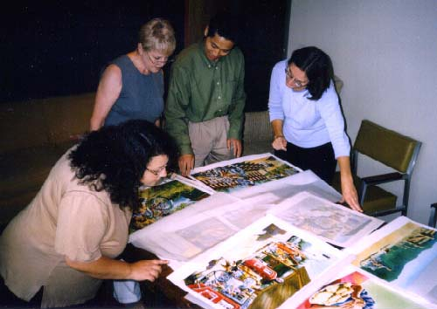
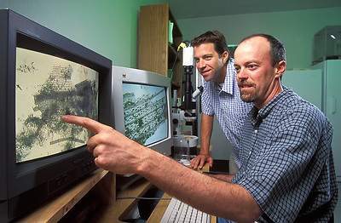

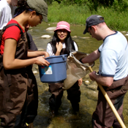
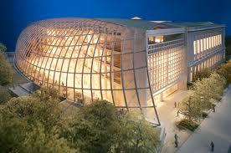

What do Stakeholders need?
Public Officials
Publishers
Data Managers
Citizen-scientists
Libraries
& Librarians
Scientists
Students
& Teachers

Slide 14
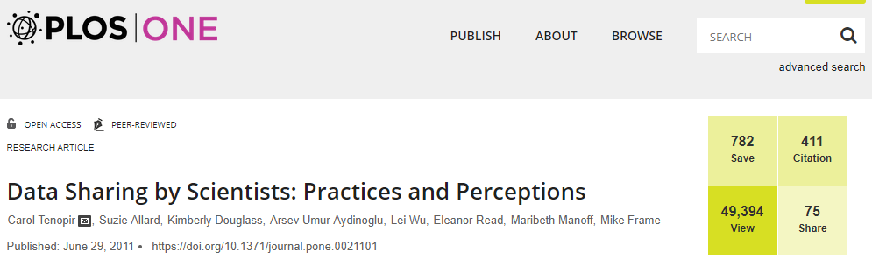
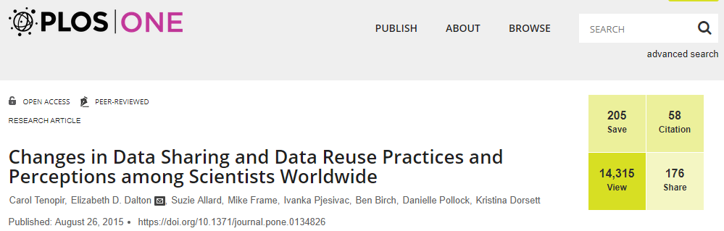
We are learning about scientists
1st Scientist Survey (2011)
Views: 49,394
Citations: 411
Shares: 75
(pub. Jun. 2011)
2nd Scientist Survey (2015)
Views: 14,315
Citations: 58
Shares: 176
(pub. Aug. 2015)
Notes:
Data Sharing by Scientists: Practices and Perceptions
Carol Tenopir, Suzie Allard, Kimberly Douglass, Arsev Umur Aydinoglu, Lei Wu, Eleanor Read, Maribeth Manoff, Mike Frame
Research Article | published 29 Jun 2011 PLOS ONE
https://doi.org/10.1371/journal.pone.0021101
Changes in Data Sharing and Data Reuse Practices and Perceptions among Scientists Worldwide
Carol Tenopir, Elizabeth D. Dalton, Suzie Allard, Mike Frame, Ivanka Pjesivac, Ben Birch, Danielle Pollock, Kristina Dorsett
Research Article | published 26 Aug 2015 PLOS ONE
https://doi.org/10.1371/journal.pone.0134826

Slide 15
3rd Scientist Survey
“Data Sharing, Management, Use, and Reuse: Practices and Perceptions of Scientists Worldwide”--Submitted April 2019
Subset: "Research Data Sharing: Practices and Attitudes of Geophysicists". Earth and Space Science 5, no. 12 (2018): 891-902. DOI: 10.1029/2018EA000461.

Slide 16
Results of DataONE scientist surveys show opportunities for libraries…

Slide 17
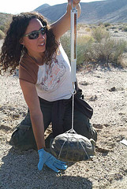
Researchers might…
Plan
Analyze
Collect
Integrate
Assure
Discover
Describe
Preserve

Slide 18
Gap between willingness to share and accessibility
  Although 87% of scientists are willing to share their data
  Only 46% agree “Others can access my data easily”
3rd Scientists Survey, 2019

Slide 19
Most are willing to share at least some data…
I am willing to (2019):
3rd Scientists Survey, 2019

Slide 20
What metadata do you currently use to describe your data? (2019)

Slide 21
What metadata do you currently use to describe your data? (2019)

Slide 22
Barriers to sharing (2019)

Slide 23
Scientists say lack of access to data… …
… is a major impediment to progress in science
75% agree or strongly agree.
… has restricted my ability to answer scientific questions
51% agree or strongly agree.
3rd Scientists Survey, 2019
Notes:
Impediment to progress to science: M=4
Restricted my ability to answer scientific questions: M=3.4

Slide 24
Why Libraries?

Slide 25
Libraries…
Facilitate interdisciplinary work and data knowledge through collections and services
Understand metadata
In it for the long haul
Know how to find information about data
In partnership with other administrative units can take a leadership role in a variety of research data services

Slide 26
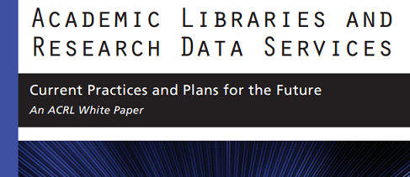
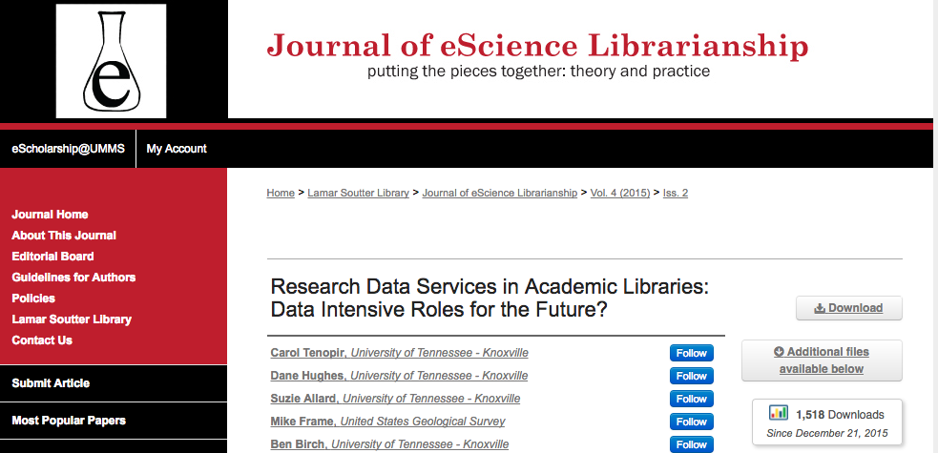
North American Library Surveys
1st Library (2012)
Citations: 152
(published June 2012)
2nd Library (2015)
Citations: 45
3,229 downloads
(published Dec 2015)

Slide 27


European Library Surveys
Tenopir, C. et al., (2017). Research Data Services in European Academic Research Libraries. LIBER Quarterly. 27(1), pp.23–44. DOI: http://doi.org/10.18352/lq.10180

Slide 28
Key Findings
Libraries offer a range of Research Data Services, but…
More libraries are planning to offer more services in the future
Libraries must use a variety of strategies for developing staff skills

Slide 29
1) Libraries offer a range of Research Data Services

Slide 30
RDS offered by most libraries currently
Consultative
Consultative
Consultative
Consultative
Consultative
Consultative

Slide 31

RDS offered, continued
Technical
Consultative
Consultative
Consultative
Technical

Slide 32
2) More libraries are planning to offer more services in the future.

Slide 33
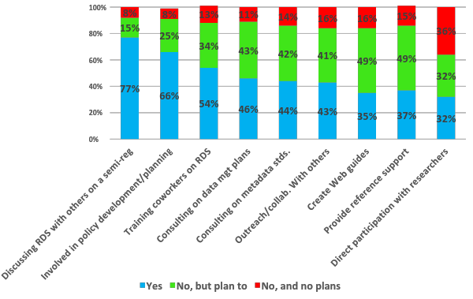
Currently offered and future plans for consultative-type services

Slide 34
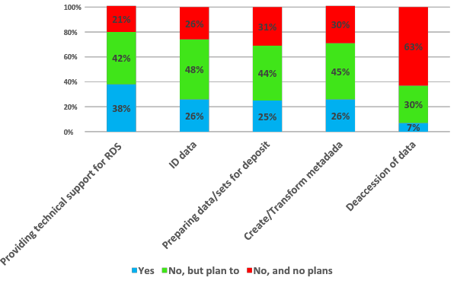
Currently offered and future plans for technical-type services
Notes:
Providing technical support (n=101)
Preparing data/sets for deposit (n=100)
ID data (n=106)
Create/transform metadata (n=103)
Deaccession of data (n=97)

Slide 35


We also know…
There is great variation between libraries
Not everyone has to offer every service

Slide 36
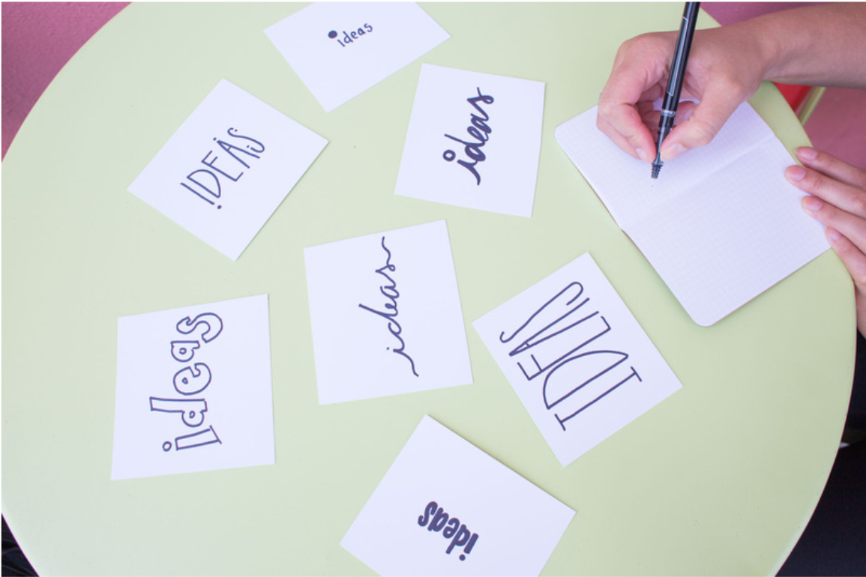

Recent Studies Reach Similar Conclusions…
Libraries offer Advisory and Support Services
BUT Overall the RDM Landscape is Immature
Data Management Planning Support
Data-Related Training
Web Resource Guides
Cox, Kennan, Lyon, & Pinfield (2017)
Notes:
2017 International Study of higher education libraries in 7 countries

Slide 37
3) Libraries must use a variety of strategies for developing staff skills

Slide 38
Hiring for RDS positions…
Have you hired staff for RDS in the last 12 months?
Notes:
n=85

Slide 39
Types of skills development…
Which of the following opportunities has your library provided for library staff to develop skills related to RDS?

Slide 40
Staff Skills Development
Dramatically increase the workload of some poor individual librarian
Collaborated with another institution to develop a skills-based MOOC
Moved staff from other support unit [ITS]
Strategies
Hired staff for projects (not permanent)
Refocused an existing role

Slide 41





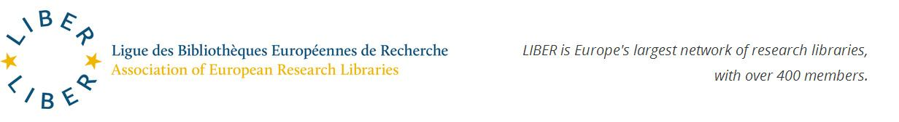
Assistance with training
Research Data Management Librarian Academy (RDMLA)
http://datalib.edina.ac.uk/mantra/
Working Group on Scientific Information Infrastructures
Notes:
The FOSTER portal is an e-learning platform that brings together the best training resources for those who need to know more about Open Science, or who need to develop strategies and skills for implementing Open Science practices in their daily workflows. Here you will find a growing collection of training materials to meet the needs of many different users, from early-career researchers, to data managers, librarians, funders, and graduate schools.
FOSTER (Facilitate Open Science Training for European Research) is a 2-year, EU-Funded (FP7) project, carried out by 13 partners across 8 countries. The primary aim is to produce a European-wide training programme that will help researchers, postgraduate students, librarians and other stakeholders to incorporate Open Access approaches into their existing research methodologies.
RDA-With over 7700 members from 137 countries, RDA provides a neutral space where its members can come together to develop and adopt infrastructure that promotes data-sharing and data-driven research
EDIAN-The School of Information and Library Science, the University Libraries, and the Odum Institute at the University of North Carolina – Chapel Hill and the MANTRA team at the University of Edinburgh teamed up to create a Coursera MOOC-- Research Data Management and Sharing. The MOOC uses the Coursera on-demand format to provide short, video-based lessons and assessments across a five-week period, but learners can proceed at their own pace
CRADLE-sponsored by the Institute of Museum and Library Services, began in 2013 with the goal of creating comprehensive and accessible educational resources for librarians, archivists, Information and Library Science (ILS) students, and data creators that focus on issues of data management, preservation, and archiving.
RDMLA-group of several university libraries partnering with Elsevier studying the need for a Research Data Management Librarian Academy and providing relevant and timely online RDM training. Their goal is to identify gaps in current training offered to identify what librarians and researchers need to contribute. From the needs assessment, they started developing coursework in Navigating Research Data Culture, Establishing and Managing Data Services, Overview of Coding Tools, Overview of Platform Tools, and others.
LIBER-It collects good practices and lessons learned in the area of research data management in libraries. The Working Group collaborates with other initiatives to evaluate and support skills development.

Slide 42
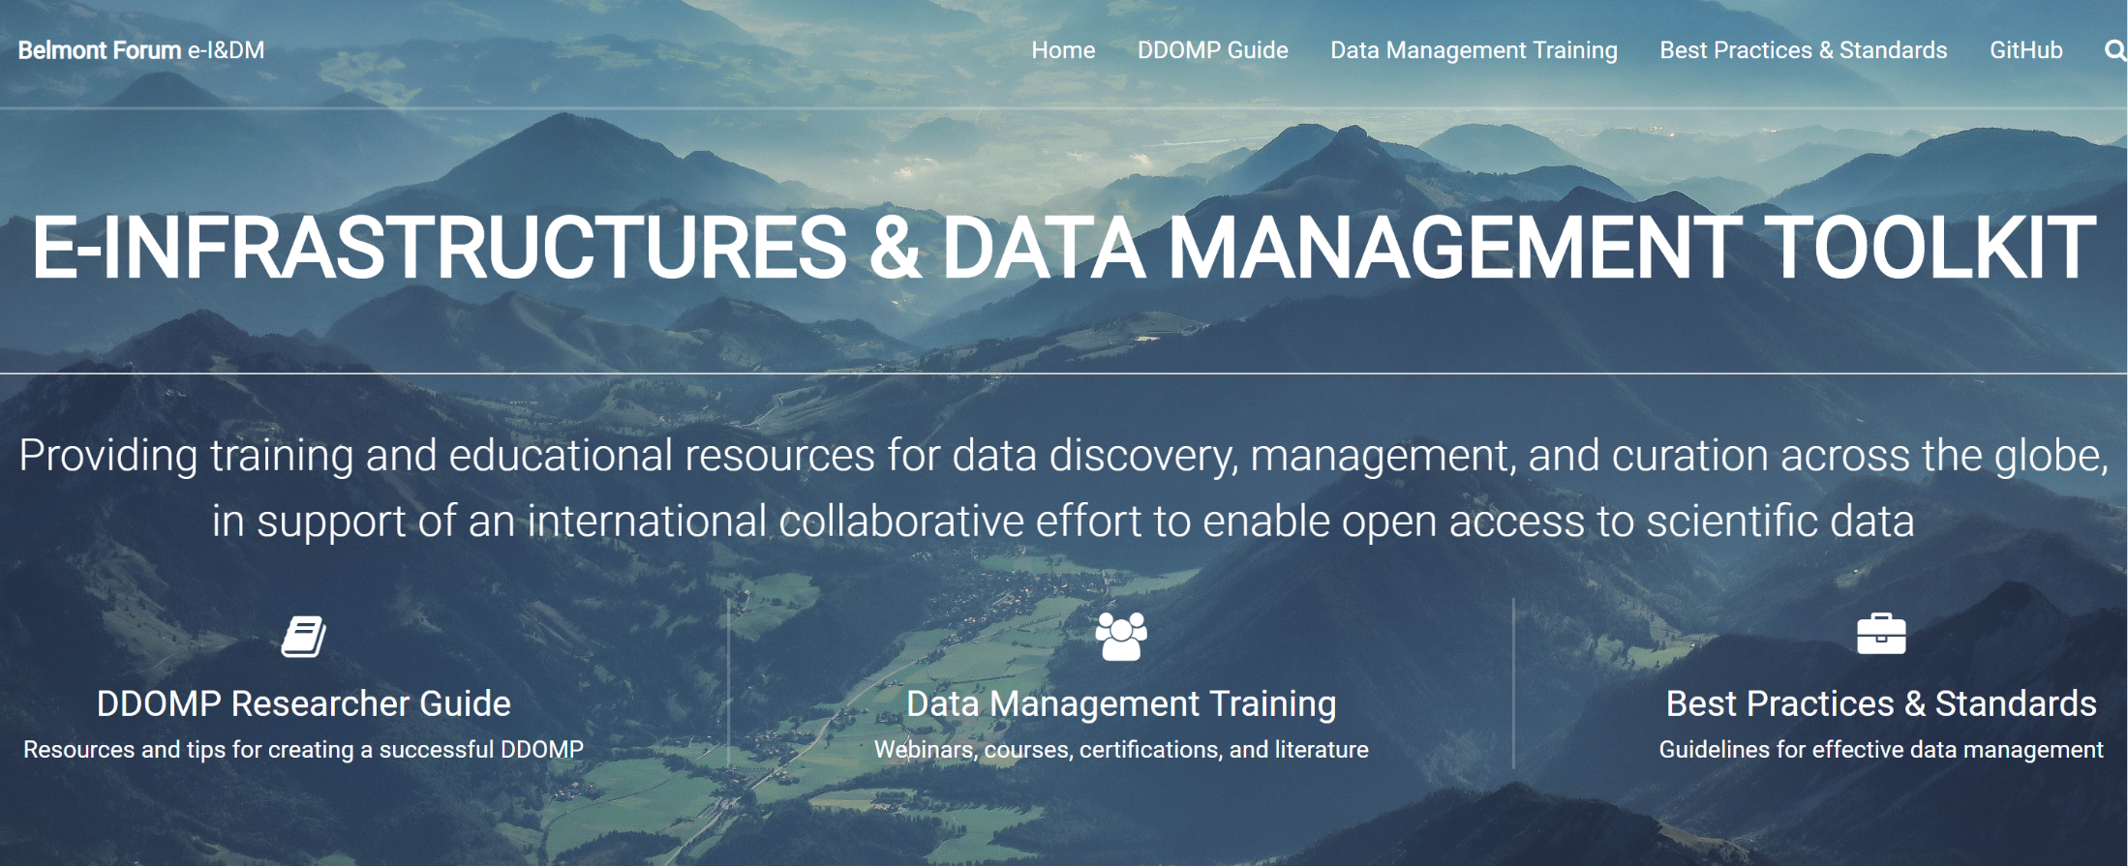
https://bfe-inf.github.io/toolkit/dmt-researcher.html
Notes:
Good research data management is essential to ensure transparency of scientific research, preserve data, enable reuse and reanalysis of data, and advance knowledge. In addition, governments, funding agencies, and publishers around the world are requiring researchers to develop data management plans and, to make the data resulting from their research openly available. As a result of all of these forces, research data is increasingly seen as an essential part of the scholarly record. Because academic libraries traditionally have a role in providing access to the scholarly record in many forms, it is not surprising that the management of research data is an important issue for academic libraries

Slide 43
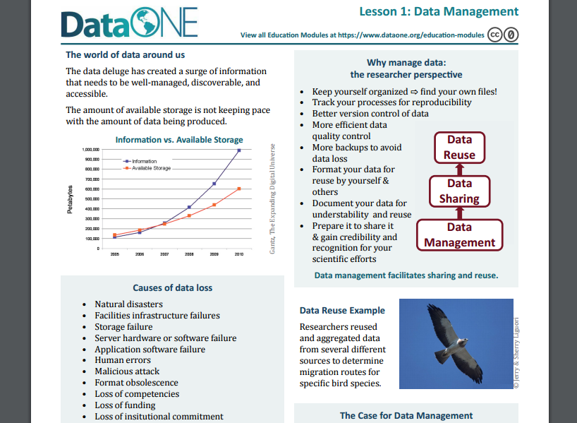
Tools for RDS Education
https://www.dataone.org/education-modules

Slide 44

Thanks to…
DataONE Usability & Assessment Working Group: Assess the needs and motivations of various stakeholders for science data. (dataone.org)
Working Group on Scientific Information Infrastructures: …collects good practices and lessons learned in the area of research data management in libraries.
Notes:
DataONE mission: Enable new science and knowledge creation through universal access to data about life on earth and the environment that sustains it. (dataone.org)
WG: collects good practices and lessons learned in the area of research data management in libraries. The Working Group collaborates with other initiatives to evaluate and support skills development.

Slide 45
Carol Tenopir
University of Tennessee
ctenopir@utk.edu

