Slide 1

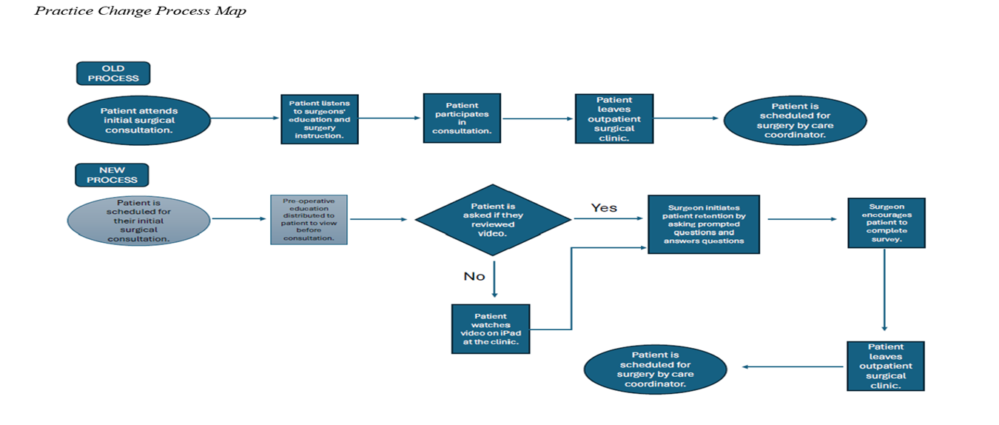


Patients who were offered a standardized evidence-based pre-operative video before their initial surgical consultation were more satisfied with their overall experience, patient education, and wait times.
Enhancing Patient Satisfaction Through the Implementation of Pre-operative Patient Education Videos: A Quality Improvement Initiative
Madison H. Tipton BSN, RN and Christina Brown DNP, APRN, FNP-BC
BACKGROUND
INTERVENTIONS
Pre-operative education improves surgical outcomes, reduces anxiety, and boosts patient satisfaction.
Traditional methods are inconsistently delivered and poorly retained.
Studies report 67% of patients remember video content, compared to 58% for written and 47% for verbal instruction.
Inadequate pre-operative education contributes to complications, readmissions, and dissatisfaction, burdening the U.S. healthcare system financially.
Standardized, evidence-based video education is a scalable, cost-effective solution to close this critical gap in surgical care.
Utilizing the clinical workflow below, patients were provided a standardized pre-operative patient education video.
LOCAL PROBLEM
The project site was an outpatient surgical clinic serving East Tennessee.
Pre-operative education is inconsistently delivered through verbal and written means, resulting in lower patient satisfaction rates and understanding.
The purpose of this project was to implement a standardized, pre-operative, evidence-based video for patients undergoing abdominal surgery.
The project aimed to increase pre-operative education satisfaction by 5% within 8 weeks of implementation.
RESULTS
All patients (100%) viewed the pre-operative video.
All patients (100%) completed the post-video satisfaction survey.
Staff reported improved workload, suggesting the intervention benefited patients and supported clinic efficiency.
Overall patient education satisfaction increased by 7.5%.
Dissatisfaction declined from 10% to 3.2%.
METHODS
The Model for Improvement (MFI) guided the project, utilizing Plan-Do-Study-Act (PDSA) cycles to test and refine the intervention.
Evidence-based literature strongly supports video intervention for patient education.
A standardized, evidence-based pre-operative video was developed with input from staff and patients, introduced at initial consultations, and made available for at-home viewing.
Outcome Measure: Patient satisfaction with pre-operative education.
Pre- and post-satisfaction data were collected.
CONCLUSIONS
Standardized pre-operative patient education video was a successful, low-cost, and low-resource improvement.
The intervention demonstrated clinical significance by increasing patient satisfaction following video implementation.
For long-term sustainability, plans involve integrating a scannable QR code, enabling patients to access educational videos on their personal devices.
ACKNOWLEDGEMENTS/FUNDING DISCLOSURE:
No funding was received for this project.

