Slide 1
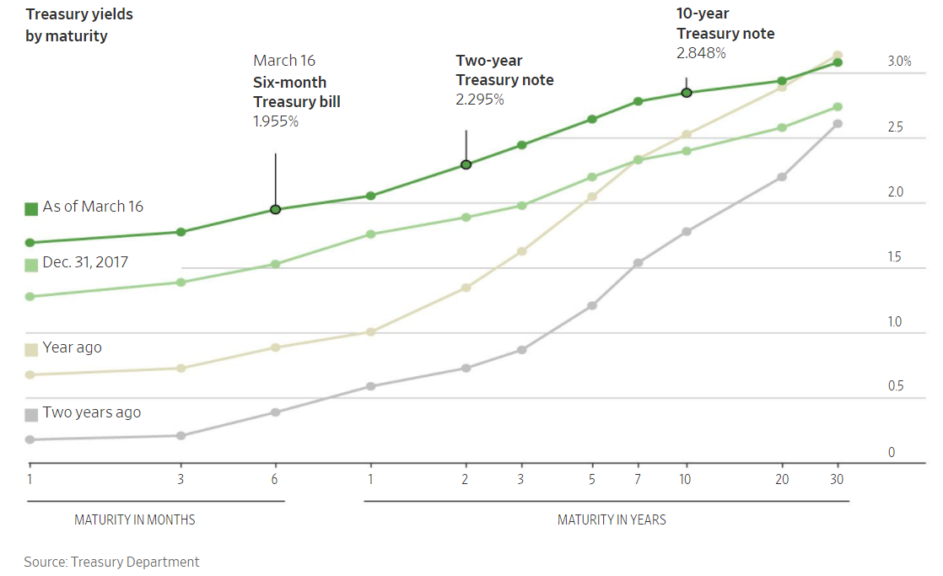
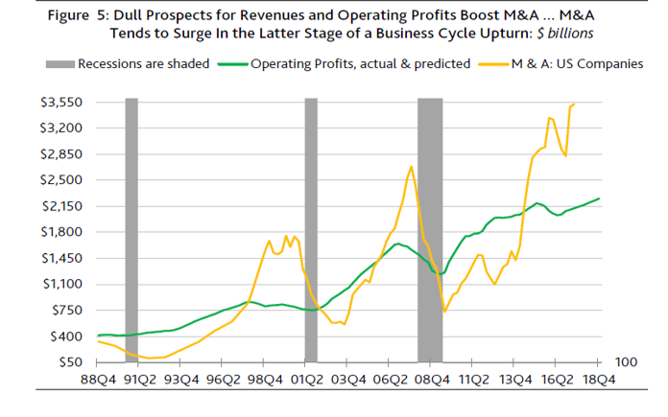
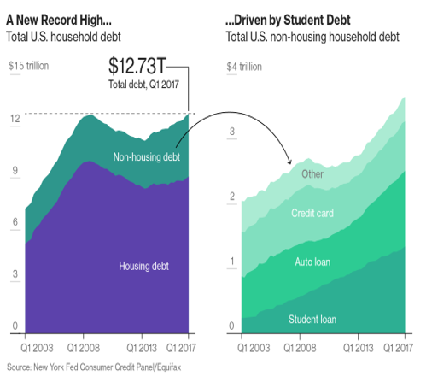
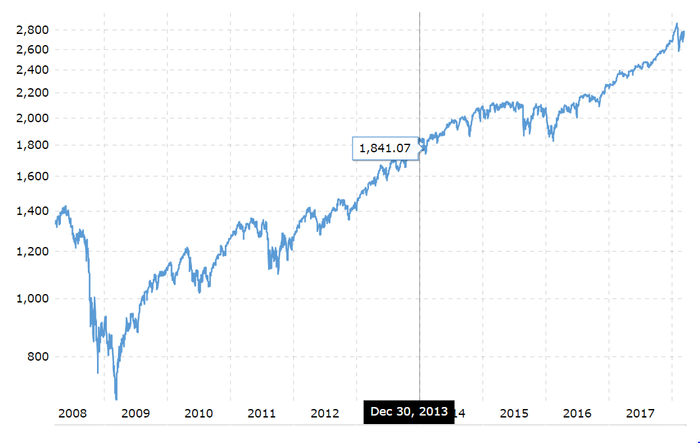
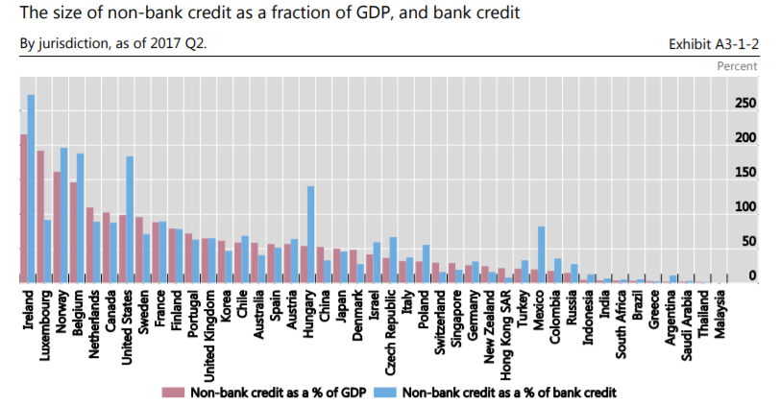
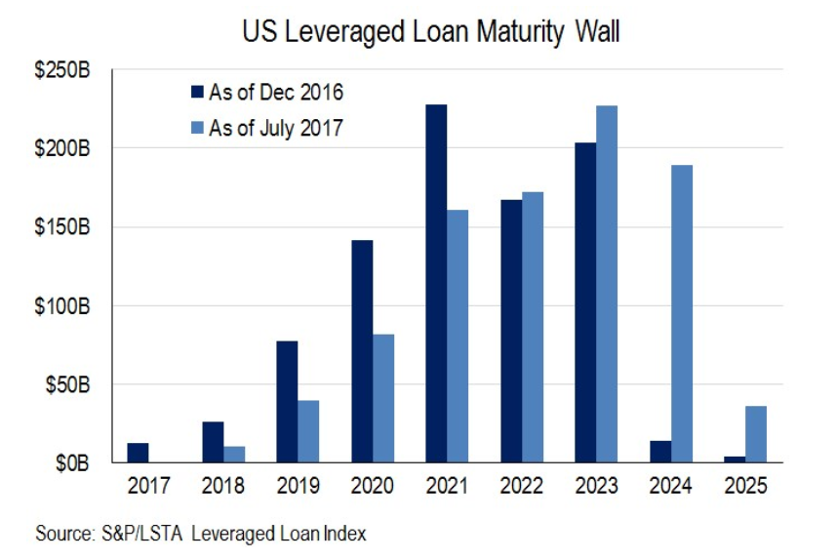

The Next Recession: Is It Time?
By Sam Paganelli
Thesis Advisor Dr. Laura Cole
Abstract
Methods and Results
Conclusion
The Great Recession of 2008 left millions of people without homes, and trillions of dollars in savings were wiped out. As well-informed individuals, we know the economy is cyclical in nature, but how could something so severe happen so suddenly? Were there warning signs that were missed? In my project, I attempt to answer these questions before the next recession. The average business cycle is approximately six years long, and the United States is currently in its ninth year of economic expansion. This fact alone has many people worried that a downturn may be imminent. The goal of my project is to take a holistic view of the health of the United States economy but do so in a way that is simple and easy to understand for the average person. A recession is defined as “A period of temporary economic decline generally identified by a fall in GDP in two successive quarters”. Because of this definition, I will tie every indicator I look at back into how it affects GDP in the United States. Some of the leading indicators I will focus on are the stock market, bond market, corporate earnings, consumer spending, production, and consumer sentiment.
Methods
Is it time for the next recession? Based on my findings, a recession is not imminent, and I do not expect a recession in the upcoming days or months. However, if the Fed continues to raise interest rates and the yield curve continues to flatten, I expect a recession sometime late 2019 to early 2020. The economy appears to be growing and expanding in a healthy nature. Unemployment is historically low and consumer spending continues to increase. The lingering memories of the housing market crash have corporations sitting on immense piles of cash and healthy balance sheets. Moving forward, I am concerned about the household consumer debt loads in an environment with rising interest rates. Additionally, fears over a potential trade war with China and inflationary concerns have caused volatility to return to the equity markets. Despite the negatives, the tax bill should put more money in corporations’ and consumers’ pockets. This could lead to an extra leg of the nine-year bull market.
I identified and analyzed leading indicators and potential risks for the U.S. economy.
The leading indicators analyzed include the stock market and the yield curve. One word explains what drives a stock price at a fundamental level over long periods of time: earnings. Current and future earnings provide the thesis that all other metrics of a company revolve around. So, if earnings drive a stock price over the long-term, how has the stock market been doing since the Great Recession? The below graph shows the astronomic rise of the S&P 500 (composite of the U.S.’s 500 largest companies) since the depths of the economic crisis. This index alone has risen approximately 300% from March of 2009 to March of 2018.
The yield curve can be an indicator of market sentiment. Its movements, based on where people are investing their dollars, indicate if people are not worried or not. This ties back into GDP and predicting the next recession because a flattening yield curve instills fear in people. This leads to a “flight to safety” (movement of money into bonds, gold, and cash), a slowing economy, GDP falling, and eventually a recession. Currently the yield curve is flattening, but it is not flat yet. This indicates that a recession should be sooner rather than later, but one is not immediately on the horizon.
Results
Introduction
As illustrated by history, the economy expands and contracts in a cyclical nature. Economic downturns are expected to happen within a reasonable amount of time, but the great recession of 2008 took the world by surprise. Trillions of dollars in retirement accounts, pension funds, and other investments plummeted to near-zero levels as panic spread. This meltdown shook the world economies to their core as governments struggled to bail out massive corporations. After the dust settled, this extraordinary event left the United States and the rest of the world wondering, “Could we have seen this coming?”
When corporations produce goods and services, the outputs contribute directly to GDP. Therefore, if corporations were to see a wide spread decline in earnings, liquidity, or any dramatic downfall similar to 2008, the U.S. economy would come down as well. As depicted by the returns in the general stock market, corporate earnings have been robust since the housing crisis. The companies in the S&P 500 have been consistently reporting all-time high cash piles. Additionally, debt to equity and debt to asset ratios remain around half of their pre-crisis levels. Corporations appear healthy as they ever have.
The United States unemployment rate is currently the healthiest it has been since 2000. Sitting at approximately 4.1%, the unemployment rate has declined significantly from the 9.9% we saw in 2009. As of January 2018, the personal savings rate was only 3.2% of disposable income. This number has been steadily on the decline since approximately 2013. U.S. Household Debt reached an all-time high at $12.73 trillion. Auto, credit card, and student loan debt are all increasing at an annual rate of over 5%.
TRIFOLD AREA – THIS GUIDE WILL BE REMOVED BEFORE PRINTING – TRIFOLD AREA – THIS GUIDE WILL BE REMOVED BEFORE PRINTING – TRIFOLD AREA – THIS GUIDE WILL BE REMOVED BEFORE PRINTING – TRIFOLD AREA – THIS GUIDE WILL BE REMOVED BEFORE PRINTING – TRIFOLD
TRIFOLD AREA – THIS GUIDE WILL BE REMOVED BEFORE PRINTING – TRIFOLD AREA – THIS GUIDE WILL BE REMOVED BEFORE PRINTING – TRIFOLD AREA – THIS GUIDE WILL BE REMOVED BEFORE PRINTING – TRIFOLD AREA – THIS GUIDE WILL BE REMOVED BEFORE PRINTING – TRIFOLD
S&P 500 Returns
References
“Global Shadow Banking Monitoring Report 2017.” Fsb.org, Financial Stability Board, 5 Mar. 2018, www.fsb.org/2018/03/global-shadow-banking-monitoring-report-2017/.
“Household Debt and Credit Report.” Center for Microeconomic Data, Federal Reserve Bank of New York, www.newyorkfed.org/microeconomics/hhdc.html.
“Treasury Yield Curve.” U.S. Department of the Treasury, United States Treasury Department, www.treasury.gov/resource-center/data-chart-center/interest-rates/Pages/Historic-Yield-Data-Visualization.aspx.
Other Risks
Other noteworthy topics include shadow banking, speculative-grade debt, and M&A activity compared to operating profits.
Acknowledgements
Thanks to Dr. Laura Cole who helped me through the process.
Contact Information
spaganel@vols.utk.edu

