Slide 1
Usability Testing to Improve Research Data Services
Rachel Volentine
Amber Owens
The University of Tennessee, USA
Notes:
Hello and welcome. Thank you for your attendance
(Rachel Introduction): Rachel Volentine (personal introduction) and my name is Amber Owens (graduate assistant in the user experience lab and recent graduate of the university with a masters in information science). (Rachel Introduction continued)
Thanks, Rachel. Now let’s continue with the presentation where we’ll discuss usability testing as a way of enhancing the use of research data service in the library.

Slide 2
Research Data Services
Services to help researchers manage their data
Includes:
Data Management planning
Reference support for citing data sets
Web guides for data sets
Technical support for data repositories
Preparing data sets for repositories
Creating metadata for data sets
Notes:
Research data services are services that can be provided by the library to assist researchers in managing data
Because of a growing need for data management planning by funding agencies such as: National Institution of Health,(NIH), National Science Foundation (NSF), and the Wellcome Trust, research data services can fill a niche with potential for immense impact in the scientific community.
Some of the support services are listed here (read list, pause for questions)
Data management planning- strategy and document outlining how to maintain data during the research process and after for as the long as the data stands to be of use
Reference support for data citation- this has all information pertaining to provenance
Web guides for data sets- how to find various data sets; comparable to pathfinder
Technical support for repositories- downloading information, understanding scheme, language, compatibility software issues
Preparing data for repositories- proposals and approval process, standards,
Creating metadata for data sets- standards, approval,

Slide 3
Data Entropy
Time of publication
Specific details
Information Content
General details
Retirement or
career change
Accident
Death
TIME
(Michener et al. 1997)
Notes:
We’ve mentioned funding as a reason for data services, but how might data management as a research service be important?
A phenomenon known as, data entropy occurs when data is left unmanaged
Data entropy causes data to not be of use. This ultimately contributes to the “death” of data essentially meaning that the data cannot be accessed or used
Longevity issues deal with file formats and media sources. Both must be updated periodically in order that the data remain useful for the long term
In the case of accident or loss a management plan can assist in staving off the entropy process
The graph shows how that soon after publication, data reuse potential begins to diminish rapidly, overtime. Left unchecked the data proves useless for purposes of furthering research
It’s for this reason that data services are key to maintaining research for potential use and reuse

Slide 4
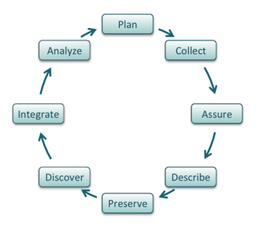
Importance of Research Data Services
Funder, journal, and institutional mandates (e.g. NIH, NSF, Wellcome Trust)
Aid intuitional compliance
Protect institutional investment in research
Produce higher quality research, expand its impact, and increase data reuse
http://www.dataone.org/best-practices
Notes:
As mentioned previously there are numerous reasons to practice sound data management at all stages of the data in its life cycle.
The data life cycle is a model for understanding how best to maintain data at all stages of use that is, planning, collection, preserving, analyzing, etc.
This process is explained in the diagram here and represents the ideal lifecycle trend for data according to DataONE (a research repository that we assisted in optimizing their data services)
Benefits to research services are:
Institutional compliance (requirements for research as set by the university for faculty/ tenure)
Increased visibility, data reuse, higher quality research and impact
As you can see, there are numerous reasons to practice sound data management
Note about the DataONE Data life cycle from their data management plan document
The cycle represents various aspects of data management
The steps represent a logical flow of activities though each activity can be performed out of sequence, repeated, and with others in tandem
http://www.dataone.org/sites/all/documents/DataONE-PPSR-DataManagementGuide.pdf

Slide 5
Usability
Usability is the ease and accessibility of a system.
Usability testing seeks to study how users interact with a system in order to improve the users’ experience and satisfaction in achieving their objectives.
Notes:
So, today we are going to discuss how research data services can be aided by usability studies. Here are a few definitions to help familiarize you with the potential of this testing
Usability testing is a means by which research data services can be optimized using case studies as a model.
Tests are carried out using certain methods such as thinking aloud and eye tracking
These methods examine performance on certain activities and measure time on task, number and severity of errors and where the eye lingers.
Results can be used to aid developers in creating websites and interfaces that increase ease of use and the overall satisfaction of the user

Slide 6

DataONE: Data Observation Network for Earth
Mission: Enable new science and knowledge creation through universal access to data about life on earth and the environment that sustains it.
Vision: DataONE will be commonly used by researchers, educators, and the public to better understand and conserve life on earth and the environment that sustains it.
Notes:
Now we will discuss how we performed usability testing to improve DataONE services. Here is a bit on DataONE also known as the data observation network for earth-supported by the U.S. National Science Foundation
Essentially it is a repository (data store house) for earth observational data
“DataONE will ensure the preservation, access, use and reuse of multi-scale, multi-discipline, and multi-national science data via three primary cyberinfrastucture elements and a broad education and outreach program.”
This research data service provider is always looking to cutting edge practice in order to expand their potential and the efficiency of their services.
Data resources: Research networks and environmental observatories
Governmental agencies and NGOs
Biological specimens
Individual scientists
Citizen scientists’ data
Natural resources and conservation data
Observational data
Global and continental land cover/land change and biogeochemical data
Census data
Providers
Academic and Agency Scientists
Research networks
Environmental observatories
Citizen groups
Students
Consumers
Academic and Agency Scientists
Research networks
Environmental observatories
Citizen groups
Students
Affiliates
Libraries & digital libraries
Academic institutions
Research networks
NSF- and government-funded synthesis & supercomputer centers/networks
Governmental organizations
International organizations
Data and metadata archives
Professional societies
NGOs
Commercial sector

Slide 7

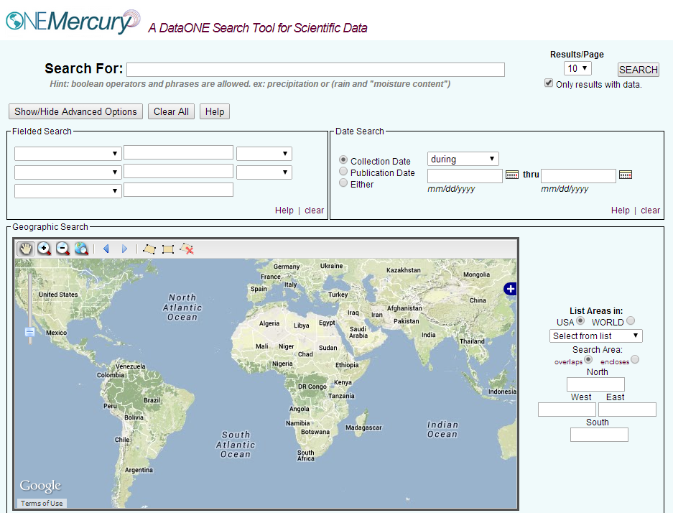
Usability Testing of
https://cn.dataone.org/onemercury/
Notes:
Now I will discuss a couple of the tools offered by DataONE and a bit on the testing procedure for their optimization in our usability lab
In 2013 there was a test conducted at their annual “all hands meeting” concerning the ONEMercury database interface
Essentially, ONE Mercury is a search interface connecting multiple databases and repositories
26 participants were asked to complete a series of tasks using the tool
There were 13 pre task questions this mostly consisted of demographic inquiries (e.g. job title, discipline, familiarity with DataONE), then there were 5 tasks that each participant was asked to complete regarding the functionality of the tool, finally 19 post task questions were asked of each participant so that they might rank a series of statements pertaining to their experience with the tool (e.g. strongly disagree to strongly agree) throughout the entire process the participant was asked to think aloud so as to gage their thought process in working with ONEMercury
We recorded the sessions (screen display, keystrokes, mouse movement-time on task, and errors)

Slide 8

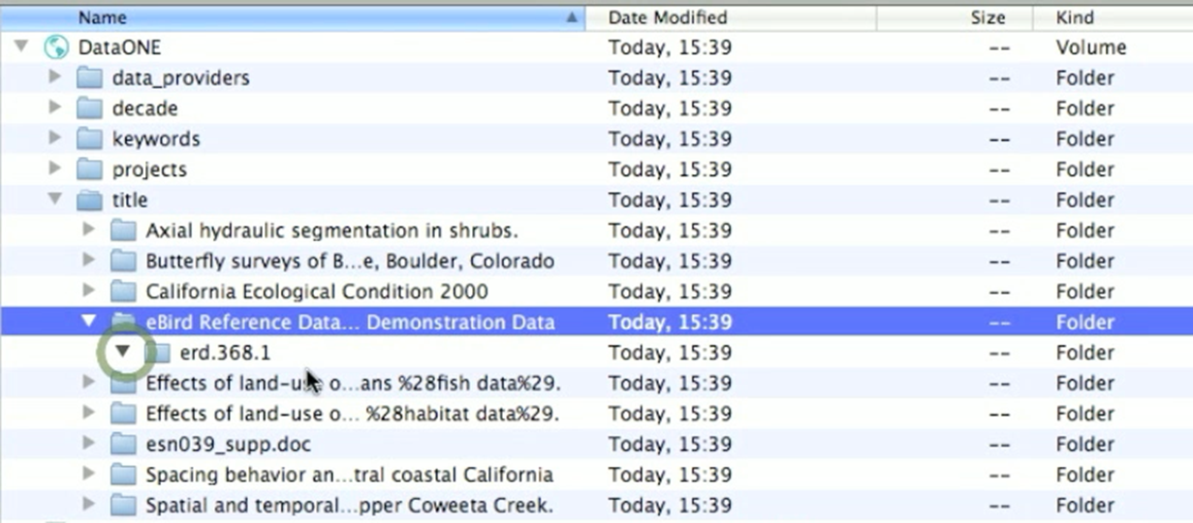
Usability Testing of
Notes:
The second tool was tested in July 2013, this was ONEDrive. It is a data management tool synced with the ONEMercury interface to allow access to DataONE content on the local hard drive.
6 participants were shown a wire frame (the wireframe is a prototype of the major navigation and content elements in a 2-d form). After viewing the wireframe participants were asked for their feedback
The goal was to improve the tool before release to the public
As a part of the test, participants were walked through how to find, retrieve, and save data sets
In the end, they were asked to comment on their overall impression
DataONE appears as network drive
Live view – changes appear immediately
Focus view using filters
keyword=“solar radiation” AND project=“Canopy Arthropods”
surname=“Fink”
Access content with unmodified applications

Slide 9
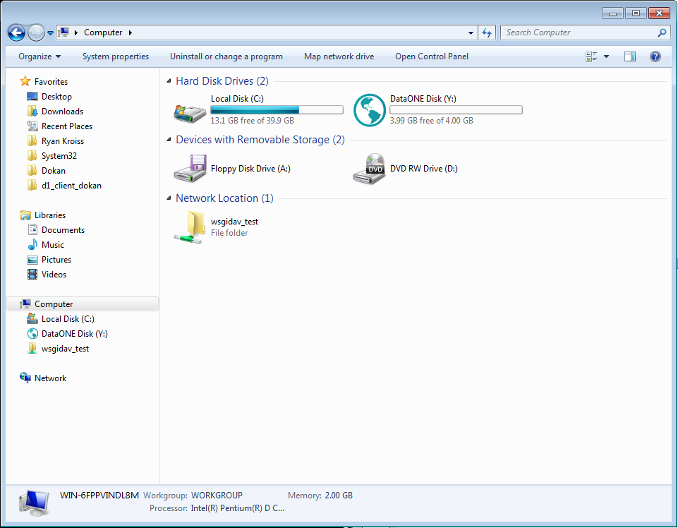
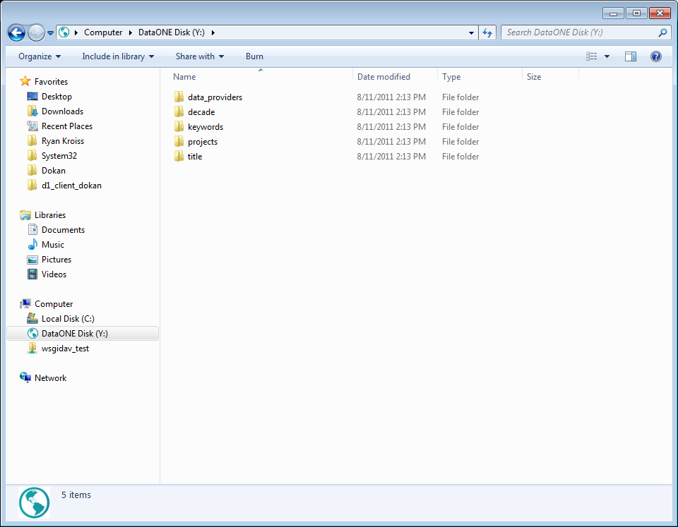
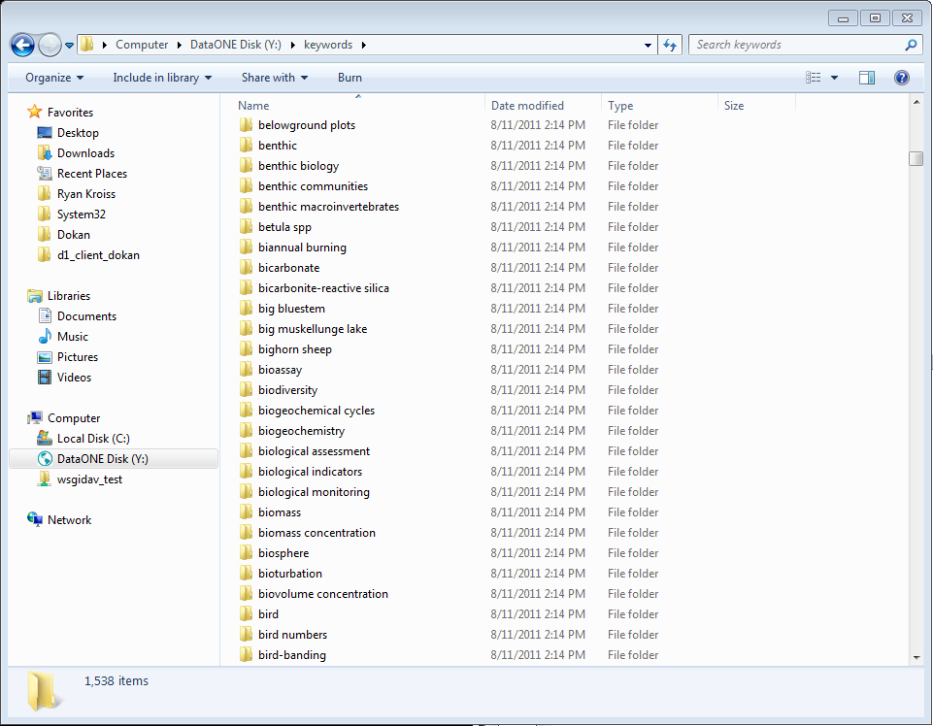
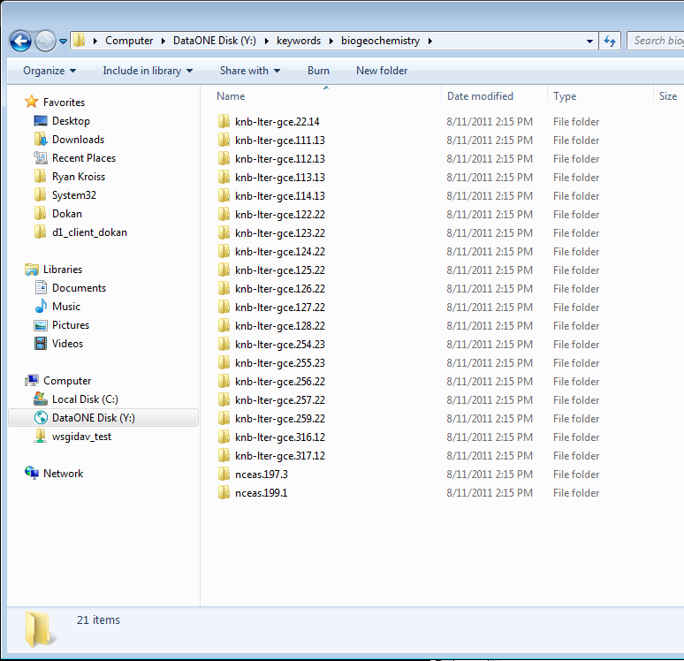
ONE Drive – Windows implementation
Notes:
This is a sample of what one might see when using one drive. The tool is synced with ONEMercury and datasets are extracted and can be saved for viewing on the desktop
Now, Rachel will present to you some of our findings .

Slide 10
Semantic Issues and Recommendations
Notes:
The usability testing of ONEDrive and ONEMercury uncovered numerous semantic usability issues dealing with the wording of various features of the tools.
These issues highlight the importance of testing the wording and phrasing on users because developers and those familiar with a product, company, or subject may not be aware of what is common knowledge and what is specialized language.
One of the general principles of design is the “system should speak the users’ language with words, phrases, and concepts familiar to the user, rather than system-oriented terms” (Neilsen 1995).
ONEMercury used acronyms (e.g., LTER, MN) that users did not know. MN for “member node” and LTER for “Long Term Ecological Research Network” are familiar acronyms for DataONE members but are not common for users.
For libraries familiar terms such as the Boolean operator, OPAC, ISBN, and ILL are common knowledge but this may not be the case for library users. Likewise, research data services need to account for unfamiliar terms so that users can effectively use the services.
It is best to write out all acronyms and abbreviations to avoid confusion.

Slide 11
Semantic Issues and Recommendations
Notes:
Efficient and easy to use search features are important in order for the user to receive the best quality results.
In ONEMercury the user can filter results by author, project, keyword, member node, and originator.
Users, however, were unclear how originator differed from author and member node and were unable to use the filter options correctly.
A help feature that defines the filters and provide more information would allow users to efficiently use the search tool.

Slide 12

Semantic Issues and Recommendations
Notes:
There were many elements in the ONEDrive and ONEMercury tools that confused users.
In many cases the usability studies showed ways of clearing up the confusion by simply relabeling or rewording the feature but in some cases a “help page” or button is needed.
“Help and documentation” is one of Jakob Neilsen’s top design principles, and he states that while it is better if there is no need for documentation, it may be necessary to provide help.
The help documentation should be easy to search, focused on the user’s task, and list concrete steps to be carried out (1995). The usability studies showed that users want help documentation and have clear ideas of what should be included.
Help pages, hover-overs, and question mark buttons next to items are all useful ways of offering assistance to the user.
By clearing up the language and functionality of the items in the research data service you can enhance user satisfaction so that navigation is a quick and easy process.

Slide 13
Structural Issues and Recommendations
Notes:
The next set of issues deals with the structure of the tool. These issues deal with the information architecture of the tool.
Strong information architecture helps users understand where they are, what they have found, and what to expect.
On ONEMercury’s search result page, the user had the options to open the “data file”, “return to search”, and “back”.
The name of every feature or button should match where it takes the user.
The buttons, however, did not perform the tasks the users expected based upon their label. The “Back” button returned the user to the search results while the “Return to Search” took them to a new search page.
It is important for the use of each page feature be clear.
Making sure the function of the button matches its purpose will avoid user confusion.

Slide 14

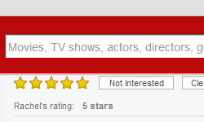
Structural Issues and Recommendations
ONEMercury
Amazon
Netflix
Notes:
Before the usability testing ONEMercury used yellow stars to show relevance of a data set. Stars are a common symbol to show relevance or quality.
Consistency is an important design principle, and objects should have similar operations and use similar elements for achieving similar tasks (Preece 2002).
The stars looked similar to the stars used on websites, such as Amazon or Netflix, to represent how the community gaged the value of the product.
However, ONEMercury’s stars represented relevance based on ranking search terms in the metadata. During the usability test many users assumed the stars served the same purpose as those in Amazon or Netflix.
While consistency throughout a tool is vital, it also needs to take into account how the item is used across different tools and web pages.
In this case it is best to show relevance without the stars in order to avoid confusion.

Slide 15
Structural Issues and Recommendations
Notes:
Usability testing can show areas where the structure of the tool needs improvement. Usability tests show preferences that the developers and designers may not have realized when developing the tool. By addressing these users’ concerns DataONE and other research data services can create a more satisfying and efficient user experience.
In our early usability testing of ONEDrive users expressed interest in downloading the data and metadata as one package. Currently the two files have to be downloaded separately. Users preferred downloading them as a zip file because it would keep the files together and especially if the user was downloading multiple data sets it would ease confusion over what belonged together.
Users also expressed concern over opening metadata in ONEMercury. Currently the metadata opens on the same page as the search results, but users would prefer the option of opening the metadata in a new tab. This would allow users to continue searching and open multiple metadata files for comparison.
The structural usability issues deal with user preferences. Their preferences show they want things to be simplified on their end.
By creating a good user interface the user is more satisfied with their experience, better able to accomplish goals, and more likely to return to the tool.

Slide 16
Technical Issues and Recommendations
Notes:
Technical issues deal with the navigability and functionality of the tool.
Technical issues are an important category to observe in usability studies. These issues often need to be addressed by the IT or infrastructure team.
ONEMercury has an option to search by geographical region using a map to select certain areas.
The map, however, did not function properly in every Internet browser. In Mozilla, Safari, and Google Chrome the map did not initially load but remained a white square until the user refreshed the browser.
This highlights the importance of usability testing on different browsers and computers since users will typically use a variety of browsers to access the site.

Slide 17
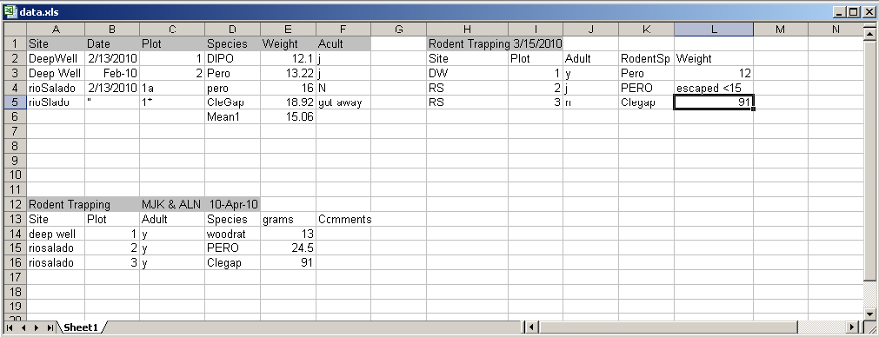
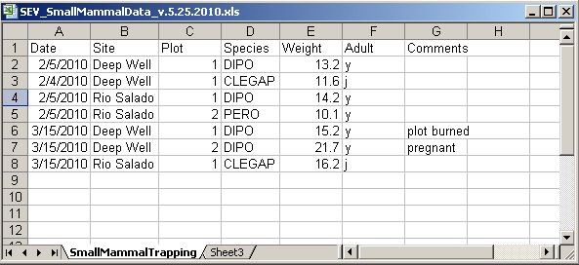
Technical Issues and Recommendations
Notes:
Another issue that arises when sharing data is how to format the data.
Excel, CSV, and XML all have their uses, but not every user will have the software to download and read each file format.
This is an ongoing technical issue that is debated in data management practices, but it is an important consideration for research data services.
DataONE recommends using plain text ascii characters (the American standard code for information interchange) for variable names, file names, and data.
This ensures that the data file will be readable by a large number of software programs.
In addition file formats should be non-proprietary (e.g., .txt or .csv files rather than .xls) so that they are stable and long-lasting (Strasser et al 2012).
In our testing of ONEDrive users said they like to see the file format before downloading the data so they can save time if the data is in the wrong format.

Slide 18
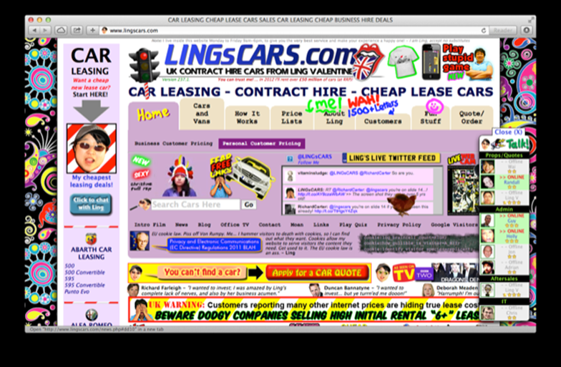
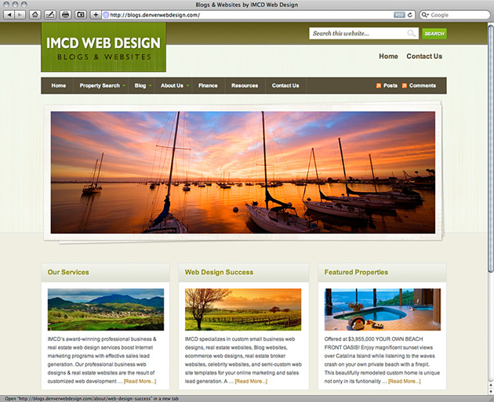
Aesthetical Issues and Recommendations
Notes:
While the ONEMercury and ONEDrive usability testing did not focus on aesthetic usability issues, it is important to take design and feel into consideration.
The visual impact of a tool can influence the user’s experience and has implications for effective communication (Hoffman and Krauss 2004) and influences how the user interacts with the tool (Schenkman and Jönsson 2000).
A poorly designed tool can turn a user away or leave them frustrated and unlikely to return. Usability testing needs to incorporate not only the navigability of a tool but the user satisfaction level.
In addition, color, texture, typography, and images influence a user’s interface with a tool as well as create hierarchy and clarity that draw the user’s attention and improve readability (usability.gov).
Think-Aloud method often addresses these issues as the user comments on what they like and do not like about a tool as they perform the tasks.
The two images show a well designed site and a poorly designed site. You can see how distracting and confusing the top site is compared to the clear and well-organized and structured site on the bottom right.

Slide 19
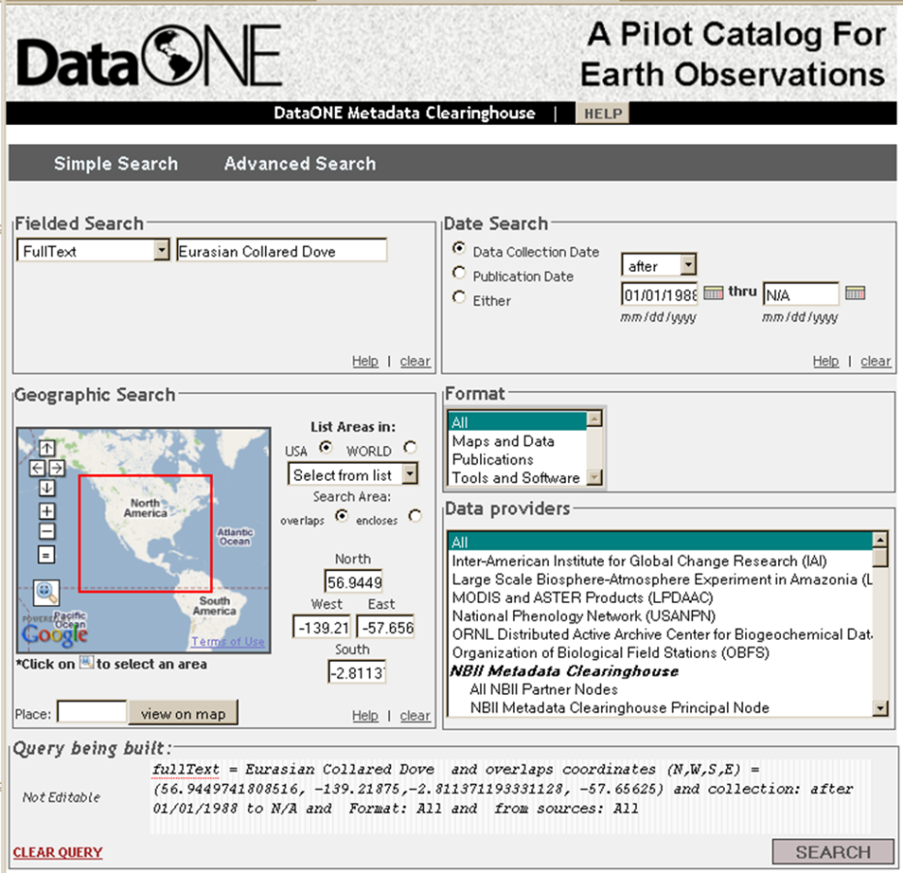
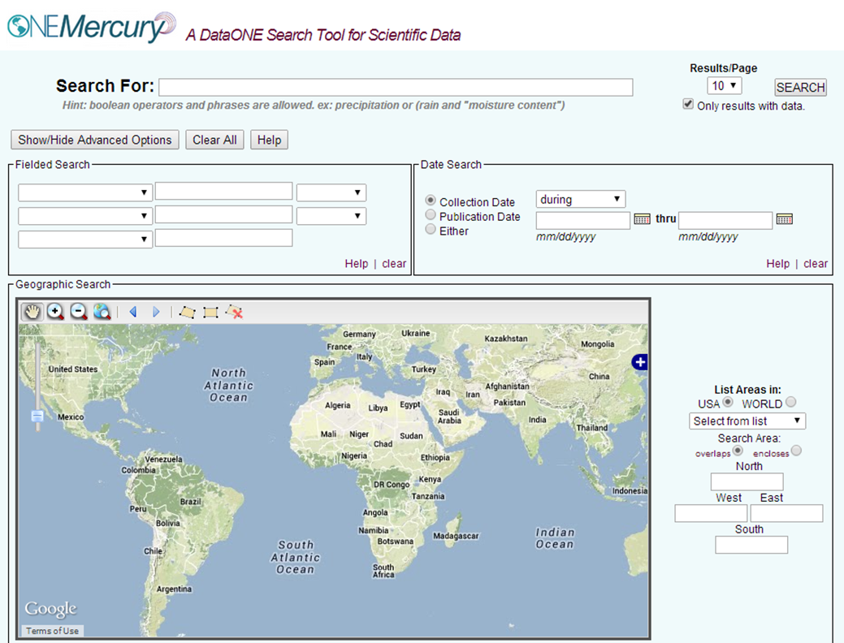
Conclusions
2009
2014
Notes:
In conclusion, research data services are becoming an increasingly important and regular service of libraries.
In order for the services to have maximum impact it is important for the services to run as smoothly, are easy to use, and developed with basic usability principles in mind.
Usability testing can assess how research data services are meeting users’ needs and ultimately improve the RDS offered by Libraries.
DataONE is dedicated to its comprehensive usability program, and the program has resulted in a large return on investment.
Usability testing on DataONE services has improved its cyber infrastructure, strengthened its community engagement, and increased its impact on the preservation and access to scientific data.
DataONE will continue to conduct usability tests on ONEMercury and ONEDrive.
Each usability test created more user-friendly and efficient tools, which are vital to DataONE’s mission, that is, to enable new science and knowledge creation through universal access to data

Slide 20
Rachel Volentine rvolenti@utk.edu
Amber Owens aowens8@utk.edu
For more information,
please see our websites:
http://www.cci.utk.edu/cics
http://www.cci.utk.edu/cics/usability_lab

