Slide 1


Data is Approaching
The changing culture of data citation, elaboration, and transparency lies ahead!
Charleston Conference
November 8, 2018

Slide 2
Participants
Heather Staines (Moderator), Hypothesis
Amy Forrester, Member Node Coordinator, DataONE
Amy Schuler, Director of Information Services and Library, Cary Institute of Ecosystem Studies
Robert J. Sandusky, AUL for Information Technology, University of Illinois at Chicago

Slide 3
FAIR Data as a Lens
...facilitate knowledge discovery by assisting humans and machines in their discovery of, access to, integration and analysis of, task-appropriate scientific data and their associated algorithms and workflows. (Force11, https://www.force11.org/group/fairgroup/fairprinciples)
Findable: Unique persistent identifier in the metadata which is rich, registered, and indexed
Accessible: Retrievable by standard protocol (open, free, univ. implementable), available even if data isn’t
Interoperable: Uses accessible shared language with FAIR vocabularies and qualified references
Re-usable: Accurate relevant attributes, clear accessible usage license, provenance, domain-relevant community standards

Slide 4


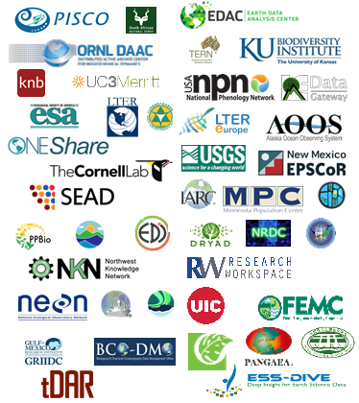
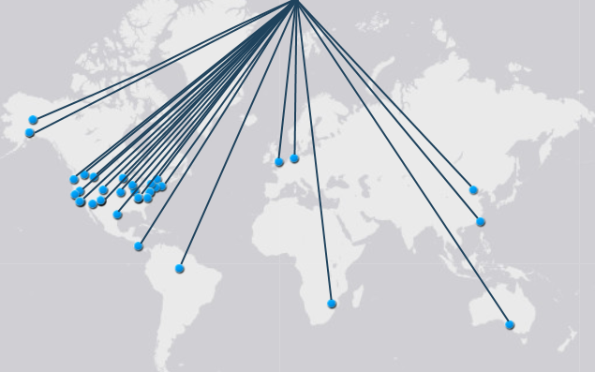
Federation of Earth and Environmental Science Repositories and Data centers
Amy Forrester
...increase data visibility and dissemination
...assist in long-term data management

Slide 5
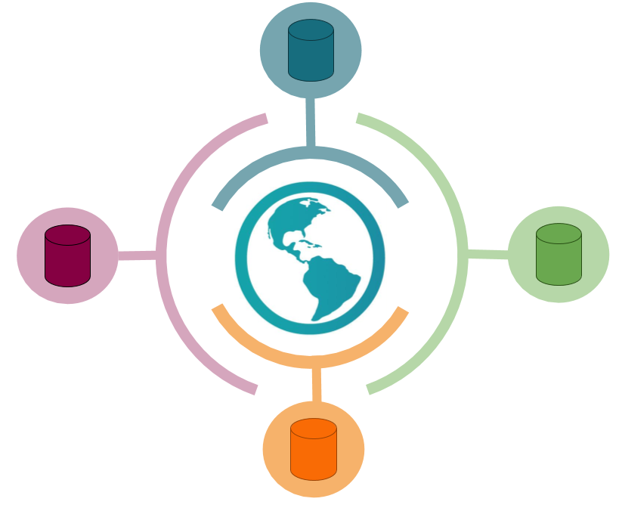
Key Points and Challenges
Not just a technological solution
FAIR Data FAIR Repository

Slide 6

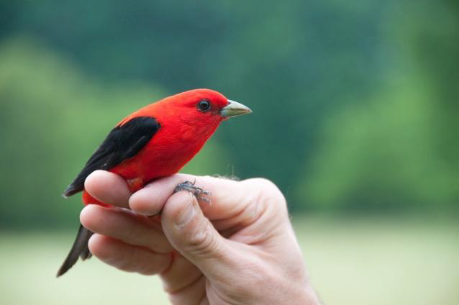
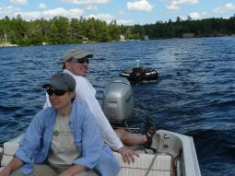
Amy Schuler
“Founded in 1983, the Cary Institute of Ecosystem Studies is one of the world’s leading independent environmental research organizations. Areas of expertise include disease ecology, forest and freshwater health, climate change, urban ecology, and invasive species.”
~100 research scientists, visiting scientists, and research support staff
~ 130 peer reviewed articles/year

Slide 7
Key Points and Challenges
*Creating a culture of data sharing*
What data should be shared? Raw, derived, code, scripts…
Understanding & creating structured metadata
Dealing with large and long term/ongoing datasets (versioning & citation challenges!)
Creating efficiencies (time, effort, etc.)
Funder requirements (for publications and data)
Teaching students (grad/undergrad)
We expect our new Figshare for Institutions repository will help solve some of these challenges

Slide 8
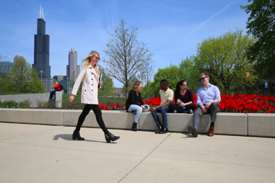
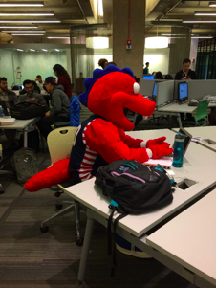

Robert J. Sandusky, Ph.D.
Associate Professor, UIC Library
Research: How do archives ensure the long-term trustworthiness of digital objects?
31,600 students
Doctoral, highest research
$267M in sponsored research, 58th in R&D funding

Slide 9
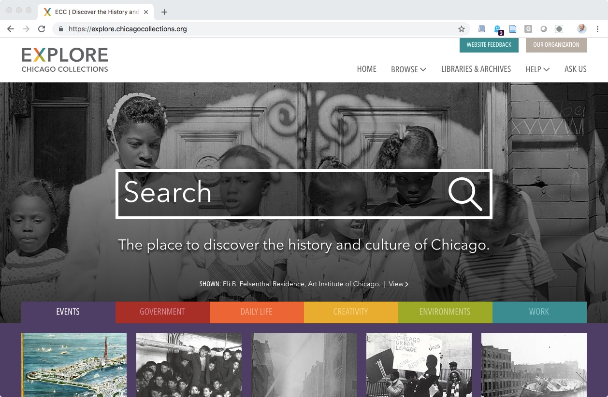
UIC University Library
Lead developer for Explore Chicago Collections
Implementing full preservation DAMS
Redesigned digitization lab
Robust scholarly publications portfolio

Slide 10
Key Points and Challenges
Does FAIR data apply to archival collections?
Humanities data management lags science data management
How many types of repositories do we need?
Recognition of data in arts and humanities
Archival responsibilities and current gaps
Scholar responsibilities
Archival sustainability

Slide 11
Moderated discussion
Heather Staines (Moderator), Hypothesis (heather@hypothes.is)
Amy Forrester, Member Node Coordinator, DataONE (aforres4@utk.edu)
Amy Schuler, Director of Information Services and Library, Cary Institute of Ecosystem Studies (schulera@caryinstitute.org)
Robert J. Sandusky, AUL for IT, University of Illinois at Chicago (sandusky@uic.edu)

