Slide 1
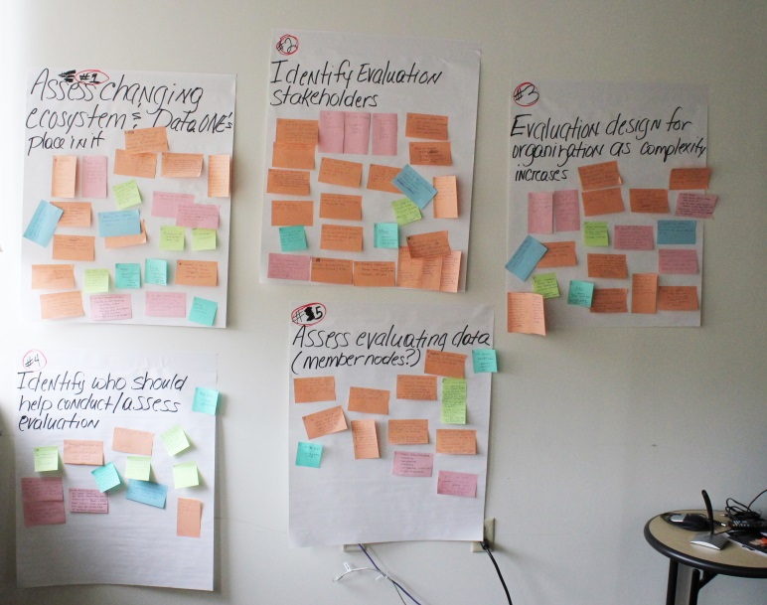
Sociocultural WG – Environmental Scan
Benchmarking exercise
Successes and failures combined
Organization
Technology
Break downs
Where in the life of technology?
Where in the life of the organization?
Where in the Data Life Cycle?
Fine tuning
Where is DataONE
now?
5 years?
Follow up to evaluation
exercise in May 2013

Slide 2


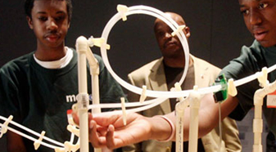

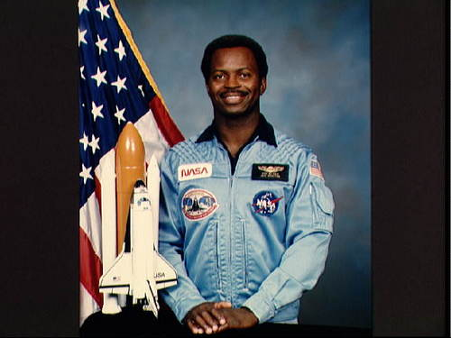
The Frames Analysis
Structural
Design, Planning &
Implementation
Symbolic - Meaning & Value
Human Resources
Organization’s Relationship to People

Slide 3
Structural Frame – Factories
Goals and objectives
Specialization and appropriate division of labor
Coordination and control
Rationality over personal agendas
Fit with organization’s circumstances
Problems because of structural deficiencies
Reframing Organizations: Artistry, Choice, and Leadership (JOSSEY-BASS BUSINESS & MANAGEMENT SERIES)
by Lee G. Bolman and Terrence E. Deal (Aug 5, 2013)

Slide 4
HR Frame – Families
Organizations serve human needs.
People and organizations need each other.
One or both suffers from poor fit.
A good fit benefits both.
Reframing Organizations: Artistry, Choice, and Leadership (JOSSEY-BASS BUSINESS & MANAGEMENT SERIES)
by Lee G. Bolman and Terrence E. Deal (Aug 5, 2013)

Slide 5
Symbolic Frame - Theaters
Myths, visions, and values associated with organization
Effective use of symbols
Formal or informal rituals used in the organization
Formal or informal ceremonies used in the organization
Good story teller in the organization, purpose of the story
Lauded heroes and heroines in the organization
Symbols that resolve confusion, positively or negatively
Culture is the superglue that holds the organization together.
Reframing Organizations: Artistry, Choice, and Leadership (JOSSEY-BASS BUSINESS & MANAGEMENT SERIES)
by Lee G. Bolman and Terrence E. Deal (Aug 5, 2013)

Slide 6
Who is in it for the long haul?
DataONE Sociocultural Working Group Organizational/Technology Lessons Drawn from Other Cyberinfrastructures
 | Structural |  | Human Resources |  | Symbolic
 | Lessons from Successes” | Lessons from “Failures” | Lessons from “Successes” | Lessons from “Failures” | Lessons from “Successes” | Lessons from “Failures”
Organization
Organization
Technology
Technology

Slide 7
Organization, e.g, IEEE - Examples
Structural
How it is arranged (WGs?)
Governance structure
Do they hold data?
How long assembled?
Where assemble?
How long operational?
Strategic preplanning and planning
Public or private support
Communication tools
Communication policy
Sustainability plan
Mission/vision
Aspect of the Data LifeCycle
Financial support
Budget
Proposal vs implementation
Authorized users
Internal/external evaluation
Technologies used (analyze these features in Technology sub- group) & will integrate
Relationship to DataONE
Human Resources
Paid, unpaid volunteers
Strategic partners and other stakeholders
How members are selected
Expectations of users
Symbolic
Name of organization
How members are selected (status?)
Building trust
Branding/marketing
Features in high profile publications

Slide 8
Technology - Examples
Structural
Suites of tools
Where they aid in the Data Lifecycle
Failures (where fall out of life cycle)
How operational is it ?
Describe features – metadata, text
Goals/milestones
Technologies integrated in the future
What users want
How products worked for users/quality control
Budget
Proposal vs implementation
Network view/particular nodes
Authorized users
Internal/external evaluation
Relationship to DataONE
Licensing/copyright/attribution
Human Resources
How big is the user community?
Skills/expertise required
Expectations of users
Symbolic
Looks like leading edge
Building trust

Slide 9
Who is in it for the long haul?
DataONE Sociocultural Working Group Organizational/Technology Lessons Drawn from Other Cyberinfrastructures
 | Structural |  | Human Resources |  | Symbolic
 | Lessons from Successes” | Lessons from “Failures” | Lessons from “Successes” | Lessons from “Failures” | Lessons from “Successes” | Lessons from “Failures”
Organization
Organization
Technology
Technology
Predict groups’ fall off (including our own)
Identify changing scopes
Identify strategic partners
Identify overlap
Tell us who to keep our eyes on

