Slide 1

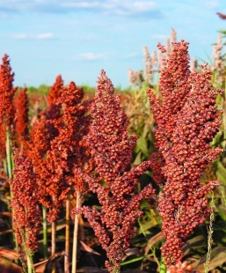
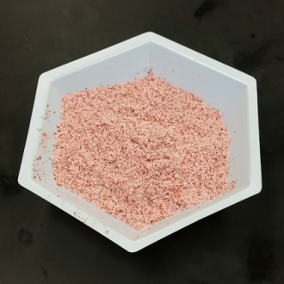
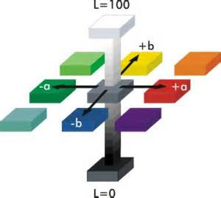
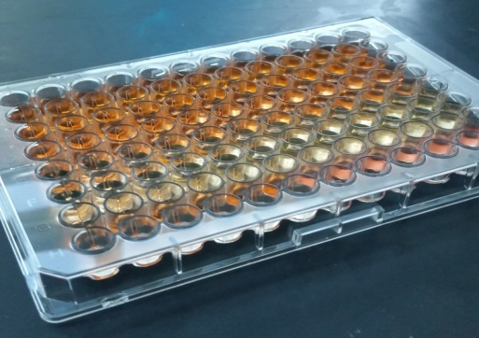
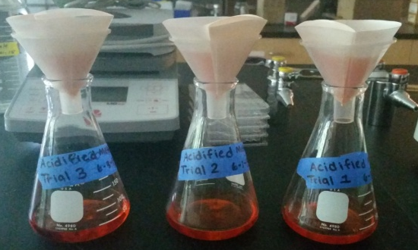
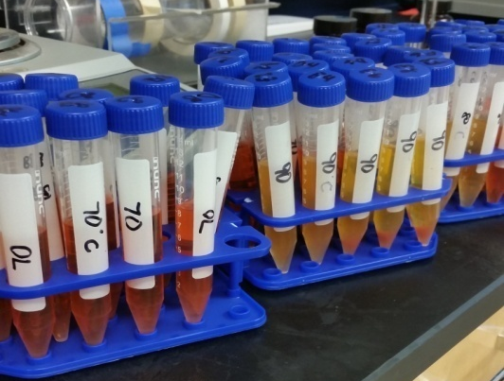


Abstract Red sorghum contains phytochemicals such as 3-deoxyanthocyanidins and flavonoids with potential application in food as coloring and health promoting agents. The objective was to determine the stability of methanolic and ethanolic extracts of sorghum as affected by pH (2, 4 and 6) and temperature of storage (4 and 22 °C). The following parameters were measured: polyphenol concentration, absorbance at 490 nm and L*, a* and b*-values to monitor changes in color, and concentrations of luteolin, apigenin and naringenin by high performance liquid chromatography. After 10 weeks, polyphenols did not change significantly at pH 2 and 4 samples stored at 4 and 22 °C, but reduced by 58.4% in pH 6 sample for ethanolic extract and by 42.5% for methanolic extract at 22 °C. Extracts with pH 2 and 6 stored at 22 °C led to increase in absorbance at 490 nm and reduction in L-values indicating darkening of the extracts which may be associated with browning reaction. Luteolin, apigenin and naringenin were reduced after 10 weeks of storage indicating degradation of these flavonoids. Our preliminary results are important in determining proper storage conditions in order to protect phytochemicals in red sorghum for potential use in food products.
Storage Stability of Sorgum Bicolor Alcoholic Extract as affected by pH and Temperature
Jordan Bradwell, Philipus Pangloli, Vermont P Dia
Department of Food Science and Technology, The University of Tennessee, 2510 River Drive, Knoxville, TN 37996-4591, USA
Introduction
Sorghum is the fifth most produced cereal in the world and contains bioactives with potential health-promoting properties¹.
Anthocyanin are natural pigments responsible for the red, violet, & blue color in fruits and vegetable; they have the potential to be used a natural food colorants².
Flavonoids are polyphenolic health promoting molecules found in many foods; they are known for their ability to modulate cell-signaling pathways³.
Antioxidants are substances that prevent or delay some types of cell damage; their primary purpose is to inhibit oxidation of other molecules⁴ .
Results
A
Polyphenols
Table 1. First-order reaction kinetics parameters and energy of activation (Ea) for the degradation of luteolin and apigenin from Sorghum bicolor extracts. Flavonoids at pH 2
Luteolin(MeOH/EtOH) Apigenin (MeOH/EtOH)
Parameter 4 °C 32 °C 4 °C 32 °C
Reaction
rate, k (wk⁻¹) 0.013/0.006 0.104/0.111 0.013/0.017 0.085/0.092
Half-life (wk) 55.0/115.5 6.7/6.2 51.7/42.0 8.2/7.5
Ea (kJ/mol) 52.1/74.0 44.2/41.9
Flavonoids at pH 4
Luteolin (MeOH/EtOH) Apigenin (MeOH/EtOH)
Parameter 4 32 4 32
Reaction
Rate, k (wk⁻¹) 0.027/0.010 0.383/0.279 0.022/0.021 0.085/0.092
Half-life (wk) 25.4/67.3 1.9/2.5 30.4/32.5 2.7/2.4
Ea (kJ/mol) 65.3/82.7 59.8/62.8
B
C
Figure 1. Storage temperature and pH affected the total polyphenol content of different buffer systems containing Sorghum bicolor alcoholic extracts. Samples stored at 32 °C showed statistically significant reduction in polyphenol concentrations after 6 wks of storage at all pH values. In general, the stability of polyphenols was not affected by solvent used in extraction as methanol and ethanol extracts showed very similar reduction under the same pH and temperature of storage. Polyphenols are important groups of naturally occurring antioxidants in foods important in quenching free radicals that can damage cells in the body.
A
B
Objectives
The objectives of this study were:
To evaluate the effect of pH, temperature, and time of storage on the color of Sorghum bicolor extracts.
To determine the degradation kinetics of individual phenolics present in Sorghum bicolor extracts.
Methanol Ethanol
pH 2 4 6 pH 2 4 6
Wk 0 Wk 0
6 6
12 12
Hypothesis
Extraction solvents, pH, temperature, and time will affect the stability of pigments and individual phenolics of Sorghum Bicolor extracts.
Figure 4. Arrhenius plots showing the degradation of luteolin (A) and apigenin (b) with respect to pH and alcoholic extracts. The figures show linear plots indicating temperature dependency of luteolin and apigenin degradations.
Conclusions
Solvents used for extraction did not differ in the concentration of polyphenols, luteolin, or apigenin.
Higher temperatures and higher pH led to acceleration of flavonoid degradations.
Degradation of luteolin, and apigenin follow the first order kinetics linear trend.
Sorghum can be used as a source of bioactive compounds with health-promoting properties and its use as a potential food colorant should be explored.
Materials & Methods
Figure 2. Color squares of each of the extracts at 22 C at different pH levels over a period of 12 weeks. L*, a* and b* values were converted to RGB values using Colormine (http://colormine.org/convert/rgb-to-lab). Color squares were generated using PowerPoint Insert shape function. An increase in pH lead to darkening as well as precipitation indicative of possible browning reaction which is accelerated at pH 6 as compared to pH 2 and pH 4 buffer systems.
Sorghum bicolor
Ground sorghum
Extraction for 2h at room temperature using the following solvents: 1% HCl in MeOH, EtOH & Water
A
Grind samples
Filtration of Extracts
Current Activities and Future Directions
Repeat of experiment to validate results for publication.
Identification of compounds present in Sorghum bicolor extracts by LC/MS-MS.
Purification of compounds and determination of its potential health-promoting properties.
Determination of the storage stability of anthocyanins from sorghum in beverage food system
ln concentration
Analyses every two weeks
Measurement of Total Polyphenols (Folin-Ciocalteu method at 630 nm)
Color (*L, *a, *b using Hunter Colorimeter)
Individual Phenolics (Luteolin and Apigenin) by HPLC
B
Store the extracts (pH 2, 4 ,6) at
4°C for 12 wk
22°C for 12 wk
32°C for 12 wk
Storage Time (wk)
References
1. de MoraisCardoso et al. (2015). Sorghum (sorghum bicolor l.): Nutrients, Bioactive Compounds, and Potential Impact on Human Health. Crit. Rev. Fd. Sci Nutr. DOI: 10.1080/10408398.2014.887057.
2. Dia, Vermont P et al. "Processing Method and Corn Cultivar Affected Anthocyanin Concentration from Dried Distillers Grains with Solubles." Journal of Agricultural and Food Chemistry J. Agric. Food Chem. (2015): 3205-218. Print.
3. Hertog, MG. "Dietary Antioxidant Flavonoids And Risk Of Coronary Heart Disease: The Zutphen Elderly Study." The Lancet (1993): 1007-011. Print.
4. Young, I S, and J V Woodside. "Antioxidants in Health and Disease." Clinical Pathology (2000): 45-46. Print.
Figure 3. Changes in the concentrations of luteolin (A) and apigenin (B) in Sorghum bicolor extracts as affected by temperature and pH follow first order reaction kinetics. Parameters of the first order reaction kinetics are listed in Table 1 and calculated using the first order reaction kinetics equation as presented in Materials and Methods section. Extracts stored at 4 °C resulted in slower degradation of luteolin and apigenin as evidenced by lower reaction rate constants, k, and longer half-lives, t_{1/2} , while extracts stored at 32 °C showed the fastest degradation indicating temperaturer dependency of degradation of these flavonoids. Extracts at pH 2 are more stable than extracts at pH4.
Data Analysis. Extractions were performed in two independent trials. All assays were done in duplicate. Data were analyzed using SAS Ver 9.4 Proc GLM procedure and Tukey Posthoc Test at P < 0.05.
Acknowledgements
Dr. Angela McClure for providing sorghum samples.

