Slide 1


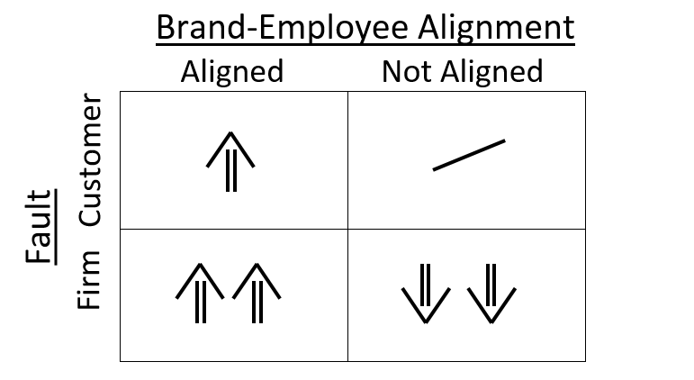
Brand Positioning vs. Employee Behavior
Kaitlin Waters
Faculty Advisor: Dr. Alex Zablah
University of Tennessee – Global Leadership Scholar
Abstract
Objectives
Methods
Conclusions & Implications
Retailers work hard to create an image for their company or their brand. But what happens when there is a service failure and the retailer’s employees are responsible for remedying it? This study examines customer repurchase intentions after a service failure. Data was collected for this study through a survey distributed to college-age students. This study will test if a retailer’s customer-facing employees have a role in portraying the retailer’s brand personality, and how that portrayal affects customer repurchase intention.
The purpose of this study will be to examine if a customer service employee’s aligned/misaligned behavior with the brand they are representing affects the extent to which customers intent to repurchase from the brand. I will examine the relationship between three factors: whose fault a retail service failure was, whether the retail employee’s behavior was aligned with the brand’s image, and the perception of the brand after the interaction between employee and customer occurs.
Key Variables of the Study:
Independent Variables: Employee-brand alignment and fault of service failure
Dependent Variable: Repurchase intention
This quantitative study employed an electronic survey examining customer’s perception of a retailer and their intentions to repurchase after the event of a service failure. Specific aspects of the research included:
Research:
Electronic survey distributed to college-age students through social media, email, and promotion in College of Business classes
Sample:
176 respondents
Hypothesis:
H1: Employee-brand alignment has a positive effect on customers’ intentions to purchase the brand in the future.
H2: The positive effect of employee-brand alignment on customers’ intentions to purchase the brand in the future will be stronger (as opposed to weaker) when the firm (as opposed to the customer) is responsible for the service failure.
Analysis:
After data collection, regression analysis was performed on SPSS.
Results do not imply that aligning customer service representative personality to the high-end personality of Luxe does not in itself have a positive effect on customers’ intentions to repurchase from Luxe (as proposed in H1).
Study shows that service employee brand alignment matters when the firm is responsible for a service failure. Specifically, employee alignment with the Luxe brand does not have a significant effect on customer purchase intentions when a service failure is the customer’s fault, but it does affect future purchase intentions when the service failure is the firm’s fault (consistent with H2)
Call for marketing and HR managers to strive to internally communicate brand personality to frontline employees to mitigate company-generated service failures
Background
This study was modeled after a study published in the Journal of Marketing called Branded Service Encounters: Strategically Aligning Employee Behavior with the Brand Positioning.
This study surveyed 254 students at Arizona State University and each respondent was randomly assigned a script to read depicting a customer service/customer interaction of a high-end retailer via telephone. They were then asked to rate the retailer based on behavior of the customer service employee.
However, this study modified variables for brand familiarity and conceptual fluency of brand meaning.
The study found that respondents gave higher ratings when the high-end retailer was represented by a high-end customer service employee. Similarly, respondents gave higher ratings to low-end retailers when they were represented by low-end employees.
“Unless you have absolute clarity of what your brand stands for, everything else is irrelevant.”
Mark Baynes, Global CMO, Kellogg Co
Predicted Results
Interaction Effect
Bibliography
Sirianni, Nancy J., Mary Jo Bitner, Stephen W. Brown, and Naomi Mandel (2013) Branded Service Encounters: Strategically Aligning Employee Behavior with the Brand Positioning. Journal of Marketing: November 2013, Vol. 77, No. 6, pp. 108-123.
Brady, M. K., Cronin, J. J., Fox, G. L., & Roehm, M. L. (2008). Strategies to offset performance failures: The role of brand equity. Journal Of Retailing, 84(2), 151-164.

