Slide 1

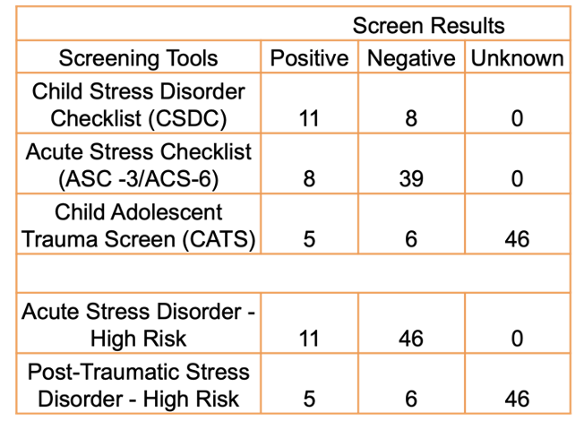
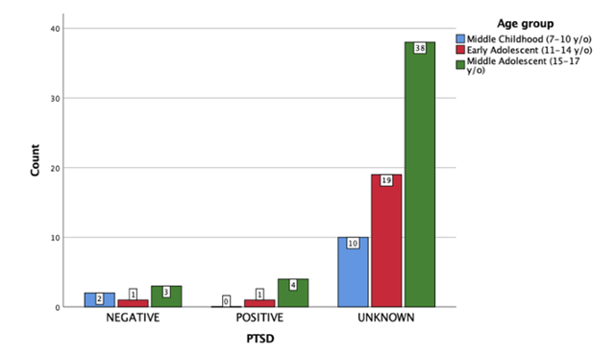
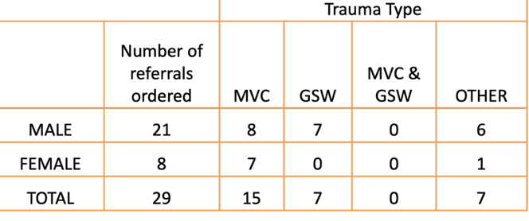


Pediatric trauma patients at risk for ASD and PTSD were more likely to be identified and receive referral orders after the implementation of a standardized ASD and PTSD screening tool.
Acute Stress Disorder and Post-Traumatic Stress Disorder Screening in Pediatric Trauma Patients
Samantha Irizarry BSN-RN; Marian Malone DNP, APRN, CPNP-AC/PC; Megan Waddell MSN CPEN
BACKGROUND
INTERVENTIONS
Two-thirds of U.S. children and adolescents report experiencing one or more potentially traumatic events by age seventeen, and 4.7% of U.S. adolescents meet the lifetime criteria for PTSD.
13.4% of the North Carolina pediatric population ages 0-17 have undergone two or more traumatic adverse childhood experiences, compared to 14% of the U.S. population.
One of the most common inappropriate diagnoses and treatments is attention-deficit/hyperactivity disorder (ADHD) in this population.
Early identification reduces the by-products of underdiagnosis of ASD and PTSD, such as mental illness, developmental delays, poor academic performance, and challenges with social interactions.
All pediatric patients ages 7-17 years old who were admitted for unintentional traumatic injuries for a minimum of 24 hours were screened for ASD and PTSD using three screening tools.
Pediatrics Trauma Patient Admitted
Meets inclusion criteria
ASD Screening
CSDC-SF or ASC 3/6 -SF used
PTSD Screening
CATS screen used at 30, 60, and 90 days
If positive, referral order placed
If positive, referral order placed
TRRP Patient Portal/Patient Management used for data collection
LOCAL PROBLEM
The site for this Evidence-Based Practice Improvement project is a level-one pediatric trauma hospital in Charlotte, North Carolina, seeing more than 130,000 patients annually.
Prior to project implementation, there was an absence of ASD and PTSD screening and referral protocol for pediatric trauma patients.
The aims of the project were:
  Implement ASD and PTSD screening at the project site for pediatric trauma patients
  Increase the number of pediatric trauma patients with referrals ordered
RESULTS
The project data analysis and pilot study statistical analysis were compared via Chi-Square and Pearson R analysis; however, without the original data set, the comparison left a margin for error.
Moreover, the data collected expanded demographics, trauma types, and referrals placed.
Data was used to determine the permanent selection of screening tools used for ASD and PTSD screening.
METHODS
The Evidence-Based Practice Improvement (EBPI) and Plan-Do-Study-Act (PDSA) models were the frameworks used for this project.
Literature search, critical appraisal, and synthesis outcomes revealed strong, consistent evidence for each screening tool utilized: Child Stress Disorder Checklist (CSDC-SF), Acute Stress Checklist (ASC 3/6-SF), and Child and Adolescent Trauma Screening (CATS).
Outcome measures were compared to the pilot study performed pre/post-intervention implementation.
CONCLUSIONS
The use of standardized screening tools increased the number of referrals placed for pediatric trauma patients at risk for ASD and PTSD.
The implementation of ASD and PTSD screening tools was integrated into the standard practice at the project site.
The screening tools were incorporated into the site’s electronic health records.

