Slide 1
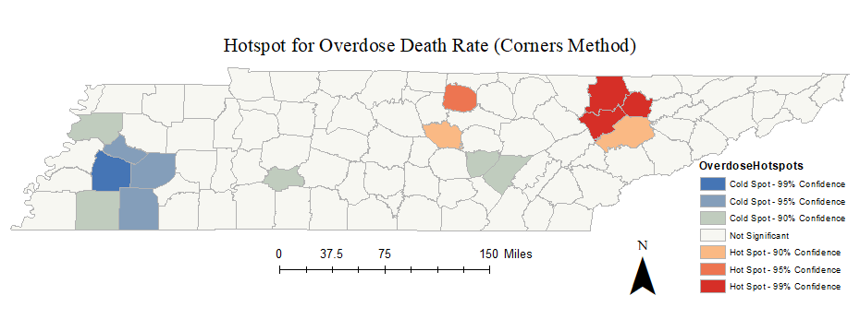
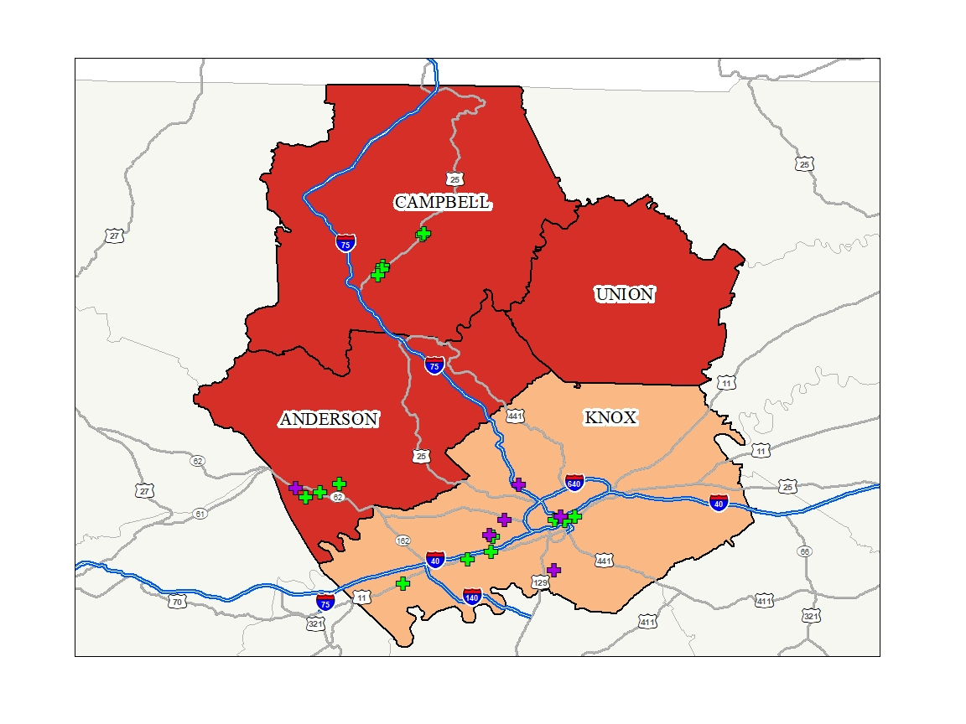
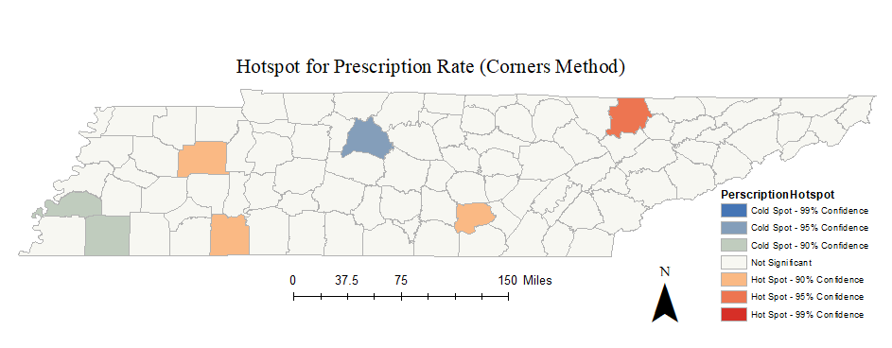
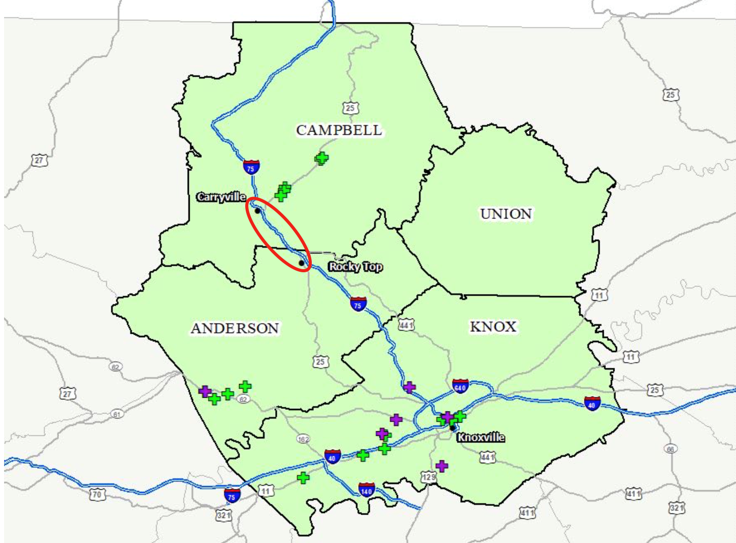
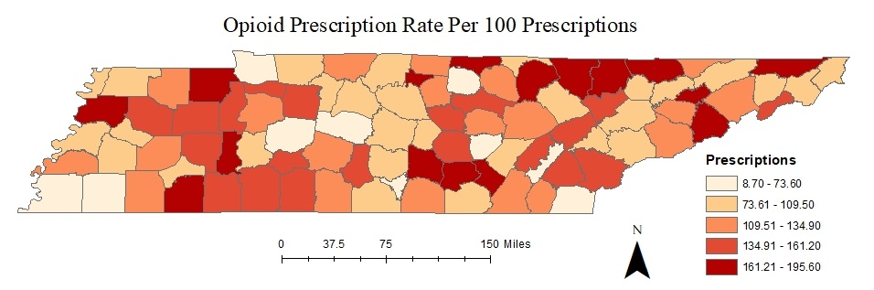

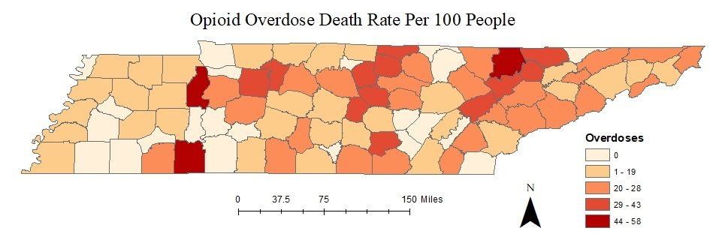
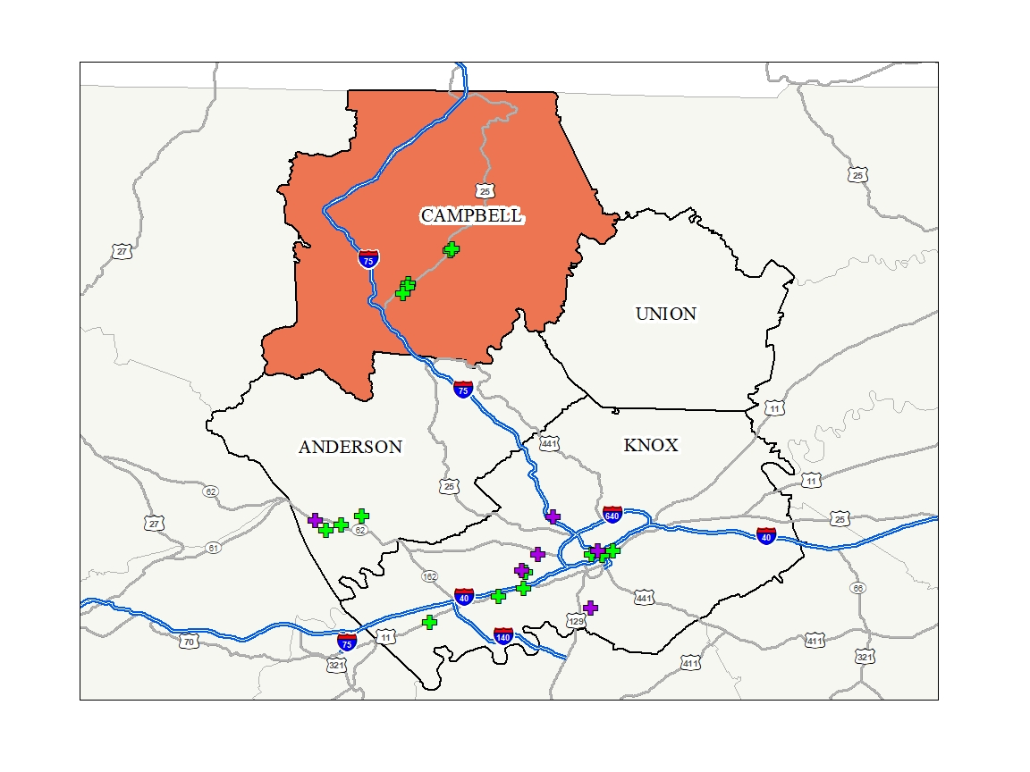

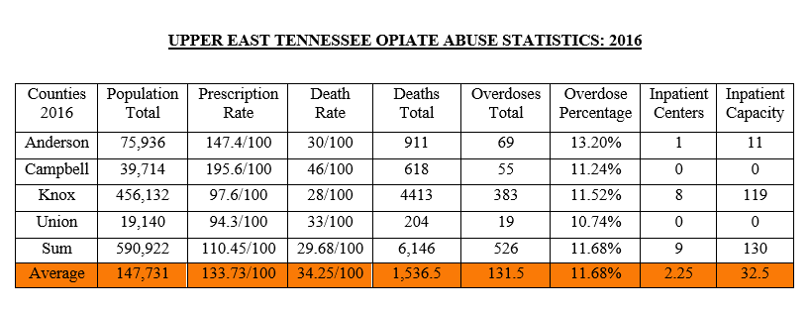
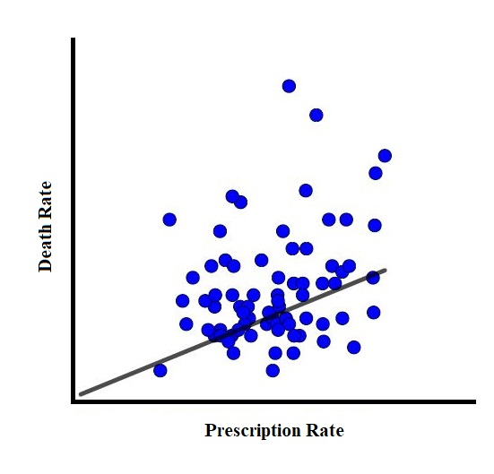
Geography of Opiate Abuse, Overdose, & Treatment in Tennessee
David Leventhal, Meghan Russell, and Kali Williams
Department of Geography, University of Tennessee, Knoxville, TN 37996
Introduction
Opioid addiction and overdose has become a national epidemic in the United States over the past 30 years. According to the Centers for Disease Control and Prevention, more than 20,000 Americans died from prescription drugs alone in 2014 – far more than alcohol-related car accidents. Of the 20.5 million American adults who had a substance abuse disorder in 2015, 2 million were addicted to prescription pain relievers and 591,000 were addicted to heroin. As early as 2012, an astounding 259 million prescriptions were written for opioid-based pain medications – more than enough to give every American adult their own bottle of pills. Four in five new heroin users went from abusing prescription painkillers to using street heroin because pills from a pharmacy are far more difficult and expensive to acquire than heroin on the black market.
Methodology
The first step to reaching the objective was to download the US Census County shapefile and select the state of Tennessee using the “select by attribute” tool. Fields were then added into the county attribute table indicating the opiate prescription rate and rate of death from overdose data. Socioeconomic data derived from the census bureau was considered; however, our research shows that this problem effects people from all economic strata.
Methodology Continued
A “corners method” hotspot analysis offered the best technique to pinpoint the biggest trouble area in the state. The corners method finds correlations between prescription and overdose deaths in counties adjacent to one another in all directions, rather than simply north, south, east, and west.
Results
Not surprisingly, prescription rates are unusually high across the state, with the exception of most urban counties where more affluent populations and easier access to preventative education and substance abuse treatment exist. Other than Knox county, urban counties had relatively low prescription and overdose rates. Some suburban counties contain high rates of prescription but lower levels of overdose, indicating more accessible treatment centers and more efficient support systems; however, some suburban and several rural areas contain numerous counties where prescription and overdose rates soar in parallel.
Results Continued
After researching the Tennessee Department of Mental Health and Substance Abuse Services website, we plotted current outpatient and inpatient treatment centers on the hotspot maps, using green crosses to represent outpatient support centers and purple crosses for inpatient centers. Currently, 8 out of 9 total inpatient centers exist in Knox County alone.
Conclusion
We conclude that a portion of the 13.8 million allocated to the state of Tennessee to fight the opioid epidemic should be used to construct a high-capacity, residential inpatient detox and drug abuse treatment center near interstate 75 around Caryville and Rocky Top, where the highest rate of opioid prescriptions are written, and where the highest rate of overdose deaths occur.
Acknowledgments
This project would not have been possible without the help of Mr. Donghee Koh, Mr. Michael Camponovo, and most importantly, Dr. Yingkui Li. The work was completed as part of Dr. Li’s course, Geography 411 - Intermediate GIS, during the Fall Semester of 2017. Special thanks to Dr. Tyler Sonnichsen for his critique of the poster, to Jeremy Auerbach for his help with statistical analysis.
While the opioid epidemic has plagued Tennesseans across the state, the data clearly shows that four counties in a fairly isolated and depressed area in the northeastern region have been significantly affected and have few options for meaningful detox and treatment programs. Outpatient and office-based opiate abuse treatment facilities exist across the region, but they are spatially limited, have low capacities, offer minimal support, and are largely ineffective. The closest inpatient facilities are located only in cities such as Knoxville, Kingsport, and Johnson City, the closest of which can be over an hour away for some residents along the fringes of the region.
Overdose deaths in Campbell, Anderson, Union, and Knox counties in 2016. A total of 526 overdose deaths occurred across all four counties, with an average overall death rate of 34.25. Knox and Campbell counties reported 383 and 55 overdose deaths with overall death rates of 28 and 46 respectively, while Anderson and Union reported 69 and 19 overdose deaths with overall death rates of 30 and 33 respectively. The 8 impatient centers in Knox County are not sufficient to service the vast area encompassing Anderson, Campbell, and Union counties.
This map displays a small perimeter (in red) where the data suggests an intensive residential inpatient detox/treatment center would be most effective in fighting the opioid epidemic in this hotspot region.
Tennessee ranks high in the number of opioid prescriptions and overdoses compared to the rest of the US. The Volunteer State is one of only 13 where doctors issued between 96-143 opioid prescriptions per 100 people. This project maps opiate prescriptions and overdoses in Tennessee, identifies a major “hotspot” of abuse and overdose, locates areas where opiate-addiction treatment centers currently exist, and proposes a location where a more intensive treatment center is needed.
Prescription rates in Campbell, Anderson, Union, and Knox counties in 2016. These counties averaged 133.725 prescriptions per 100 people, Campbell and Anderson led at 195.6 and 147.4 respectively. Knox and Union county doctors wrote 97.6 and 94.3 prescriptions per 100 people respectively. The population of Knox county was over three times larger than that of Anderson, Campbell, and Union combined, accounting for its lower prescription rate, while Union county’s population was only. 19,000, accounting for its lower prescription rate.
An ordinary least squares (OLS) statistical analysis shows a direct, positive causal correlation between prescription rate (independent variable, horizontal x axis) and death rate (dependent variable, vertical y axis), illustrated in this scatter plot.
Of all the trouble areas, none were as highly concentrated as four adjacent counties in Upper East Tennessee - Anderson, Campbell, Knox, and Union counties. In these four counties alone, 526 overdose deaths were reported in 2016, or 11.68% of all deaths. On average, 131.5 people died from overdose while the total capacity for inpatient care across all counties is only 130 patients, 119 of which are in Knox county alone.
Data Sources
Data Access and Dissemination Systems (DADS). “American FactFinder - Community Facts.” Tennessee, 5 Oct. 2010, <https://factfinder.census.gov>.
“Find a Licensed Facility or Service.” Tennessee Department of Mental Health and Substance Abuse, <www.tn.gov/behavioral-health.html>.
“Opioid Overdose.” Centers for Disease Control and Prevention, 31 July 2017, <www.cdc.gov/drugoverdose/maps/rxcounty2016.html>.
“Vital Signs.” Centers for Disease Control and Prevention, Centers for Disease Control and Prevention, 1 July 2014, <www.cdc.gov/vitalsigns/opioid-prescribing/>.
“Vital Signs.” Centers for Disease Control and Prevention, 23 Mar. 2017, <www.cdc.gov/vitalsigns/prescriptionpainkilleroverdoses/index.html>.

