Slide 1
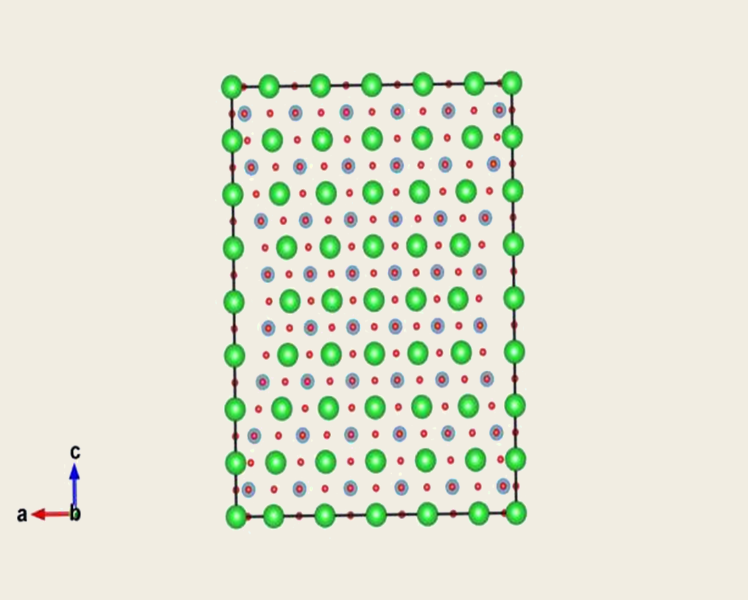
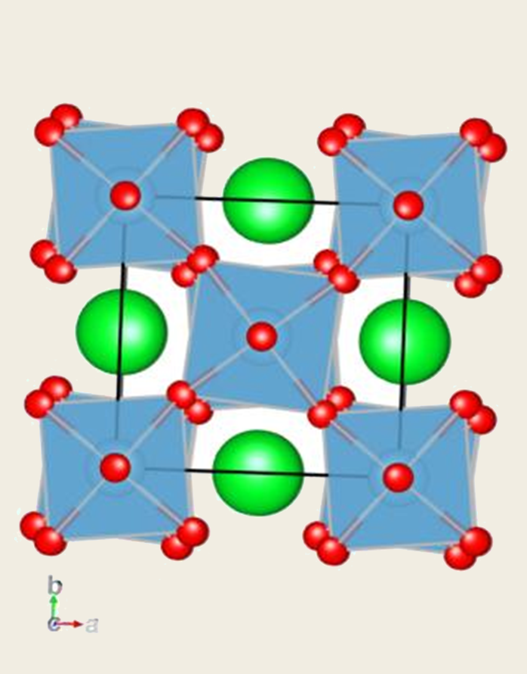
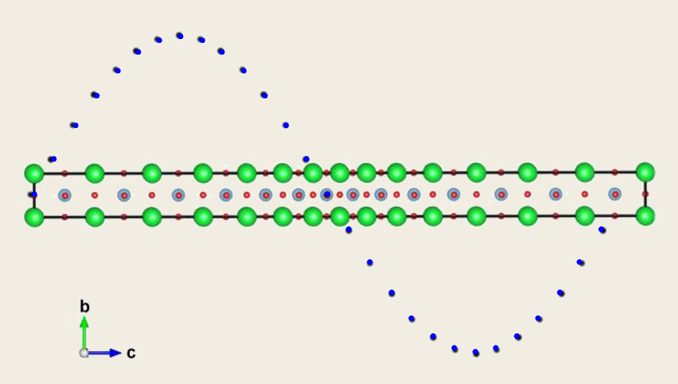

Flexoelectric Effect in Perovskites using Ab Initio Calculations
Plymill, H. Xu
University of Tennessee Materials Science and Engineering
Abstract
Preserving the Strain Gradient
Results
Flexoelectricity is a property that dielectric materials exhibit where they become polarized when they are subjected to an inhomogeneous deformation. In the past, this effect has been largely ignored, as its effect in bulk materials has been much less significant than the related effect of piezoelectricity, the polarization of material due to uniform deformation. Interest in flexoelectricity has been increasing in recent years due to the development of nanotechnology. Flexoelectricity is proportional to the strain gradient a material is subjected to making the flexoelectric effect immense on the nanoscale. Additionally, the flexoelectric effect scales with the dielectric constant making it have a significant effect in newly developed high permittivity materials such as ferroelectrics and relaxors. Applications being looked into for this phenomenon include improving the electro-mechanical response of piezoelectric materials as well as the creating of electro-mechanical sensors and actuators out of non-ferroelectric insulators. Research in this project includes using Density Functional Theory (DFT) simulations to determine the longitudinal flexoelectric coefficient, which is difficult to determine experimentally. This calculation was performed for several high permittivity perovskite compounds. Additionally, calculations of the flexoelectric coefficient using local density approximation (LDA) functionals and generalized gradient approximation (GGA) functionals are compared.
Some of the tested structures, like the rhombohedral barium titanate case shown above, do not maintain the strain gradient throughout the relaxation process. It was observed, however, that with increasing maximum strain applied, that more stability was maintained in the structure. Increasing the system size had the most dramatic effect of ensuring that a uniform strain gradient was maintained on the system throughout the relaxation process as seen in the strontium titanate case below.
Results show that as we increase the size of the super cell, the value for the calculated flexoelectric coefficient converges to a single value. This is due to the strain gradient becoming more uniform in larger systems. Preliminary tests on other perovskite systems suggest that lead titanate experiences a similar flexoelectric effect to strontium titanate while barium tianate has a smaller effect.
Methodology
Results for 14 unit cell tests with 1% strain applied with compounds in cubic form
Create Strain Gradient
Displace Atoms
Relax System
Calculate Flexoelectric coefficent
Calculate Polarization
A strain that varies as a cosine function in the z direction is applied to the system to create an inhomogeous strain longitudinally. This makes the displacement of atoms follow a sine function and the strain gradient follow a negative sine function. Then the atoms are relaxed to their lowest energy positions with the exception of the A-site atoms, which are fixed to preserve the strain gradient. The A-site atoms were chosen as they participate the least in polarization. After relaxation, the born effective charges are calculated using density functional perturbation theory. The flexoelectric can then be obtained by dividing the polarization by the strain gradient in the supercell.
Comparing LDA and GGA
Future Work
LDA and GGA functionals were compared for the strontium titanate calculations. The lattice parameter obtained using the LDA functional was 3.859Å with a c/a ratio of 1.004. The obtained lattice parameter using the GGA functional was 3.898Å with a c/a ratio of 1.0006. The GGA values are closer to the experimentally measured lattice parameter and c/a ratio of 3.898Å and 1.00056 respectively. Regardless of the potential used, the system relaxed the same way across different system sizes and strains. The born effective charges differed depending on the functional used. The most variance was found in the titanium and oxygen atoms, which participate the most in the polarization process. This lead to the values of polarization being calculated using the LDA functional to be higher than the polarization calculated using the GGA potential. Higher polarization values thus led to higher flexoelectric coefficients being calculated.
We will perform a more comprehensive analysis of the compounds currently being analyzed as well as an analysis of new systems to find optimal flexoelectric compounds. Additionally, these systems will be tested to determine their respective transverse flexoelectric coefficient which is believed to be an order of magnitude higher than the longitudinal one.
Displacement for 1% strain Strontium Titanate
Supercell with inhomogenous strain applied in z-direction with imposed curve showing displacement from centrosymmetry.
Born Effective Charge in Z direction for Titanium in strontium titanate Systems
Model for supercell with transverse strain applied to it that is to be used for future calculations of transverse flexoelectric coefficient.
View of x-y plane of strontium titanate supercell showing octahedral rotation.

