Slide 1
Process Design and Economic Analysis
CBE 490
Andrew Hix, Rachel Kendall, Will Maningas, Mark Moore, Rachel Svoboda

Slide 2
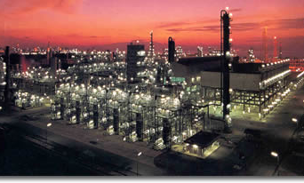
Gas to Liquid Plant
Shell GTL plant in Bintulu, Malaysia

Slide 3
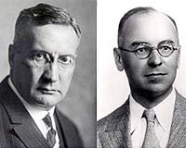
History and Definition
Create liquid hydrocarbon fuels from a variety of feedstocks
Fischer-Tropsch Reaction is the core of GTL technology
1923 Germany
Notes:
Gas to liquids technology or GTL, as the name implies, is an umbrella term for a group of technologies that can create liquid hydrocarbon fuels from a variety of feedstocks. One way to do this is by using a syngas unit to convert methane into hydrogen and carbon monoxide, and using a Fischer-Tropsch synthesis to convert the syngas (hydrogen and carbon monoxide) into hydrocarbons.
Since the invention of the original process by Franz Fischer and Hans Tropsch, working at the Kaiser Wilhelm Institute in the 1920s, many refinements and adjustments have been made. The term "Fischer-Tropsch" now applies to a wide variety of similar processes (Fischer-Tropsch synthesis or Fischer-Tropsch chemistry). Fischer and Tropsch filed a number of patents, e.g., US patent no. 1,746,464, applied 1926, published 1930.^{[8]} It was commercialized in Germany in 1936. Being petroleum-poor but coal-rich, in Germany the FT-process was used by Nazi Germany and Japan during World War II to produce ersatz (German: substitute) fuels. F-T production accounted for an estimated 9% of German war production of fuels and 25% of the automobile fuel.^{[9]}
The United States Bureau of Mines, in a program initiated by the Synthetic Liquid Fuels Act, employed seven Operation Paperclip synthetic fuel scientists in a Fischer-Tropsch plant in Louisiana, Missouri in 1946.^{[10][9]}

Slide 4
GTL General Reactions
1) Synthesis Gas Formation
CH_{n} + O₂ → nH₂ + CO
2) Fischer-Tropsch Reaction
2nH₂ + CO → (CH₂)_{n} + H₂O
3) Refining
(CH₂)_{n} → fuels, lubricants, etc.

Slide 5
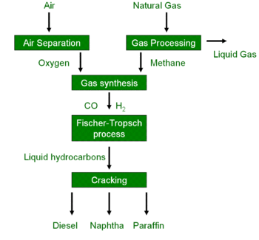
Overview of GTL Process
Notes:
The process for converting natural gas to liquid hydrocarbons consists of three primary steps: synthesis gas production, GTL synthesis, and product work up.

Slide 6
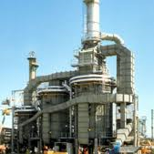
Synthesis Gas Production
1) Steam Reforming
CH₄ + H₂O ⬄ CO + 3H₂
2) Partial Oxidation
CH₄ +3/2O₂ → CO + 2H₂O
3) Shift Reaction
CO + H₂O ⬄ CO₂ + H₂
Notes:
When using the Fischer-Tropsch reaction within the GTL process, a specific molar ratio of hydrogen to carbon monoxide must be used as feed, depending upon the product desired. The syngas unit houses a series of reactions which ultimately convert clean methane into syngas. In order to meet the desired ratio of hydrogen to carbon monoxide leaving the syngas unit and being fed to the Fischer-Tropsch reactor, steam and carbon dioxide are required as feeds to drive the reforming reaction (Long, 3, 2009). The following are the three primary reactions used for syngas production:
The partial oxidation runs to completion; whereas, the other two reactions meet equilibrium. Generally, a heat balance is used to determine the amount of oxygen supplied. The combination of these reactions determines the amount and composition of the product sent from the reformer and to the Fischer-Tropsch reactor. The composition of the synthesis gas can be altered to some extent by changing the operating pressure, temperature, and feed composition.

Slide 7
GTL Fischer-Tropsch Reaction
xH₂ + CO => H₂O + (CH₂)_{n}H₂
Syngas is converted to hydrocarbons
Iron, nickel, or cobalt based catalyst
Moderate temperature and pressure
Initiation, Elongation, Termination
Selectivity
Separations
Notes:
Varying chain length, 200-300 degrees Celsius, 10-40 bar
There are also side reactions that produce olefins and alcohols, but the desired product lies within the hydrocarbons (Samuel, 4, 2003).
The exact mechanism of this reaction is still under debate; however, simply stated, the following occurs: initiation of carbon chain formation, chain elongation by successive carbon building blocks, and termination of chain growth by desorption and hydrogenation of saturated species, desorption of unsaturated species, or hydrogenation, hydrolysis, and desorption of oxygenated species (al-Shalchi, 24, 2006).
Selectivity is controlled by temperature, synthesis gas composition, reactor resistance time, and catalyst formulation. For example, high temperatures favor gasoline production.

Slide 8
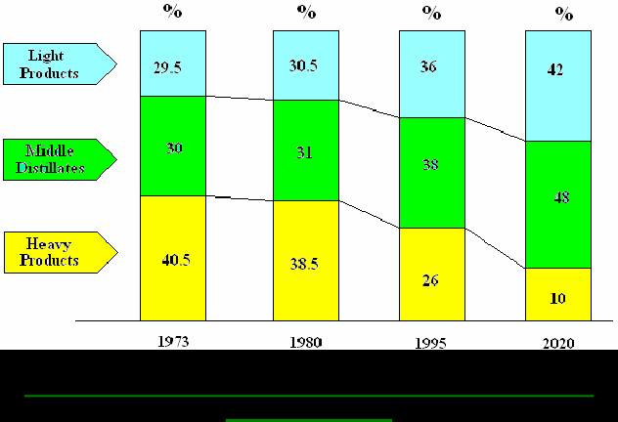
Why GTL Technology?
World Natural Gas Reserves
Country/Region | % Share
Former Soviet Union | 40.0
Iran | 14.9
Africa | 6.7
Asia Pacific | 6.6
South Africa | 4.1
Europe | 3.8
Saudi Arabia | 3.7
Other (ME countries) | 14.1
USA | 3.3
Mexico and Canada | 2.8
World Demands for Petroleum Products
Notes:
Natural gas provides over a fifth of the world’s energy, and its consumption is on the rise. It is estimated that the world’s gas reserves are greater than 6000 trillion cubic feet (Tcf), and that these reserves can cover the world’s needs for more than 60 years (al-Shalchi, 6, 2006). Al-Shalchi also states that, “The world consumption of natural gas equal to about 2.5 Tcf, most of it is consumed by the big industrial countries” (al-Shalchi, 6, 2006). This shows a clear demand within the world for natural gas.
Despite that fact that there is currently plenty of natural gas to fuel the world, the location of the natural gas, along with the location of the demand for natural gas, creates difficulties. A substantial portion of known reserves are situated in locations remote from high consumption areas, as the table demonstrates (Table 1).
Transporting these natural gases by ship, train, or truck is uneconomical, and much more expensive than transporting liquid petroleum. Although pipelines have been used with success in order to transport some natural gas, pipelines are also expensive, and in many cases, geographically unfeasible. The Fischer-Tropsch Reaction gives a way to bypass the larger expense of transporting a gas by transforming this gas into liquid before transporting it.
Also, the demands for light and middle products, gasoline and diesel, respectively, is steadily increasing due to an increasing presence of vehicles in both developed and developing countries. The demand for heavy petroleum products is steadily declining (See Figure 1).

Slide 9
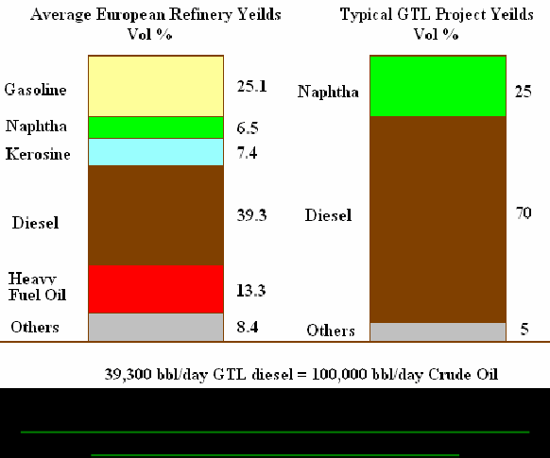
Petroleum Products and the GTL Industry
GTL technology gives a higher yield of light and middle products.
Notes:
Another benefit of the GTL process is the higher yield of light and middle products, which better meets the demand outlined in Figure 1. Typical refineries yield a significant amount of heavy petroleum products, whereas, the Fischer-Tropsch Reaction/GTL process produce products which more closely correlate with the world’s petroleum demands as seen in Figure 2.
The Fischer-Tropsch Reaction also yields more efficient oil, with less particulate matter upon emission. Reduced sulfur content and a lower aromatic content is generated upon combustion with FTR diesel, which helps to meeting certain health and environmental regulations. Additionally, it produces 45% less carbon dioxide emissions compared with coal to obtain about the same amount of energy (Samuel, 2, 2003). Because of the cleanliness of GTL fuels, they are also an ideal feedstock for fuel cells.

Slide 10
Objective
The task at hand is to design a specified Fischer-Tropsch Reaction Unit (FTR), including reactor effluent separation facilities, as part of a planned GTL plant. The designed FTR unit must integrate with the already present specified units within the GTL plant in order to allow for diesel (C11-C20) and naphtha (C5-C10) production.

Slide 11
Additional Considerations
Safety
Environmental Impact
Economics

Slide 12
Syngas Unit Design Specifications:
The Syngas Unit(which is upstream of the FTR) is to convert 500 MSCF/D of clean methane (500 PSIG, 100F) to syngas.
The syngas needs to be made with a H2/CO molar ratio of 2:1
Maximum feed preheat temperature is 1000F
Notes:
The 2:1 ratio is the same as the ratio of consumption in the FTR

Slide 13
Syngas Unit Design Specifications:
Feed preheat furnace expected to perform at 85%
Suggested ranges for operating conditions:
  Temp: 1600-1950 F
  Pressure: 300-500 PSIG
  Steam/CH4 in Feed: 0.5 mol/mol minimum to prevent coking in the feed preheater

Slide 14

Fischer-Tropsch
Rate Equation
Catalytic
Heterogeneous

Slide 15




FTR Product Selectivity
Anderson-Shulz-Flory (ASF)
Notes:
For C5+ only!
It was assumed that all hydrocarbon products produced in the Fischer-Tropsch Reaction were straight-chain alkanes.
Alpha = ASF chain growth parameter
Wn=relative weight fraction of carbon number n
Mn=relative mol fraction of carbon number n

Slide 16



FTR Product Selectivity
Light Ends (C2-C4)
Notes:
Using the CO molar feed rate as a basis, each of the reactant and product feed rates was divided by the CO molar feed rate to derive a stoichiometric equation for the Fischer Trophsh reaction as a function of the average reactor temperature. Using the feed conditions, rate equation and stoichiometric equation and specifying the reactor length, tube count, tube diameter, and the reactor cooling rate, the reactor was fully characterized and able to be simulated in Hysys. Reactor pressure drop was calculated automatically using the Ergun equation which is embedded in the Hysys PFR solver utility.

Slide 17
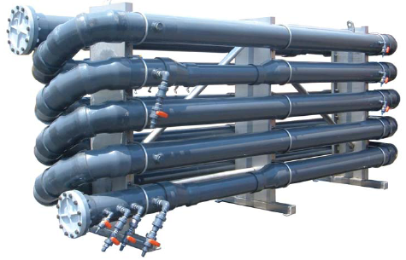
Plug Flow Reactors
Reasonable Reaction Yield
Thermal Stability
Pressure drop below 50 psi

Slide 18
Thermal Stability
Recycle Loop
  FTR not an equilibrium reaction
  Dilute reactor feed
Multiple Reaction Trains
  Naptha 644 bbl/hr
  Diesel 8927 bbl/hr
  Below 600˚ F
  20 Trains
    Tube count and diameter
Notes:
First, it was determined that diluting the reactor feed would be an effective method of suppressing the initial temperature spike. Since the Fischer-Tropsch reaction is not an equilibrium reaction, and therefore Le Chatelier’s Principle was not an issue, it was determined that a cost effective way to dilute the reactor feed was to add a recycle loop to mix the fresh reactor feed with a portion of the reactor effluent. Since hydrocarbons have high heat capacities, this proved to be an effective method of temperature control.
The second method was to split the feed stream into multiple reaction trains. After 42 iterations, it was determined that effective temperature control, which kept the reaction temperature below 600ºF, could be achieved with 20 reaction trains with two reactors in each train, designated PFR-100 and PFR-100-2. In addition the reactor’s heat transfer performance was manipulated by changing the tube count and tube diameter (Figures 5 and 6).

Slide 19
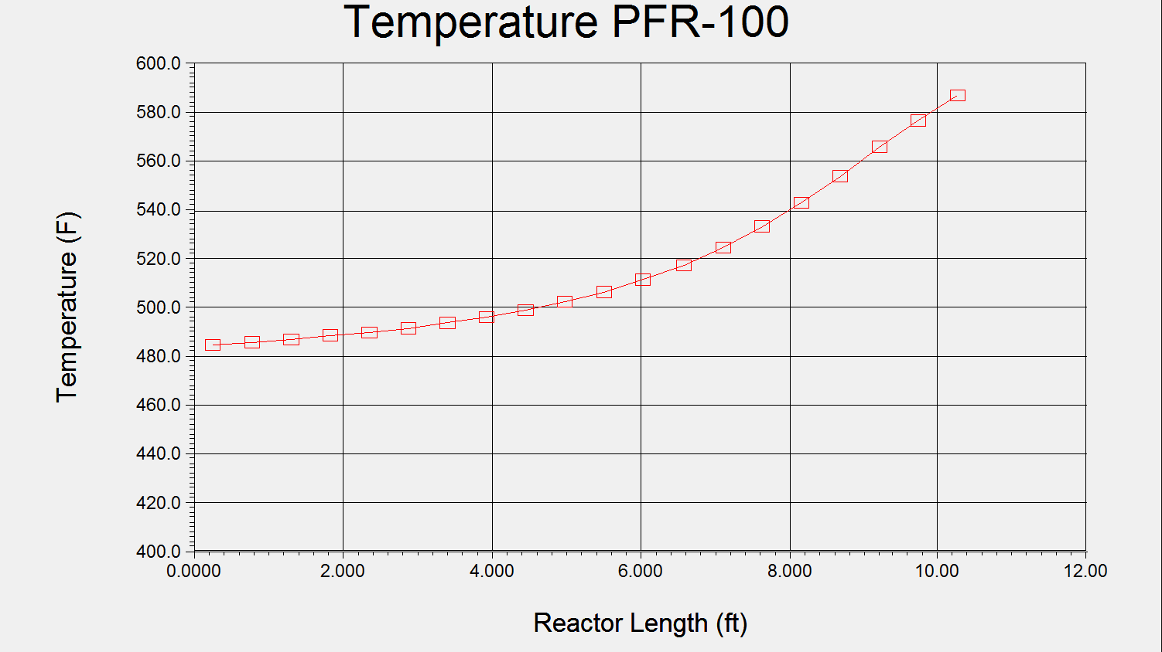
Temperature as a Function of Reactor Length
PFR-100

Slide 20
Pressure Drop
Temperature control helped
  Splitting feed stream
Decrease reactor length
Increase tube count
Heat transfer rate
Notes:
However, attempts to control the temperature and pressure came partially at the expense of the reaction yield. Diluting the feed decreased the reaction rate, lowering the yield. This was another reason why a second reactor was added to each reaction train.

Slide 21
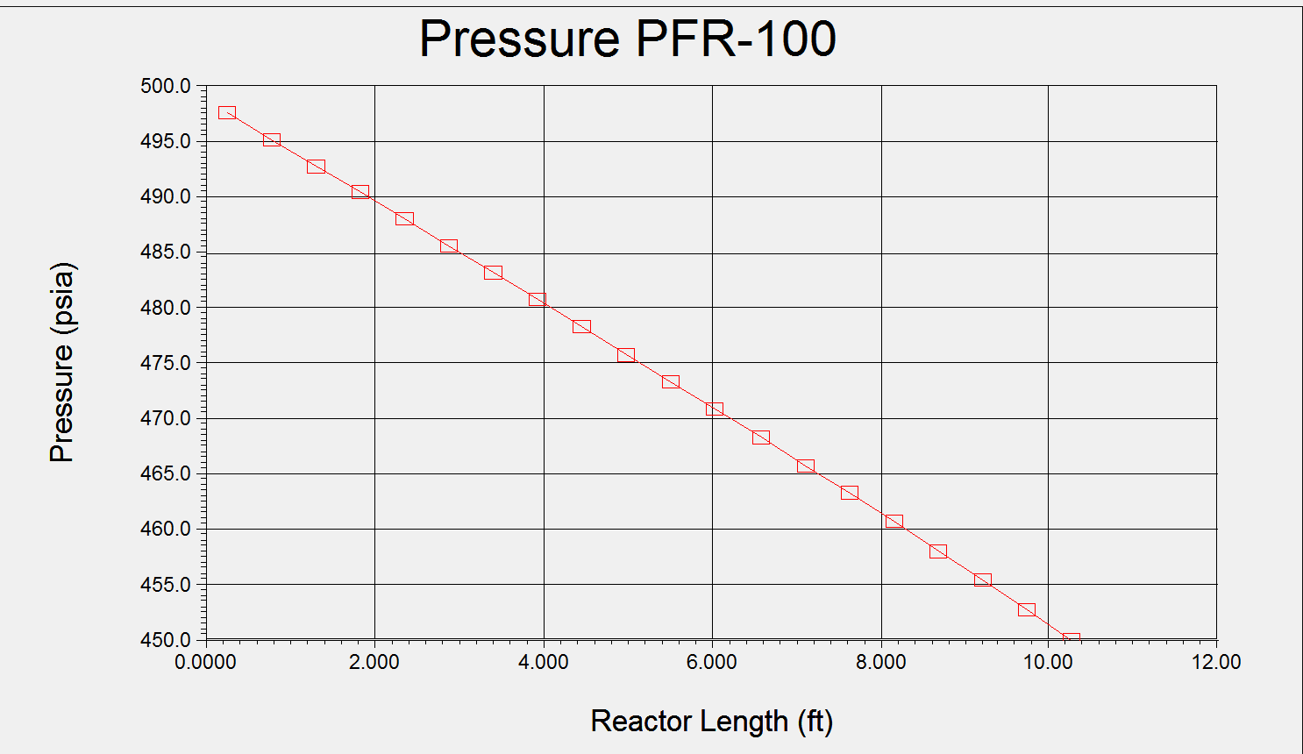
Pressure as a Function of Reactor Length
PFR-100

Slide 22
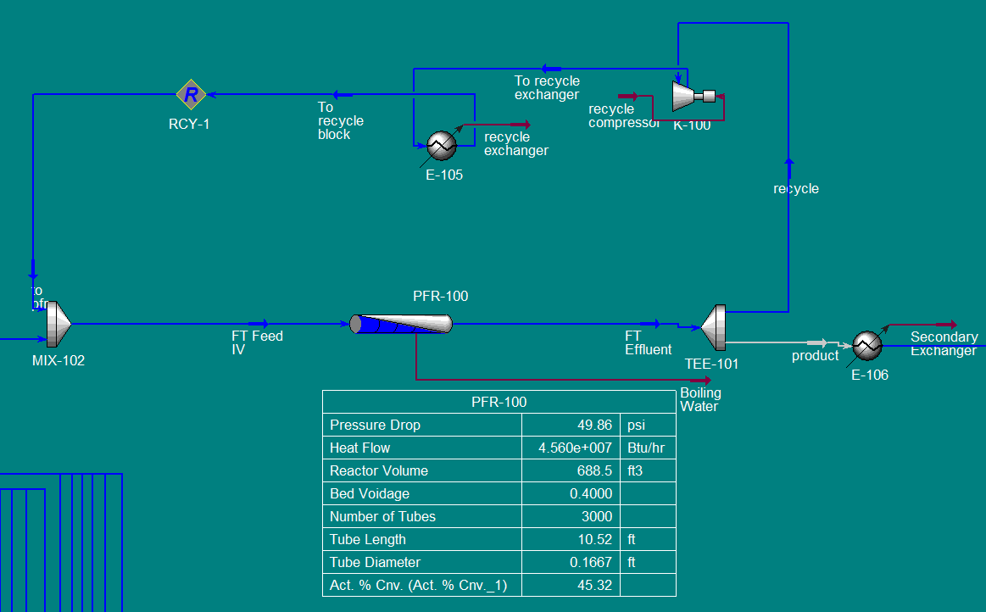
PFR-100 Reactor Specifications

Slide 23
Separations
FTR Reactor Effluent
  C1-C4 28%
  C5-C10 1.7%
  C11+ 1.8%
  Water 46%
  CO 3.7%
  CO₂ 18%
  H₂ 0.02%
Product Streams
  Naphtha C5-C10
  Diesel C11-C19

Slide 24
Separations
Alkane Vapor III
Alkane Liquid III
Reactor
Effluent
Alkane Liquid II
Water
Alkane Liquid
Water
Water

Slide 25
Separations
Alkane Vapor III
Alkane Liquid III
Naphtha

Slide 26
Separations
Naphtha II
Alkanes Liquid II
Alkanes Liquid
1271 lbmol/hr
C11+

Slide 27
Separations
Naphtha
Naphtha II

Slide 28
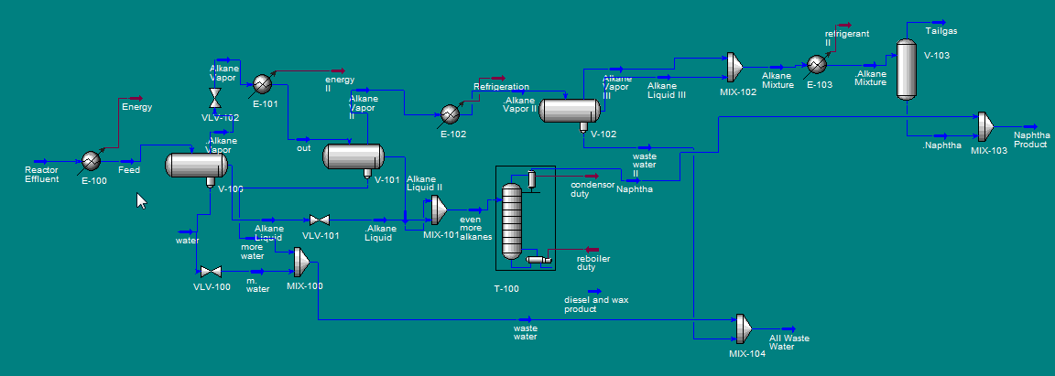
Separations

Slide 29
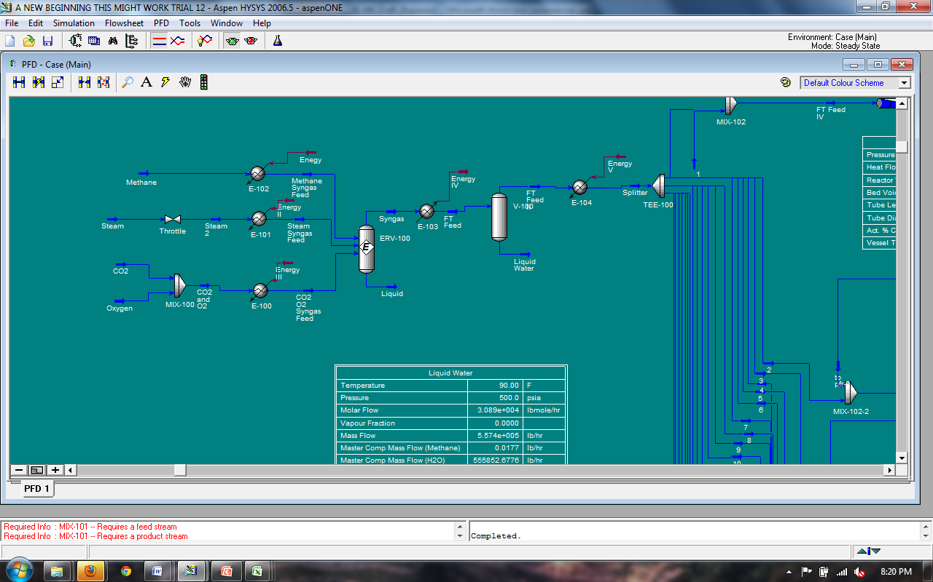
Controls-Column ERV-100
Composition control for stream exiting MIX-100
Entering temperatures controlled by heat exchangers
Entering streams controlled by ratio controller

Slide 30
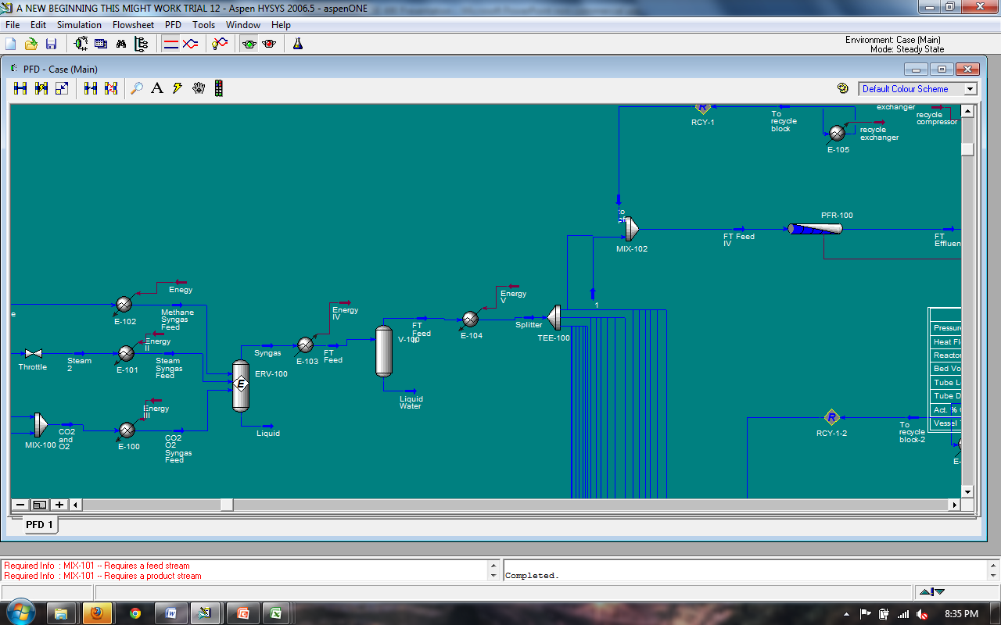
Controls-V100
E-103 controls the temperature of V-100 feed
Level of V-100 controlled by FT feed stream exiting the top of the column
Temperature of feed into splitter TEE-100 maintained by E-104

Slide 31
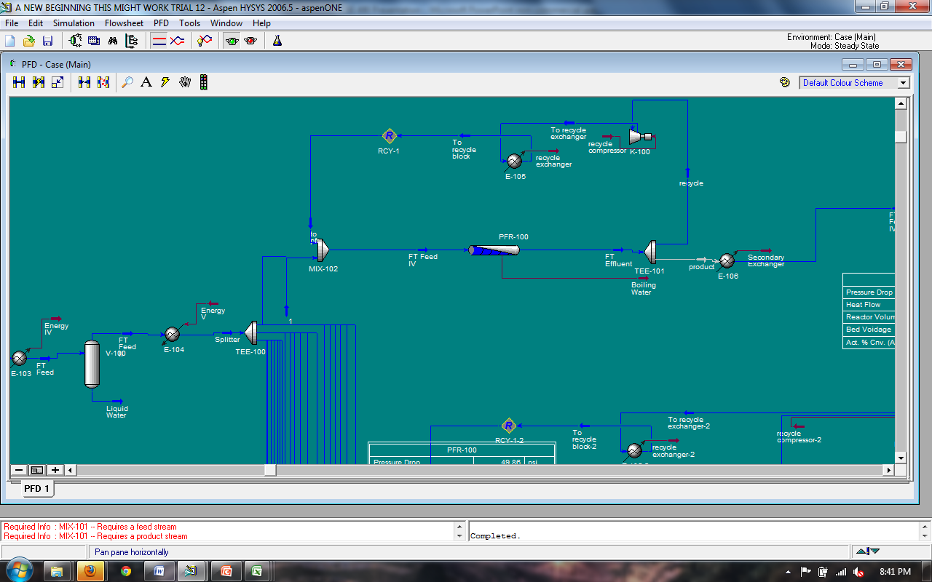
Controls-PFR-100
Temperature can be controlled by manipulating the recycle ratio of the exit stream of TEE-100
Flow into PFR-100 controlled by TEE-100 flow controller

Slide 32
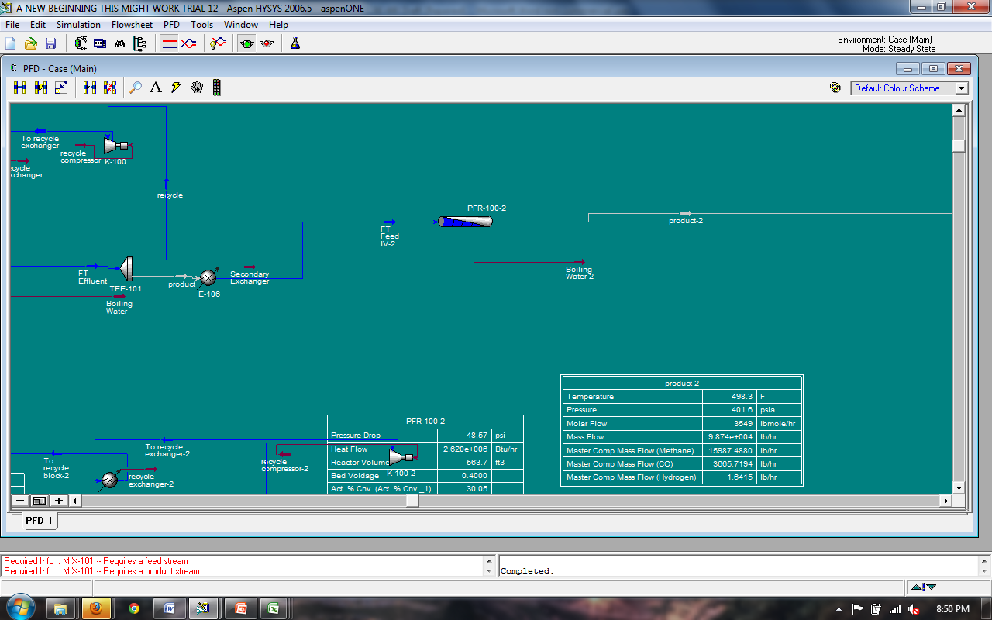
Controls-PFR-100-2
Temperature and pressure controlled by E-106
Flow control on rate of product exiting the PFR

Slide 33
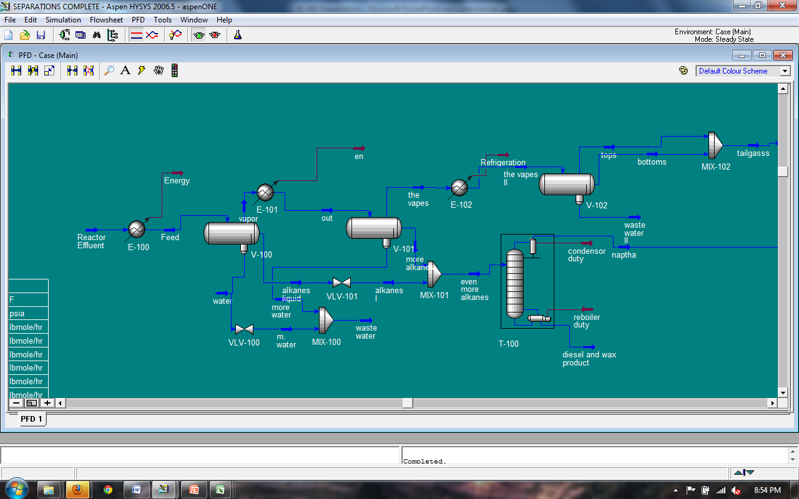
Controls-Separations
V-100 temperature controlled by E-100
V-100 pressure controlled by rate of exiting vapor

Slide 34

Controls-Separations
E-101 controls temperature of stream entering V-101
Flow controller on vapors exiting V-101 to control pressure
Exiting temperature of V-101 controlled by E-102

Slide 35
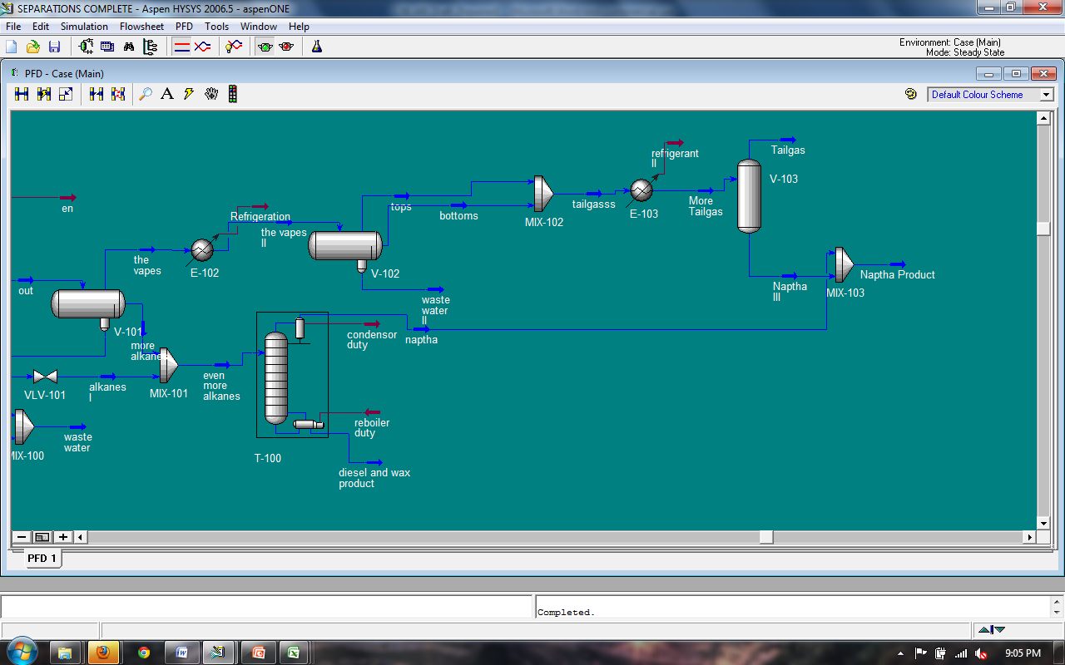
Controls-Separations
Pressure of V-102 controlled by exiting streams
Composition controller on bottoms products of T-100
Flow of MIX-103 controlled by naptha exiting T-100

Slide 36
Controls-Separations
Composition controller on streams entering MIX-103
Flow control on tailgas exiting MIX-102 in order to control naptha III stream

Slide 37
Costing the plant
Equipment Costs
Utility Costs
Depreciation
Taxes
Turnaround

Slide 38
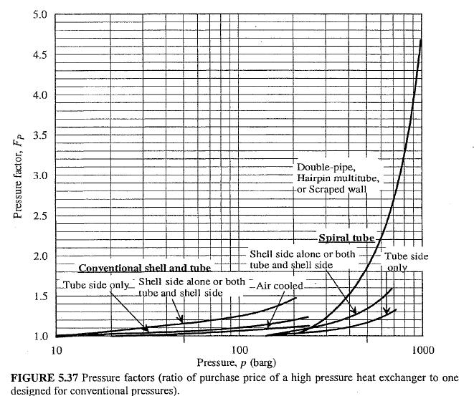
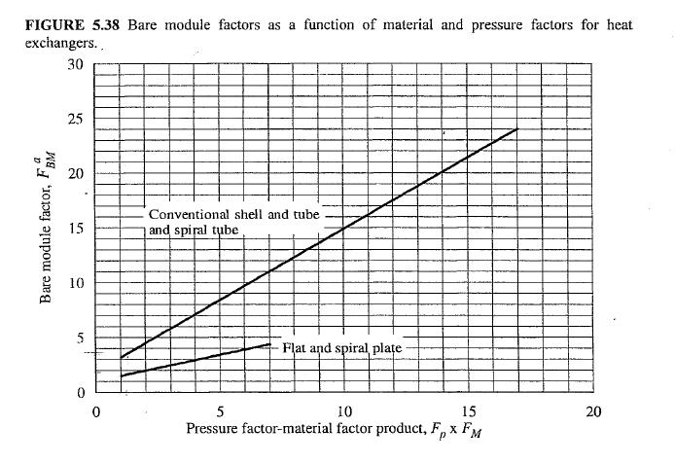
Heat Exchangers
Pressure Factor
Bare Module Factor

Slide 39
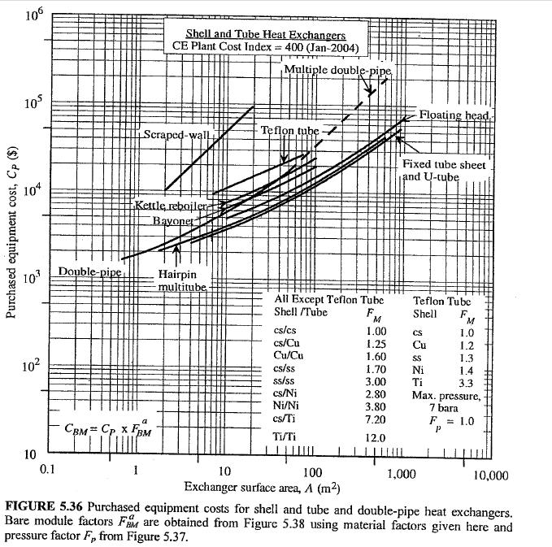
Heat Exchangers
Purchased Cost
Notes:
$630,000
PFR $417,000
Catalyst $625,000

Slide 40
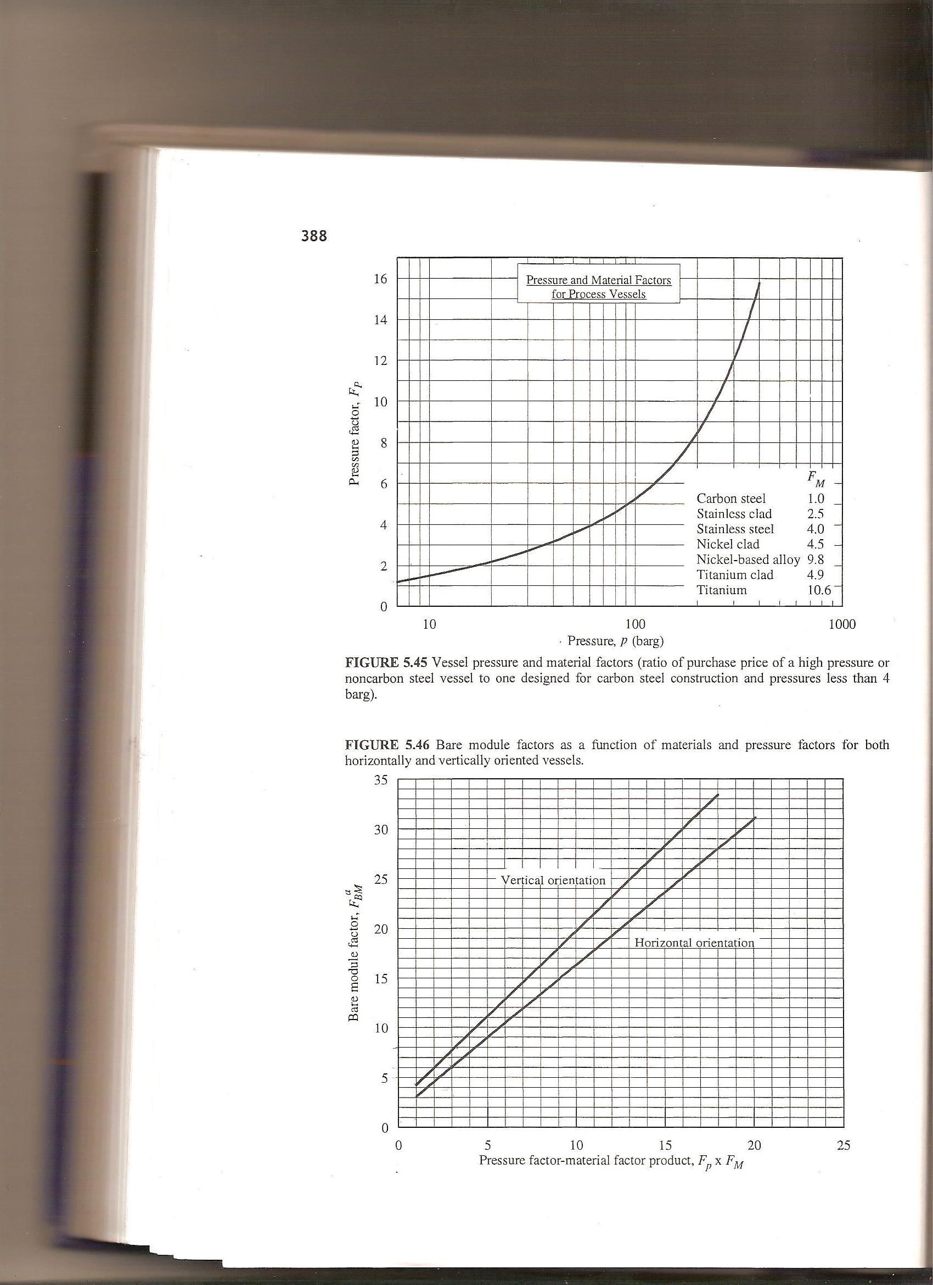
Process Vessels
Pressure Factor
Bare Module Factor
Notes:
$1,920,000

Slide 41
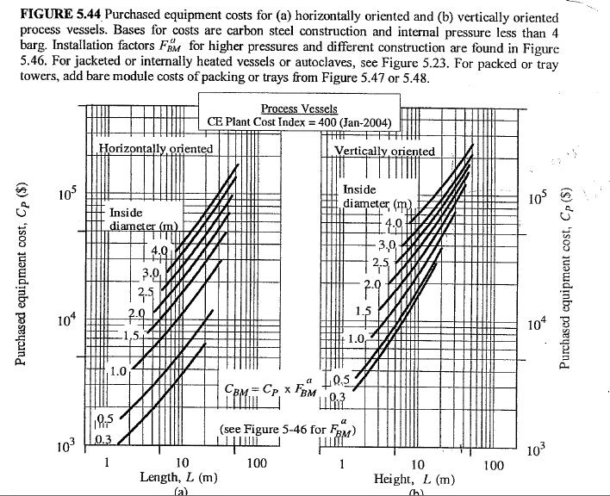
Process Vessels
Purchased Equipment Cost
Notes:
$1,920,000

Slide 42
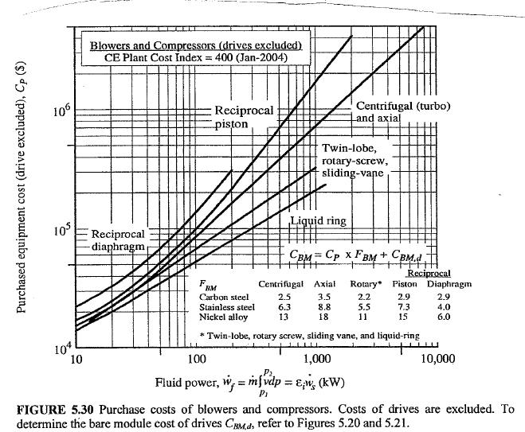
Compressor Purchased Cost
Notes:
Compressor cost $69,750,000Total Equipment cost was $72,000,000.

Slide 43
Appendix A
Utilities
Electricity
Compressor Demand (Kw-hr) | Electricity Generated (Kw-hr) | Electricity to Sell (Kw-hr) | Net Profit ($/hr)
111183840 | 923040000 | 8.1E+08 | $24,355,684.80
Cooling Water
Consumption (gal/hr) | Consumption (1000gal/hr) | Purchased Cost ($/hr) | Generation (gal/hr) | Generation (1000gal/hr) | Selling Price ($/hr) | Net Cost ($/hr)
194091216 | 194091.216 | 97045.6 | 710003 | 710.003 | $248.50 | $96,797.11
Steam
20 lb Steam Consumption (lb/hr) | 20 lb Steam Generation (lb/hr) | 20 lb Steam to Sell (lb/hr) | 600 lb Steam Consumption (lb/hr) | 600 lb Steam Cost ($/hr) | Net 20 lb Steam Profit ($/hr)
1005946 | 4605022 | 3599076 | 3360000 | $16,800.00 | $7,198.00
Fuel Gas
Generated (lb/hr) | Preheat Furnace Requirement (lb/hr) | Fuel Gas to Sell (lb/hr) | Fuel Gas Profit ($/hr)
955900 | 151997.5 | 803903 | $12,648.00

Slide 44
Manufacturing Cost Summary
Fixed Capital, C_{FC} | $72,331,010.00
Total Capital Investment | $347,188,848.00
Total Yearly Operating Expenses | $10,415,665.44
Annualized Turnaround Cost | $868,319.06
Depreciation (Annual) | $4,822,067.33
Annual Revenue Before Taxes | $219,681,893,948.17
Taxes | $72,495,025,002.90
Annual Revenue After Taxes | $147,186,868,945.27

Slide 45
Conclusions
Highly exothermic reaction
High feed rate
Stringent design criteria
=High fixed capital costs
Strict energy conservation methods necessary for profitability
More generous design criteria could lead to lower capital and operating costs and higher profit margins

Slide 46
References
1) Al-Shalchi, Wisam. "Gas to Liquids Technology (GTL)." Scribd. N.p., 2006. Web. 27 Jan 2011. <http://www.scribd.com/doc/3825160/Gas-to-Liquids-GTL-Technology>.
2) “GTL Process Using the Fischer-Tropsch Method: Gas to Liquids.” Web. 25 Apr 2011. <http://en.wikipedia.org/wiki/gastoliquids>
3) Long, Richard. "AIChE 2011 National Student Design Competition." Gas to Liquids. (2009): 1-11. Print.
4) Mulheim an der Ruhr. “The Return of a Classic to Fuel Production.” TerraDaily: News About Planet Earth. Carbon Worlds. 2005. Web. 25 Apr 2011. <http://www.terradaily.com/news/carbon-05b.html>
5)"PF Flocculator." P-Tec. Web. 8 May 2011. <http://ptecdaf.com/flocculator.php>.
6) Samuel, P. "GTL Technology - Challenges and Opportunities in Catalysis." Bulletin of the Catalysis society of India 2. (2003): 1-18. Web. 27 Feb 2011. <http://203.199.213.48/183/1/254_P._Samuel.pdf>.
7) "Steam Reformer for Syngas Production." The Linde Group. Web. 8 May 2011. <http://www.linde-engineering.com/en/process_plants/furnaces_heaters_and_incinerators/steam_reformers_for_syngas_production/index.html>.
8) Tijm, Peter J. A. “Gas to Liquids, Fischer-Tropsch Advanced Energy Technology.” Future’s Pathway. 2009. Web, 25 Apr 2011. <http://www.booklanddirect.com/>.

Slide 47
Questions??

