Slide 1
The Importance of Data, Information, and Knowledge in Scholarly Communication
Carol Tenopir
University of Tennessee
ctenopir@utk.edu
LISC 75 Years:
University of Cape Town

Slide 2
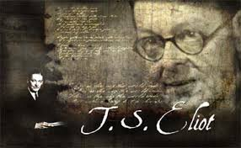
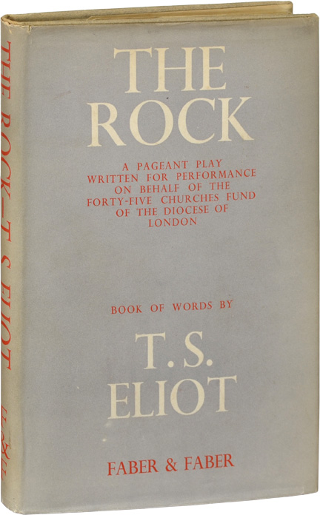
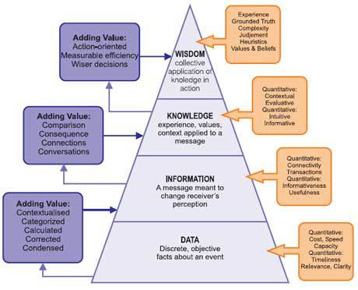
Where is the wisdom we have lost in knowledge?
Where is the knowledge we have lost in the information?

Slide 3
Communication Means
Secondary Publications and Listings
WRITTEN REPORTS
Work Initiated
ORAL REPORTS
Information Progress
Reports of Preliminary Findings
Oral reports
Personal Correspondence
Informal Discussions
Work Completed
Published Convention Program
Formal Progress Report
Special Group Meetings
Local Colloquia
Patent Office Gazette
Patent
Manuscript Started
Colloquia Outside Own Institution
Small Informal Conference
State/ Regional Conference
Research in Progress Listings
Final Technical Report
Manuscript Distribution
Copies of Convention Presentation
Thesis
Preprint Distribution
National/International Conference
NTIS Data Base
Manuscript Submitted
Dissertation Abstracts
Invited Conference
Journal Publication
Current Contents
Reprint Distribution
Other A&I Publications
Articles Revised
Reviews
Book Publication
Adapted from Garvey, Lin and Nelson 1970, Lin, Garvey, and Nelson 1970, and Garvey and Griffith 1972

Slide 4
Communication Means
Oral Communication
Discussions
Reviews
Secondary Publications
Written Reports
Articles

Slide 5
Lab/Field notebook
Specimens
Conversations
Sounds
Scientists Working
Data Sets
Photos
Direct Observations
Meetings
Publications

Slide 6
Lab/Field notebook
Specimens
Conversations
Sounds
Scientists Working
Data Sets
Photos
Direct Observations
Meetings
Publications

Slide 7
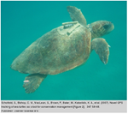
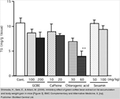
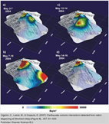
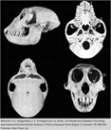
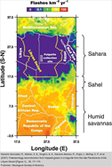
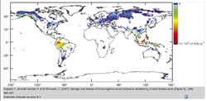
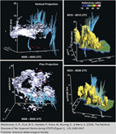
In science, images visualize data or are data…

Slide 8
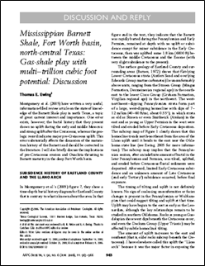
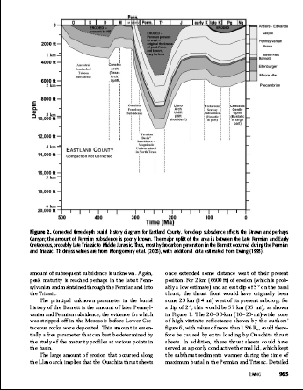
Text, data, and images together convey scientific meaning

Slide 9





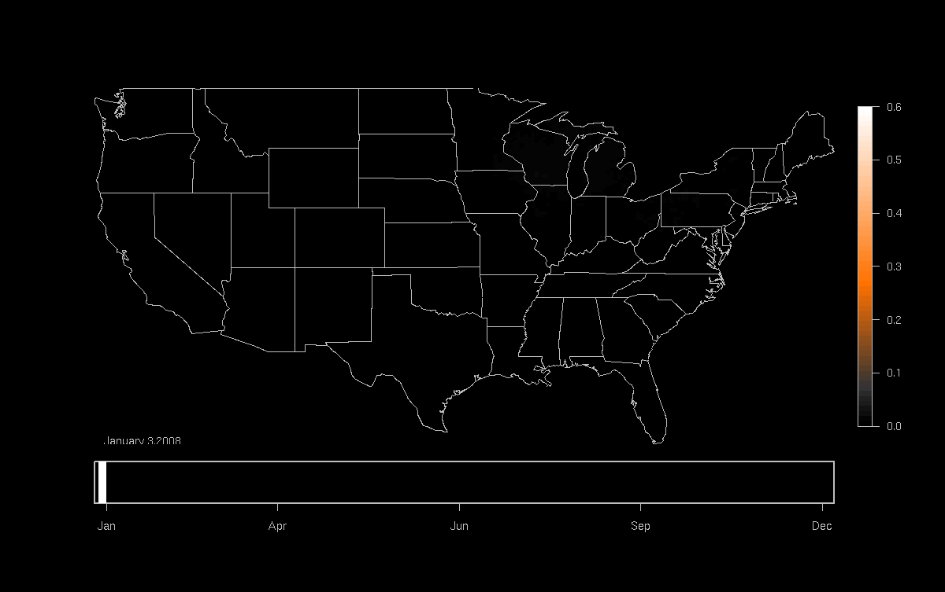

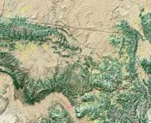

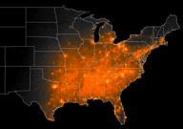



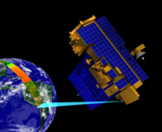



And…together with models can enable scientific discovery
Diverse bird observations and environmental data from 300,00 locations in the US integrated and analyzed using High Performance Computing Resources
Model results
Occurrence of Indigo Bunting (2008)
Land Cover
Jan
Apr
Jun
Sep
Dec
Meteorology
Examine patterns of migration
Infer how climate change may affect bird migration
MODIS – Remote sensing data
Spatio-Temporal Exploratory Model identifies factors affecting patterns of migration

Slide 10
Granularity in the Journal World
Granularity=
Divisible: Made up of conveniently small and independent parts

Slide 11
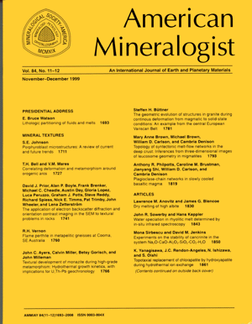
1. Journal
Title 2. Issue

Slide 12
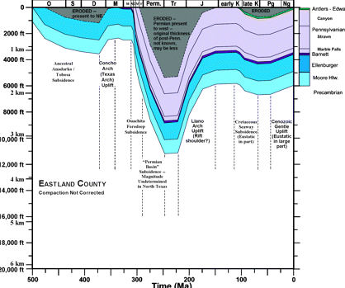
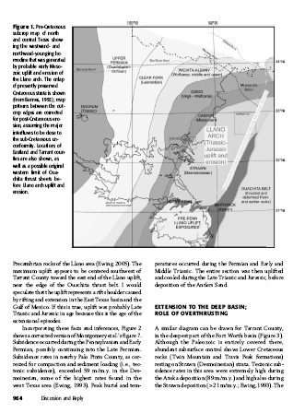
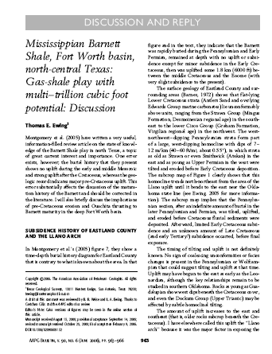
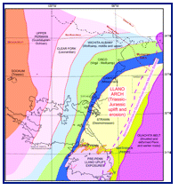
3. Article

Slide 13
4. Objects (figures, tables, pictures)

Slide 14
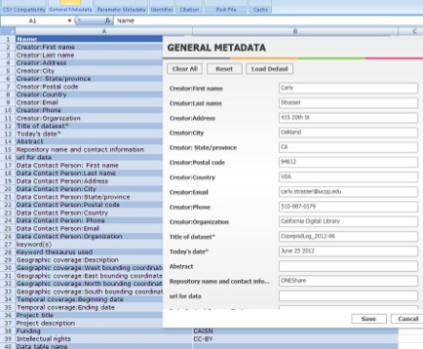
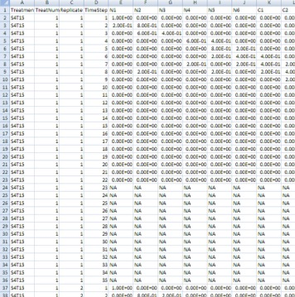
The Article can also be a starting point to expand…

Slide 15
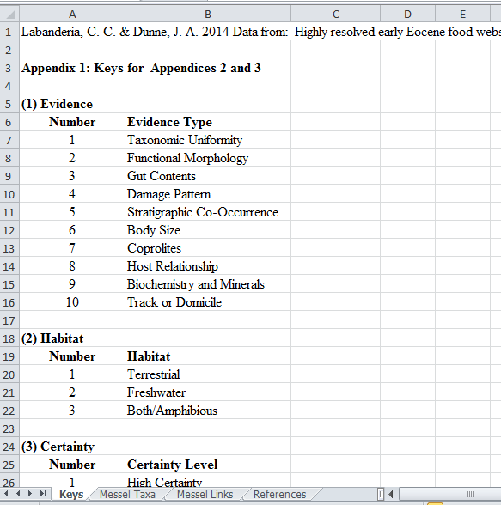
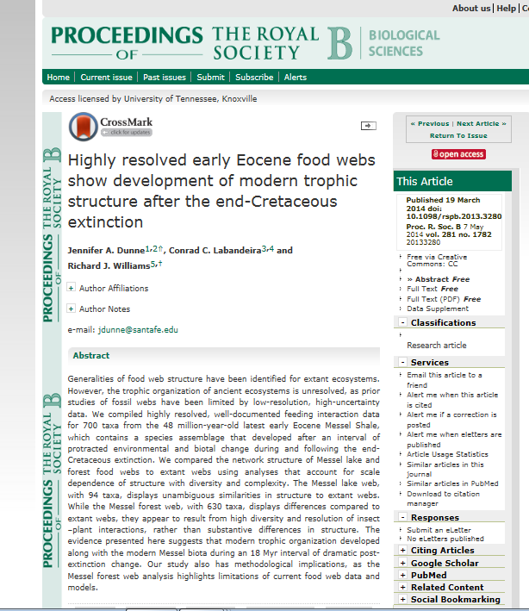
Data Repositories like Dryad help link datasets to journal articles

Slide 16
Scientists…
Sometimes need an entire article or most of one (catching up or writing)
Sometimes need just a part like a paragraph or picture (teaching or to check a fact)
Sometimes need data beyond the article (research)
…so research helps understanding

Slide 17
Study of How Scientists Search for and Use Images and Figures
Observing 350+ Searches
Pre and Post Surveys
Search Diaries

Slide 18

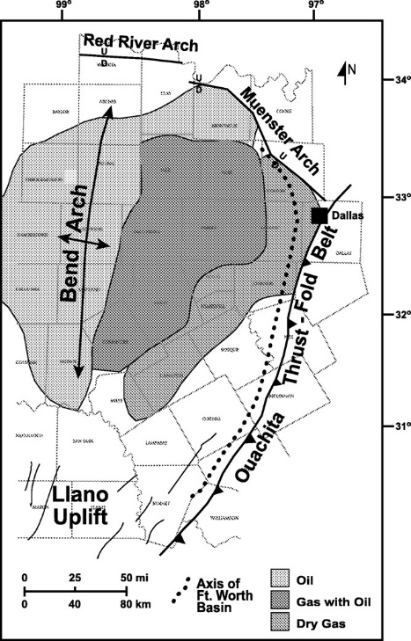
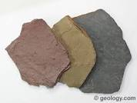
What scientists currently do to find images…

Slide 19
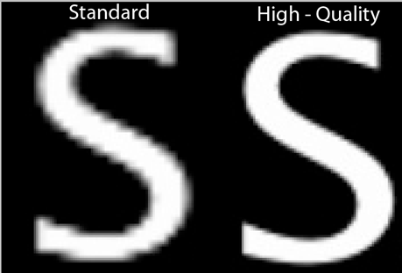
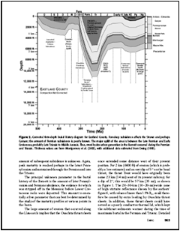
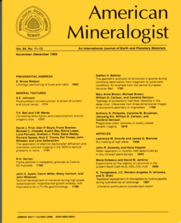
Suggestions for Success
Images must be of high quality with ability to enlarge thumbnail images
The context of the whole article is important—it may be dangerous to see images without the context
Allow table contents to be searchable and support extraction of data from tables

Slide 20
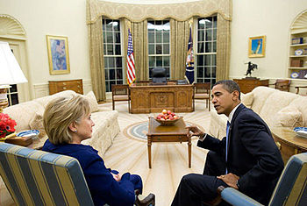
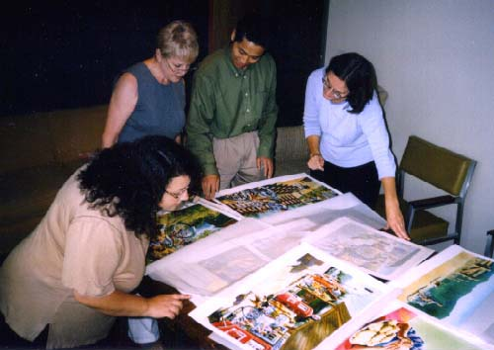
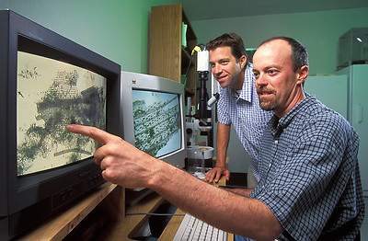

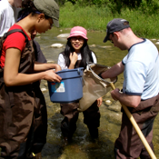
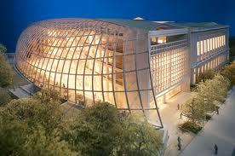

DataONE Assessment of Stakeholders
Public Officials
Publishers
Data Managers
Citizen-scientists
Libraries
& Librarians
Scientists
Students
& Teachers

Slide 21
Gap between willingness to share and accessibility (2011)
  Although 75% of scientists agree “I share my data”
  Only 36% agree “Others can access my data easily”

Slide 22
Consequences of Lack of Access to Other Datasets (2011)

Slide 23
Reasons for Not Making Data
Electronically Available (2011)

Slide 24
Reference support services, by type of institution…
Baccalaureate Colleges
Does your library provide reference support for finding and citing data and data sets? (n = 216)

Slide 25
Technical support services, by type of institution…
Baccalaureate Colleges
Does your library provide technical support for research data services systems? (n = 216)

Slide 26
Staff development, by type of institution…
Baccalaureate Colleges
Has your library provided opportunities for staff to develop skills related to RDS? (n = 215)

Slide 27
In conclusion…
Access to data and visual material can help scientists in many ways
When posing research questions or designing systems, think at many levels of granularity—journal issues AND whole articles AND parts of articles AND extensions to articles such as data
Knowledge is formed by understanding data and information, and LIS education and research can help

Slide 29
Thank you
  Carol Tenopir
  ctenopir@utk.edu

