Slide 1
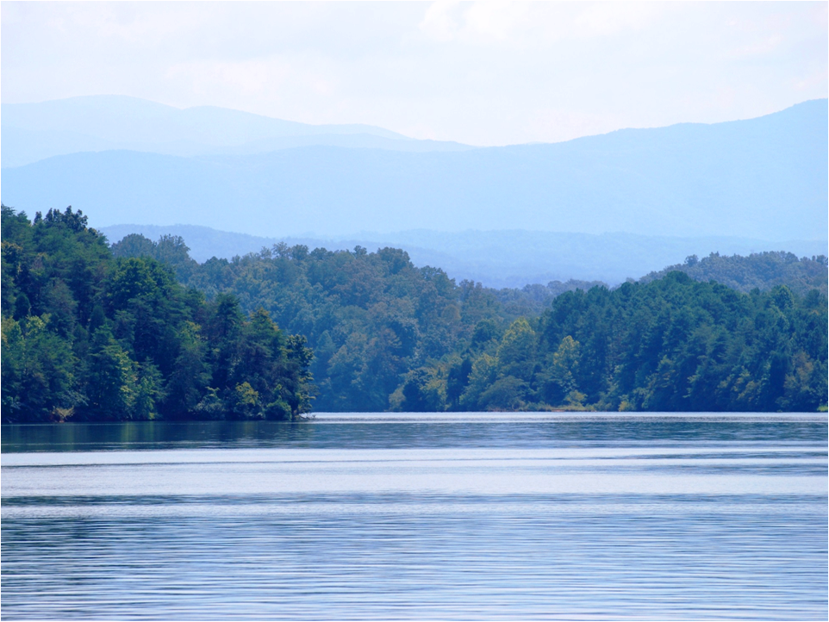

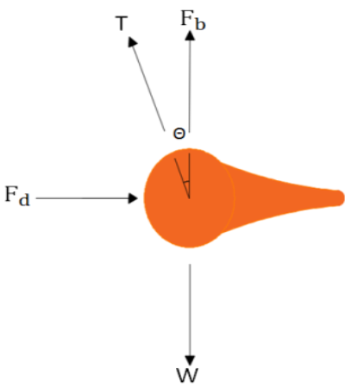
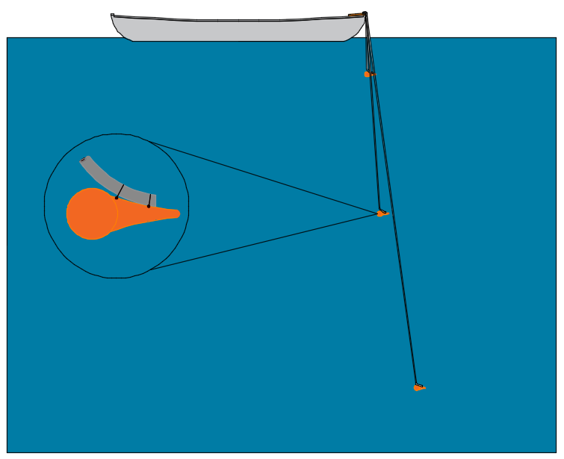
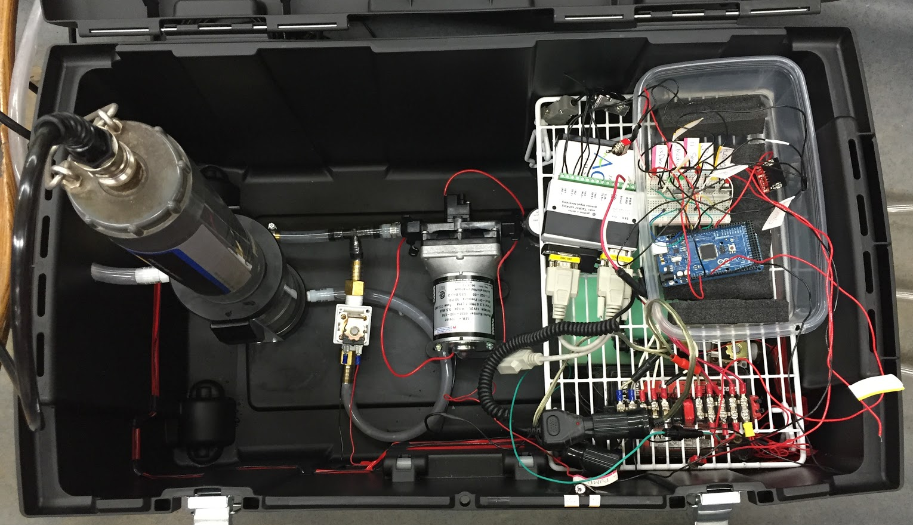
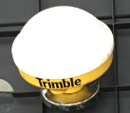
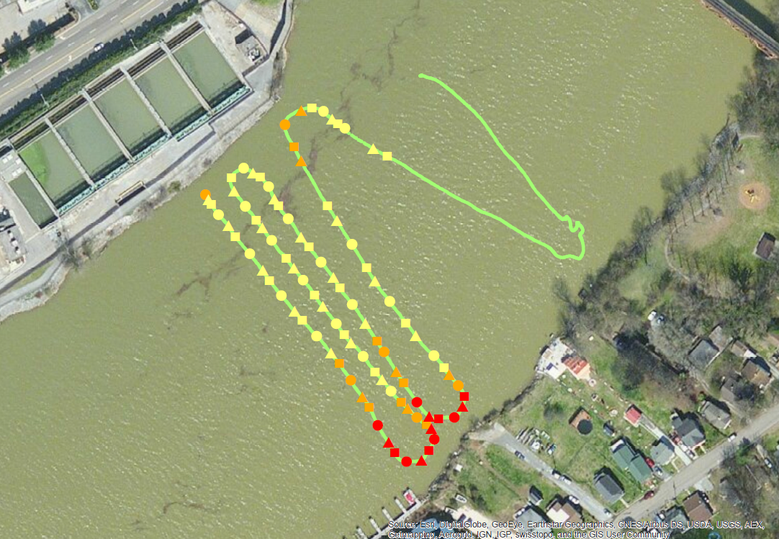
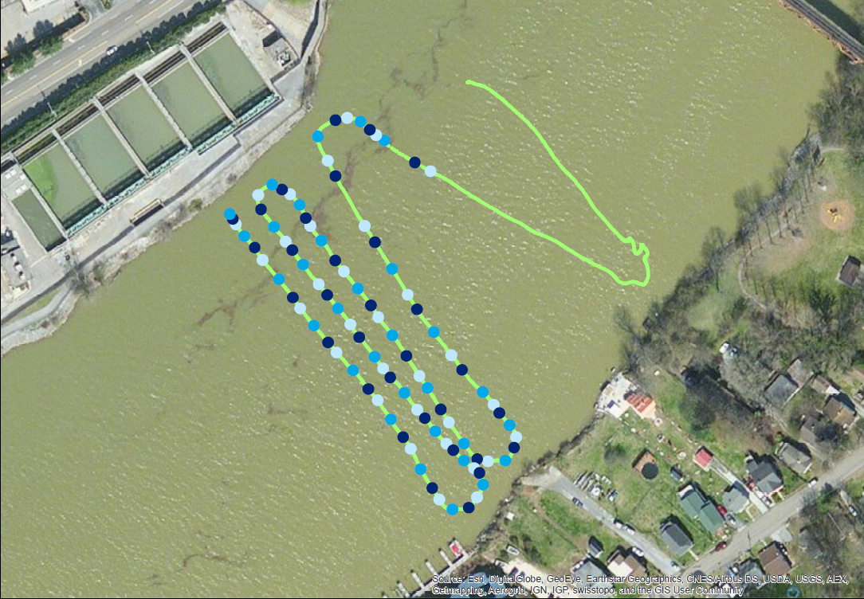
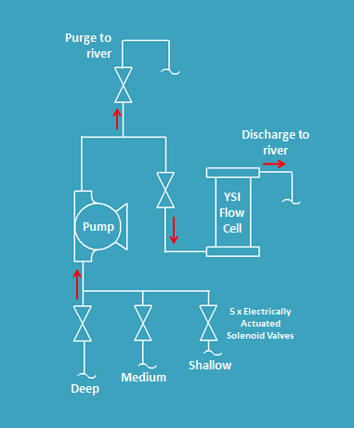
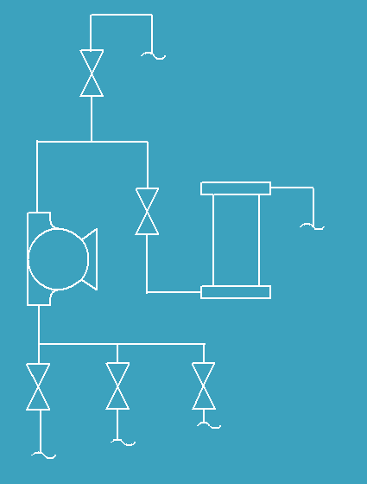

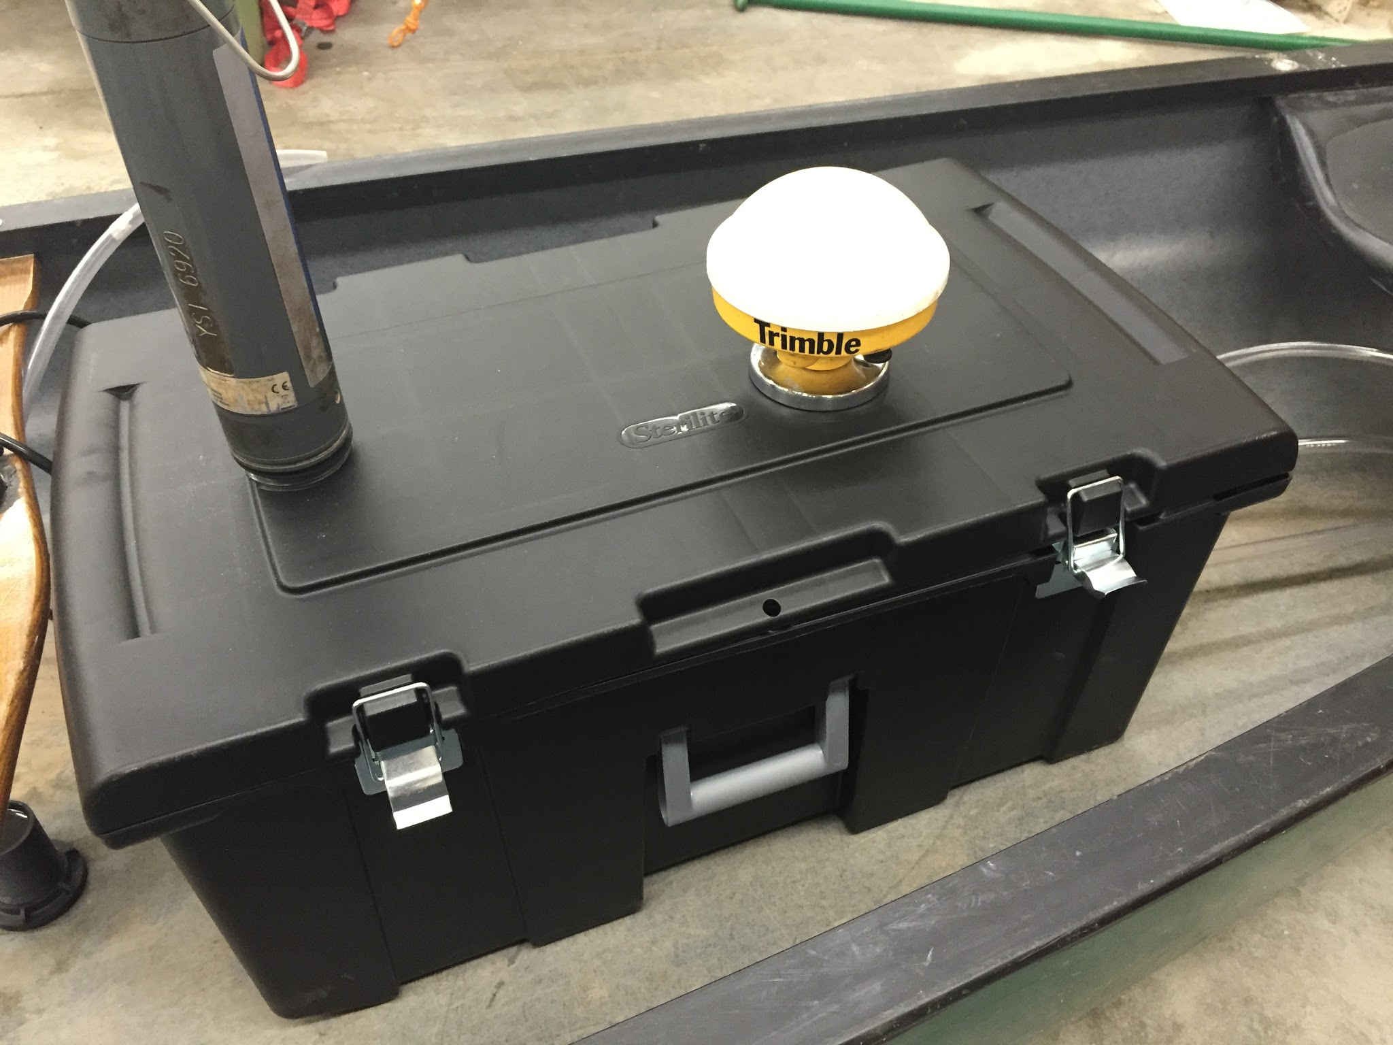

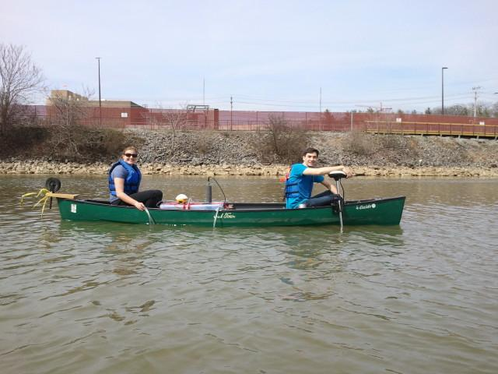
A Mobile Canoe-Mounted, Geo-referenced, 3-D Water Quality Analyzer
Alysse Ness, Alex Shpik, Ryan Vernich
Advisors Dr. Paul Ayers and Dr. Andrea Ludwig
Engineering Analysis
Abstract
The water collection tubes are not directly under the boat due to layback and sideback. This location error can be estimated by taking into account river current, boat travel speed, and drag force acting on the weight.
Open channel river velocity profiles were used to approximate the local river velocity. A free body diagram of the weight was used to calculate tubing tension, drag force, and angle. This information was used to estimate the displacement from the georeferenced data point.
Water quality analysis is vital to ensure the health of water sources, identifying pollutants, and modeling how pollutants travel throughout a river system. We have designed a mobile, canoe-mounted, water quality analyzing system that will enable researchers to efficiently collect a large number of water quality samples with an associated GPS location and depth for each data point. While the canoe travels in parallel swaths bank to bank, the unit will alternately collect samples from three different depths: 20, 10, and 2 ft. The system measures water quality in multiple cross sections to acquire an adequate representation of how water quality changes across and below the surface of a river. Current methods of collecting water samples consist of stationary samples that measure changes in water quality at only one location over time. The water quality on the surface is different than water quality at different depths due to stratification, and our design allows us to adequately represent the mixing process at a river confluence.
This is an FBD of all the forces acting on the weight.
The tubing is attached to a weight to limit layback and sideback.
Device Control
An Arduino Mega R3 microcontroller is used to control the solenoid system. Five digital pins on the Arduino connect to a breadboard with mounted transistors and indicator LEDs. The transistors actuate our solenoids and direct water flow according to the written program. We also have two switches: one to “pause” the system and another to enable the user to alternate to a “shallow water” setting as the overall depth of our water body varies within different cross sections. Separate from the Arduino is an on/off switch for the pump to stop flow completely in the sytem.
Is the power switch engaged?
Design Components and Criteria
Initialize Program
No
Pause – Flash LED
Criteria
Measure temperature (⁰C), pH, dissolved oxygen (mg/L), electrical conductivity (uS/cm), and turbidity (NTU)
Cost <$4000, assuming client utilizes an existing GPS, YSI sonde, and versatile enough for any water vehicle
Optimize power supply to sample for at least 2 hours of simultaneous sampling and geo-referencing
Able to sample water from depths of up to 20 feet
Shallow and deep water setting to allow for versatile application in various water bodies
Mostly automated for minimized chance of error
Yes
Record valve status
Water quality analyzer
Data components
Purge Flow Cell with New Water
Turn LED’s on/off
Flow Cell Valve Open
River Purge Valve Closed
Pump
Analyze Water in Flow Cell, Purge Next Line
Record valve status
Turn LED’s on/off
Control components
Flow Cell Valve Open
River Purge Valve Closed
Valve
Final Data Product
GPS
This photo shows how our different data components and how they sit inside the box for our design.
Flow Process
Aboard the canoe, a pumping system with electrically actuated solenoid valves conveys each water sample to the YSI-brand water quality sonde for analysis. The device draws water samples up from shallow, medium, and deep water in a repeated pattern. During the repeated pumping pattern, while a sample is being analyzed, the next water sample is pumped into the line. This process eliminates the need to purge the line between measurements.
Purge to river
Purge to river
Purge to river
Discharge to river
Discharge to river
Discharge to river
YSI Flow Cell
Pump
YSI flow cell
Pump
With each water quality value assigned to a geo-referenced location and depth, we can develop multiple three-dimensional value maps of a river, illustrating spatial distribution of water quality throughout cross sections and down the river. The maps presented in this section represent data collected from an in-field test. For our project, the specific area of interest is at the confluence of the Holston and French Broad River. At this location, aerial maps show drastic color differences between the two rivers.
5 x Electrically Actuated Solenoid Valves
5x electrically actuated solenoid valves
Shallow
Medium
Shallow
Deep
Medium
All of the electrical components are securely housed inside a box and strapped in to the canoe.
Deep
The data presented here was collected on the Tennessee River near UT’s campus.

