Slide 1


Assessing Data Practices for DataONE
Carol Tenopir
University of Tennessee
ctenopir@utk.edu
Notes:
1

Slide 2


Open Science Movement…
…governments and funding agencies are requiring data management
U.S. Office of the the President
U.K. Freedom of Information Act 2000, and the Freedom of Information (Scotland) Act 2002
Notes:
Motivation for sharing and reusing data and the need for better data services comes from several drivers.
The first of these is the growing open science movement, with government initiatives to make data publicly available. This is from the US, but there are initiatives in other countries as well. In the U.S., Data management and data sharing mandates have been established by the National Science Foundation, the National Endowment for the Humanities, the National Institutes of Health and others (University Libraries, University of Minnesota, 2011).
Australian Research Council.
Other drivers come from the nature of science itself; science is becoming more interdisciplinary and data driven (4th paradigm)

Slide 3

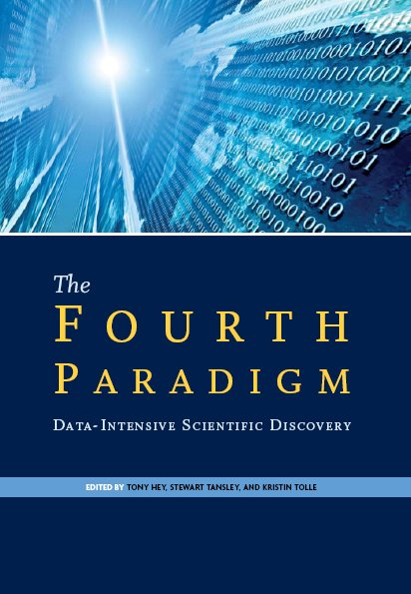
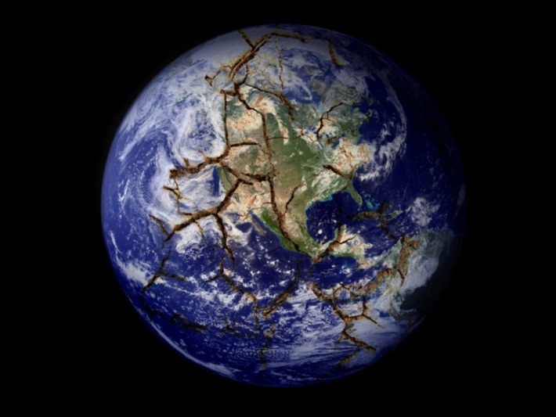
Science is more collaborative, interdisciplinary,
computational, and data-intensive
Notes:
Science is becoming more data intensive, computational, and collaborative
Science has entered a “fourth paradigm” that is more collaborative, more computational, and more data intensive (Hey, Tansley, & Tolle, 2009a) than the previous experimental, theoretical, and computational paradigms. This emerging scientific paradigm is often referred to as e-science or e-research (Hey, Tansley, & Tolle, 2009b). Increased reliance on technology in all parts of scientific endeavor, or cyberinfrastructure, and the establishment of data management and data sharing mandates by many research funding bodies have motivated academic libraries to respond to the changing needs of their faculty and student researchers and consider how best to engage in e-science through the development of library-based research data services (RDS).
And, there is a recognition that data is being lost.

Slide 4
NSF Sustainable Digital Data Preservation and Access Network Partners (DataNet)
Will create exemplar partners to address “…one of the major challenges of this scientific generation: how to develop the new methods, management structures and technologies to manage the diversity, size, and complexity of current and future data sets and data streams”.
Notes:
The project I am describing today is part of the National Science Foundation’s DataNet program, which was set up in NSF as a result of these pressures..

Slide 5
Need new types of organizations that will…
integrate library and archival sciences, cyberinfrastructure, computer & information sciences, and domain science expertise to:
  provide reliable digital preservation, access, integration, and analysis capabilities for science and/or engineering data over a decades-long timeline
Notes:
Nsf says we need a new approach

Slide 6

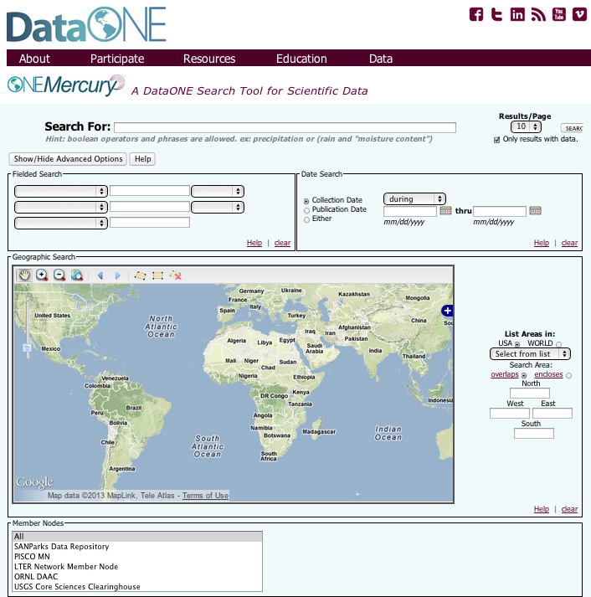




The DataONE Vision and Approach:
Providing universal access to data about life on earth and the environment that sustains it, as well as the tools needed by researchers
1. Building community
2. Developing sustainable data discovery and interoperability solutions
3. Enabling science through tools and services
Assure
Plan
Discover
Integrate
Analyze
Collect
Describe
Preserve
Notes:
DataONE was one of two originally funded DataNets, there are now 3 others. DataONE is a combination of people, hardware, and software.

Slide 7
DataONE Principles
1. Data should be part of the permanent scholarly record and requires long-term stewardship.
2. Sharing and reuse maximize the value of data to environmental science.
3. Science is best served by an open and inclusive global community.
4. The data environment is dynamic and requires evidence-based decision-making about practice and governance.
Notes:
Observing also allowed us to distill the complexity of the enviroment to four key principles. These provide clarity in understanding the environment and in understanding the approach of DataONE.

Slide 8
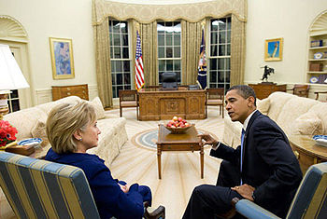
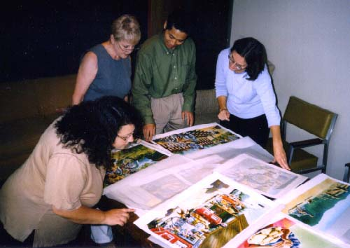
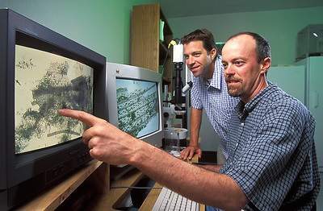

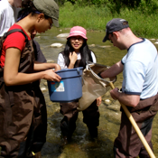
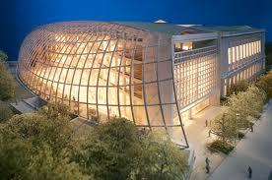

Assessment of Stakeholders
Public Officials
Publishers
Data Managers
Citizen-scientists
Libraries
& Librarians
Scientists
Students
& Teachers
Notes:
I am vice-chairperson of the Usability & Assessment Working Group. One of our tasks is to identify and assess data sharing by various stakeholder groups. We have completed the first round of assessments (scientists, libraries, librarians, educators) and now are working on a second round, plus some policy makers

Slide 9
Data Lifecycle
Collect
Discover
Integrate
Analyze
Plan
Assure
Preserve
Describe
Notes:
Put this into context with the Data Lifecycle. All of these steps are needed.

Slide 10
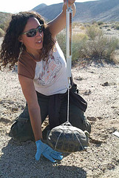
Researchers might…
Collect
Analyze
Assure
Integrate
Describe
Discover
Deposit
Preserve
Notes:
But stakeholders don’t always follow all. Researchers, for example, may be focused on collecting and analyzing; so this is a key stakeholder group and I’ll give just a few highlights of the original survey of scientists.
Personas are a representation of the objectives and behavior of a real group of users; DataONE working group members created these fictional representations by synthesizing data collected from users, particularly from surveys. DataONE WG members also used nterviews collected by researchers in the Digital Curaiton Profiles project at Purdue and UIUC. Creating these personas was actually a means of engagement & collaboration.
Scenarios differ from personas because they are focused on the context and process of an activity rather than on the individual engaged in the activity. We create these narratives to describe the expected flow of an activity based on the characteristics of the researcher when it was aligned with the information lifecycle. Scenarios are projections of expected behaviors to portray user behavior with respect to the system interface and represent the workflow indicating usage of a product by the users in a real life situation.
Here is an example of an early career field scientist where the current data practices are in blue and pink represents the places in the data lifecycle that can be augmented by tools or infrastructure from DataONE.

Slide 11

Librarian & Libraries
Level of my knowledge & skills ?
Are RDS priority?
Collect
Preserve
Discover
Integrate
Analyze
Plan
Assure
Describe
Level of participation with data?
Role in partnering with researcher?
Level of involvement with metadata?
Is there an agency repository that accepts data?
Role of librarian discovering data?
Stewardship role (select & deselect)?
Role of the librarian to help preservation?
Notes:
Libraries, particularly academic and research institute libraries, are often talked about as the most logical place to build data sharing infrastructure. But Librarians also have questions about their role. We wanted to find out, through Academic university librarian survey
Do academic librarians have the background, skills and education to provide RDS?
What are librarian attitudes regarding the importance of RDS?
What factors contribute to or inhibit engagement of librarians in RDS?

Slide 12
A few results of scientists baseline survey …
Notes:
Over 1300 international respondents. Originally used champions to distribute to their institutions (labs and universities); although got away from us, so we didn’t bother this time. Also publisher distributed to their author list. Got about the same number this time; close to 1400.

Slide 13
What metadata do you currently use to describe your data?
676
266
96
97
95
95
12
21
26
DIF
DwC
DC
EML
FGDC
Open GIS
ISO
My Lab
NONE
Notes:
A variety of metadata schemes are used to describe data, but not surprisingly, the most common answer is “none”.
12) What metadata do you currently use to describe your data, if any (check all that apply)?
DC (Dublin Core) 2.2%
DwC (Darwin Core) 1.7%
DIF (Directory Interchange Format) 1.0%
EML (Ecological Metadata Language) 7.9%
FGDC (Federal Geographic Data Committee) 7.9%
ISO (International Standards Organization) 8.0%
OGIS (Open GIS) 8%
metadata standardized within my lab 22.1%
none 56.1%
Other (please specify) 6.8%

Slide 14
Gap Between Willingness to Share and Accessibility

Slide 15
Reasons for Not Making Data
Electronically Available

Slide 16
Next libraries (in all types of academic libraries)…
Notes:
Unit of analysis = library
223 ACRL libraries
From stratified panel of directors from all types of academic libraries so a bit more systematic. This time fewer responses because they are no longer being paid.
Current RDS and educational offerings
Plans for next 24 months

Slide 17
Informational / Consulting RDS Currently Offered or Planned
Notes:
Currently, a minority of US and Canadian academic libraries are offering research data services, with more planning to begin in the next year to two years. More libraries are offering or planning to offer informational/consultative-type services, rather than technical assistance services. Overall, more libraries are planning to offer research data services in the future than are offering them now, with reference-type services the most popular.
RDS 1 – Consulting with faculty or students on data management plans
RDS 2 – Consulting with faculty or students on metadata standards
RDS 3 – Collaboration with other RDS providers
RDS 4 – Reference support for finding and citing datasets

Slide 18
Informational / Consulting RDS Currently Offered or Planned
Notes:
RDS 5 – Creating Web guides and finding aids for datasets / data repositories
RDS 6 – Directly participating on a project (as a team member)
RDS 7 – Discussing RDS with others on a semi-regular basis
RDS 8 – Training co-workers in your library, or across campus, on RDS

Slide 19
Technical / Hands-On RDS Currently Offered or Planned
Notes:
RDS 1 – Providing technical support for RDS systems (e.g. a repository)
RDS 2 – Deaccessioning /deselection of datasets for removal from a repository
RDS 3 – Preparing datasets for deposit into a repository
RDS 4 – Creating or transforming metadata for datasets
RDS 5 – Identifying datasets that could be candidates for repositories

Slide 20
RDS varies by type of institution…….
Has your library provided opportunities for staff to develop skills related to RDS? (n = 215)
Notes:
Survey Question: Has your library provided opportunities for staff to develop skills related to research data services (RDS)?
Answer Choices:
Yes
No

Slide 21
Conclusions
A majority of scientists are willing to share some data under certain circumstances
Most scientists do not use (or know about?) metadata standards
Lack of time and money are major challenges for anything new
Most academic libraries do not yet offer RDS, but many are planning to
Librarians believe RDS are important and consistent with library mission and role
Notes:
This is next-generation librarianship. The curation of research data is an activity that has gained traction in the wake of library and information science programs offering concentrations in data curation and institutes in digital curation, promising a cohort of librarians qualified to meet the challenges of managing data.
http://www.arl.org/rtl/eresearch/escien/nsf/leadershiproles.shtml
Authors: Patricia Hswe and Ann Holt. Part of ARL’s transforming research libraries series.
Libraries are at an early point in transition to RDS—requiring resetting of priorities, realignment of responsibilities, and opportunities to develop skills

Slide 22

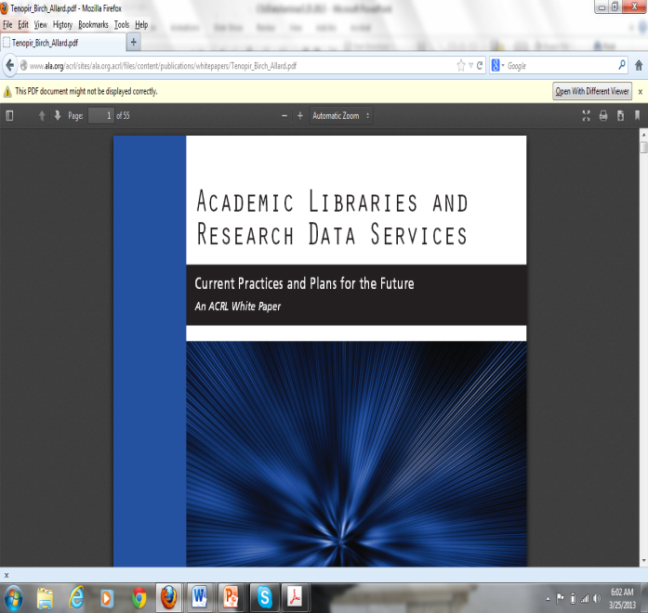


Academic Libraries And Research Data Services: Current Practices and Plans for the Future, ACRLWhite Paper, 2012.
Academic Librarians and Research Data Services: Preparation and Attitudes, IFLA Journal, v39, n1, 2013
Data Sharing by Scientists: Practices and Perceptions, PlosONE, 2011.
2014 analysis underway

Slide 23
Scientists Follow-up Survey
2014

Slide 24
Method
Web surveying (Qualtrix)
Sampling (snowball – volunteer sample)
Total number of respondents: N= 1346
Data collection: Oct. 17, 2013- March 19, 2014

Slide 25
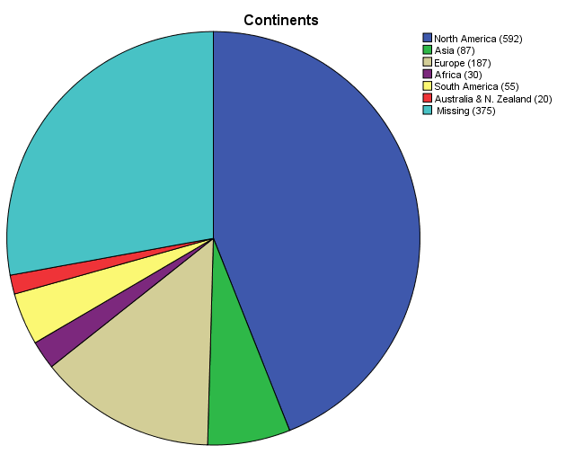
Number and Percentage of Respondents per Continent (N=1346)
27.9%
44%
1.5%
4.1%
2.2%
13.9%
6.5%

Slide 27
Making Data Available to Others (N = 1,346)

Slide 28
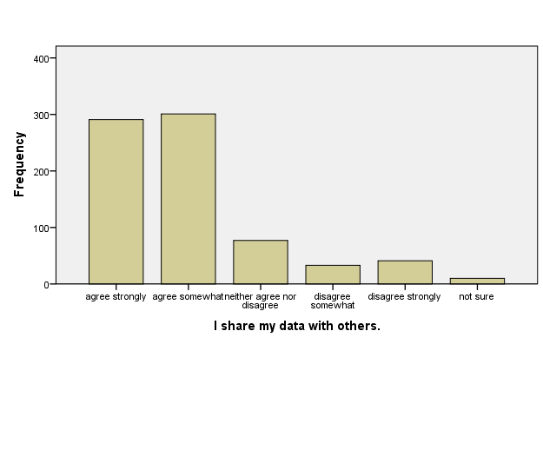
Data Sharing Practices

Slide 29
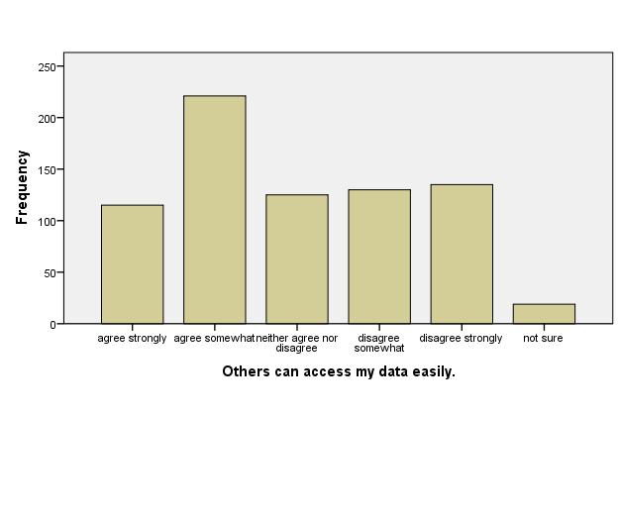
Data Sharing Practices Cont.

Slide 30
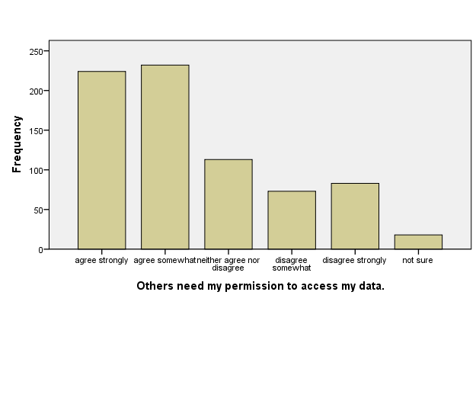
Data Sharing Practices Cont.

