Slide 1

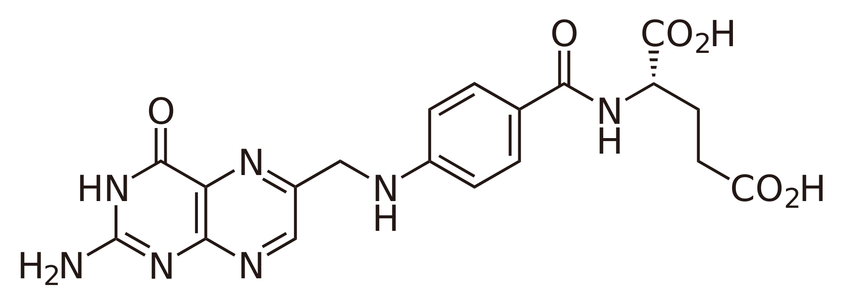
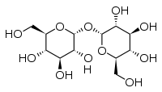
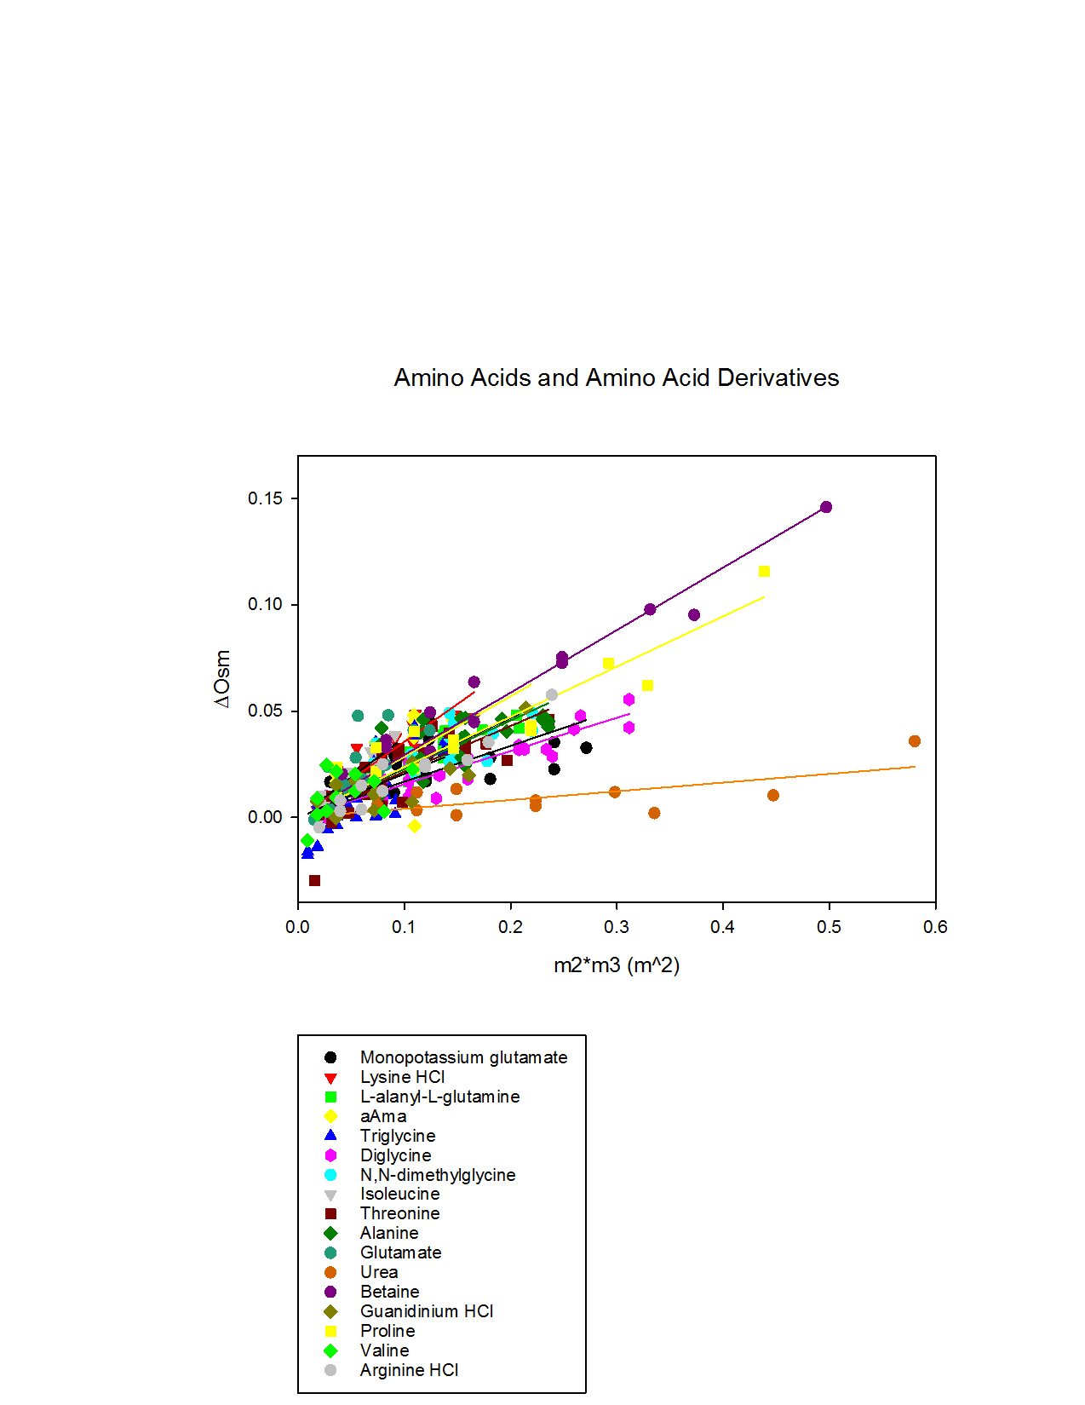
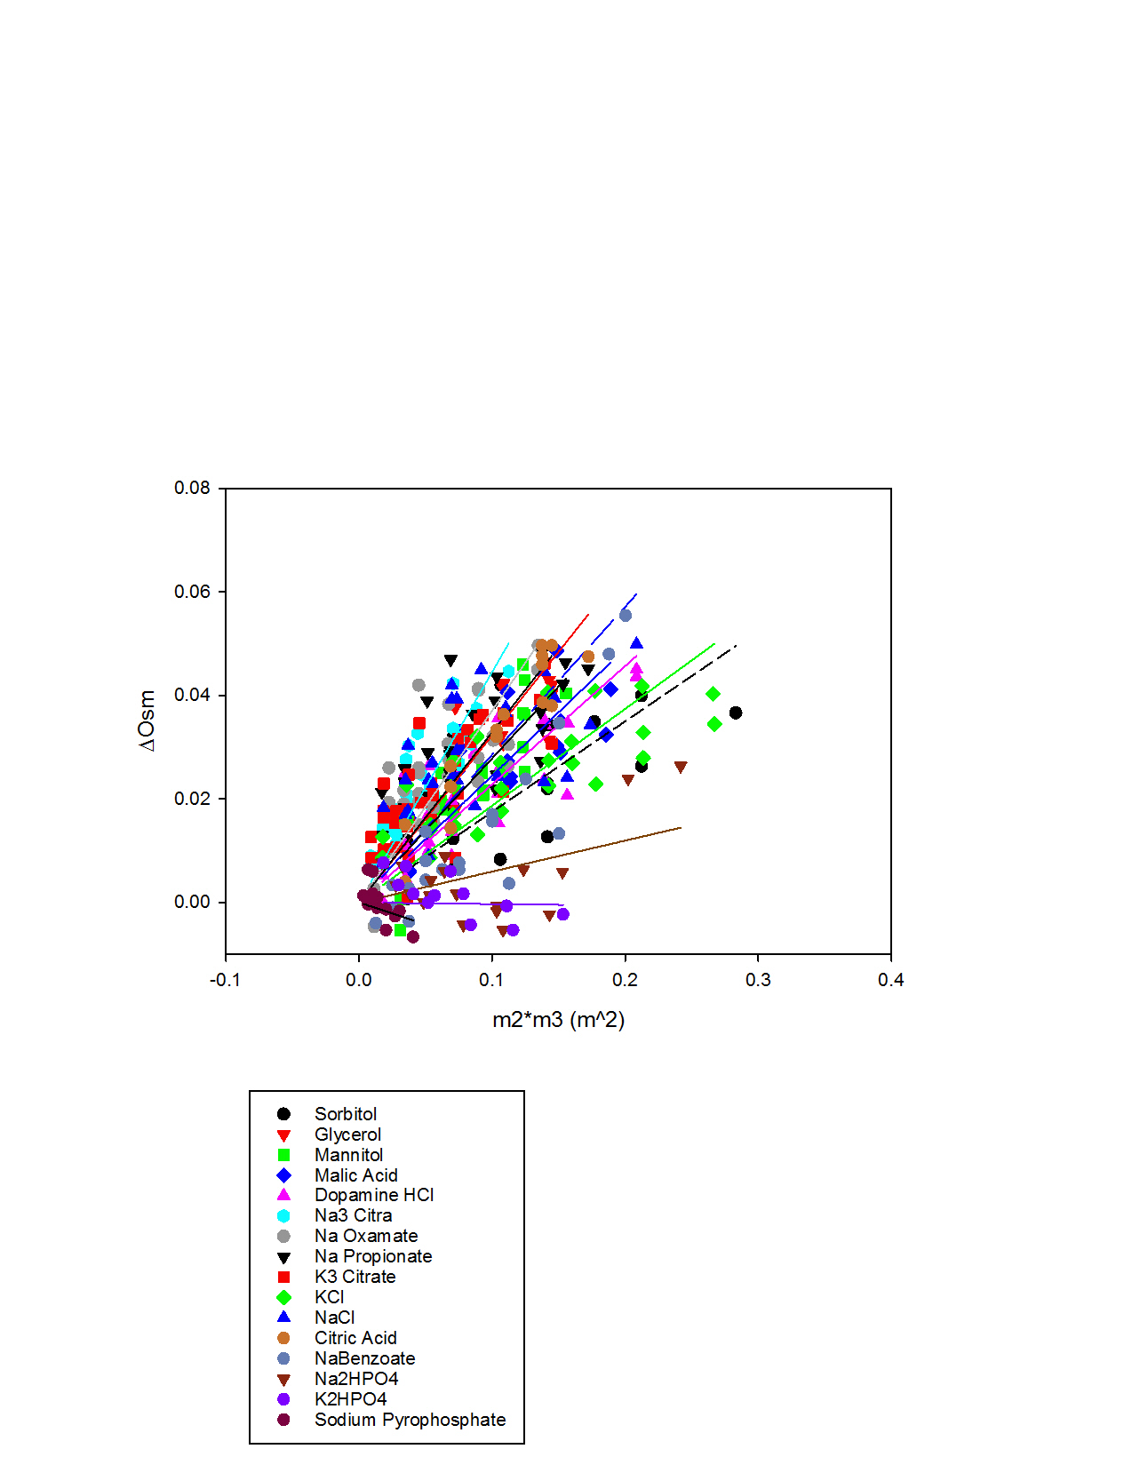
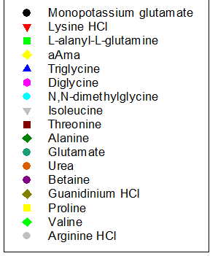
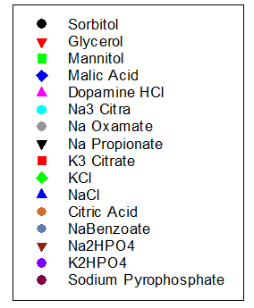
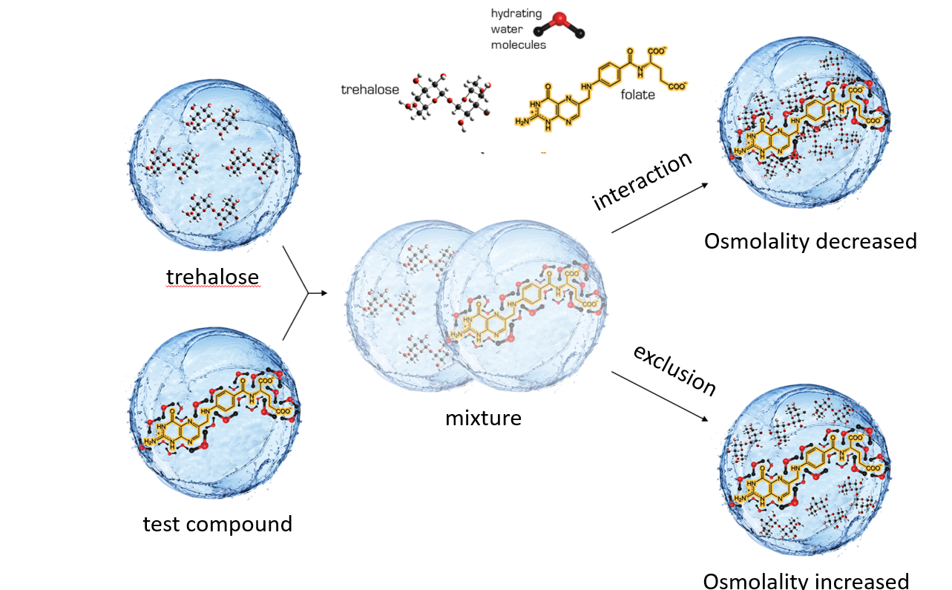
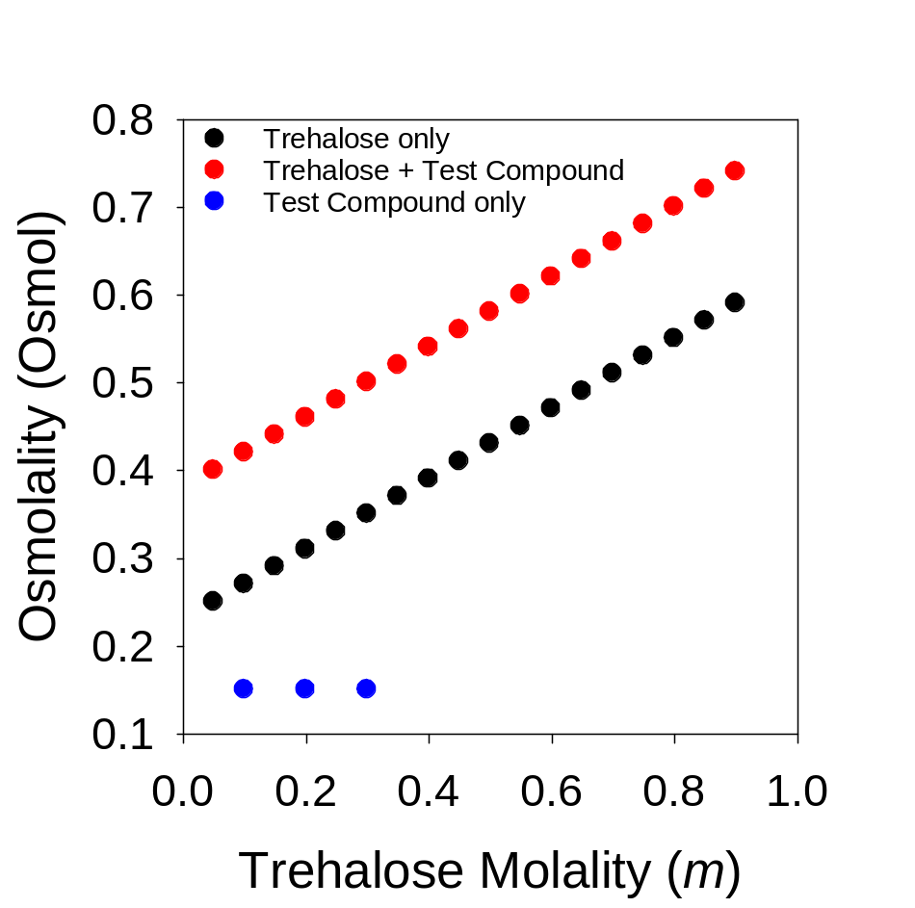
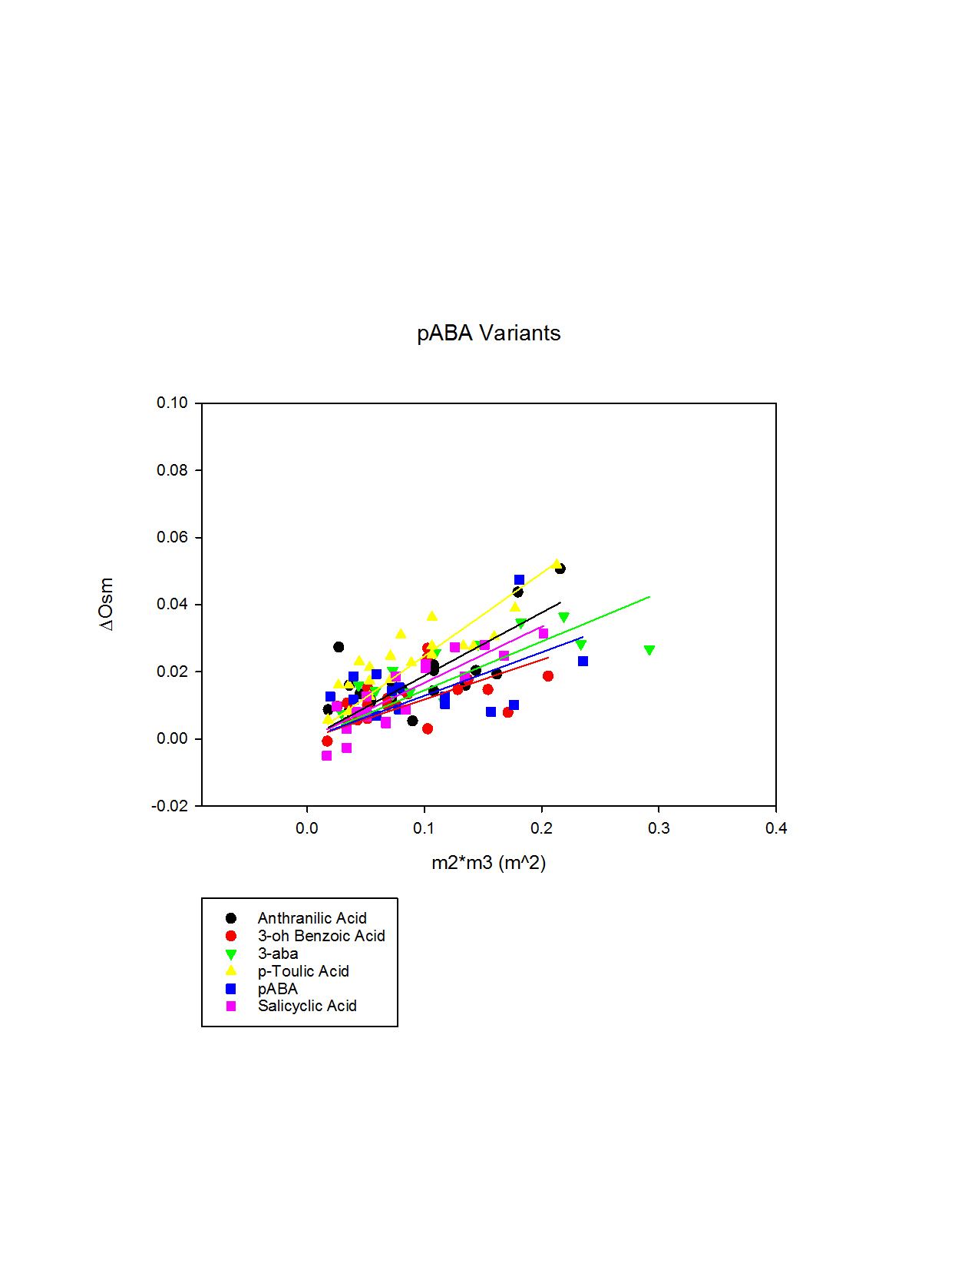
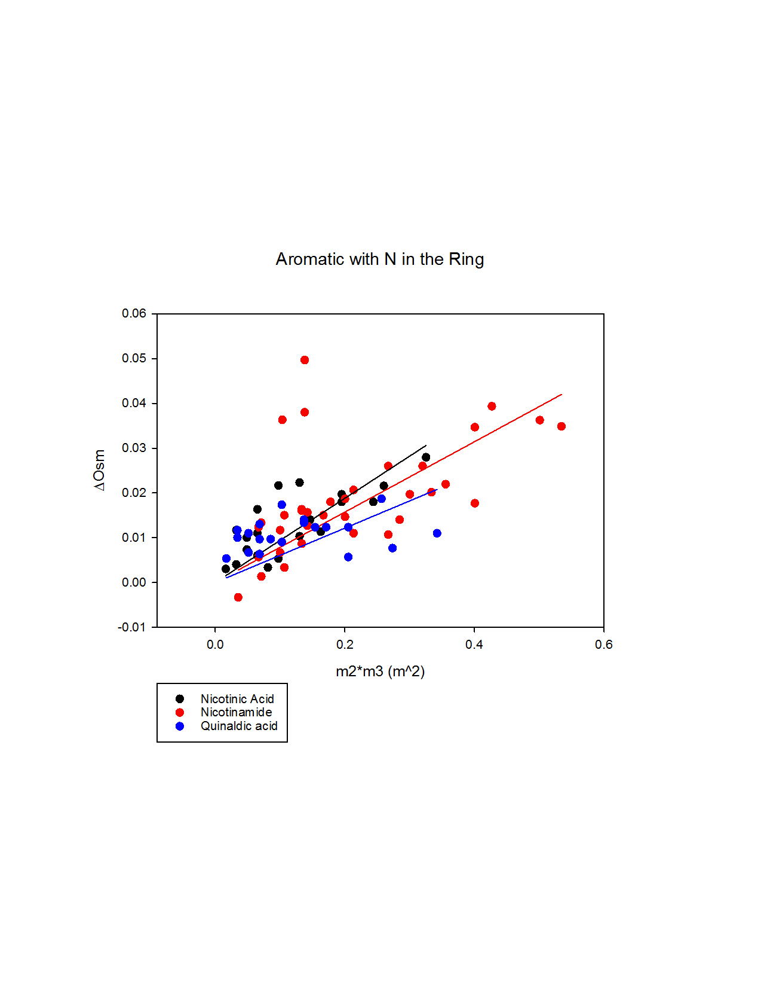


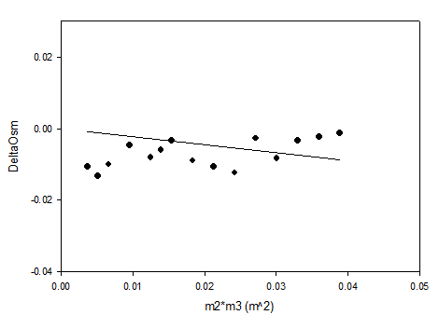

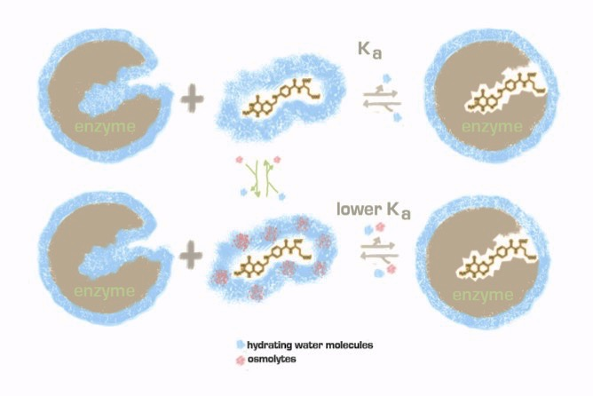
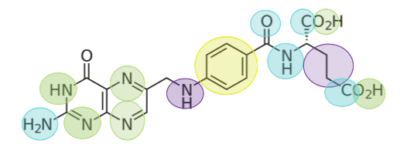
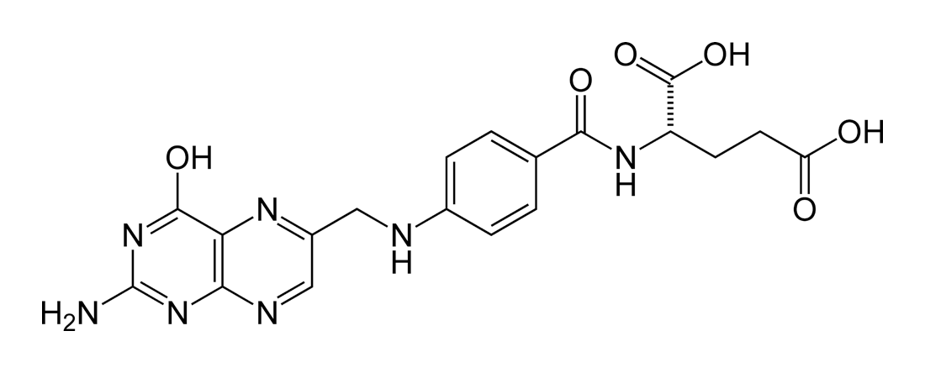
Interactions of Trehalose with Model Folate Compounds
Folate
Carolyn R. Ware, Deepika Nambiar, Carla Arrieta, Michael Duff Jr., Elizabeth Howell
Department of Biochemistry & Cellular and Molecular Biology, University of Tennessee, Knoxville 37996
Trehalose
.
.
.
Abstract
Folate (vitamin B9) is an essential element in cellular metabolism. Folate is obtained from dietary intake, as the human body is unable to produce it, and it is required for the synthesis of many basic subunits used to compose both DNA and RNA. Previous studies have shown that folate interacts weakly with osmolytes, small molecular weight compounds produced by the cell when under stress, when the cell is crowded with them (Figure 1). Moreover, it has also been demonstrated that there is weaker binding between dihydrofolate reductase and dihydrofolate in the presence of these osmolytes and when the cell is under osmotic stress. This is an interesting finding when it comes to developing better anti-folate drug therapies that help eliminate unwanted cells from the body (i.e. bacterial and cancer). Because of these results, we are now interested in the mechanisms through which these enzyme-osmolyte interactions occur. This study uses vapor pressure osmometry to determine the type of interactions that occur between trehalose (a common cellular osmolyte) and various compounds that mimic functional groups found on folate. Through our studies, we have found positive preferential interaction coefficients for reactions between trehalose and various amino acids, amino acid salts, amides, carboxylic acids, and carboxylate salts, meaning that these compounds prefer to interact with water rather than trehalose. Using these results we will be able to understand how trehalose interacts with various atom types and how these atoms can contribute to cellular interactions and processes.
Methods
This study uses vapor pressure osmometry to determine whether or not interactions are present between trehalose and the model folate compounds. We use three types of test solutions: 1. Trehalose+water, 2. Test compound + water, 3. Trehalose+test compound+water. If the osmolality of the test compound, trehalose, and water solution is increased from the osmolality of the trehalose and water solution, then no interaction is said to occur and vice versa. From this we are able to obtain a preferential interaction coefficient
Results
Amino Acids and Amino Acid Derivatives
Carboxylic Acids and Carboxylate Salts
A
B
pABA Variants
Aromatic Compounds w/ N in ring
C
D
Figure 2. Model showing the theory behind vapor pressure osmometry. If trehalose and the test compound interact, then the osmolality of the overall solution is decreased. If no interaction is present, then the overall osmolality is increased.
Figure 3. From the values obtained for each sample, we are able to graph the osmolality of each sample versus the molality of trehalose.
Atom Type | α-value
Aliphatic Carbon | 0.001311
Aromatic Carbon | -0.00019
OH | 0.000469
Amide Oxygen | 0.00094
Amide Nitrogen | 0.000278
Cationic Nitrogen | -0.0005
Carbonyl Oxygen | 0.000816
Phosphate Oxygen | -0.00121
Aromatic Nitrogen | 0.000384
Amine Nitrogen | 0.000351
A
Atom Type | Kp
Aliphatic Carbon | 0.645444
Aromatic Carbon | 1.052528
OH | 0.873067
Amide Oxygen | 0.830462
Amide Nitrogen | 0.924815
Cationic Nitrogen | 1.135715
Carbonyl Oxygen | 0.779244
Phosphate Oxygen | 1.219007
Aromatic Nitrogen | 0.896173
Amine Nitrogen | 0.905074
B
Figure 4. From the graph is figure 3, we then graph the change in osmolality (Δosmolality) between the solution containing trehalose, water, and test compound and the solution containing only trehalose and water versus the product of the molality of the test compound and trehalose. A line is then plotted and the slope of this line gives us the preferential interaction coefficient (μ23/RT). If this slope is negative, then the test compound and trehalose are interacting. If the slope is positive, then trehalose is excluding the test compound.
Figure 5. A) Graph of Δosm versus m2*m3 for amino acids and amino acid salts and their corresponding linear fit. B) Graph of Δosm versus m2*m3 for carboxylic acids, inorganic salts, and other compounds and their corresponding linear fit. C) Graph of of Δosm versus m2*m3 for pABA variants and their corresponding linear fit D) of Δosm versus m2*m3 for aromatic compounds with N in the ring and their corresponding linear fit
Table 1. A) Table of each type of functional group with their corresponding α-value. The more negative the value, the more this group is contributing to the overall interaction between folate and trehalose. B) Table of each type of functional group and their corresponding Kp value.
.
.
This preferential interaction graph in Figure 4 is that of folate and trehalose. The μ₂₃ / RT = -0.165 ± 0.044 m⁻¹ thus folate interacts with trehalose. We chose to test trehalose with folate (our lab’s primary interest) because trehalose is a highly prevalent osmolyte within E. coli. We are now interested in which functional groups contribute most to this interaction. Because of this, test compounds used are those that have functional groups similar to those on folate (figure 6). Thus, through these experiments, we will be able to narrow down where exactly trehalose is binding on folate through its interaction patterns with these model compounds.
Conclusions and Future Directions
All compounds tested thus far exhibit positive μ₂₃ / RT values with the exception of sodium pyrophosphate and sodium phosphate dibasic. However, from our α-value and Kp calculations, though primarily excluding, we see that these groups exhibit varying degrees of contribution to the interactions between folate and trehalose (shown above). We are continuing experiments with a larger number of compounds that are variants of the PABA ring as well as compounds that contain aromatic rings with nitrogen in the ring. Preliminary results show more negative μ₂₃ / RT values giving us an idea that we are beginning to see compounds that contribute more heavily to the interaction of trehalose and folate.
Amino acid salts
Solute Accumulation
Kp = 1.1-1.5
Amides
Amino Acids
Kp = 1.0-1.1
Aromatic w/ N in ring
Bulk (Kp = 1.0)
Kp = 0.85-1.0
Kp = 0.7 - 0.85
Figure 1. Figure showing the interactions of osmolytes with enzyme substrates and the resulting effect on the kinetics of the reaction. When osmolytes are present, the K_{a} is lowered and the equilibrium is shifted left.
pABA variants
Kp= 0.6-0.7
Inorganic salts
Carboxylate salts and carboxylic acids
Solute Exclusion
Acknowledgements
I would like to acknowledge all of the members of the Howell Lab here at UT for their support in this project. I would also like to thank the BCMB department for funding.
Figure 6. Folate compound with the types of functional groups being tested highlighted.

