Slide 1

Anesthesia-to-Post anesthesia care unit handoff standardization
Maureen Taylor, Cassie Bivens, Mark Cresap, Steven Halcomb
University of Tennessee, Knoxville

Slide 2
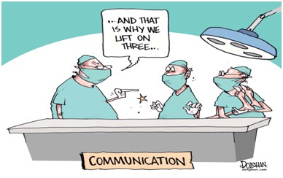
Introduction
Notes:
The exchange of pertinent medical information from one medical professional to another is known as the handoff (Benton et al., 2019).
Communication errors during the transition period can lead to medication errors, delays in care, high stress within the work environment, and increased burnout within the nursing staff. One of the areas of the hospital where effective handoffs are critically important, given the high frequency, is in the post-anesthesia care unit (PACU).
The most frequently reported cause of sentinel events within U.S. hospitals deal with communication errors (Pond, 2014).

Slide 3
Overview of problem
The PACU environment:
  Rapid turnovers
  Large volumes
  Rushed environments
Cost of communication failure:
  30% of malpractice claims
  1,744 deaths
  $1.7 billion in malpractice costs over five years
(The Joint Commission, 2017)
Notes:
-PACU is the perfect environment for a patient safety opportunity to be compromised.
-The average length of stay for a patient in the PACU is between 1.9 to 3.2 hours (Ganter et al., 2014).
-A standard twelve-hour shift of a PACU nurse can receive report, or handoff, three to six times for just one bed. The typical ratio for a PACU nurse is 2 beds.

Slide 4
Clinical Significance
Evidence has shown by formalizing handoffs, nursing staff satisfaction improved from 46% to 74%, with a perception of better patient care at an overall 88% after the study (Talley et al., 2019).
The American Association of Nurse Anesthetists (AANA) has also labeled it best practice to have a structured PACU handoff process.
The WHO placed handoff into their High 5’s Initiative
In 2010, the guideline requirements for The Joint Commission became a standard of practice.

Slide 5
Clinical Problem
An unstructured handoff process threatens patient safety, leads to decreased satisfaction among PACU nurses, and reduces the amount of information that is transferred (Robins & Dai, 2019).
This high-volume area for handoff creates a demand for the standardization of practice and the potential for significant impact.
It is estimated that upwards of 4,000 patient handoffs occur every single day within teaching hospitals, just like UTMCK (The Joint Commission, 2017).
Notes:
-Reasons for incomplete handoffs include, but are not limited to, the following: multitasking, lack of time, knowledge of the patient, formal handover structure, and a chaotic environment (Robins & Dai, 2019).

Slide 6
Clinical Problem
Subjective handoffs can open the gap for communication errors leading to dissatisfaction and stress with the facility’s nursing staff.
There is no standardized handoff in the PACU at the University of Tennessee Medical Center.
Needs Assessment:
  UTMCK Think Tank marked handoff as an organizational priority
  Quality Improvement Coordinator
  PACU Nurse Manager
Notes:
-A large portion of complaints is due to anesthesia providers giving subjective handovers causing variations in the quality and quantity of information received.
-The quality of handoff affects anesthesia recovery management with a poor handoff potentially leading to medication errors, hemodynamic instability, and delay in treatment.

Slide 7
Project purpose and goal
Purpose
  To implement a standardized handoff tool as a resource when anesthesia providers are reporting to a PACU nurse after every case at the University of Tennessee Medical Center.
Goals
  Using the best evidence to implement a checklist as a handoff tool to evaluate nurse satisfaction before and after the handoff tool is implemented.
  Nurse satisfaction will be evaluated as the nurse’s perception of the quality of report received and the ability to keep the safety of the patient intact throughout the PACU stay

Slide 8
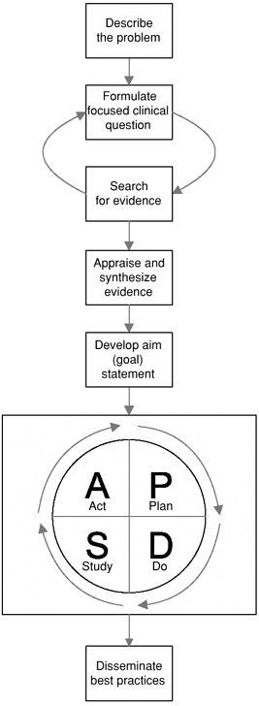
guiding framework
Figure 1: EBPI Model (Levin, 2010)
Notes:
This model integrates evidence-based practice with practice improvement (Levin et al., 2010). The PACU handoff project focuses on evidence-based and quality improvement by taking the best evidence within in literature, regarding standard handoffs, and implementing it into practice to improve the nursing care provided to the patient. The framework simplicity and relevance are what lead to the ultimate decision in the use of this model.
EBPI is a precise, simple, systematic method to develop, guide implementation, and evaluate the project outcomes. The project originated from a clinical problem (nurse dissatisfaction with handoff) in which literature was searched and a PICO question developed. This model will then assist in the critical appraisal of evidence, evaluating outcomes, and ultimately disseminate into practice
Seven Steps:

Slide 9
PICOT Question
“In PACU nurses, how does a standard handoff tool compared to subjective verbal reports affect nurse satisfaction within one month.”

Slide 10
Evidence

Slide 11
Literature search
Records identified through database searching
(n=151)
Additional records identified through other sources
(n=0)
Identification
Records after duplicates removed
(n=27)
Screening
Records screened
(n = 27)
Records excluded
(n =9)
Full-text articles assessed for eligibility
(n=18)
Full-text articles excluded, with reasons
(n =5)
Did not have nurse satisfaction as a measurable outcome
Had nurse-nurse handoff, not provider to nurse
Eligibility
Studies included for critical appraisal
(n=13)
Quantitative (n=12)
Qualitative (n=1)
Included
Notes:
To answer the PICOT question for the project, a thorough search of the literature was conducted.
Once the literature search was conducted, articles that met the inclusion criteria selected for critical appraisal of evidence.
The inclusion criteria included the following:
outcomes measured nurse satisfaction
a handoff tool or checklist was the intervention implemented
handoff was between provider and nurse
The exclusion criteria for the three articles were:
measured provider satisfaction as opposed to nursing satisfaction
handoff toolkit designed for nurse-nurse shift handoff

Slide 12
Critical appraisal
All studies were systematically appraised as per the Johns Hopkins Nursing Evidence-Based Practice in order to establish the validity and reliability of the studies that will support and affect practice change
The Johns Hopkins Nursing Evidence-Based Practice Appendix D: Evidence Level and Quality Guide was used to assign a level and quality rating for each of the 13 total articles that met the inclusion and exclusion criteria
    Level I – 2 articles
    Level II -3 articles
    Level III -7 articles
  All assigned quality grade A or B, indicating good or high-quality evidence.
  A clinical practice guideline, was appraised, leveled, and graded as a non-research source using the Appraisal of Guidelines for Research and Evaluation (AGREE) II instrument
Notes:
There were twelve quantitative studies and one qualitative study to be critically appraised
The Johns Hopkins Nursing Evidence-Based Practice guidelines and AGREE II tools were used for critical appraisal of the evidence and clinical practice guidelines
For all individual research studies and systematic reviews, the Johns Hopkins Nursing Evidence-Based Practice Appendix E: Research Evidence Appraisal Tool was used.
After appraisal of the evidence, the Johns Hopkins Nursing Evidence-Based Practice Appendix D: Evidence Level and Quality Guide was used to assign a level and quality rating for each of the articles
There was a total of thirteen critical appraisals assigned a level and quality. After each critical appraisal was completed, information was summarized into individual evaluation tables for easier interpretation of the evidence

Slide 13
synthesis
From the information that was synthesized, the implementation of a standardized handoff tool was beneficial to nurse satisfaction, quality of information transferred, and patient safety
After all appraisals were complete and assigned a level and quality rating, they were synthesized into an evidence table
Ten different handoff tools were evaluated across the studies:
  3 custom checklists
  WHAT tool
  I-PASS
  PATIENT
  1 electronic checklist
  1 study used a combination of checklists
  1 physical checklist
  One incorporated a “time-out” as an intervention
WHAT tool had highest statistically significance increased nurse satisfaction and communication along with the highest level of evidence with the greatest return of surveys at 94%
Implementation of timeout with standardized handoff due to consistent significance of timeout improvement on nurse satisfaction, information transferred, quality of information, communication, and patient safety data
Notes:
From the information that was synthesized, the implementation of a standardized handoff tool was beneficial to nurse satisfaction, quality of information transferred, and patient safety.
These three aspects are important to show that a standardized handoff is important to improve patient outcomes and satisfaction which is pertinent to the PICOT question.
No study was included in the evidence synthesis that showed a negative outcome for patients or healthcare providers whenever a standardized handoff was used.
The outcomes from the studies show that a standardized handoff is important to improving patient outcomes and staff satisfaction.

Slide 14
Clinical expertise
Clinical practice guidelines are rigorously developed based on systematic reviews of research evidence with statements of clinical practice recommendations and an evaluation of their benefits and harms (Melnyk, 2015)
Clinical Practice Guidelines play a critical role in EBP since they help to reduce healthcare variation and improve patient outcomes (Melnyk, 2015)
A clinical practice guideline was chosen as a non-research form of evidence and was appraised, leveled, and graded using the Appraisal of Guidelines for Research for Research and Evaluation (AGREE II) instrument
The objective of the clinical practice guideline chosen for the DNP project is to guide improving perioperative team communication through a culture of safety that incorporates team training, simulation training, standardized transfer of patient information (commonly referred to as handovers or handoffs), briefings, time outs, surgical safety checklists, and debriefings (Fearon et al., 2018)
Recommendations from the practice guideline suggest that the use of checklists in handovers, briefings, and debriefings provide a defense against adverse events (Fearon et al., 2018)
Notes:
The objective of the clinical practice guideline chosen for the DNP project is to guide improving perioperative team communication through a culture of safety that incorporates team training, simulation training, standardized transfer of patient information (commonly referred to as handovers or handoffs), briefings, time outs, surgical safety checklists, and debriefings (Fearon et al., 2018).

Slide 15
Patient preference
Patients and families trust that healthcare workers will communicate and work together to ensure they receive the best possible care, along with improved outcomes
Developing a patient’s trust in healthcare professionals will help to reinforce the patient/provider relationship, which helps to increase patient rapport and confidence in their medical care.
Handoff provides critical information that allows the nurse to make the patient experience a shared value of safety and quality (IHI, 2020).

Slide 16
Recommendations for Practice
There is GOOD AND CONSISTENT evidence to support implementation and utilization of standardized handoff tool to guide OR to PACU transfers to enhance nurse satisfaction.
Synthesis of the literature did not reveal enough evidence to support the use of specific handoff tool.
It is recommended that the practice site choose a tool that best meets the needs of the stakeholders.

Slide 17
Aims for recommended practice change
“By September 2021, 95% of all anesthesia-to-PACU-handoffs occurring within the post-anesthesia care unit at the University of Tennessee Medical Center will utilize a standardized handoff approach.”

Slide 18
implementation

Slide 19

Setting and population
Setting
The project site is located at the largest teaching hospital in Knoxville, Tennessee which is comprised of 685 beds
24-bed post anesthesia recovery unit (PACU) known as “Phase I recovery”
Population
69 registered nurses
patient load of approximately 23,000 patients annually
Others include a nurse manager, team leader PACU RN, anesthesiologist, and anesthesia resident
Notes:
Phase I recovery facilitates the awakening or recovery of patients from anesthesia for post-operative patients to prevent unnecessary mortality and morbidity following surgery.
This area is populated by total of 69 registered nurses. There is one PACU nurse manager present during normal workday hours. There is also one team leader, one anesthesiologist, and one anesthesia resident present in the PACU 24 hours a day and seven days a week. Furthermore, there is a large patient load of approximately 23,000 patients in the PACU annually, which supports the need for our intervention. Approval for the execution of this project has been granted by the PACU nurse manager and quality improvement coordinator.

Slide 20

Project team/stakeholders
Project Team
DNP Student #1
DNP Student #2
DNP Student #3
DNP Student #4
Anesthesia Quality Improvement Chair
Nurse Anesthesia Program Director
Nurse Anesthesia Associate Program Director
PACU Nurse Manager
Anesthesia Providers
PACU Staff Nurses
National Patient Safety Goals
Anesthesiology Performance Improvement and Reporting Exchange (ASPIRE)
Key Stakeholders
Project site staff: PACU nurse manager, anesthesia providers, PACU staff nurses, and anesthesia quality improvement chair
Project associated faculty: nurse anesthesia program director, and nurse anesthesia associate program director
National standards: Anesthesiology Performance Improvement and Reporting Exchange (ASPIRE), and the Joint Commission (JACHO)
Notes:
This project team consists of four doctorate of nursing practice students enrolled in the nurse anesthesia concentration, the anesthesia quality improvement chair, the nurse anesthesia program and assistant program directors, anesthesia providers, and PACU nurses and nurse manager. All project team members have specific responsibilities which will provide for a smooth, accurate implementation process.
The key stakeholders were identified to facilitate practice change in an evidence-based quality improvement project. The identification of appropriate stakeholders for this proposed project is guided by those who will be affected by the practice change, and the specific site and setting.

Slide 21

Finances
Economically Competent Project
Associated Costs- printing paper copies of the handoff tool
Cost-effective- considering the potential savings vs the associated costs
Notes:
The Joint Commission estimated $1.7 billion in malpractice costs were related to healthcare communication failures from 2012 to 2017. Communication failure complications can cause increased length of stay and increased healthcare costs for the organization while decreasing the organizations quality indicator scores. Even though this project will not directly generate revenue, it generates safety, provider confidence, and better patient experiences. This project coincides with the organizational goals, mission, and values, and meets the criteria of the Institute for Healthcare Improvement’s Triple Aim of improving the health of the population and experience of care while decreasing costs per capita (IHI, 2020).
Our project is an economically competent one. There is cost only associated with the printing of the handoff tool that will be implemented into practice in the PACU setting. There are no other associated costs that this project will require. In regard to dissemination, the cost-effectiveness of this project is an important aspect to consider when looking at adapting this projects principle to other facilities to improve handoff.

Slide 22

barriers and facilitators
Knowledge
Time
Compliance and sustainability
Population size
Work ethic
Supportive leadership
Notes:
The identification of potential barriers, or obstacles, and facilitators, or opportunities, within the project site and its members is vital to the success of the implementation and dissemination of the change.
The categories listed are described in Table 6 and 7 of the project proposal as being both barriers and facilitators specific to each key stakeholder. A mitigation plan for the barriers and an aid plan for the facilitators was made to ensure successful implementation.
For example, the variable of time can be a barrier to PACU staff nurses due to busy shifts not allowing time to navigate the new standardized handoff tool. This can be mitigated by staff education during huddle meetings about handoff elements and how to optimize utilization of tool. However, time can also be a facilitator for PACU staff nurses. There may be more time in the workday created by the implementation of this project. This facilitator can be aided by encouraging the staff with EBP concerning standardization of anesthesia-to-PACU handoffs since they increase information transfer while not increasing overall handoff times.

Slide 23
Implementation timeline
Spring 2021-Summer 2021
Implement PDSA Cycles
Fall 2021
Disseminate best practices
Notes:
As stated previously, the EBPI Model will be used to guide the implementation and evaluation of the project. Starting in the Spring of 2021, the project team will start conducting tests for change. The tests for change are directed by PDSA cycles, which include planning a solution, implementing the evidence, evaluating the implementations, and making adjustments based on the weaknesses found during the evaluation process (Levin et al., 2010). Implementation of PDSA cycles could be accomplished by implementing the standardized handoff in the PACU. After implementation, an evaluation of the implementation would be done and adjustments could be made, and the cycle continues until project satisfaction among the project team and stakeholders is reached.
Following the EBPI framework, after the implementation of PDSA cycles, a dissemination of best practices through the Final Project Defense, preparation of a manuscript, and to publish and present our findings.
A full timeline of our entire project is illustrated in table 8 of our proposal document.

Slide 24
Implementation process
Notes:
Step1: Describe the Practice Problem.
Step 2: Formulate Focused Clinical Question.
Step 3: Literature Search
Step 4: Appraise and Synthesize Evidence.
Step 5: Develop an Aim Statement.
Implementation Process
Step 6: Plan-Do-Study-Act Cycles.
After submission to and approval from the IRB, we will
Divide roles of the four project leaders
Communicate to all key stakeholders
Email, zoom, in-person meetings
Identify Implementation team
Form team leadership roles between four DNP students
Obtain buy-in from hospital through stakeholders and mitigating barriers to change
Conduct educational meetings with anesthesia providers and PACU nurse staff addressing change related to handoff tool, utilization, and knowledge gaps
Analyze nurse satisfaction with subjective handoffs and set a goal
Implementation of handoff tool in first PDSA cycle in Phase 1 PACU recovery
Assess for knowledge gaps and provide constant feedback
Monitor for compliance
Encourage positive culture and attitudes
Measure nurse satisfaction with handoff tool
Meetings twice a week to determine adherence
Track outcome data and disseminate findings to staff, providers, and stakeholders
Make changes after each PDSA cycle is complete
Analyze the data
Develop plan to sustain change
Set standardized handoff policy and integrate handoff tool across all PACUs.
Step 7: Dissemination of Best Practices.
Final Project Defense
Prepare manuscript
Publish and present findings

Slide 25
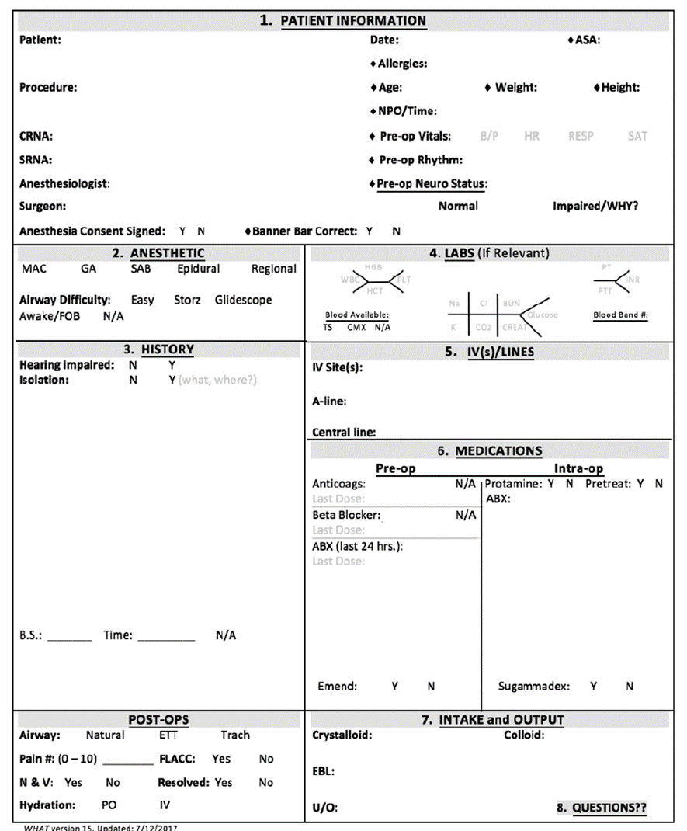
Written Handoff Anesthesia Tool (WHAT)
From: Lambert, L. H., & Adams, J. A. (2018). Improved Anesthesia Handoff After Implementation of the Written Handoff Anesthesia Tool (WHAT). AANA Journal, 86(5), 361–370. Reprinted with permission.
Notes:
Lambert & Adam’s Written Handoff Anesthesia Tool or WHAT tool will be the implementation tool used in our project. As described in table 2 of the project proposal, the WHAT tool significantly improved nurse satisfaction and increased communication in the PACU setting between anesthesia providers and PACU nurses during handoffs. Lambert and Adams (2018) is considered high quality, level II, evidence, per the Johns Hopkins .
There will be copies of this tool distributed and filled out by anesthesia providers to the best of their ability and physically handed off to PACU nurses during the handoff process. This tool includes patient information, anesthetic type, history, labs, IV’s and lines, medications (both preop and intraop), I’s and O’s, and post op assessment details.

Slide 26
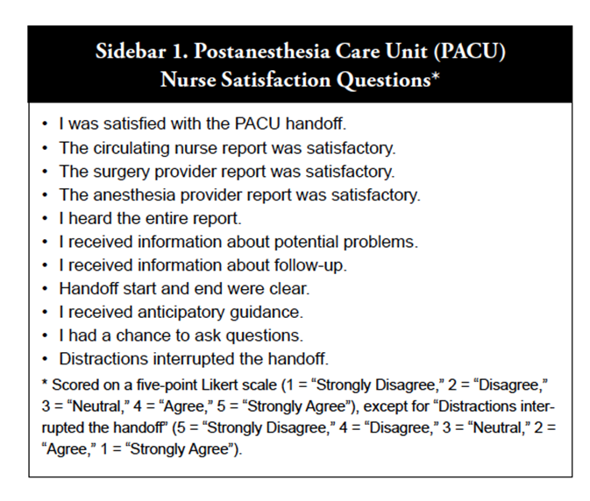
Nurse Satisfaction Screening Tool
From: Caruso, T., Marquez, J., Wu, D., Shaffer, J., Balise, R., Groom, M., Leong, K., Mariano, K.,Honkanen, A., Sharek, P. (2015). Implementation of a standardized postanesthesia care handoff increases information transfer without increasing handoff duration. The Joint Commission Journal on Quality and Patient Safety, 41(1), 35-42. Reprinted with permission.
Notes:
Since Lambert & Adams (2018) did not include a nurse satisfaction survey, we made the decision to utilize the postanesthesia care unit nurse satisfaction questions by Caruso et al (2015). The authors created and provided this nurse satisfaction survey, which is scored on a five-point Likert scale. The DNP students thought this most closely aligned with the implementation goals of the project.

Slide 27

Evaluation

Slide 28
Measures of success
Outcome
  Increase the overall nurse satisfaction of report handoff in the PACU with the post-implementation of the standardized WHAT tool.
Process
  Nurse satisfaction will be evaluated as the nurse’s perception of the quality of report received and the ability to keep the safety of the patient intact throughout the PACU stay.
Notes:
A data evaluation plan is represented in Table 9, which describes the variables and data tools necessary for reporting findings and are indicators for the success of the proposed project. The validity of the chosen standardized tool and the nurse satisfaction survey is detailed in Table 10.

Slide 29
Data evaluation
Data Collection
PACU Nurse Satisfaction Survey: Implemented at one week, one month, and two months.
Data Variables
Independent Variables: pre-intervention and post-intervention times.
Dependent Variables: included in Table 9
Notes:
Based on the literature, the recommendations for practice change to standardize anesthesia-to-PACU handoff are described in Table 3 and Table 4. These evidence-based recommendations include a written handoff tool with a checklist, utilization of a mnemonic, and the inclusion of a “time-out” called before the handoff (Canale, 2018; Caruso et al., 2015). Synthesis of the literature revealed enough evidence to support the use of the WHAT tool over the I-PASS mnemonic and PATIENT mnemonic and was selected for implementation. The WHAT tool meets all the criteria of the practice change recommendations and demonstrates the best logicality for administration by the PACU staff and anesthesia providers. The validation data for the selected WHAT handoff tool can be found in Table 2 (Synthesis of Evidence Table).
Data Collection
from Caruso et al., 2015, which is depicted in Appendix D
Data Variables
Independent Variables since the project consists of a pre- and post-survey.
Dependent Variables: Patient Safety, “Time Out”, Compliance, Nurse Satisfaction Survey from Caruso, et al., 2015

Slide 30
Data analysis
Descriptive statistics for all data variables.
Time frame of 1 month.
Independent sample t-test,
Data will be analyzed using version 27 of SPSS.
Notes:
-a descriptive statistics section will be created according to the data collected during the statistical analyses from the variables listed in Table 9. The range of values for the first 3 variables are nominally measured 1 and 2 for yes and no, respectively. The remaining variables’ range of values are 5-point Likert Scales, and the level of measurement is an interval, or an average of the Likert Scale scores.
-The time frame for the data evaluation is 6 months which includes the pre- and post-implementation periods.
-Paired sample t-tests will be completed for each individual participating in the project for the pre- and post-tests. This will require each PACU RN participating in the project to be assigned an anonymous number. The anonymous number will be used to track and match the pre- and post-tests so they can be compared. This is a necessity of the paired sample t-tests and will add to the statistical strength of the data. If the individuals completing the survey cannot be numbered and sorted anonymously, independent t-tests will be used. According to Cary Springer, independent t-tests will still provide data but will have weaker statistical significance than the paired sample t-tests.

Slide 31
Data security
Data points recorded in a password protected data collection spreadsheet.
No PHI on data collection tool.
Data collection spreadsheet will be stored in the HIPAA/PHI certified UTK sponsored OneDrive for Business for storage platform.
Protected lock box where copy of WHAT tools will be placed after use during handoff.
Lockbox will always remain on UTMC campus and keys will only be given to those working on this project.
Notes:
The ethical aspects of implementing the project include the protection of human subjects and information security which will be ensured through the Institutional Review Board (IRB) determination. DNP evidence-based practice improvement projects are not typically considered subject to the federal human subjects’ protection regulations (Hockenberry, 2014). However, because patient health information will be discussed during the implementation phase of the project, it is best practice to seek IRB approval (Alexandrov, Brewer, & Brewer, 2019).

Slide 32
FINDINGS

Slide 33
Results
 | Pre-Post Survey Results per question
 | 1 | 2
 | Mean | Mean
I was satisfied with the PACU handoff | 4.1 | 3.9
The circulating nurse report was satisfactory. | 4.3 | 3.7
The surgery provider report was satisfactory. | 3.3 | 3.0
The anesthesia provider report was satisfactory. | 4.2 | 3.8
I heard the entire report. | 4.4 | 3.9
I received information about potential problems. | 4.3 | 3.9
I received information about follow-up. | 3.7 | 2.7
Handoff start and end were clear. | 4.3 | 3.9
I received anticipatory guidance. | 3.9 | 3.5
I had a chance to ask questions. | 4.6 | 4.4
Distractions and interruption were limited during the handoff. | 3.7 | 3.0
OVERALL MEAN PRE-POST SURVEY
 | time | N | Mean | Std. Deviation | Std. Error Mean
satisfaction | 1 | 12 | 4.0606 | .66391 | .19165
 | 2 | 11 | 3.6248 | .45471 | .13710
Notes:
Time 1 = Pre implementation survey with an overall mean score of 4.06
Time 2 = Post implementation survey with an overall mean score of 3.6248

Slide 34
Results Cont.
Results of the Independent Samples Test were t(21)=1.819, p=0.083. Not significant because larger than .05 but close
 |  | Levene's Test for Equality of Variances |  | t-test for Equality of Means
 |  | F | Sig. | t | df | Significance |  | Mean Difference | Std. Error Difference | 95% Confidence Interval of the Difference
 |  |  |  |  |  | One-Sided p | Two-Sided p |  |  | Lower | Upper
satisfaction | Equal variances assumed | 1.251 | .276 | 1.819 | 21 | .042 | .083 | .43581 | .23955 | -.06236 | .93399
 | Equal variances not assumed |  |  | 1.849 | 19.517 | .040 | .080 | .43581 | .23564 | -.05651 | .92814
Notes:
Independent sample T test between overall sat pre to post.
Is there a not significant difference in satisfaction. 0.083. trend towards significant besides (one with most drop). Biggest difference with the information about follow-up.

Slide 35

Implications

Slide 36
Lessons Learned
A standardized approach utilizing WHAT Tool did not significantly increase nurse satisfaction for PACU nurses at this institution.
Poor communication and compliance contributed to small sample size that weakened strength to our findings.
Inability to individualize nurses for pre and post survey results decreased strength in results.
Incorporating follow up information, such as pager numbers on WHAT tool would promote satisfaction.

Slide 37

Dissemination

Slide 38
Dissemination plan
Stakeholder Presentation
Project Defense
Poster Presentation
Research Think Tank
PACU Education
Unit Council meetings

Slide 39
conclusion

Slide 40
discussion
Unstandardized handoffs have been recognized as a priority intervention by the Joint Commission and the National Quality Forum Report.
Standardized handoff has been shown to reduce sentinel events in the hospital setting.
PACU nurse satisfaction and confidence in quality of care is increased when a standardized handoff is implemented.
No current standard of practice which leads to variability of handoffs from one provider to the next.
This project is economically competent based project.
Proposed project has longevity and adaptable.
Notes:
-When arriving to the PACU after the surgical procedure the patient is attached to a new monitor and vital signs are being taken. While the patient is being attached to the monitor the PACU nurse and nurse anesthesia provider are performing the handoff. This time is critical for information to be communicated effectively and clearly.-The problem of an unstandardized handoff in the postoperative phase has been recognized by many regulatory bodies such as the National Quality Forum Report and The Joint Commission. In 2005, the National Quality Forum Report recommended that a standardized approach to handoff that could improve communication should be established in each PACU setting. The Joint Commission on Accreditation of Healthcare Organizations (JCAHO) has made the standardization of handoff from anesthesia providers to PACU nurses a national patient safety goal since 2006 (Tabaac et al., 2014). In their model, JCAHO included minimal interruptions as well as verification of proper communication by repeating back information (Tabaac et al., 2014). Also, as stated by the Anesthesia Practice Safety Foundation (APSF) in 2012, there is a need to investigate studies and identify best practices for effective postoperative handoffs.
-Handoffs have been the target for several quality improvement projects because handoff can precipitate high-risk situations. The Joint Commission’s evaluation in 2006 of accredited healthcare organizations showed that 35% of sentinel events were due to errors that occurred during handoff (The Joint Commission, 2020). The Joint Commission also states the most frequently reported cause of sentinel events in the United States in hospitals is poor communication (Street et al., 2011). Between the years of 2004 and 2014, studies have suggested that handoff errors make up almost 80% of serious events (Lee et al., 2016). According to Talley et. al (2019), during the Joint Commission’s evaluation, 50% of sentinel events were due to ineffective provider handoffs. Over 70% of the 3,000 sentinel events within the past nine years were caused by communication problems, with over half occurring during the handoff of anesthetized patients (Canale, 2018).
-This dissatisfaction has led to nurse burnout and negative attitudes towards handoff from nurse anesthesia providers. The personnel that is involved in the handoff process who become distracted have shown that the probability of remembering critical information from a nurse anesthesia provider was 67.5% (Tabaac et al., 2014).
-Standardized tools that have been implemented in certain facilities have shown to increase overall data transfer up to 20% when compared to handovers recorded using hand-written notes (Segall et al., 2012)
-There is cost only associated with the printing of the handoff tool that will be implemented into practice in the PACU setting.
-

Slide 41

Questions?

Slide 42
References
Please see pages 81-85 of Proposal document for reference list.

