Slide 1

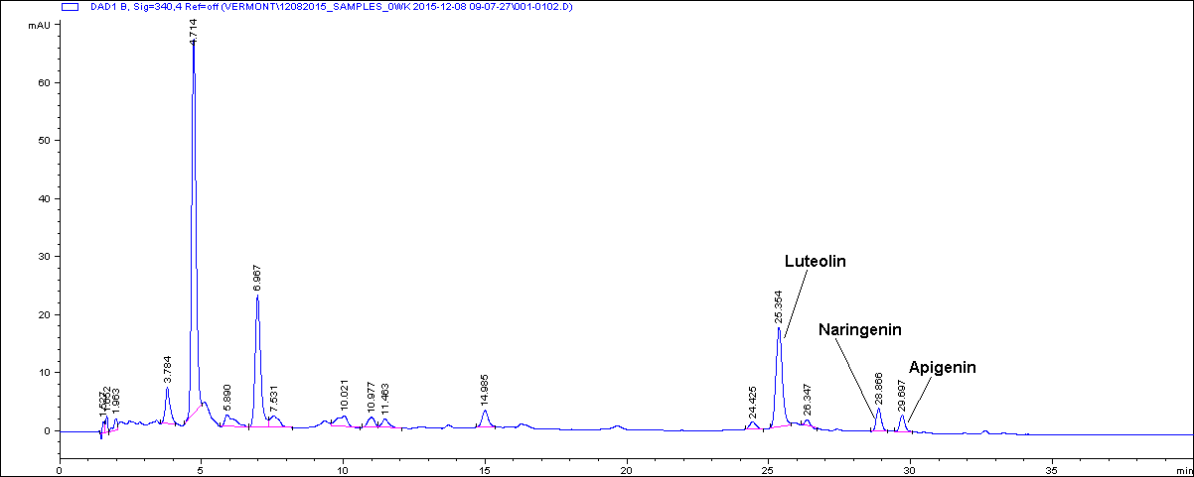




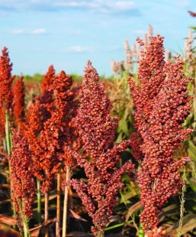
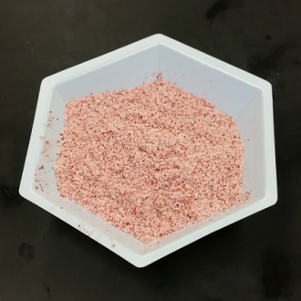
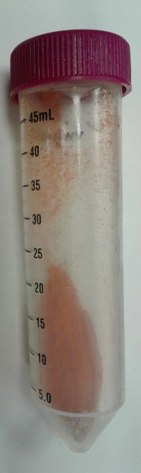
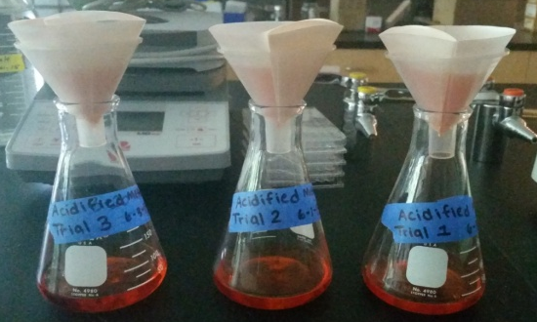
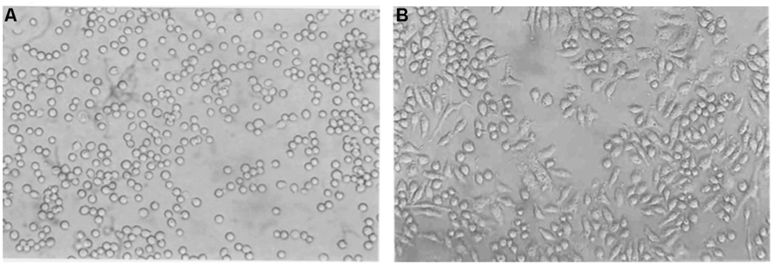
Abstract Red sorghum contains phytochemicals such as 3-deoxyanthocyanidins and flavonoids with reported health benefits. The objective was to determine the chemical composition of sorghum phenolic extracts that were extracted with acidified methanol and separated into co-pigments and anthocyanin fraction by chromatographic procedure. In addition, the ability of sorghum extract to modify activation of the inflammasomes, a macromolecular protein complex involved in several malignancies, was evaluated. The total polyphenols, total flavonoids and total anthocyanins of the sorghum phenolic extract was quantified and phenolic profile was determined by high performance liquid chromatography. The ability to modify the inflammasomes was evaluated using THP-1 human macrophages as an in vitro model. Treatment of sorghum phenolics in lipopolysaccharide-primed and adenosine triphosphate-activated THP-1 human macrophages resulted in reduction in IL-1β and IL-18 secretion. Our study showed the potential of sorghum phenolics to serve as a chemopreventive agent against diseases associated with aberrant activation of the inflammasomes.
Sorghum Phenolic Extracts: Chemical Characterization and Biological Activity Determination
Jordan Bradwell, Philipus Pangloli, Vermont P Dia
Department of Food Science
The University of Tennessee, 2510 River Drive, Knoxville, TN 37996-4591, USA
Introduction
Sorghum is the fifth most produced cereal in the world and contains bioactives with potential health-promoting properties¹.
Anthocyanin are natural pigments responsible for the red, violet, & blue color in fruits and vegetable; they have the potential to be used a natural food colorants².
Flavonoids are polyphenolic health promoting molecules found in many foods; they are known for their ability to modulate cell-signaling pathways³.
Antioxidants are substances that prevent or delay some types of cell damage; their primary purpose is to inhibit oxidation of other molecules⁴ .
Results
Table 1. Bioactive components of sorghum phenolic extracts
Bioactive Amount, mg/g
Anthocyanins 0.00024 ± 0.00004
Flavonoids 13.6 ± 10.1
Polyphenols 102.1 ± 15.8
A) B)
Objectives
The objectives of this study were:
To determine the composition of sorghum phenolic extracts: polyphenols, anthocyanins, & flavonoids.
To analyze the ability if these extracts to modify activation of inflammasomes
LPS, 0.5 µg/mL - + + + +
ATP, 5 mM - - + + +
NLRP3 (110 kDa)
Figure 3: Sorghum phenolic affected the expressions of pro-IL-1β and caspase-1 without affecting NLRP3-ASC inflammasomes components. Bars with different letter(s) are significantly different from each other (P < 0.05, n = 3).
pro-IL-1beta (31 kDa)
caspase-1 (10 kDa)
ASC (22 kDa)
Hypothesis
Sorghum phenolic extract will inhibit activation of the inflammasomes in THP-1 human macrophages through its antioxidant property.
Figure 1. Chromatogram of sorghum phenollics showing the presence of different phytochemicals in the extract. B) Antioxidant activity of sorghum phenolic extract using 2,2-diphenyl-1-picrylhydrazyl (DPPH) assay. As the amount of sorghum phenolic increases, less radical species are evident based on the decreased amount of DPPH present in the sample. Points with different letter are significantly different from each other (P < 0.05, n =8).
Actin (41 kDa)
0 0 0 25 50 µg/mL Sorghum phenolic
- + + + + LPS, 0.5 µg/mL
- - + + + ATP, 5 mM
Materials & Methods
Inflammasomes
A) B)
Conclusions
Sorghum contains phytochemicals with antioxidant activity.
Sorghum phytochemicals are potential inhibitors of inflammasomes activation associated with different chronic diseases.
Sorghum phenolics inhibited inflammasomes activation through the following proposed mechanism.
Sorghum bicolor
Ground sorghum
Extraction for 2h at room temperature using the following solvents: 1% HCl in MeOH, EtOH & Water
Grind samples
Phytochemical Analysis
HPLC
Antioxidant Assay
Filtration of Extracts
Freeze drying
LPS (Exogenous)
Mature IL-1β and IL-18
TLR4
Cell treatment
Pro-IL-1β
Pro-IL-18
Cell supernatant
IL-1β
IL-18
Cell lysates
Western blot for inflammasomes-associated proteins
NF-κB
ROS
NLRP3
ASC
Active Caspase-1
THP-1 human macrophages
LPS, 0.5 µg/mL - + + + +
ATP, 5 mM - - + + +
LPS, 0.5 µg/mL - + + + +
ATP, 5 mM - - + + +
ATP (Endogenous)
NLRP3
ASC
Activation of the inflammasomes was accomplished by 0.5 µg/mL lipopolysaccharide (LPS) and 5 mM adenosine triphosphate in the presence or absence of sorghum phenolic extracts at 25 and 50 µg/mL.
Inflammasome
NLRP3
ASC
Pro-Caspase-1
Figure 2. Sorghum phenolics reduced the production of pro-inflammatory cytokines IL-1β and IL-18 in LPS-primed and ATP-activated THP-1 human macrophages. At 50 µg/mL, sorghum phenolics reduced IL-1β production by 59.7% (A) and IL-18 by 32.0%. Bars with different letter(s) are significantly different from each other (P < 0.05, n = 3).
References
1. de Morais Cardoso et al. Crit. Rev. Fd. Sci Nutr. (2017): 372-390. 2. Dia, Vermont P et al. J. Agric. Food Chem. (2015): 3205-218.
3. Hertog, MG. The Lancet (1993): 1007-011. 4. Young, I S, and J V Woodside. Clin.Pathol. (2000): 45-46.
Data Analysis. Extractions were performed in three independent trials. All assays were done in triplicate. Data were analyzed using SAS Ver 9.4 Proc GLM procedure and Tukey Posthoc Test at P < 0.05.
Acknowledgements
Dr. Angela McClure for providing sorghum samples.

