Slide 1
DataNet: Collaboration, Curation,
and Data in the iSchools:
DataONE
Carol Tenopir
University of Tennessee
ctenopir@utk.edu
iConference 2011
February 9, 2011

Slide 2
Topics
What are appropriate methods to study data practices in the sciences?
How might methods vary when studying data practices in the social sciences and humanities?
What are the challenges for iSchools to participate in large, distributed, virtual collaborations?
How do studies of data practice vary from other kinds of information-related behavior research?
How can selection and collection policies of libraries and archives be adapted to data curation?

Slide 3

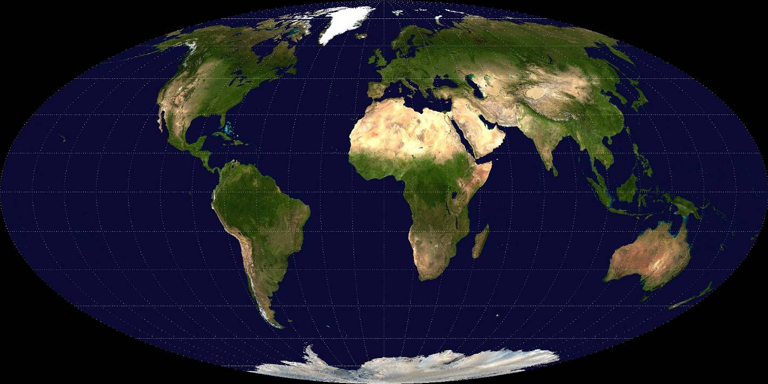

DataONE
(Data Observation Network for Earth)
Sponsored by the National Science Foundation, Division of CyberInfrastructure
P.I., Bill Michener, University Libraries, Univ. New Mexico
Presenter Name
Notes:
First the context of DataONE
…engages diverse partners to meet environmental challenges by providing access, tools and preservation of earth and environmental data.

Slide 4


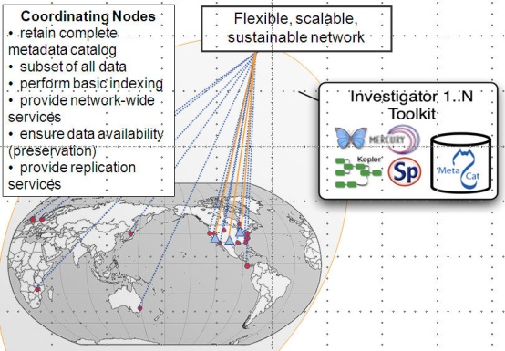


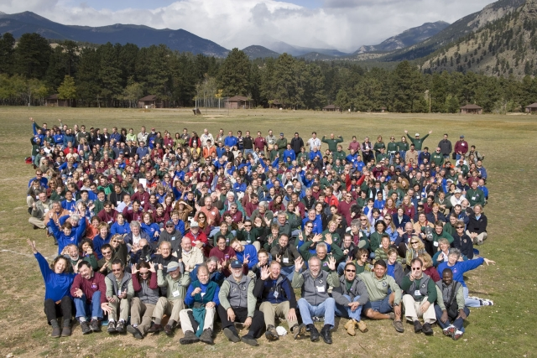



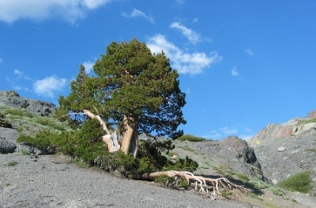

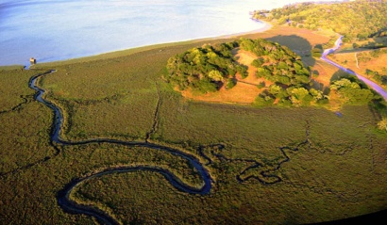

Vision and Mission
Provide universal access to data about life on earth and the environment that sustains it
Build on existing cyberinfrastructure
Create new cyberinfrastructure
Support communities of practice

Slide 5
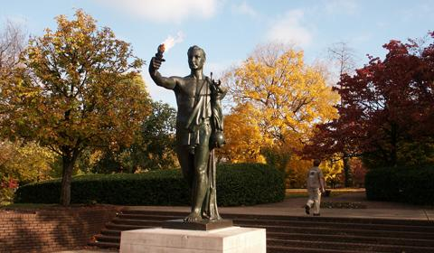
Tennessee DataONE team:
--UT SIS Faculty (Suzie Allard, Carol Tenopir, Bruce Wilson)
--Programmer
--UT Librarians
--3 GRAs
--Post-doc
--IMLS ScienceLinks
doctoral students (6)
--ORNL partners

Slide 6
















Working with diverse partners helps with teaching data practices in the sciences: Practica, courses, research opportunities, guests
Notes:
What are appropriate methods to study data practices in the sciences?

Slide 7
In addition to regular courses…
Environmental Informatics taught by DataONE Co-PI from USGS Center for Biological Informatics
Environmental Information Science developed by team of doctoral students and Post-Docs led by Suzie Allard
Guest lecturers in “Contemporary Issues in STEM Communication and Information”
Notes:
The course will focus on the interdisciplinary field of environmental informatics. When information science encountered the capabilities of computers and telecommunications in the late twentieth century, the discipline of informatics came into being. As does information science, informatics addresses the collection, classification, storage, retrieval, and dissemination of recorded knowledge. Application of computers and telecommunications—especially the Internet and the World Wide Web — to these functions has created new opportunities and new challenges for information management and delivery. And in the natural sciences, information science and computing technology are joined by the relatively new technology of geographic information systems to allow for an even greater depth of knowledge to be stored and applied.
A real world approach, through case studies, class projects, and guest lectures, will be employed to allow the students to experience the challenges facings researchers, land managers, decision makers, information professionals, and policy makers in the area of biological data acquisition, management, and delivery. The emphasis of the class will be on the data and information science aspects of environmental informatics through discussions in the areas of: information life cycle, metadata management, data and information standards, geospatial technologies, web technologies, and project management.

Slide 8
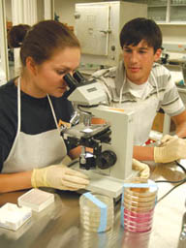

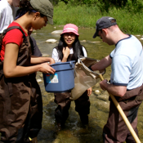
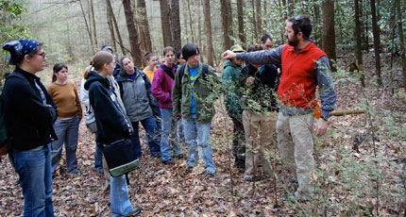
Working directly with scientists…
Notes:
Practica and research opportunities

Slide 9

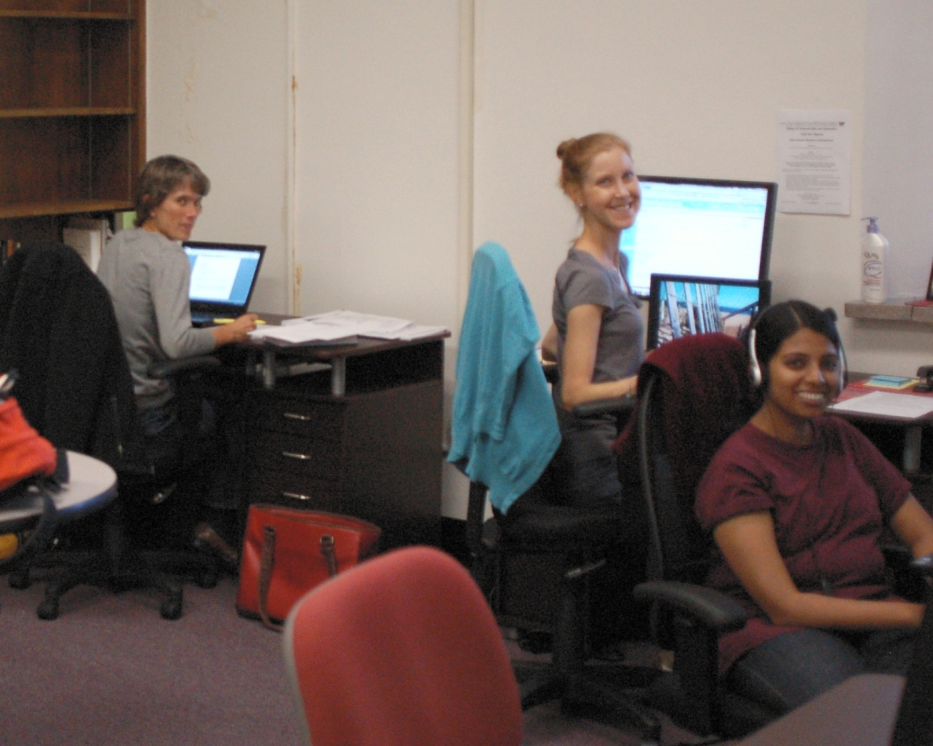
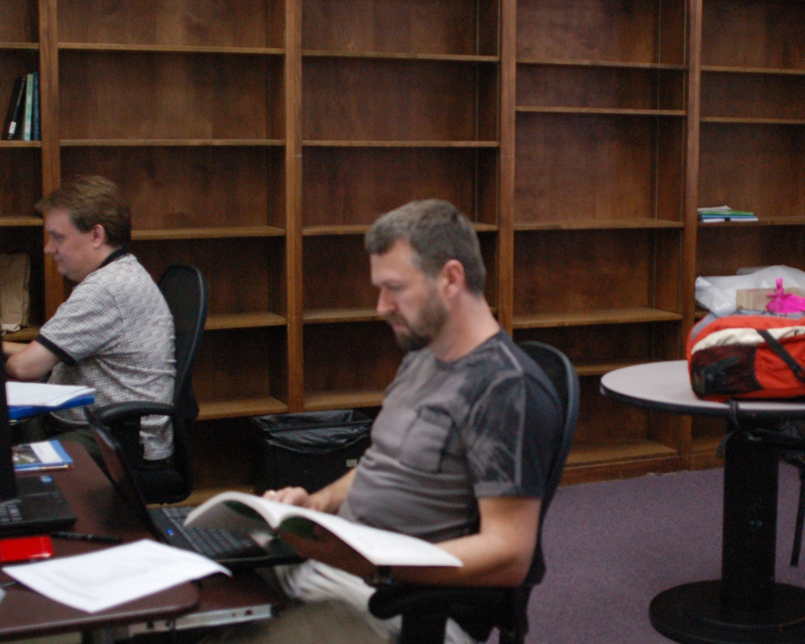


Linking Education and Science to Develop the Next Generation of Educators for Science Librarians and Data, Information and Communication Specialists

Slide 10




Digital Curation Education in Research Centers (DCERC)
Addresses the need for information professionals who can aid scientists in navigating and managing the “digital deluge”
Actively engages students with the current practices and challenges facing scientists

Slide 11


DataONE structure
NSF
External Advisory Committee
DataNet Partners
Principal Investigator
Leadership Team
Executive Director
Director
Development & Operations
DataONE
Office
Director
Community Engagement & Outreach
R&D
CI Operations
Core CI Team
R&D
Operations
DIUG
Education and Outreach Team
Federated security
Sociocultural barriers to data sharing and preservation
Distributed storage
Data preservation, metadata, and interoperability
Community engagement and education
Citizen science and public outreach
Scientific workflows
Long-term sustainability and governance
Data integration and semantics
Exploration, Visualization, Analysis
Exploration, Visualization, Analysis
Usability and assessment
Usability and assessment
Cyberinfrastructure & Research Working Groups
Engagement & Research Working Groups
Notes:
How do studies of data practice vary from other kinds of information-related behavior research?

Slide 12
Assessments (baseline and ongoing) …
… identify the current state of data needs, practices, knowledge of standards, and motivations regarding data collection, access, and preservation to identify how DataONE can help and to measure changes over time
GOOD PRACTICES
TIME

Slide 13
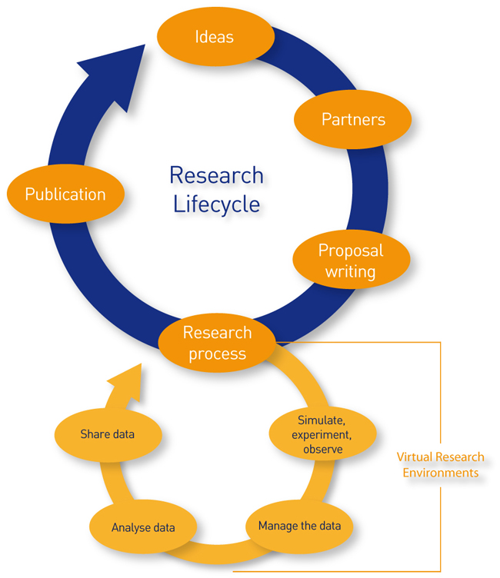
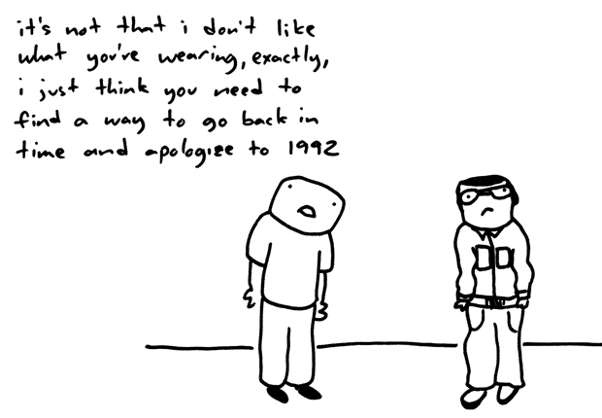
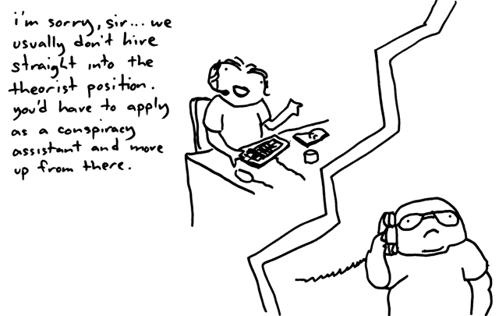
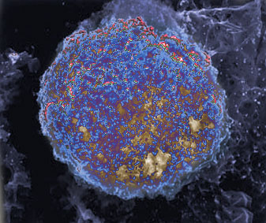
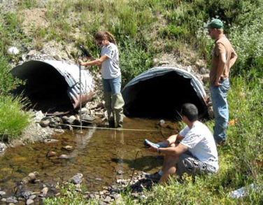
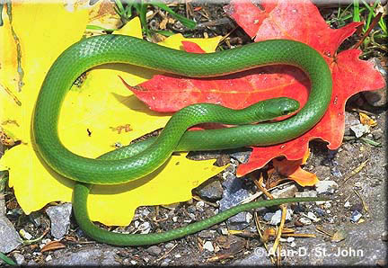
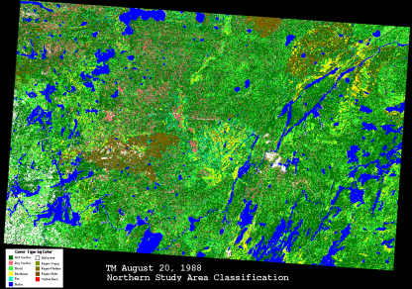
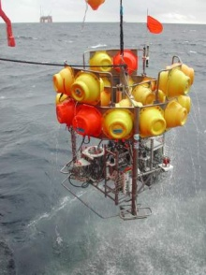
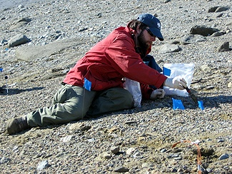
Personas, Scenarios, Use Cases…
Notes:
In a discipline such as science data management that is now building and changing it is particularly important to use information science research methods and those that focus on workflows, research and data lifecyle and scientists’ needs, perceptions, and behaviors. Personas, scenarios, use cases inform both cyberinfrastructure and community engagement

Slide 14
IS Challenges
Recruiting students with a science background
Data managers: specialized science domain vs. generalized info science and matching that with jobs
Collaboration with diverse partners
Notes:
The first is by far the biggest challenge.

