Slide 1

DataONE and USGS
Mike Frame, Sub-group lead
DataONE UA Working Group Meeting
May 1-3, 2012

Slide 2

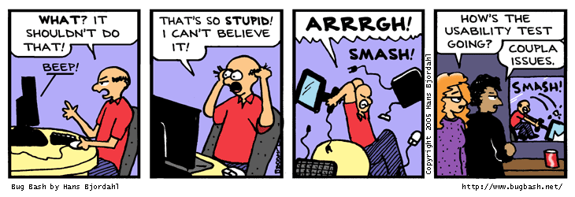
Usability Testing Sub Group
1. Usability Strategy for the coming Year
  What are we going to test
  Who will participate
  Who will we test
  When
  How
2. Development of Questions, Script, Approach
3. Perform UA Analysis

Slide 3
Possible Schedule
Tuesday Afternoon
Development of General UA Strategy; Script/Questions
Wednesday Morning
8:30 – 10:30 Script refinement, development
11:00 – 1:30 – UA Testing
Wednesday Afternoon
1:30 – 5:00 UA Testing
Thursday Morning
8:30 – 11:00 Summarization/Results Write-up

Slide 4
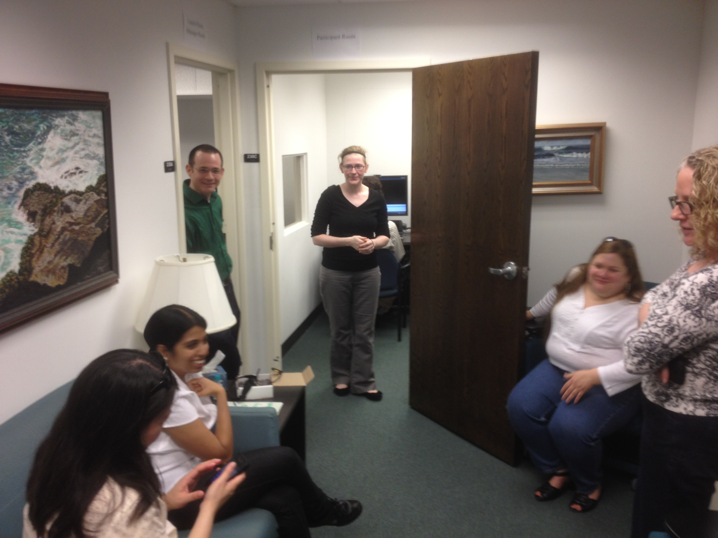
Report out to the entire UA/SOCIO Group

Slide 5
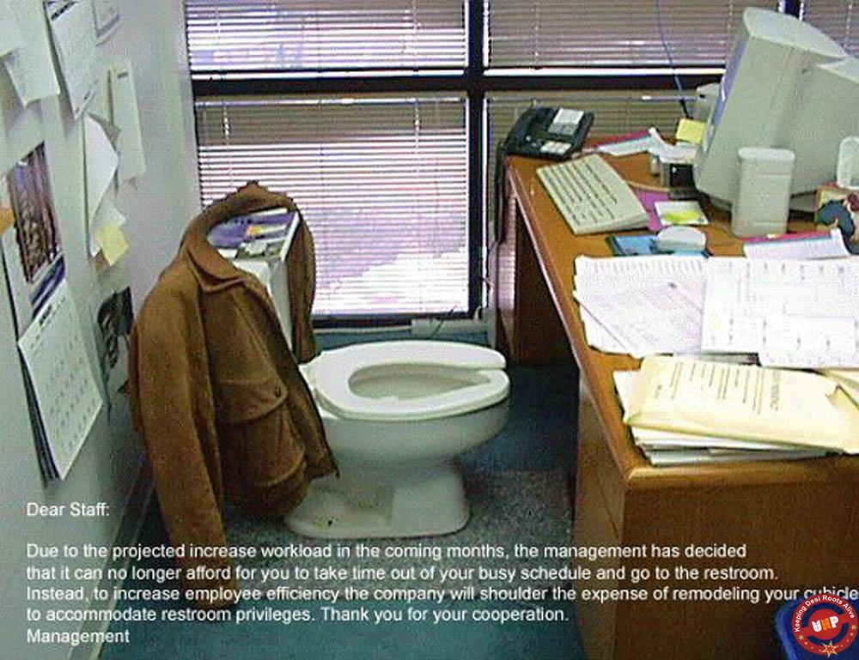
No breaks Allowed

Slide 6
Usability Testing Sub group
Major Activities:
Heuristic Analysis of DataONE.org & ONEMercury
Usability Analysis Strategy for coming year
Usability test/script questions, approach, possible venues

Slide 7
Heuristic Evaluation: dataone.org
High Priority Issues (address pre-usability testing)
Search this site / ONEMercury search
  “search this site” implies searching EVERYTHING
  Text box search with search site/search data needed
Consistency of navigation: home page vs rest of site
Inconsistent use of color text for hyperlinks vs headers
ONEMercury promo on homepage: no indication that it’s a search tool

Slide 8
Heuristic Evaluation: dataone.org
Medium Priority Issues (likely will be a focus during usability testing)
“Products” category – implies DataONE authorship; really Products and Resources
Reusability of best practices and education modules
  Consider offering these as rich text for printing and incorporation in other resources
Problematic access to Software Tools and Best Practices
  Too many access options
  Offer inconsistent levels of access
  Tagging inconsistencies
For discussion: utility/relevance of some tools to DataONE community; logos can imply promotion or relationships with vendors

Slide 9
Heuristic Evaluation: ONEMercury
High Priority Issues (address pre-usability testing)
Branding changes from dataone.org to ONEMercury
  Retain DataONE identity in upper left logo
  ONEMercury needs a tagline to state explicitly that it’s a science data search (as do other DataONE products)
  Nav from dataone.org site at top is confusing (appears to user to be ONEMercury nav), should be removed
    Hyperlink DataONE lgoo to go to dataone.org home
    Consider adding “back to DataONE Web site” link

Slide 10
Heuristic Evaluation: ONEMercury
High Priority Issues (address pre-usability testing)
SEARCH button needs to be added at bottom of page as well as top
Results page filters push results lower on page.
  Toggle filters visible/hide (like simple/advanced search) to increase default real estate?
  Move Return to Search to upper left, stretch pagination and sort options
Results content needs to be left-justified
Clarity of filter labels Originator, Author, Member Nodes, Data Providers for non-DataONE users

Slide 11
Heuristic Evaluation: ONEMercury
High Priority Issues (address pre-usability testing)
Sort operations are ambiguous
  Are they being used/useful?
  Date Range: isn’t it really start date?
  Source: organization? Member node?
  Add hover tags to explain labels
Help file is from last iteration of ONEMercury

Slide 12
UA Strategy for the Year
Philosophy:
  Iterative UA Testing
  Perform at major conferences
  Development of framework for other DataONE Tools
  Share Findings across DataONE

Slide 13
Approach to UA Testing
Visited the UT Usability Lab
Reviewed Scientist & Data Manager Assessment
Considered Personas when developing UA test
Developed questions related to:
Pre-questionnaire
UA Assessment/script
Post questionnaire

Slide 14
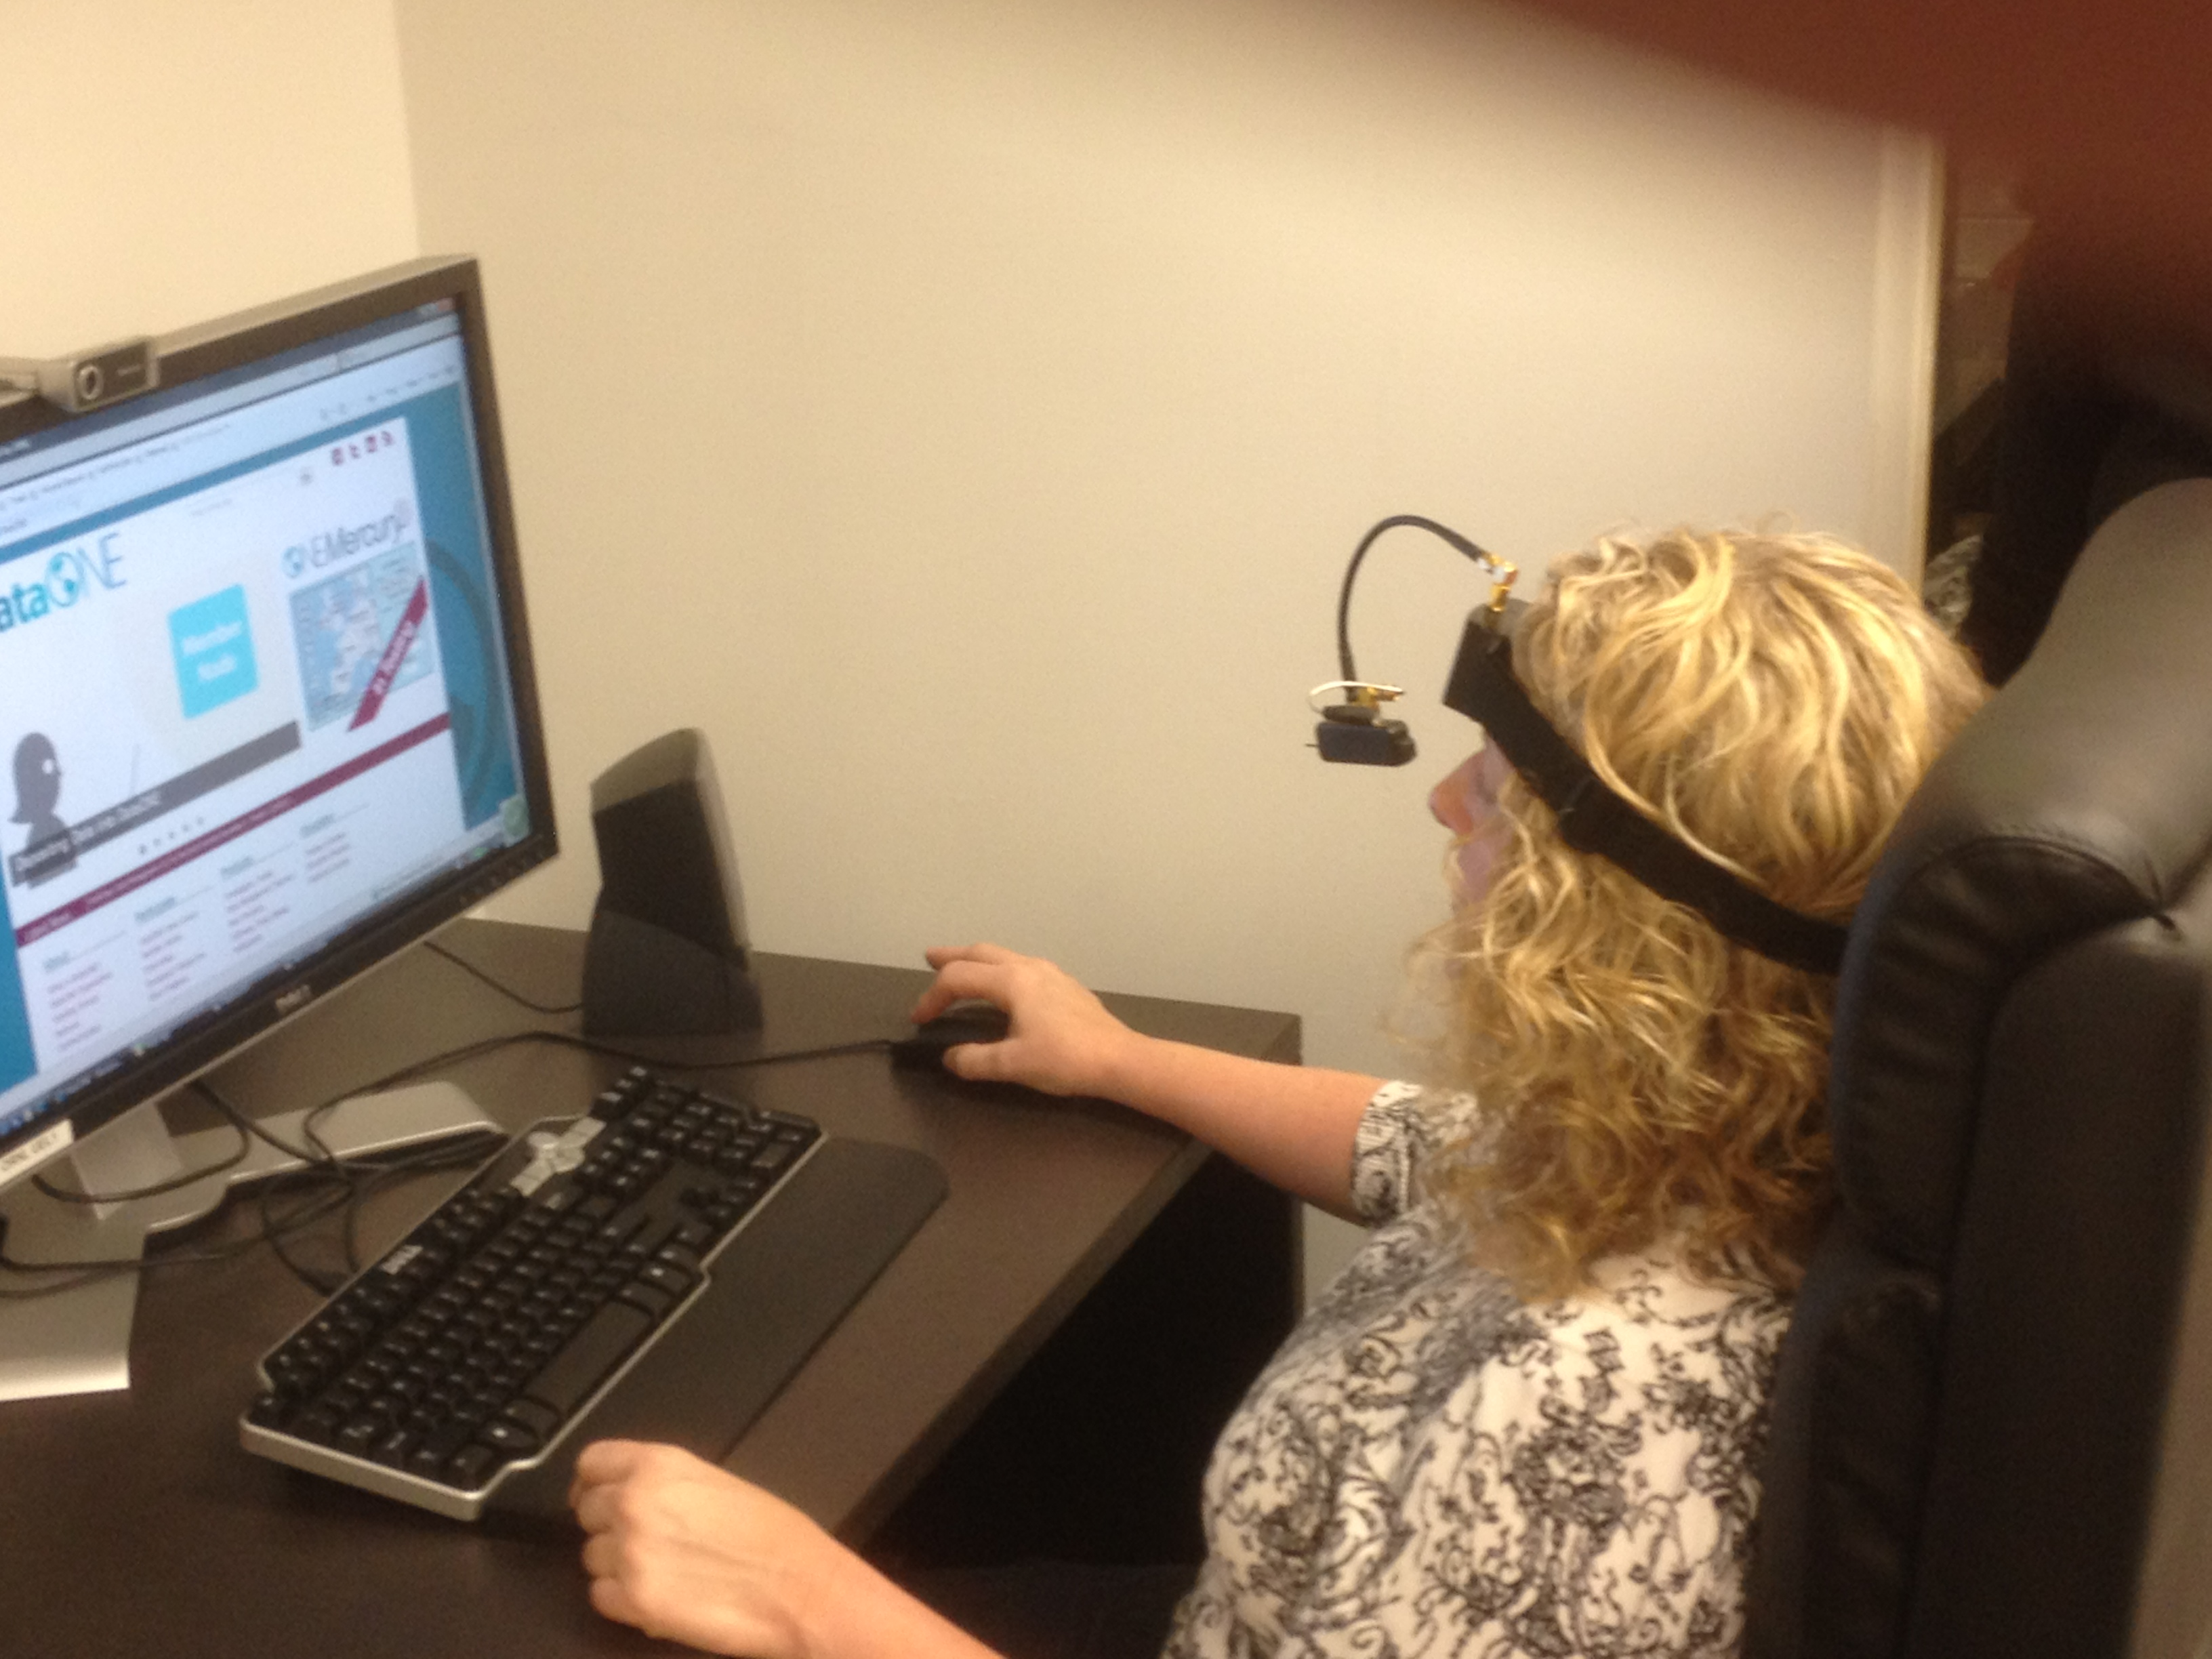
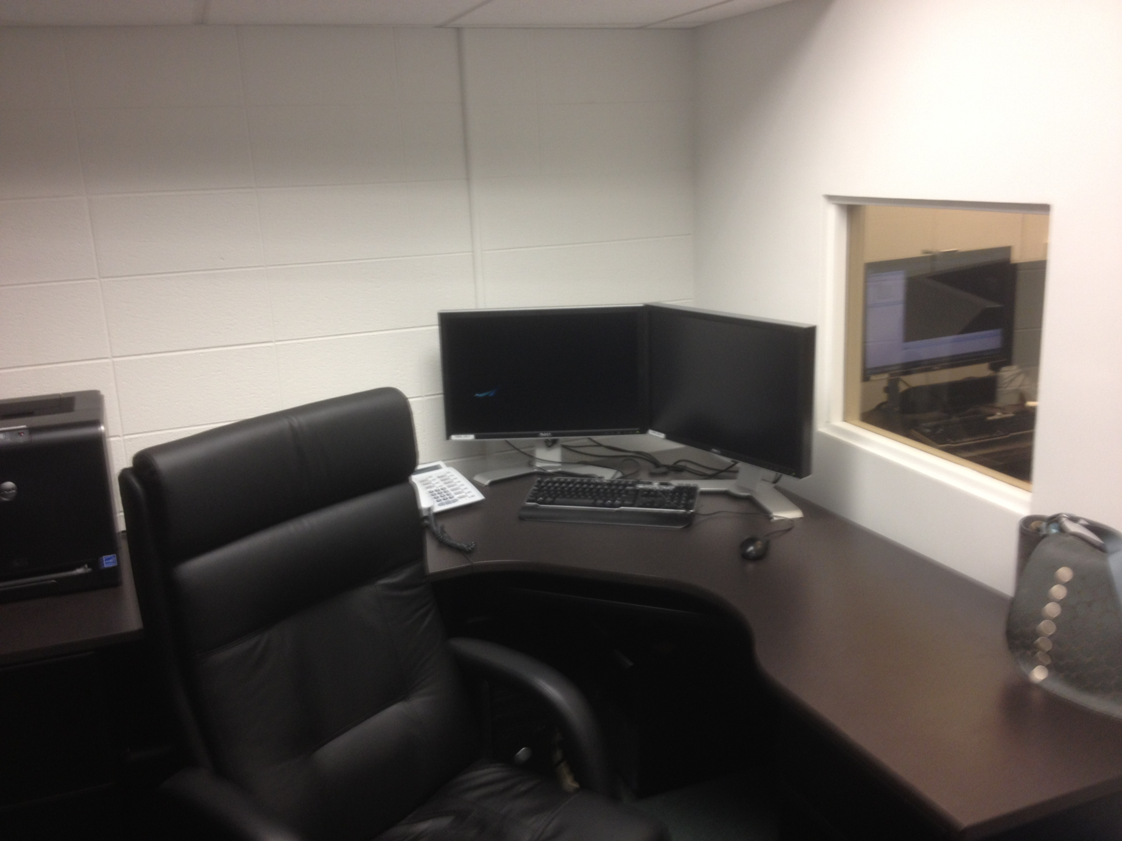
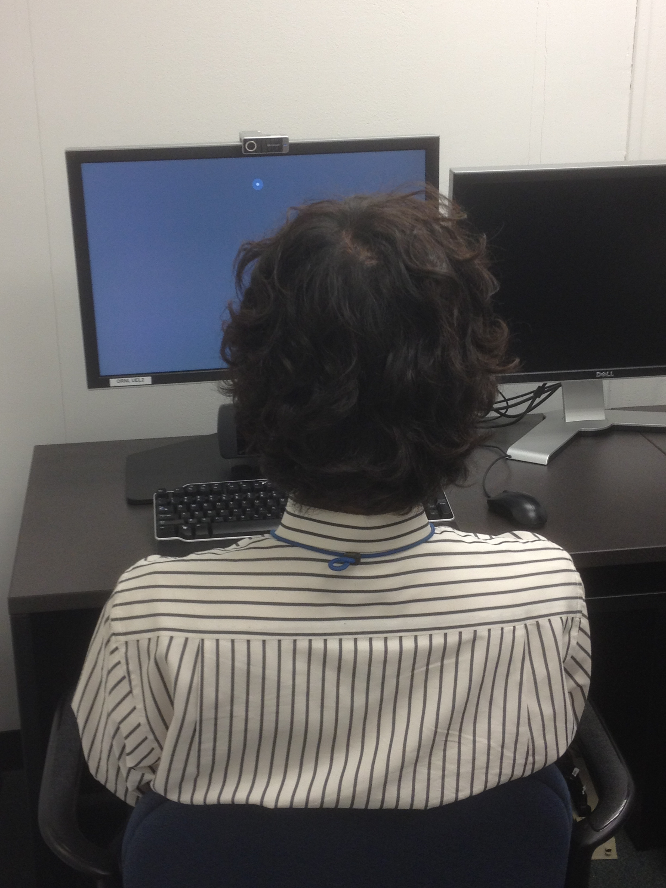
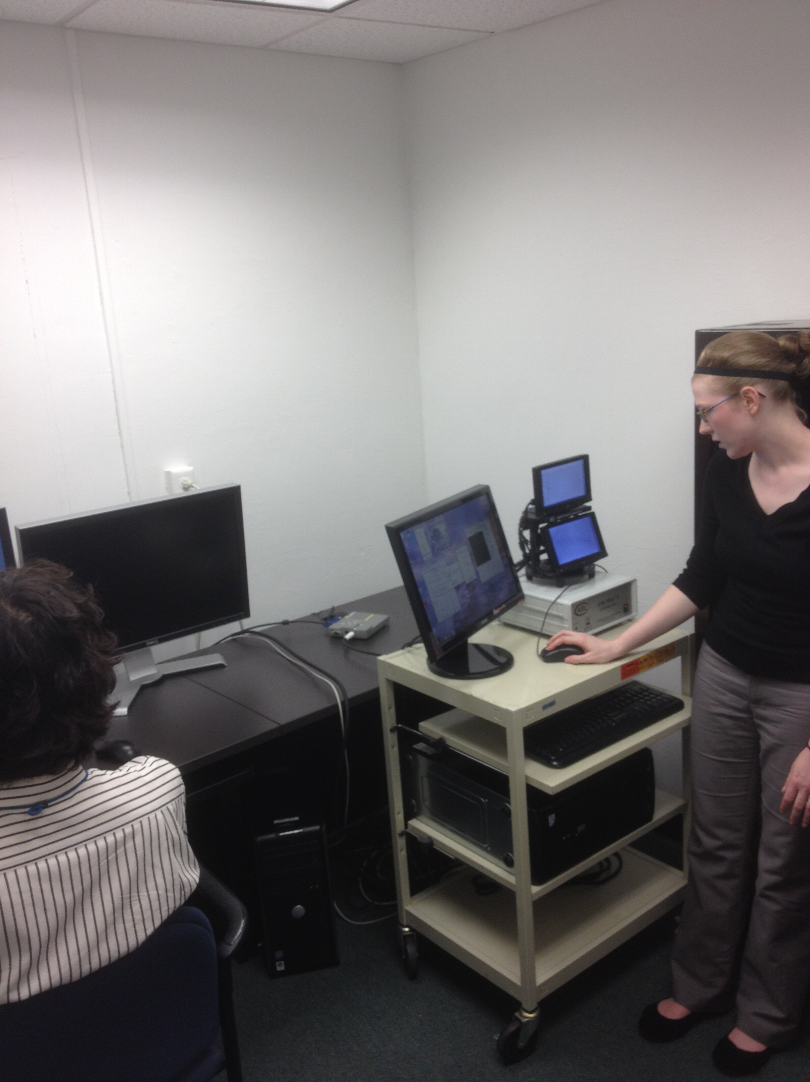
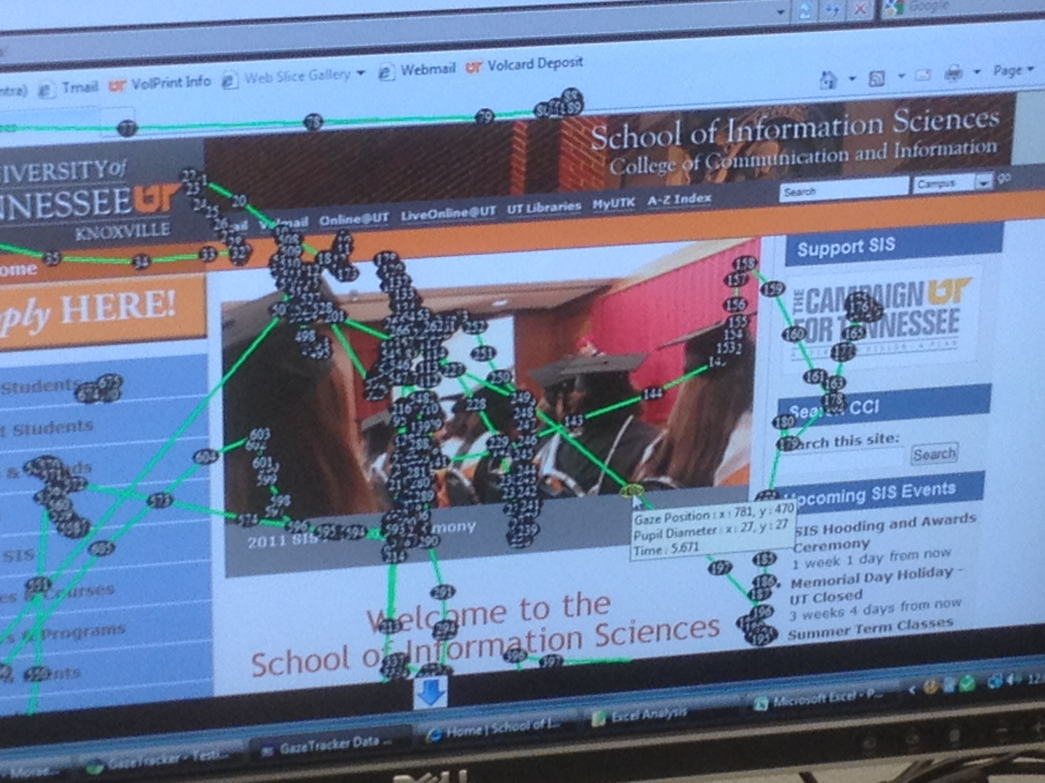
UT Usability Lab

Slide 15
Usability Testing Strategy – Round 1
DataONE, ONEMercury
UA Testing at DUG/ESIP
ESIP community email
14/16 available slots
30 minute per person
Will use MORAE
Will do “Think Aloud”
Incentives will be offered
UA Testing in Future
Fall/Summer Semester – Graduate testing with Eye Tracking
Conference in 2013 – Eye Tracking

Slide 16
UA Questions

Slide 17
UA Questions

Slide 18
UA Testing at DUG/ESIP - Timeline
May/June – finalize test scripts, approach, coordinate with DUG/ESIP
July – Actual Testing
August – November – Data Analysis & Summaries
September – Present initial analysis results at AHM

Slide 19
Possible other UA Testing Venues
DataONE DUG/ESIP - July 15 -20, 2012
ESA - August 5-10 2012
AGU - December 3-7 2012
ASIS&T - October 26-31st 2012
ALA Midwinter - January 25-29, 2013 (Seattle)
AAAS - February 14-18 2013
ACRL - April 10-13, 2013 (Indianapolis)

Slide 20
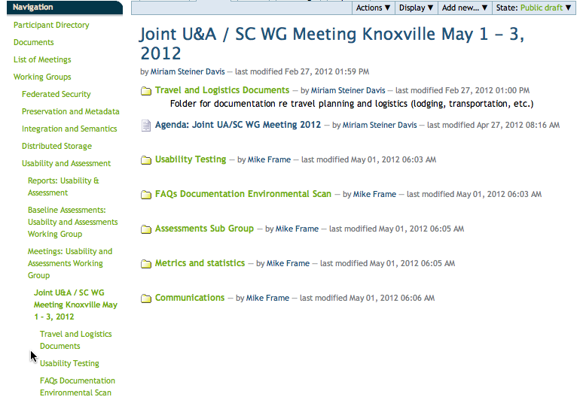
Lessons Learned
Awareness of Past efforts, documents, expertise
Communications across Working Groups
Managing Expectations
Usability approach will be iterative
Joint Working Groups sessions are effective
Tracking of requests/improvements
Process for address Conflicting Input between CE/CI
Breaking down silos
Coordination between Assessments & Usability is a must
Review Progress of all CE Groups – relationships, overlaps, joint activities, etc.

