Slide 1



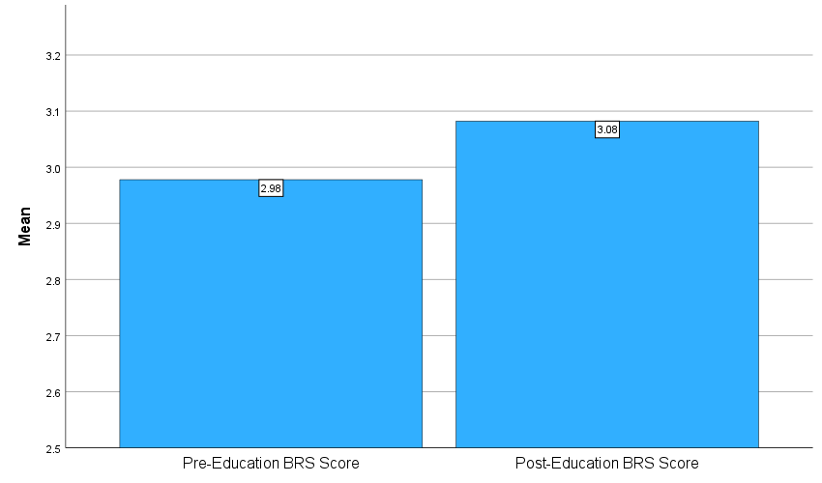


56.41% of individuals had an increased BRS score within three months of receiving resiliency skills education.
Utilizing Non-Pharmacological Interventions to Increase Resilience
Laura Kate Inman, BSN, RN & Allyson Neal, DNP, PNP, PMHNP
BACKGROUND
INTERVENTIONS
Resilience is the psychobiological capacity to respond/adapt to life events, manage psychological effects of life events, and return to a healthy state of mind. The Brief Resilience Scale (BRS) is a tool for assessing resiliency. The mobile mental healthcare clinic’s patients were not receiving resiliency screening. To address this, the provider implemented the BRS and resilience education.
BRS was implemented to assess pre- and post-education resilience scores.
Patients were educated on resilience, how to increase it, and given handouts with this education.
Non-pharmacological changes included yoga/exercise, volunteering, joining groups, journaling, sleep, eating healthily, meditation, guided imagery, and prayer.
LOCAL PROBLEM
A mobile mental healthcare clinic lacked resilience assessment. To address this, the BRS was implemented. There was a total of 48 participants.
Purpose: Screen for resilience, educate on non-pharmacological ways to increase resilience, and rescreen within three months to determine education efficacy.
Aim: By January 12, 2025, 80% of individuals screened for resilience will have an increased resilience score at the follow-up appointment at the project site.
Goal: To influence providers to implement resilience screening and education.
RESULTS
There were 48 participants, with 39 participants aged 19-75 included in analysis. Mean pre-education BRS of 2.98 increased 3.08 within three months post-education.
CONCLUSIONS
METHODS
Implementation of resilience education yielded statistically/clinically significance difference in BRS scores.
Psychoeducation improves outcomes. Providers should consider integrating resiliency education.
Next steps are continued patient education via provider and advocacy for further research on resilience patient education.
Iowa Model and Plan-Do-Study-Act (PDSA) cycles were used.
BRS scores were evaluated initially and within three-month follow-up. After baseline screenings, patients were educated on resilience, how to increase it, and given handouts with this education.
Specific/outcome measure variables were pre- and post- education scores.
Paired sample T-test determined statistical significance.
ACKNOWLEDGEMENTS/FUNDING DISCLOSURE:
If you would like to thank anyone for their support (i.e., the project site staff, etc.) or received funding state it here

