Slide 1
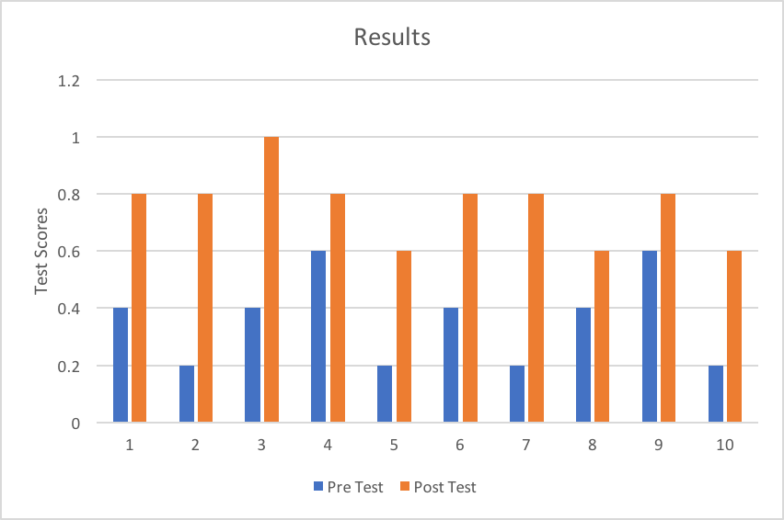

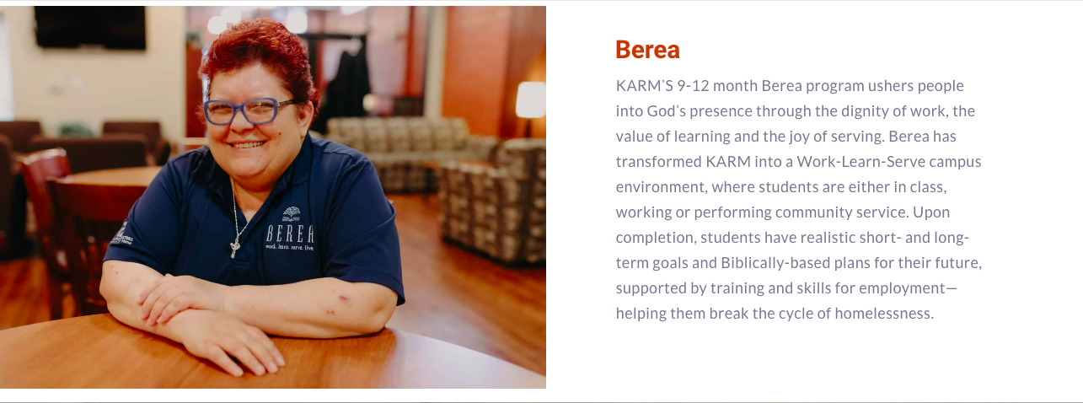
Health Education For the Homeless
Courtney McCarty
University of Tennessee, College of Nursing
Mentor: Dr. Freddie Kojima
Knoxville Area Rescue ministries (KARM) manager Ms. Marylin Gibbs
Purpose:
To evaluate the effectiveness that the information pamphlets had on enhancing health education within the homeless population, after having one day to study and learn.
Introduction:
- Homelessness is one of the most vulnerable populations in our community
- Many of these people struggling with homelessness lack the access and understanding of health care.
- Because of poor living conditions and limited access to healthcare systems, homeless persons are exposed to many communicable infections
- “Implementing efficient strategies to survey and prevent the spread of communicable infections among the homeless is a public health priority” (Badiaga, 2008).
- Knoxville Area Rescue Ministries (KARM) is a homeless shelter that not only focuses on providing basic life needs, but also provides opportunities for their members to grow as individuals and gain knowledge that will help them to reintegrate as working individuals into society. And it is here that I implemented my project.
Methods:
Pre and post test
10 Berea Students from KARM
Pre test about Hepatitis and MRSA
Each student was given a pamphlet about Hepatitis (A-E) and MRSA
Given one day with the pamphlets to look over and learn the information
Post test given the next day
5 questions (same questions each time)
Outcomes were measured by the number of questions answered correctly
Conclusion:
Most of the homeless population lack proper health education about Hepatitis and MRSA.
“Homelessness is associated with numerous behavioral, social, and environmental risks that expose persons to many communicable infections, which may spread among the homeless and lead to outbreaks that can become serious public health concerns” (Badiaga, 2008).
With more people willing to work with this population, we can not only help this individual community, but we can help better protect the nation as a whole.
Badiaga, Sékéné, et al. “Preventing and Controlling Emerging and Reemerging Transmissible Diseases in the Homeless.” Emerging Infectious Diseases, Centers for Disease Control and Prevention, Sept. 2008, www.ncbi.nlm.nih.gov/pmc/articles/PMC2603102/.
Health Quality Ontario. “Interventions to Improve Access to Primary Care for People Who Are Homeless: A Systematic Review.” Ontario Health Technology Assessment Series, Medical Advisory Secretariat, 1 Apr. 2016, www.ncbi.nlm.nih.gov/pmc/articles/PMC4832090/.
“Access to Health Services.” Access to Health Services | Healthy People 2020, www.healthypeople.gov/2020/topics-objectives/topic/social-determinants-health/interventions-resources/access-to-health.

