Slide 1





Research Data Services in European University Libraries:
Current Offerings and Plans for the Future
Carol Tenopir
University of Tennessee
and
Hanken School of Economics
ctenopir@utk.edu

Slide 2


Academic Year 2016-2017
A bit about me…

Slide 3
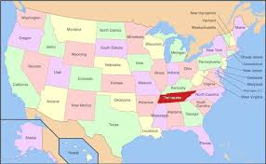
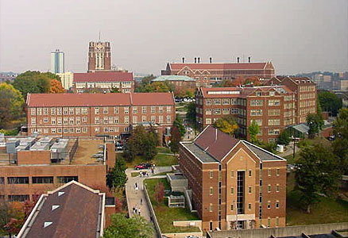
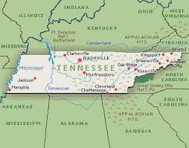


University of Tennessee, Knoxville

Slide 4


DataONE Usability & Assessment Working Group: Assess the needs and motivations of various stakeholders for science data. (dataone.org)
Working Group on Scientific Information Infrastructures: …collects good practices and lessons learned in the area of research data management in libraries.
Notes:
DataONE mission: Enable new science and knowledge creation through universal access to data about life on earth and the environment that sustains it. (dataone.org)
WG: collects good practices and lessons learned in the area of research data management in libraries. The Working Group collaborates with other initiatives to evaluate and support skills development.

Slide 5
Research Data Services are…
…services that address the full data lifecycle, including the data management plan, digital curation (selection, preservation, maintenance, and archiving), and metadata creation and conversion.

Slide 6
Data Lifecycle
Collect
Discover
Integrate
Analyze
Plan
Assure
Preserve
Describe

Slide 7

Library Challenges
Level of my knowledge & skills ?
DMP tools?
Collect
Preserve
Discover
Integrate
Analyze
Plan
Assure
Describe
Level of participation with data?
Partnering with researcher?
What to do about metadata?
Is there a repository for data?
Develop tools for data discovery?
Stewardship role (select & deselect)?
How to ensure preservation?
Notes:
Librarians also have questions about their role. We wanted to find out, through Academic university librarian survey
Do academic librarians have the background, skills and education to provide RDS?
What are librarian attitudes regarding the importance of RDS?
What factors contribute to or inhibit engagement of librarians in RDS?

Slide 8
Research Data Services are…
…services that address the full data lifecycle, including the data management plan, digital curation (selection, preservation, maintenance, and archiving), and metadata creation and conversion.
Services can be informational or technical

Slide 9
Informational/Advisory RDS
Collaboration and outreach
Policy development and planning
Discussing RDS with others
Reference for finding and citing data
Creating web guides and finding aids
Directly participating on a project
Consulting on DMPs and metadata
Training co-workers on data issues
Notes:
Standards for metadata or data

Slide 10
Technical RDS
Providing tech support for RDS systems/data repositories
Identifying datasets for deposit in repositories
Preparing datasets for deposit
Deselecting datasets for removal from a repository
Creating or transforming metadata

Slide 11

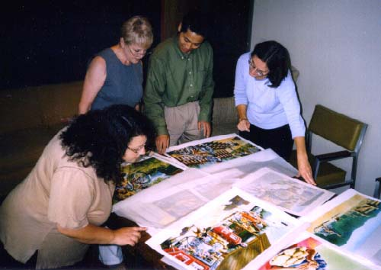
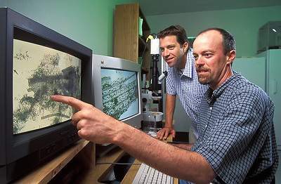

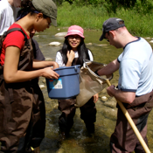
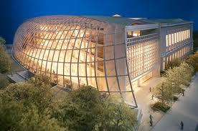

Assessment of Stakeholders
Public Officials
Publishers
Data Managers
Citizen-scientists
Libraries
& Librarians
Scientists
Students
& Teachers

Slide 12
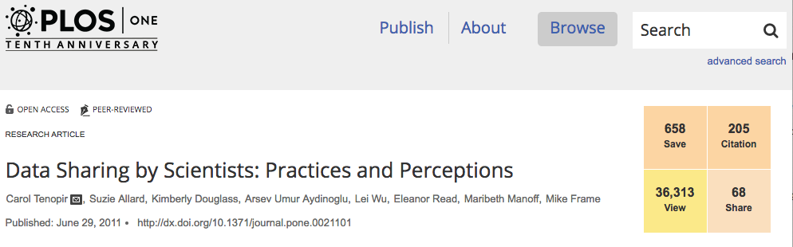
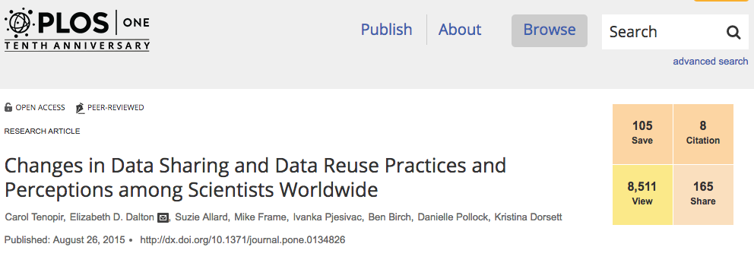
We are learning about Scientists
1st Scientist Survey (2011)
Views: 36, 313
Citations: 205
Shares: 68
(published Jun 2011)
2nd Scientist Survey (2015)
Views: 8,511
Citations: 8
Shares: 165
(published Aug 2015)
Notes:
Update al metrics?

Slide 13
Results of DataONE scientists surveys show opportunities for universities and libraries…

Slide 14
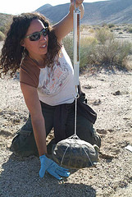
Researchers might…
Plan
Analyze
Collect
Integrate
Assure
Discover
Describe
Preserve
Notes:
But stakeholders don’t always follow all. Researchers, for example, may be focused on collecting and analyzing; so this is a key stakeholder group and I’ll give just a few highlights of the original survey of scientists.
Personas are a representation of the objectives and behavior of a real group of users; DataONE working group members created these fictional representations by synthesizing data collected from users, particularly from surveys. DataONE WG members also used nterviews collected by researchers in the Digital Curaiton Profiles project at Purdue and UIUC. Creating these personas was actually a means of engagement & collaboration.
Scenarios differ from personas because they are focused on the context and process of an activity rather than on the individual engaged in the activity. We create these narratives to describe the expected flow of an activity based on the characteristics of the researcher when it was aligned with the information lifecycle. Scenarios are projections of expected behaviors to portray user behavior with respect to the system interface and represent the workflow indicating usage of a product by the users in a real life situation.
Here is an example of an early career field scientist where the current data practices are in blue and pink represents the places in the data lifecycle that can be augmented by tools or infrastructure from DataONE.

Slide 15
What metadata do you currently use to describe your data? (2014-2015)
Notes:
Just one place beyond the decimal and correct DC to 7.1 and open GIS to 7.2
2014/15

Slide 16
Most are willing to share at least some data…
I am willing to:
Notes:
Delete date in captions just (n=609) and (n=623)
2014/15

Slide 17
Gap between willingness to share and accessibility
  Although 80% of scientists agree “I share my data”
  Only 46% agree “Others can access my data easily”
Notes:
n=743; 2014-15

Slide 18
Barriers for scientists
Notes:
2014/15

Slide 19
However, lack of access to data …
… is a major impediment to progress in science
75% agree or strongly agree.
… has restricted my ability to answer scientific questions
53% agree or strongly agree.
Notes:
Impediment to progress to science: M=4
Restricted my ability to answer scientific questions: M=3.4

Slide 20
Libraries…
Facilitate interdisciplinary work and data knowledge through collections and services
Understand metadata
Know how to find information about data
In partnership with other administrative units can take a leadership role in a variety of research data services
Carol Tenopir

Slide 21

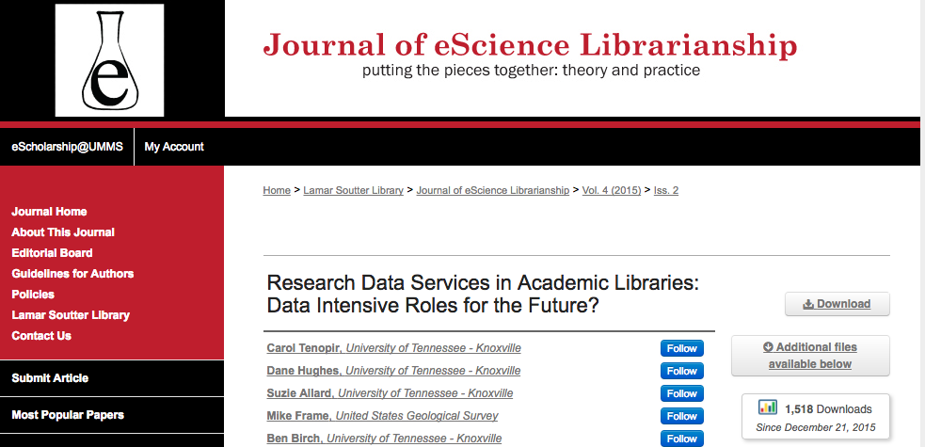
European Survey Builds on Previous DataONE Library Surveys
1st Library (2012)
Citations: 82
(published June 2012)
2nd Library (2015)
Citations: 11
1,518 downloads
(published Dec 2015)
Notes:
Update alt metrics

Slide 22

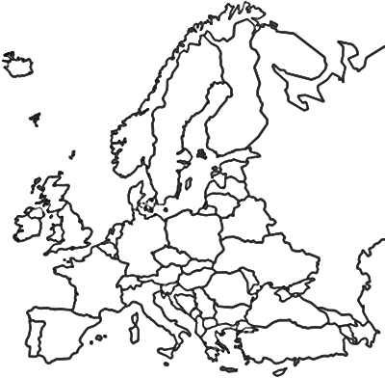
LIBER Survey of European Academic Research Libraries: 2016-2017
Survey Respondents
LIBER Academic Library Membership
North: 19%
North: 15%
West: 51%
West: 53%
East: 17%
East: 16%
South: 13%
South: 17%
Notes:
n=119; (answered both a demographic & analysis questions) n=109 answered by country
West: 51% North: 19% East: 17% South: 13%
n=333 (LIBER pop)
West: 177 (53.1%) East: 52 (15.6%) North: 49 (14.7%) South: 55 (16.5%)

Slide 23
Key Findings
LIBER academic libraries offer a range of Research Data Services, but…
2. Consultative RDS are most common (fewer libraries offer technical RDS)
3. Libraries use a variety of strategies for developing staff skills

Slide 24
1) LIBER academic libraries offer a range of Research Data Services

Slide 25
RDS offered by most libraries currently
Consultative
Consultative
Consultative
Consultative
Consultative
Consultative
Notes:
*yes only responses*
Outreach/collaboration with other RDS providers (n=107)
Consulting on data and metadata standards (n=105)
Consulting on data mgt plans (n=107)
Training colleagues on RDS (n=95)
Involved in policy development/planning (n=95)
Discussing RDS with others (n=95)

Slide 26
RDS offered continued
Technical
Consultative
Consultative
Consultative
Technical
Notes:
*Yes only*
ID datasets (n=106)
Direct participation with researchers (n=94)
Creating web guides (n=100)
Providing tech support for finding/citing data (n=101)
Providing ref. support for RDS (n=101)

Slide 27
2) Consultative are more commonly offered than technical RDS

Slide 28
Currently offered and future plans for consultative-type services
Notes:
Outreach/collaboration with other RDS providers (n=107)
Consulting on data and metadata standards (n=105)
Consulting on data mgt plans (n=107)
Training colleagues on RDS (n=95)
Involved in policy development/planning (n=95)
Discussing RDS with others (n=95)
Creating web guides (n=100)
Provide reference support (n=101)
Direct participation with researchers (n=94)

Slide 29
Currently offered and future plans for technical-type services
Notes:
Providing technical support (n=101)
Preparing data/sets for deposit (n=100)
ID data (n=106)
Create/transform metadata (n=103)
Deaccession of data (n=97)

Slide 30


We also know…
There is great variation between libraries
Some universities and some countries within a region are ahead in RDS

Slide 31
3) Libraries have a variety of strategies for developing staff skills

Slide 32
Have you hired staff for RDS in the last 12 months?
Notes:
n=85

Slide 33
Has your library provided opportunities for library staff to develop skills related to RDS?
Notes:
n=87

Slide 34
Which of the following opportunities has your library provided for library staff to develop skills related to RDS?
Notes:
n=87
Collaboration with others with skills related to RDS (n=8)
In-house staff workshops (n=41)
Support for staff to join working groups related to RDS (n=51)
Support for staff to take courses related to RDS (n=52)
Support for staff to attend conferences/workshops (n=68)

Slide 35
Staff Skills Development
Dramatically increase the workload of some poor individual librarian
Collaborated with another institution to develop a skills-based MOOC
Moved staff from other support unit [ITS]
Strategies
Hired staff for projects (not permanent)
Refocused an existing role

Slide 36




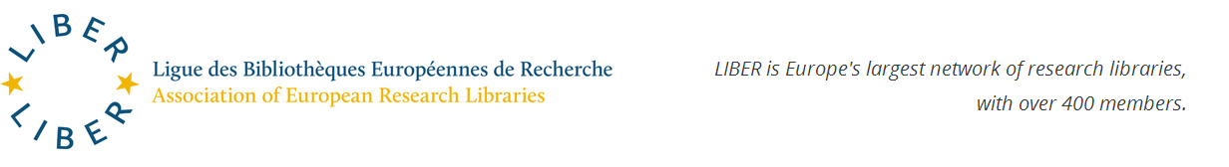
Assistance with training
http://datalib.edina.ac.uk/mantra/
Working Group on Scientific Information Infrastructures
Notes:
The FOSTER portal is an e-learning platform that brings together the best training resources for those who need to know more about Open Science, or who need to develop strategies and skills for implementing Open Science practices in their daily workflows. Here you will find a growing collection of training materials to meet the needs of many different users, from early-career researchers, to data managers, librarians, funders, and graduate schools. FOSTER (Facilitate Open Science Training for European Research) is a 2-year, EU-Funded (FP7) project, carried out by 13 partners across 8 countries. The primary aim is to produce a European-wide training programme that will help researchers, postgraduate students, librarians and other stakeholders to incorporate Open Access approaches into their existing research methodologies.

Slide 37
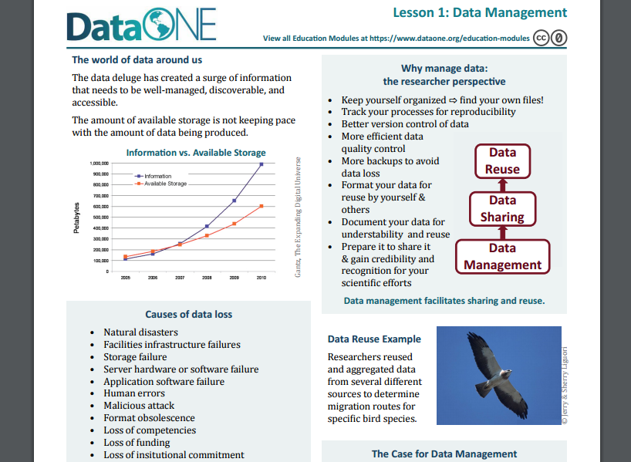
Tools for RDS Education and Assistance
https://www.dataone.org/education-modules

Slide 38
DataONE Education Modules
Why Data Management
Data Sharing
Data Management Planning
Data Entry and Manipulation
Data Quality Control and Assurance
Protecting Your Data
Metadata
How to Write Quality Metadata
Data Citation
Analysis and Workflows
Legal and Policy Issues

Slide 39
Thanks to the LIBER Study Team!
Research Data Services in European Academic Research Libraries. https://www.liberquarterly.eu/articles/10.18352/lq.10180/
Carol Tenopir-University of Tennessee
Sanna Talja-University of Tampere
Wolfram Horstmann-University of Gottingen
Birgit Schmidt-University of Gottingen
Elina Late-University of Tampere
Lynn Baird- University of Idaho
Robert Sandusky- University of Illinois-Chicago
Suzie Allard-University of Tennessee
Dane Hughes-University of Tennessee
Danielle Pollock-University of Tennessee

