Slide 1

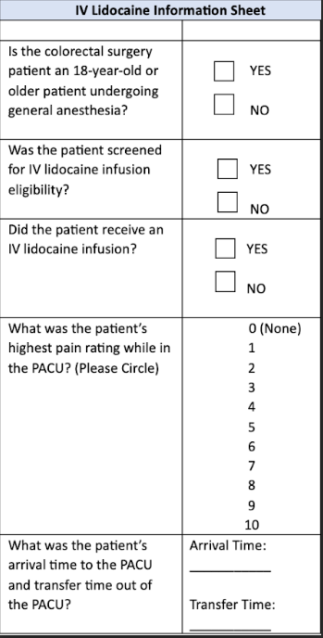
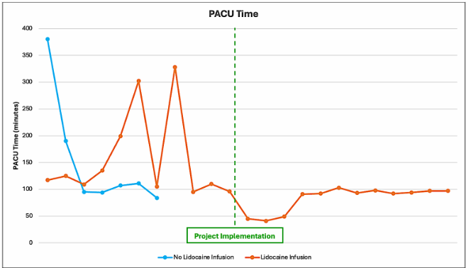
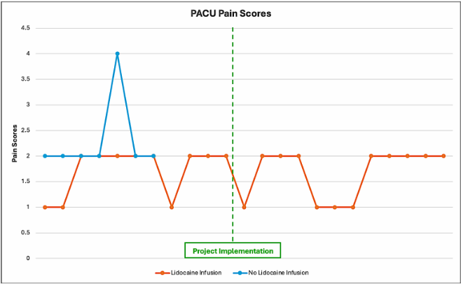


Adults undergoing colorectal surgery are more likely to have increased intravenous lidocaine compliance, decreased PACU pain scores, and decreased PACU length of stay after the implementation of an electronic medical record computer-based algorithm.
What a Pain: The Use of Intravenous Lidocaine Infusions to Improve Postoperative Pain in Adults Undergoing Colorectal Surgery
JOSHUA KNIGHT RN, BSN; SHELBY PARKER RN, BSN; SNEHAL PATEL RN, BSN; HETAL PATEL RN, BSN; JAMES ALBERDING CRNA, DNP, APRN; RENEE DIXON CRNA, MSN, APRN
BACKGROUND
INTERVENTIONS
Vulnerable populations, including veterans and surgical patients, face significant health disparities such as delayed care, limited access, and higher rates of chronic pain and opioid prescriptions.
Intravenous lidocaine for colorectal surgery has been shown to reduce intraoperative opioid use and improve outcomes under ERAS protocols.
Implementing a computer-based algorithm (CBA) is linked to improved compliance with ERAS protocols.
A CBA was put in place to prompt providers to initiate intravenous lidocaine drips on eligible patients.
All patients presenting for colorectal surgery were screened for intravenous lidocaine eligibility.
Preemptive education on intravenous lidocaine infusions was provided to anesthesia and post-anesthesia care unit (PACU) staff.
LOCAL PROBLEM
The project site in East Tennessee has seen an increase in postoperative pain scores among patients undergoing colorectal surgery.
The issue has been linked to decreased compliance with ERAS protocols, largely intravenous lidocaine use.
The purpose of this project was to implement a CBA pathway for perioperative lidocaine infusions within the site’s electronic medical record (EMR) for adult colorectal surgery patients.
The aims of the project were:
  Increase compliance with lidocaine infusions by 25%.
  Decrease patient postoperative pain.
  Decrease patient PACU length of stay.
RESULTS
Intravenous lidocaine compliance increased from 61.1% to 100% post-implementation.
PACU length of stay decreased from 110.5 minutes pre-implementation to 92.5 minutes post-implementation.
There was an increase in the number of patients reporting minimal or no pain post-implementation.
METHODS
The Evidence-based Practice Improvement process model was used to guide this project’s development.
Literature search and critical appraisal demonstrated support for the use of intravenous lidocaine for colorectal surgery.
Outcome measures of intravenous lidocaine compliance, PACU length of stay, and patient postoperative pain scores were measured for a 3-month pre-implementation and post-implementation period.
CONCLUSIONS
The use of a CBA resulted in a statistically significant (p < 0.05) increase in intravenous lidocaine compliance and a decrease in PACU times.
There was a decrease in PACU pain scores.
The CBA was integrated into standard care at the practice site.
The use of intravenous lidocaine in colorectal surgery patients is necessary for postoperative pain scores and PACU times.
References

