Slide 1

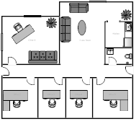
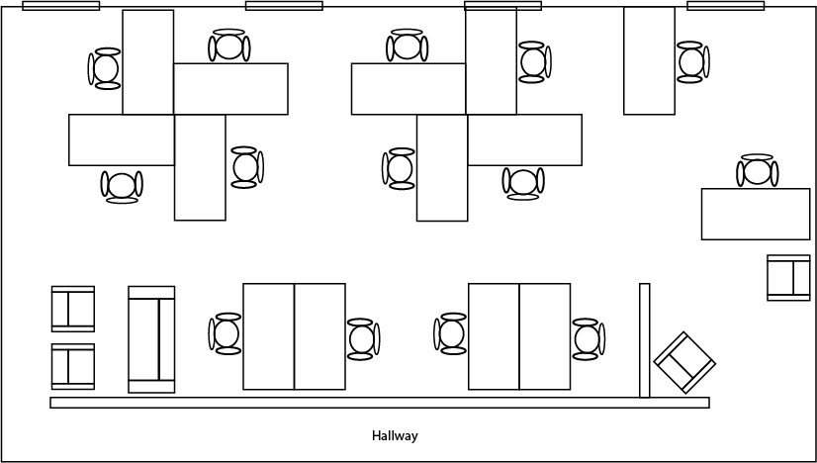
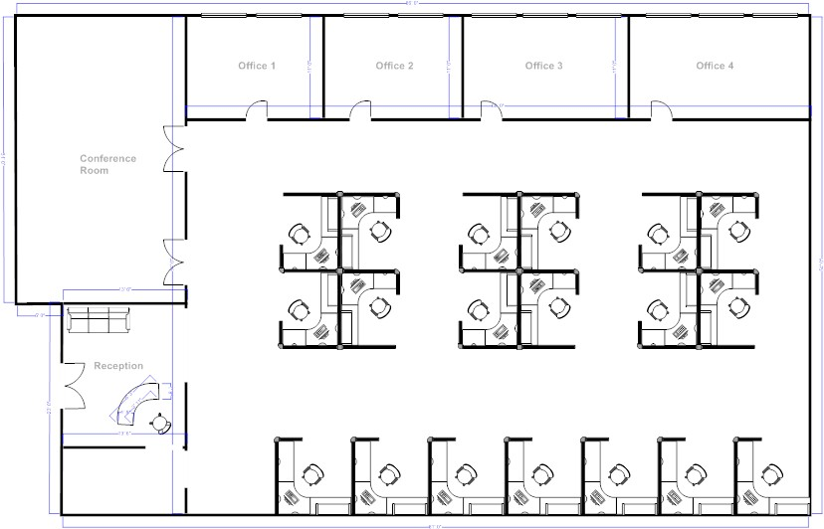
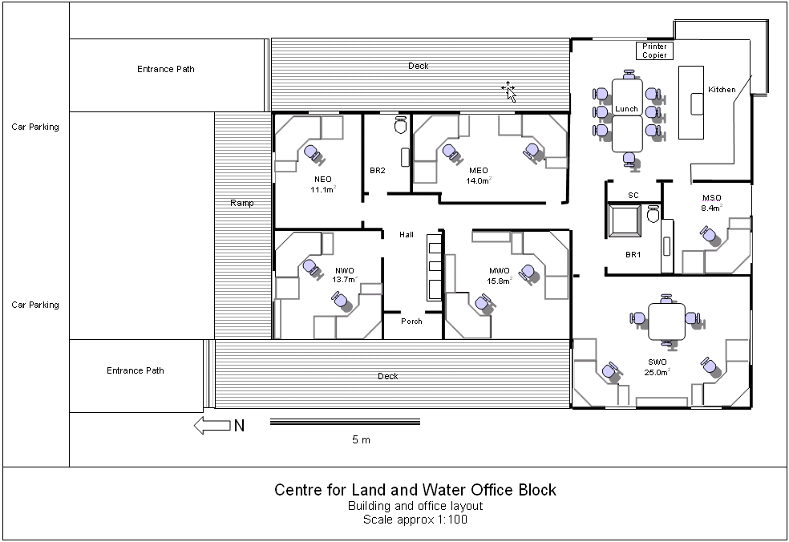
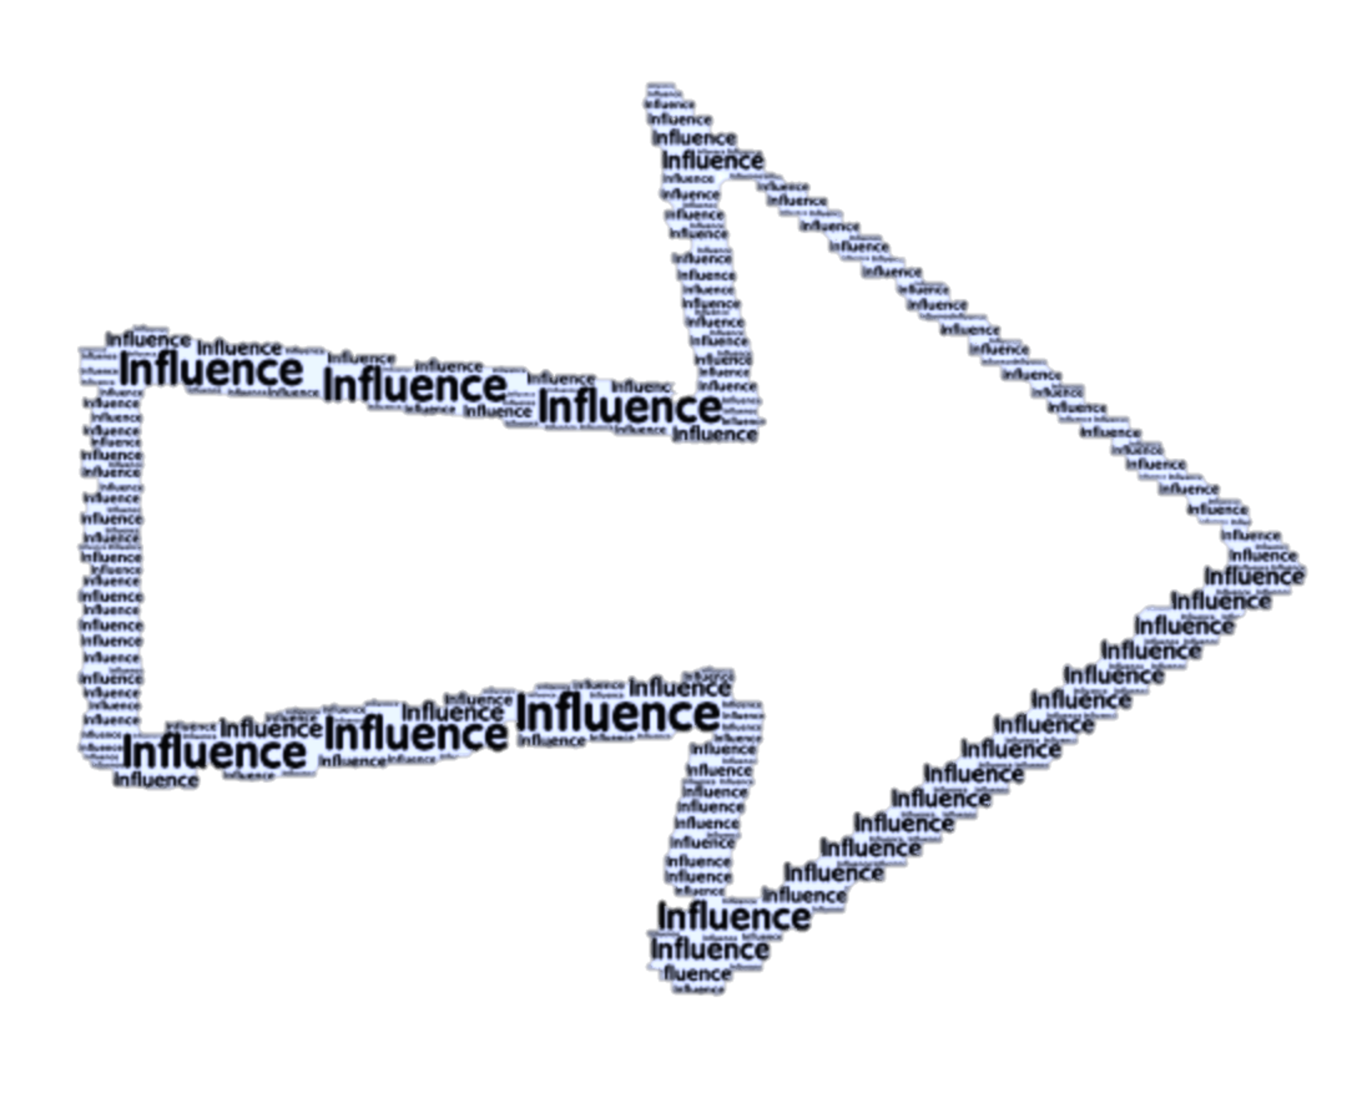
Is Changing Your Layout Worth The Payout?
The Impact of Office Layout on Employee Wellness and Reactions
Samantha Steichen
Abstract
Office Layout
Open
Partially Open
Shared
Closed
Methodology
With an increase in focus on company culture over the past few years, thousands of companies are spending millions of dollars to renovate their office buildings. These investments are occurring with no research that proves that certain office layouts benefit employees more than others. Research in this area could not only save companies millions of dollars, but it could lead to an overall increase in employee wellness and reactions. The objective of this study is to find a correlation between the physical layout of work and employee wellness and reactions.
Survey/Mixed Method Investigation
Target Group: adults above 18 who have full time jobs (30+ hours)
Testing to find if there are differences in employee attitudes based on level of office privacy
Breaking study into 5 parts:
  Office Privacy
  Workspace Collaboration
  Workspace Stress
  Creativity
  Work Tension
Conclusion
If corporations think changing their office layout is worth the cost savings, employees need to be given the option of increasing their time spent working from home. This is due to the fact that the more time employees spend at home, the less workspace stress & tension they have.
Introduction
Decrease in Office Privacy
The current research on this topic attempts to recognize the impact of office layout on employee wellness and reactions. This research includes companies in various industries and employees with various personalities and values within their work life.
Hypotheses
W
O
R
K
S
P
A
C
E
S
T
R
E
S
S
References
H1: Office privacy is negatively related to work tension through the influence of workspace stress
Ajis, Azizah Md, Shin Muramatsu, and Ryusuke Naka. "Comparative Study of Small Office Layout Based on Amount of Communication and Knowledge Creation Behavior." Applied Mechanics and Materials 773-774 (2015): 789-93. Web.
Carroll, A. B. (2006, July 29). Trust is the key when rating great workplaces. Retrieved from http://onlineathens.com/stories/073006/business_20060730047.shtml
Gilbert, J. (2011). The millennials: A new generation of employees, a new set of engagement policies. Ivey Business Journal, 75(5), 26-28.
Goldgehn, L. A. (2004) Generation Who, What, Y? What You Need to Know about Generation Y. International Journal of Educational Advancement, v5 n1 p24-24.
Huyler, Debaro, Yselande Pierre, Wei Ding, and Adly Norelus. "Millennials in the Workplace: Positioning Companies for Future Success." (2015): n. pag. Web. 16 Jan. 2017.
Kim, Jungsoo, and Richard De Dear. "Workspace Satisfaction: The Privacy-communication Trade-off InÂ open-plan Offices." Journal of Environmental Psychology 36 (2013): 18-26. Web.
Levenson, A. (2010). Millennials and the world of work: An economist’s perspective. Journal of Business and Psychology, 25(2), 257.
Mishra, Karen, Lois Boynton, and Aneil Mishra. "Driving Employee Engagement." International Journal of Business Communication 51.2 (2014): 183-202. Web.
Mitchell-Ketzes, Susan. "Optimising Business Performance through Innovative Workplace Strategies." Journal of Facilities Management 2.3 (2003): 258-75. Web.
Olson, Branka. "Knowledge Workspace Design Problem Definition: Assimilative Coherence Effects on Project Outcomes." SSRN Electronic Journal (2016): n. pag. Web.
Schullery, N. M. (2013). Workplace engagement and generational differences in values. Business Communication Quarterly, 76(2), 252.
Annu. Rev. Psychol. 47.1 (1996): 485-512. Web.
WORK TENSION
Acknowledgement
Thesis Advisor: Dr. Tim Munyon
H2: Office privacy is negatively related to creativity through the influence of workspace collaboration
Contact Information
Samantha Steichen
ssteiche@vols.utk.edu

