Slide 1

An Experiment with Name Entities in Wikidata @University of Tennessee Libraries
Anchalee Panigabutra-Roberts (Q62393357)
Head, Cataloging
University of Tennessee (Q1150105)
Libraries
LD4 Linked Data for Libraries Conference
Harvard University
May 11, 2019
Notes:
Good morning. Sabaah el kheir. My name is Anchalee Panigabutra-Roberts with the Thai nickname, Joy. I am the Head of Cataloging at the University of Tennessee Libraries in Knoxville, the flagship campus. And I am also the coordinator of Tennessee NACO Funnel. I will share with you my experience working with Wikidata and name entities for my own author profile and some name entities that can be used in the future for Volopedia, the web-based encyclopedia for all things related to the University of Tennessee’s Volunteers.

Slide 2
Outline
Wikidata: the lessons learned
The hands-on experiment with Q62393357 and other name entities
The mind and the machine
Notes:
My talk will focus on my learning experience in applying Wikidata to build an author’s profile in Scholia, a tool for author profiling in Wikidata. Since I’m new to Wikidata, the learning curve to create new Wikidata and to update the existing ones to connect with the new items had been steep, but truly worth it. I also explored different tools, queries and visualization in Wikidata. In conclusion, I will reflect on my experience using Wikidata and things to ponder for the future.

Slide 3
Use Case Scenarios: Name Entities in Wikidata
An Author’s Profile: Anchalee Panigabutra-Roberts (Q62393357)
  To test Wikidata’s applicability for researchers’ profiles
Name entities in Volopedia (test site: http://r2test7.com/entries/agriculture-club/ )
  To explore the possibility to use Wikidata for name entities for this online encyclopedia for the University of Tennessee Volunteers.
Notes:
I chose to create name entities in Wikidata due to my own interest in researchers identifiers and identity management.
The first scenario is to create a set of entities for my own author’s profile to test Wikidata’s applicability for researchers’ profiles.
The second case is to create Wikidata for name entities in Volopedia Project, the online encyclopedia for the University of Tennessee Volunteers.
(321 edits as of May 5 - 1.40 a.m.)

Slide 4
Learning Wikidata
Introduction https://www.wikidata.org/wiki/Wikidata:Main_Page
Tutorial: Wikidata:Tours https://www.wikidata.org/wiki/Wikidata:Tours
Wikidata SPARQL Query Tutorial https://www.youtube.com/watch?v=1jHoUkj_mKw
Wikidata:Community Portal https://www.wikidata.org/wiki/Wikidata:Community_portal
Hands-on with real data (Q62393357 and others)
Notes:
Here are some of the tools I learned and applied. My Wikidata username is Apanig. I read through the introduction and took the tutorial or the Wikidata tours. Once I learned enough to create Wikidata items, I also learned to query the data using SPARQL to play around with the visualization capabilities in Wikidata. And the community portal offers more resources for Wikidata. For the application of Wikidata, I started with my own author’s profile.

Slide 5
Explored Tools
Wikidata Query Service: https://query.wikidata.org/
Tools: https://www.wikidata.org/wiki/Wikidata:Tools
  ORCIDator: https://www.wikidata.org/wiki/Wikidata:ORCIDator
  Query data
    Scholia: https://tools.wmflabs.org/scholia/
    Scholia - Q to bibliography: https://tools.wmflabs.org/scholia/q-to-bibliography-templates?q=Q62393357
  Visualize data
    Reasonator: https://tools.wmflabs.org/reasonator/
    SQUID: https://tools.wmflabs.org/sqid/#/
Notes:
These are also the tools I played around with.

Slide 6
Author’s profile ~ Q62393357
Notes:
Apanig = 322 edits in Wikidata

Slide 7
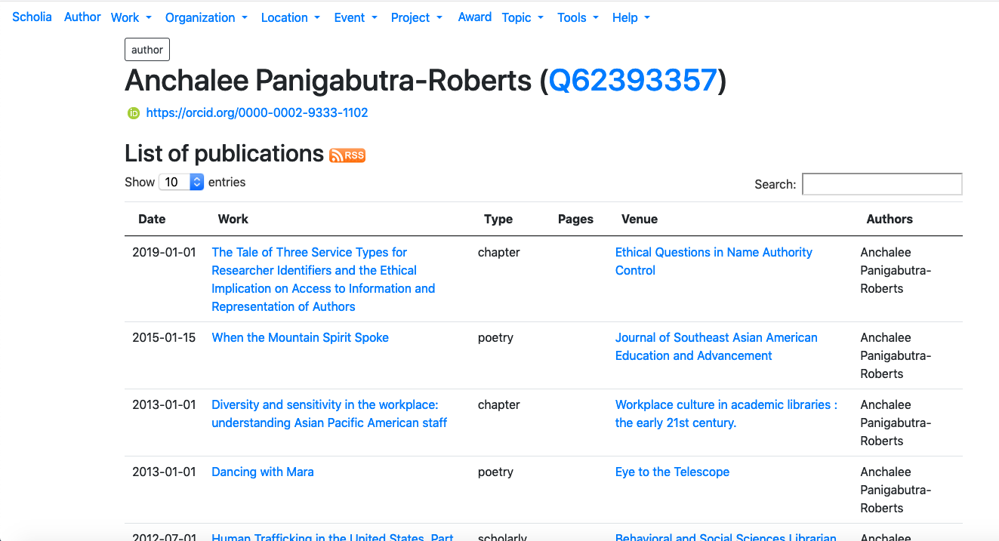
https://tools.wmflabs.org/scholia/author/Q62393357
Notes:
Because of my interest in researcher IDs, I found Scholia in the tools and decided to experiment with it. I could use ORCIDator: https://www.wikidata.org/wiki/Wikidata:ORCIDator to pull my ORCID data into Wikidata to create my profile in Scholia. I still had to modify each publication’s Wikidata to complete my profile in Scholia to look like this. You can see all my edits at apanig in Wikidata ( https://www.wikidata.org/wiki/Special:Contributions/Apanig ) for more than 300+ edits). And even with the drop-down menu, adding information to Wikidata Is not straightforward.. I need to understand its ontology and how the item, property and value work and linked data.
Thankfully, the online course I took from Steven J. Miller, Linked Data for Beginners (September 2018), helped me understand the ontology’s concepts used in Wikidata. An introduction course to programming in Coursera, Programming for Everybody, was also helpful when writing the queries. Wikidata’s tutorials are also helpful, but having these foundational courses helped me learn Wikidata better.
This author’s page includes all my publications.

Slide 8
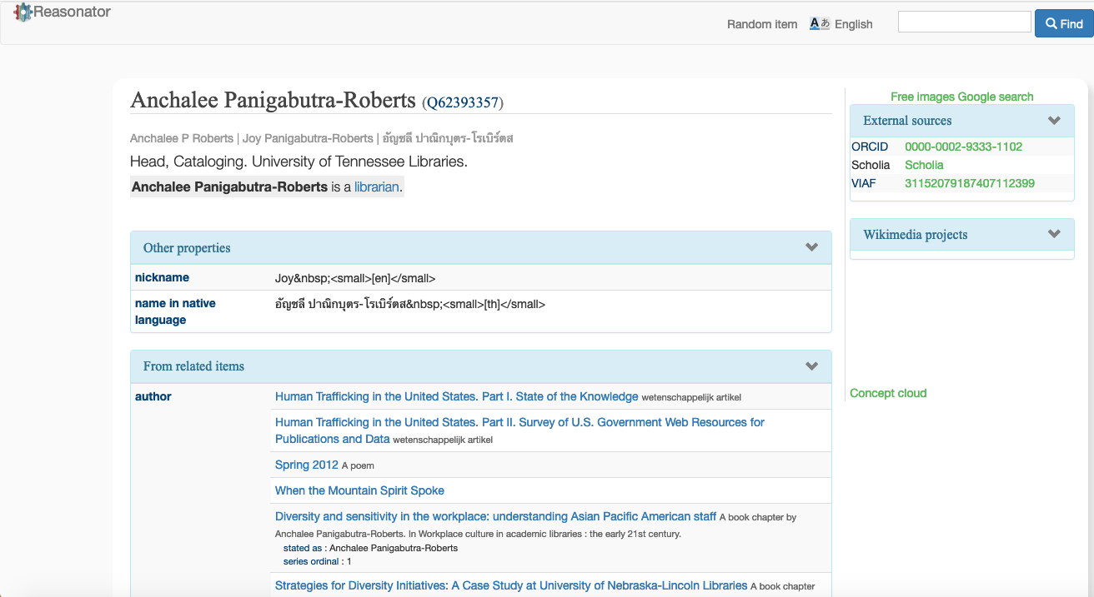
https://tools.wmflabs.org/reasonator/?&q=62393357
Notes:
Reasonator is another tool I played with in Wikidata. It’s the closest thing I could have my Wikidata displayed in the more readable form.
In the box for external sources, ORCID ID was added by me, so was Scholia.
It looked like VIAF (Virtual International Authority File) harvested my Wikidata to add to VIAF, since I already created my name authority in LC Authority File that went into VIAF before I created my Wikidata.
About ‘reasonator’: It displays Wikidata entries and it will do so in a item-type-optimized fashion, and also show related, significant data through simple reasoning (hence the name).
Reasonator is a self-contained JavaScript class (plus some HTML/CSS), using the Wikidata API and SPARQL queries so it can easily be ported to other locations. As always, code under GPL.
(source: https://tools.wmflabs.org/reasonator/ )

Slide 9
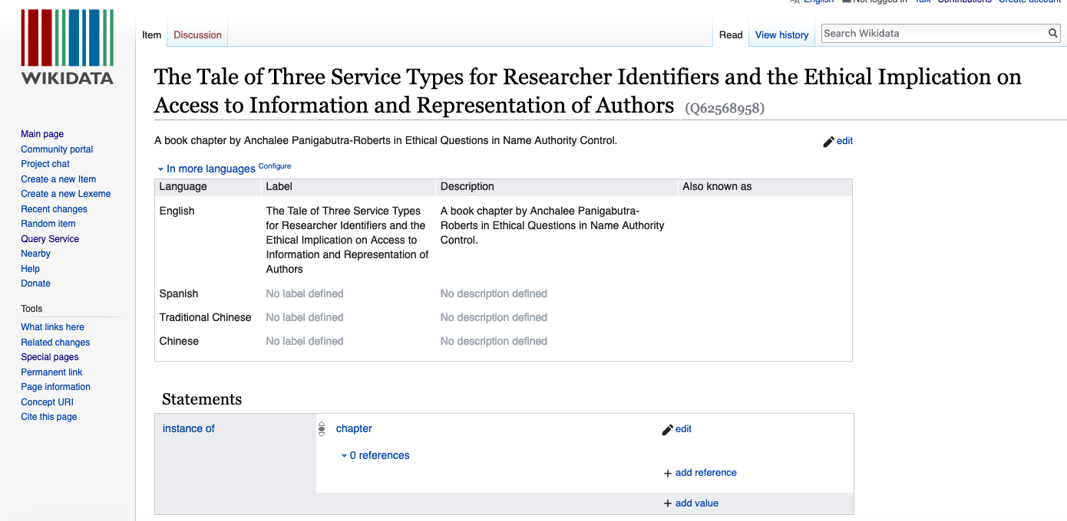
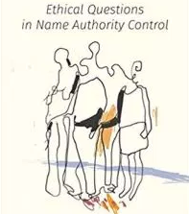
Access to Book Chapters & Conference Proceedings in Wikidata
(Better Than Using MARC/RDA)
Q62569414
Q62568958
Notes:
I also created this Wikidata for my book chapter published in the book, Ethical Questions in Name Authority Control, since I had not added it to my ORCID. I’m happy that I could have the access to my book chapter better in Wikidata than I would have in MARC/RDA record, with multiple contributors. You can read my chapter to find out more about this issue on providing access to authors of book chapters and conference proceedings in catalog records.

Slide 10
Query Service
SELECT DISTINCT ?item ?itemLabel ?instanceLabel ?publication_date
WHERE {
?item wdt:P50 wd:Q62393357 ;
wdt:P31 ?instance ;
wdt:P577 ?publication_date .
SERVICE wikibase:label { bd:serviceParam wikibase:language "[AUTO_LANGUAGE],en" }
}
Notes:
I experimented with the query service and visualization to create the timeline for all the works I have created.

Slide 11
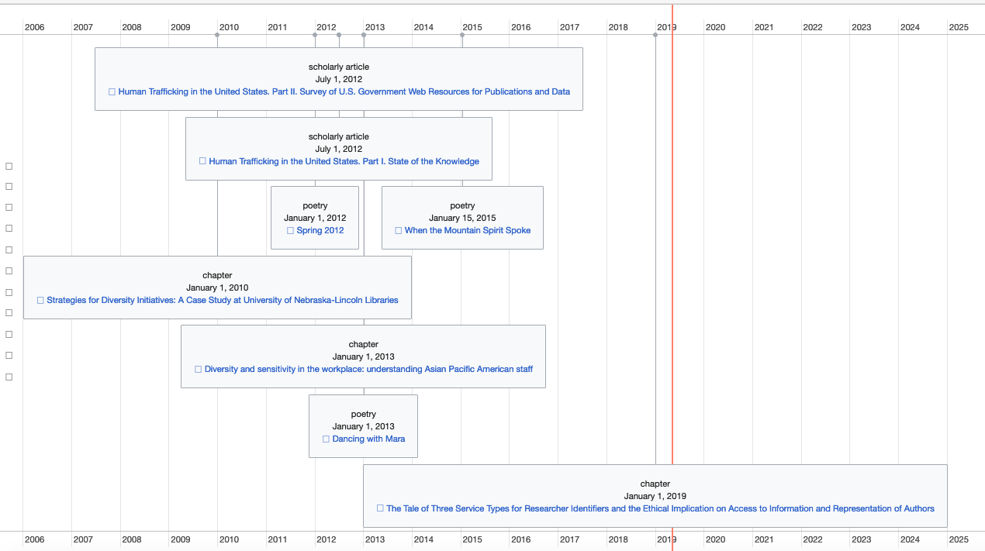
Timeline for Joy’s Publications
(Short URL: w.wiki/3dz)
Notes:
You can check out data visualization tools along the left-hand side of the query service screen. I queried the data for all items related to me as an author by types/genre and publication dates to have this timeline display.

Slide 12
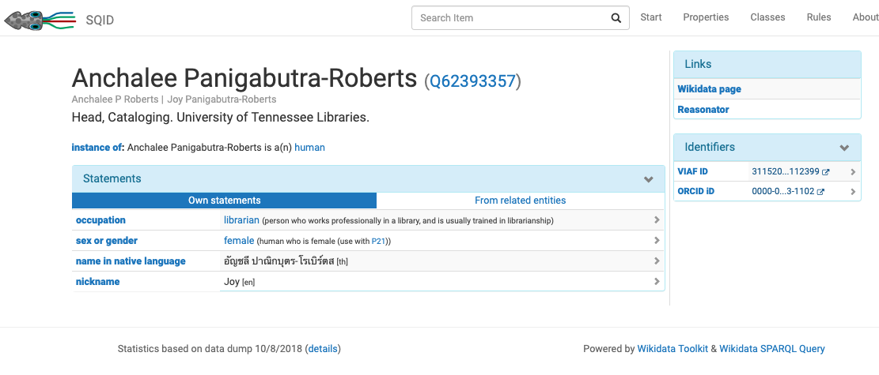
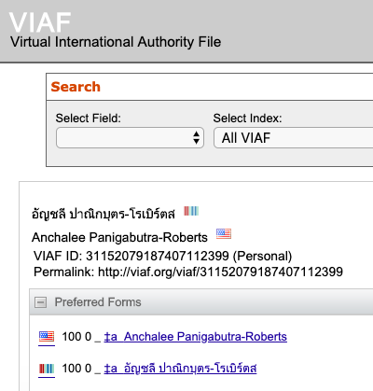
https://tools.wmflabs.org/sqid/#/view?id=Q62393357
A SQUIDDY SURPRISE!
Notes:
SQUID is another tool to extract, query and process data in Wikidata.
I noticed the VIAF’s link from this page to find out that VIAF harvested my Wikidata to create a brand new authority record for me, attached to the same VIAF as my LC authority record.
*About SQID
SQID is a project of the Knowledge-Based Systems Group of TU Dresden. Developers include Markus Krötzsch, Michael Günther, Markus Damm, and Georg Wild.
SQID is programmed in JavaScript with additional server-side code in Java and Python to extract, query, and preprocess data.
https://tools.wmflabs.org/sqid/#/about

Slide 13
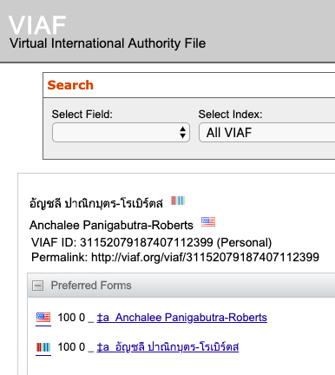
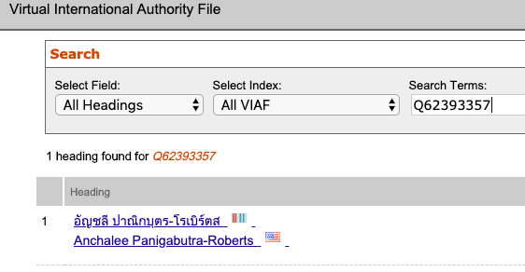
Wikidata ID
Joy’s name in Thai scripts
Notes:
Since all of my publications are in English, my LC name authority is in English with no reference to the Thai scripts.
In Wikidata, since I created it for myself, so there is no need to authenticate/verify the information/literary warrant. That’s why I added my name in the Thai scripts.
VIAF chose to use my name in the Thai scripts as the main heading and use the English one as the variant/see reference. Thank you VIAF for honoring my Thai scripts in the name, but it won’t work for the citations for my publications which are all in English at this point in all of my formal publications.
For VIAF’s algorithm, I would recommend using the name used in the publications as the clue for the headings as you would normally do for the macro to create NARs in Connexion Client. True, we do have many international authors and creators using their own scripts, but we also have international folks working in the U.S. and also at many American or other European-based higher education institutions worldwide as well. [And I am speaking of the one consortium, AMICAL, American liberal arts institutions outside of the U.S. where the instructions, communications and research are all in English. I was at the American University in Cairo and roughly 40% are Americans, 40% Egyptians and 20% international. I hope this is something for VIAF to consider to base on the publications’ languages. And you can search with Wikidata ID. ]

Slide 14
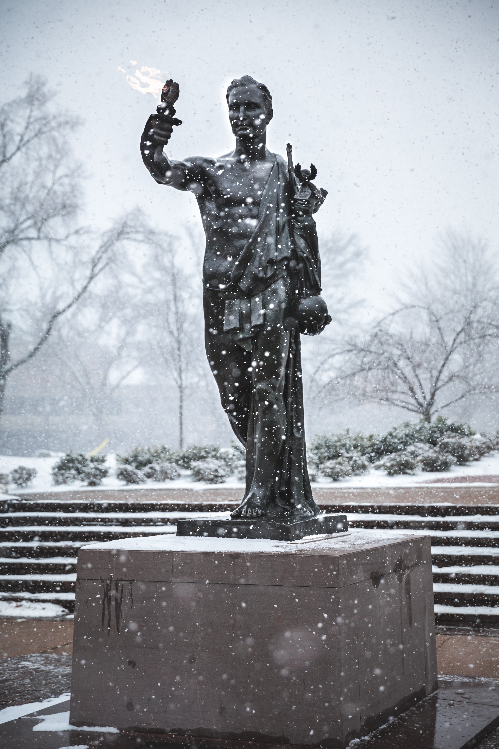
Name Entities as Subject Entities
Not a SACO member?
Wikidata as an alternative for non-SACO members
The Volunteer statue (Q63134368)
Notes:
Not a SACO Member? No worry! You can use Wikidata for names as subject headings. In this case, I need the name authority for the Torchbearer, the UTK’s Volunteer statue. I modeled this Wikidata after the ‘Statue of Liberty’ https://www.wikidata.org/wiki/Q9202
LCSH Manual H 405: Establishing Certain Entities in the Name or Subject Authority File: https://www.loc.gov/aba/publications/FreeSHM/H0405.pdf

Slide 15
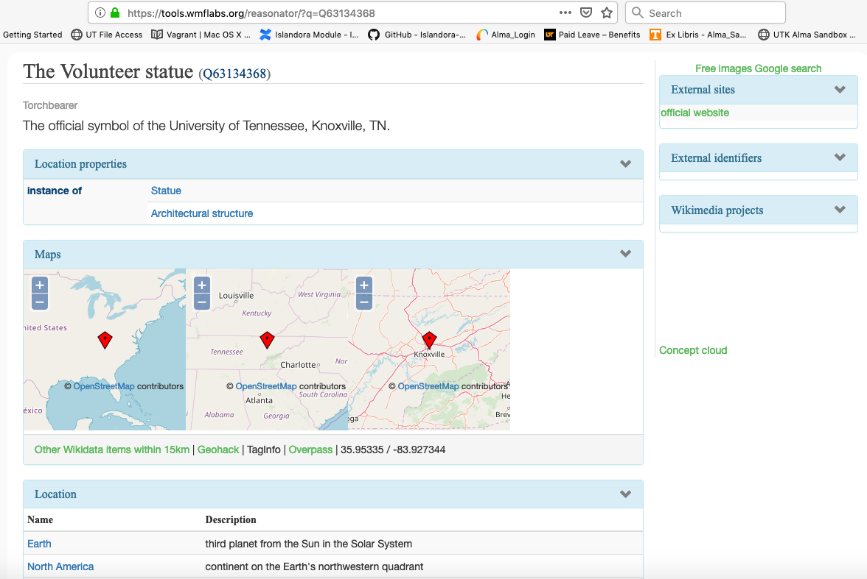
Notes:
In Volopedia, the Volunteer statue is a major feature since it is our official symbol for UT in Knoxville, with the nickname, the Torchbearer. Since this is a place name that fits in the names as subjects in the LC/PCC Subject Authority Cooperative Program (SACO), Wikidata gives us, the NACO-only libraries, a good option to create place name authorities unique to our institutions that can be ingested into our local websites or web-based content like Volopedia (to be published in WordPress). If SACO can later harvest the data, then we would enrich and contribute to SACO and VIAF indirectly. That is my suggestion for a use case for Wikidata for libraries.

Slide 16
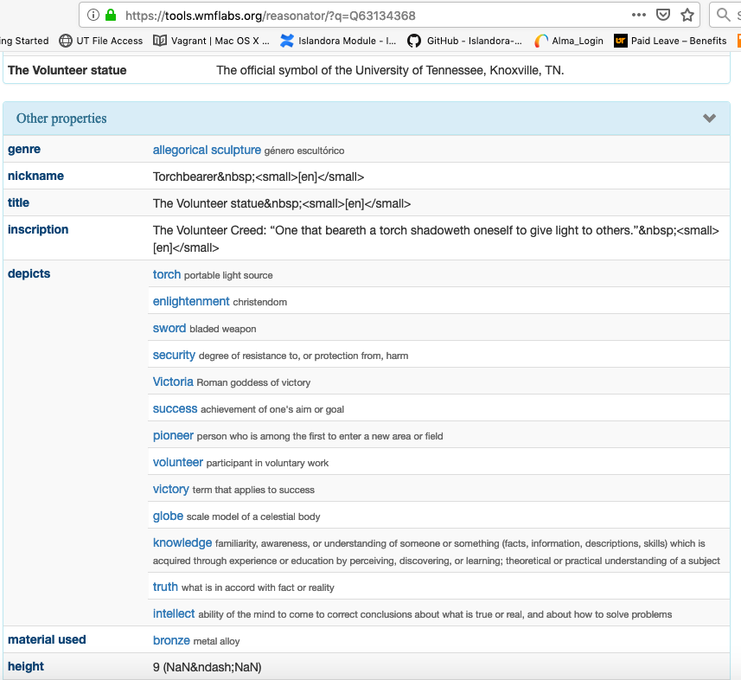
The Volunteer statue (continued)
For the full Wikidata: https://tools.wmflabs.org/reasonator/?q=Q63134368
Notes:
Using the property, depicts, I had to add many concepts to describe what the statue depicts. One term, enlightenment, has a narrower definition than what I looked for. In Wikidata, enlightenment, has a narrow definition
enlightenment (Q592592) -> an instance of: religious concept ->facet of -> Buddhism.
I need the meaning of enlightenment as ‘the act or means of enlightening” -> 'enlightening
: providing or tending to provide knowledge, understanding, or insight” which is broader than the religious aspect of Buddhism, although not too far off.
Knowing and understanding = enlightening. I would like to see a closer alliance of Wikidata’s concepts based on the English-language dictionary.

Slide 17
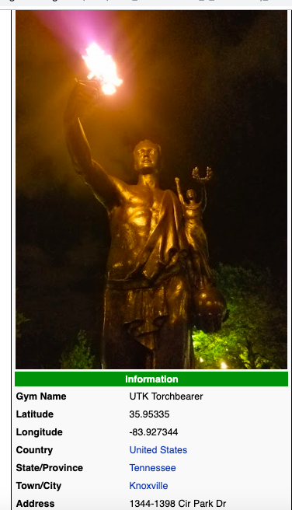

https://pkmngotrading.com/wiki/UTK_Torchbearer_-_Knoxville,_TN
By Promotional press kit material for the Pokémon series. Artwork is by Ken Sugimori for the video games and player's guides., Fair use, https://en.wikipedia.org/w/index.php?curid=19801255
Notes:
When I looked for the values for the coordinates for the Torchbearer, Pogemon Go came to a rescue. I would need to learn more about locations used in Wikidata especially for resources for coordinates.

Slide 18
Map of Torchbearer in SPARQL
#Map of Torchbearer
#defaultView:Map
SELECT * WHERE {
?item wdt:P31*/wdt:P279* wd:Q63134368;
wdt:P625 ?geo .
}
Wikidata for ‘Torchbearer’:
Map: http://tinyurl.com/yy89q6kb to SPARQL
To the result – map: http://tinyurl.com/yxwbu97o
Reasonator: https://tools.wmflabs.org/reasonator/?q=Q63134368
Notes:
With the coordinates, they allowed me to play with the SPARQL for maps, in this case, it is for the Torchbearer.

Slide 19
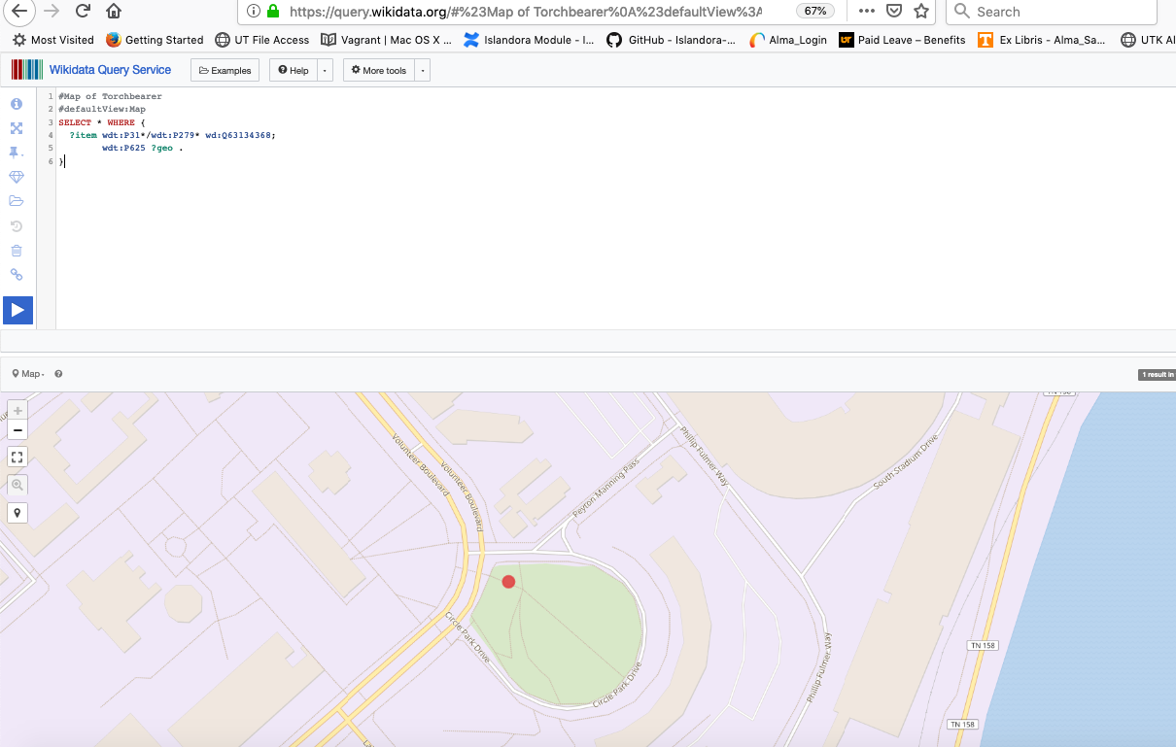
Torchbearer Statue @UTK
Notes:
Here is the map rendered from the SPARQL query.

Slide 20
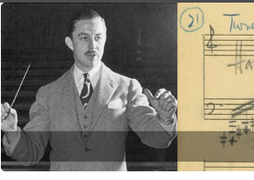
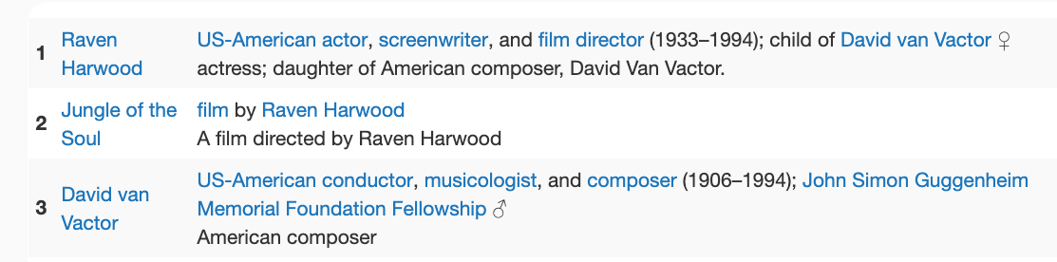
Wikidata:Linked Data & Family Relationship
Raven Harwood (Q62075064)
David Van Vactor (Q2182197 )
https://digital.lib.utk.edu/collections/vvsmcollection
https://tools.wmflabs.org/reasonator/?find=Q62075064
Notes:
David Van Vactor is an American composer of the contemporary classical music and the founder of the Music Program at UTK. He was also the 3rd conductor of Knoxville Symphony Orchestra (the KSO). At UT, we created his music compositions’ digital collection and updated David Van Vactor’s name authority and created a new one for Raven Harwood, his daughter. There is not much information we could find about Raven except for her assistant to her father for his music composition. However, from the keyword search by her name in WorldCat, I found that Harvard Film Archive has her film, Jungle of the Soul, that she directed via WorldCat. Many thanks to Amy Sloper, the Archivist at Harvard Film Archive, who confirmed that they do have the film. Her confirmation enabled me to add the film to Raven Harwood’s name authority record and Wikidata. Another connection at Harvard is that the composer’s grandson, DAVID VAN VACTOR, PHD, Professor of Cell Biology, Harvard Medical School. I will leave his Wikidata in my Harvard colleagues’ capable hands. I already built a foundation for his Wikidata. ☺

Slide 21
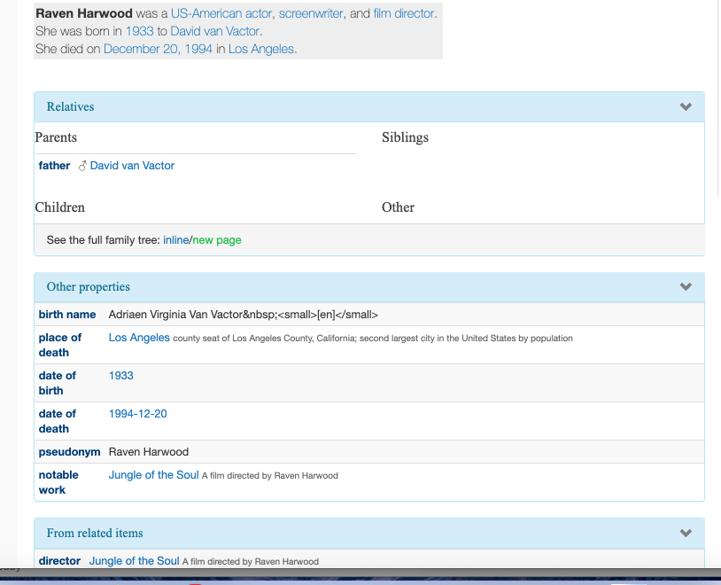
https://tools.wmflabs.org/reasonator/?&q=62075064
Notes:
A daughter ~ father linked data for Raven and David, her father.

Slide 22
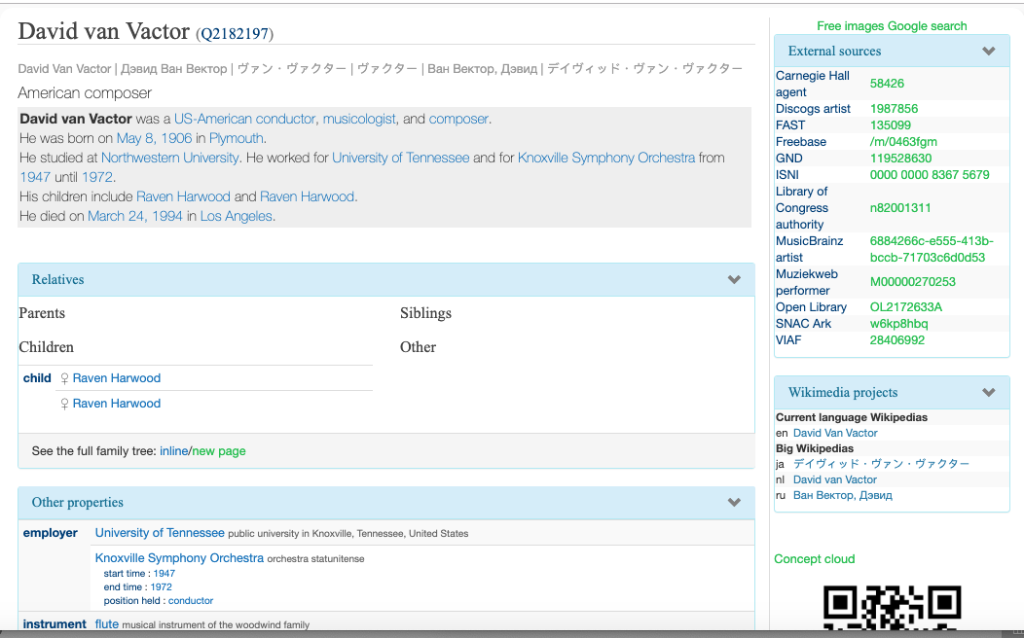
?
Notes:
David’s renown reputation gave him richer information. I just have a question why Raven’s name shows up twice here, when I added only one item of Raven’s to David’s Wikidata.

Slide 23
Envision Wikidata:LC Name Authorities As
Bridges Connecting UT Collections Across MARC/RDA, EAD, MODS and Dublin Core Metadata in the Modern Library Discovery System
LC Name Authorities
UT General & Special Collections
(MARC/RDA)
SCOUT~UT Archives' Finding Aids
(EAD)
UT Digital Collections
(MODS)
TRACE (institutional repository)
(Dublin Core)
Notes:
At UT Libraries, we contribute name authority records to leverage the power of information search and retrieval across our collections. I hope that in the future Wikidata can connect all our collections and beyond and leverage the power of linked data to benefit our users, as well.
Our current library services applications: Ex Libris Alma/Primo, Archivists’ Toolkit→to migrate to ArchivesSpace, Islandora and Digital Commons (migrate to?)
Connecting the dots. Linked data and AI.

Slide 24
The mind and machine
Notes:
Beyond connecting information among our collections, we also use information technologies to help connect our users with information. I would like to explore this relationship of human and machines as a way to conclude my talk.
The extension of ourselves https://www.wired.co.uk/article/artificial-intelligence-extended-intelligence?utm_source=pocket-newtab
Not singularity

Slide 25

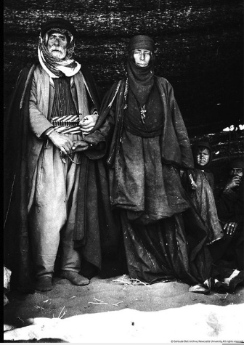
Connecting the Dots of ‘Gertrude Bell’
Movie: https://queenofthedesertmovie.com/press/
Mobile Wikidata
Netflix: https://www.netflix.com/title/70295170
Letter from Baghdad: PBS:
Notes:
My reflection on our own role as the mediator between our users and the collections and the information retrieval tools came upon me when I was watching on Netflix: Queen of the Desert (Q15407746) . Then I searched in Google for ‘Gertrude Bell’ Wikidata on my mobile phone and found the m.wikidata for her. https://m.wikidata.org/wiki/Q231360
Then I recalled watching a documentary on PBS about her. I searched Google for ‘Gertrude Bell PBS’ and found ‘Letter from Baghdad’
I don’t know how my brain works to recall the PBS documentary, but this process helped me analyze the relationship of what the machine can do vs. what we humans can do in the information process.

Slide 26
Leverage the power of Wikidata
Elevate the power of AI (fueled by both humans & machines))
Disclaimer: not advocating for singularity.
Notes:
I try to be realistic about human and computer coexistence. Not a new subject in the library world, since library automation came along.
This information search process made me ponder our role in the information world driven by mobile apps, voice commands/assistants, visually driven in the context of social networks and eventually, block chains.
I also wonder how sustainable our data in Wikidata will be; from data security, data ownership and rights issues, long-term preservation and perpetual access of the data, our institutional relationship with Wikimedia Foundation from personnel, budget and governance perspectives (RIM), things my admins need to decide on. At the application level, how our current platforms (Alma, Primo, etc.) will be able to interact with Wikidata. I have many more questions before we will integrate Wikidata into our actual workflow.
In closing, I ponder our symbiosis relationship with information mediated by both human and machine. That is the future of information and us.

Slide 27
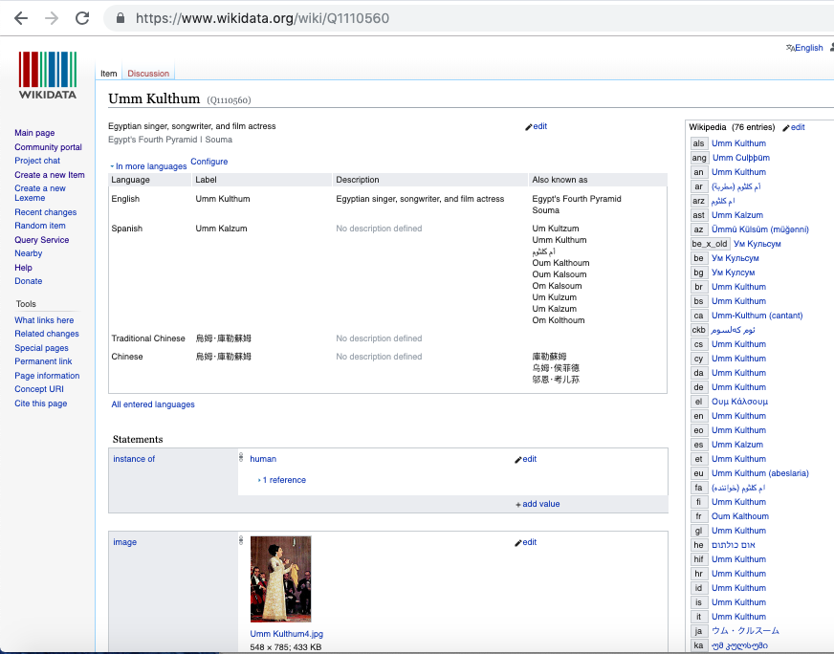

Slide 28
Resources
Association of Research Libraries. ARL White Paper on Wikidata, Opportunities and Recommendations. Washington, DC: ARL, 2019. Retrieved on May 7, 2019 from: https://www.arl.org/storage/documents/publications/2019.04.18-ARL-white-paper-on-Wikidata.pdf
LCSH Manual H 405: Establishing Certain Entities in the Name or Subject Authority File: https://www.loc.gov/aba/publications/FreeSHM/H0405.pdf
Simonite, Tom. Encyclopedia automata: where Alexa gets its information. Wired, Volume 27, Issue 3, pages 22-23, March 1, 2019. Also available online as ‘Inside the Alexa-Friendly World of Wikidata’ at: https://www.wired.com/story/inside-the-alexa-friendly-world-of-wikidata/
The Rolling Stones (Q11036). Reasonator: https://tools.wmflabs.org/reasonator/?&q=11036
(For a complex Wikidata and a long display of Reasonator).
Statue of Liberty: https://www.wikidata.org/wiki/Q9202

Slide 29
Image Credits
University of Tennessee, Knoxville. Office of Communications & Marketing. Torchbearer. February 2015. Retrieved May 6, 2019 from https://tinyurl.com/y25gl5xw

Slide 30
~*~*~*~*~*~*~*~*~ *~*<>*<>~*~*~*~*~*~*~*~*~*~*~
Many Thanks to:
LD4 Conference Program Committee
LD4 Conference Organizers
LD4 Conference Participants & Presenters
Notes:
Many thanks to the program committee for giving me this chance to share my experience experimenting with Wikidata with all of you.
I want to thank the organizers for putting together this conference and to all the participants and presenters for sharing your tools, tricks and wisdom with me.

Slide 31
Any questions?

