Slide 1
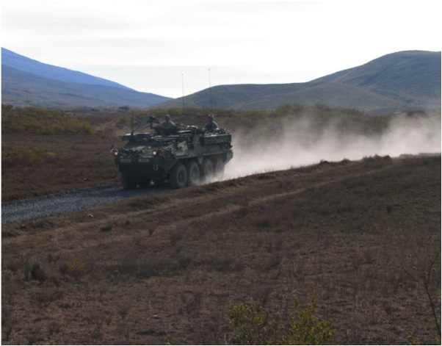
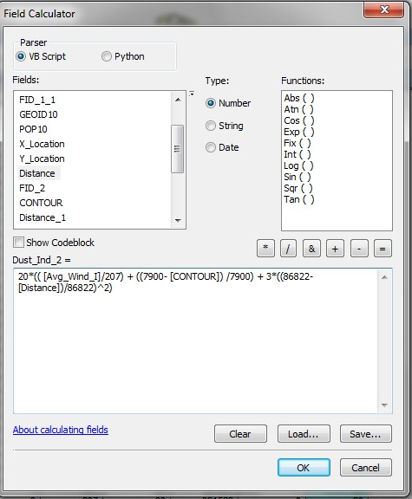

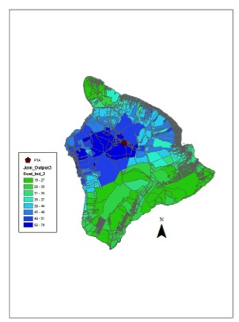
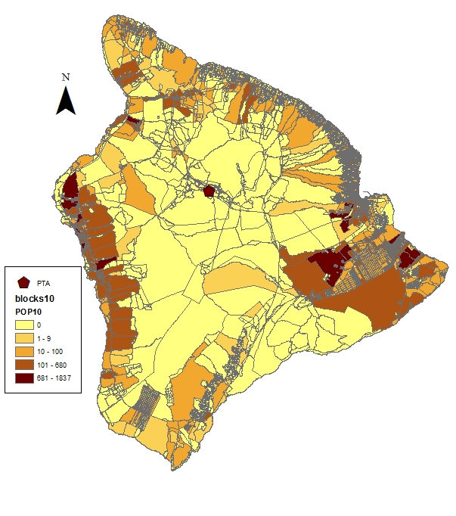
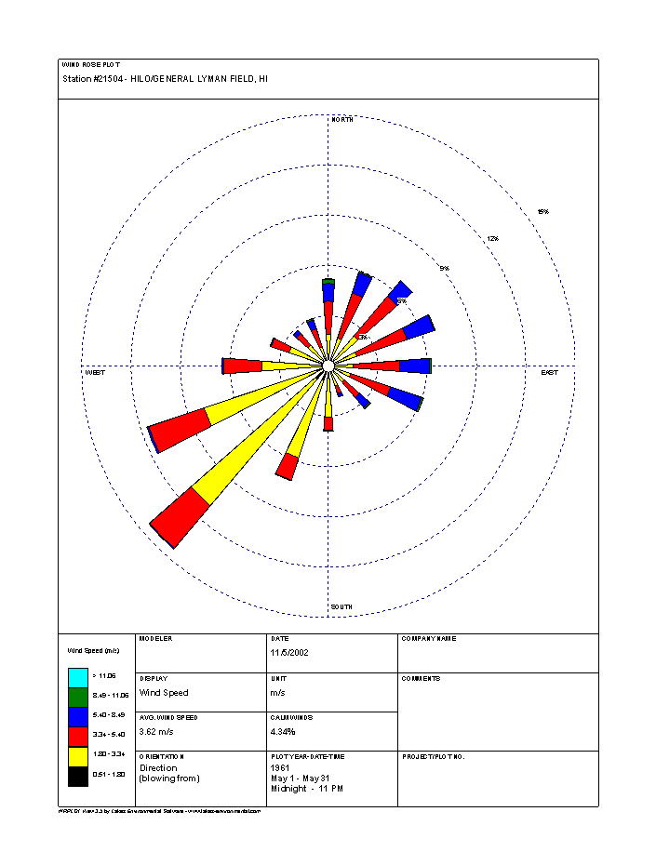
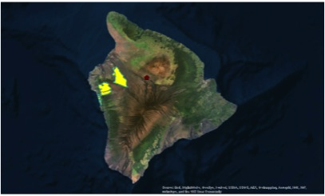
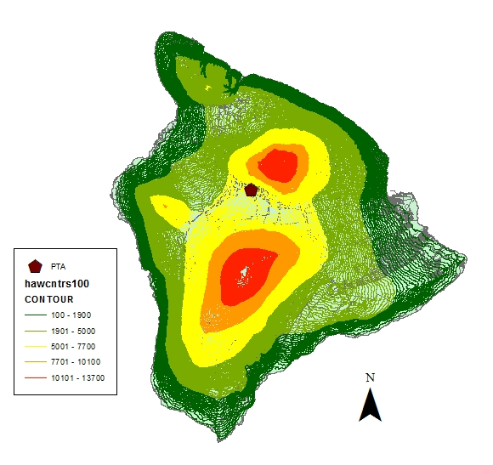
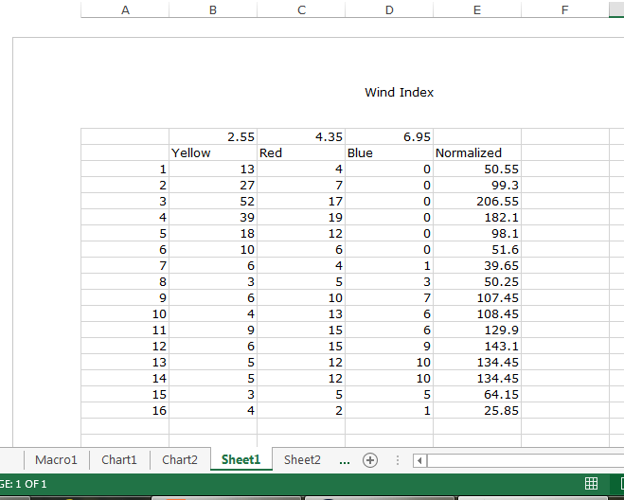
Using GIS to Identify At-Risk Populations of Military-Generated Dust
Darcy Ayers¹, Advisor Dr. Hyun Kim²
¹Anthropology, University of Tennessee; ²Geography, University of Tennessee
Abstract
This project uses GIS through an anthropological perspective to identify local populations surrounding Pohakuloa Training Area (PTA) that are most at risk from military vehicle-generated dust. Using ArcGIS, I analyzed wind rose, elevation, distance, and census tract data. When studying demographics, I evaluated the spatial distribution and density of the adjacent population. The resulting GIS data was a combination of a process-based dust dispersion estimates (from wind, topography, and distance from source) with my demographic research in order to determine the risk associated with populations on the island of Hawaii. The current populations being subjected to high levels of dust exposure were identified and quantified through a rudimentary algorithm relating the variables considered. The resulting map portrayed the spatial distribution of the generated dust across the island and identified the populations which will be experiencing significant impacts due to the dust dispersion.
Background
GIS Analysis
In the age of sustainable development, applied anthropologists are discussing how to proceed with development in a way that is sustainable for both the environment as well as the people influenced by the development. In the United States, an exciting new frontier of study combines quantitative data collection and qualitative research to assess how environmental, economic, and governmental changes are affecting the societal health of local communities. This fairly unexplored field of research provides the ideal setting for interdisciplinary study – in this case, a combination of anthropology and geography. In the case of PTA, an Environmental Impact Statement was developed to quantify the amount of environmental degradation produced from the dust. However there was a significant lack of information on the social impacts of the dust. My project is meant to continue the process of impact quantification from an anthropological perspective.
Using the input data of distance, elevation, and wind speed and direction in the following algorithm:
(Figure 5)
Figure 6
I observed the current areas being subjected to different levels of dust exposure. (Figure 6)
I then Selected by Attributes to identify the top ~1.5% (2,900 people) of island’s population that are most at risk from vehicle generated dust.
(Figure 7)
Figure 5
Data & Methods
Interpreting Results & Future Directions
Used 2010 US Census block data from Hawaii’s government planning website to calculate distance of each block from PTA (Figure 1)
Used elevation contour line data at 100ft intervals from Hawaii’s government planning website (Figure 2)
Used Hilo wind rosette data (Figure 3) from National Water and Climate Center under USDA National Resources Conservation Service to create normalized wind index (Figure 4)
Once the high-exposure risk areas were detected, the next steps would be to employ applied anthropological methods of interviewing populations living in these areas and monitoring their health changes. If necessary, a long-term solution may be to implement modifications to vehicle training procedures at the base in order to facilitate dust control. Finally, it is important to observe future population changes and keep track of areas that may be experiencing population growth. Future directions of this project may include integrating a more physics-based dust dispersion model as well as expanding the research area to other military bases across the country or world.
Figure 1
Figure 3
PTA
Figure 4
Figure 7
Figure 2

