Slide 1
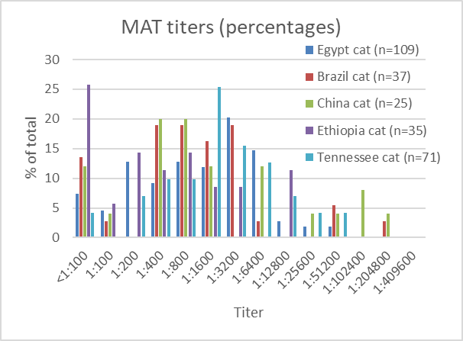
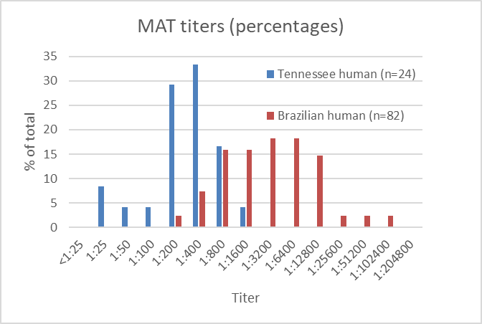
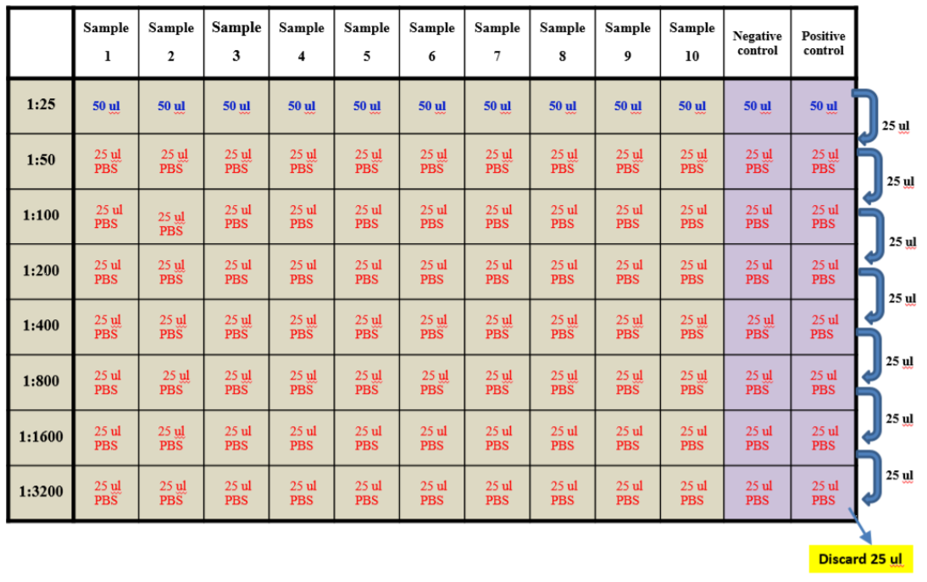
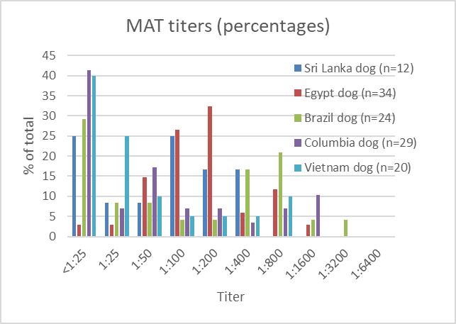
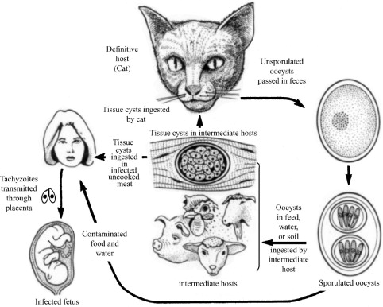
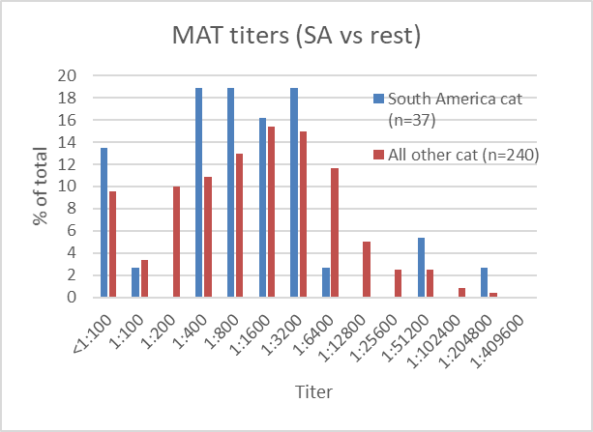
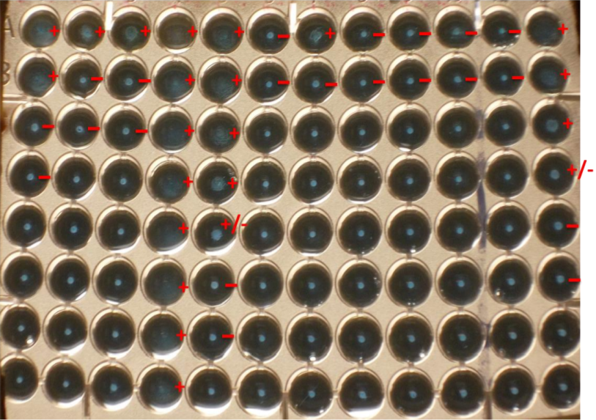
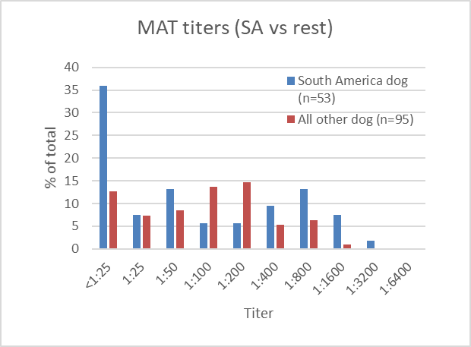
Determining if host serum IgG titer is associated with Toxoplasma gondii virulence
Riley Byrd and Chunlei Su
Department of Microbiology, The University of Tennessee
INTRODUCTION
RESULTS
MAT Test Schematic
Toxoplasma gondii is a protozoan parasite that causes the disease toxoplasmosis in animals and humans. One third of the world’s human population is chronically infected with this parasite (1). Toxoplasma gondii has two infectious forms: oocysts shed in the feces of felids (domestic and wild cats) and tissue cysts in chronically infected animals (Figure 1). Humans may become infected via ingestion of food or water contaminated with oocysts, the consumption of tissue cysts in undercooked meats, or vertical transmission from the mother to the fetus. Previous studies have found that T. gondii strains from South America are genetically diverse from and tend to be more virulent and causing more severe diseases in humans than strains from elsewhere (2). Also, a previous study found that higher anti-Toxoplasma IgG levels were correlated with severity of toxoplasmosis in humans (3). We hypothesize that more virulent strains can induce a stronger immune response to chronic infection than less virulent strains, resulting in higher IgG antibody levels in the hosts. To test this hypothesis, we used the modified agglutination test (MAT) to measure anti-Toxoplasma IgG levels in serum samples from animals (cats & dogs) and humans from South America and elsewhere. The IgG titers were then compared to determine if IgG level can be used as a marker to predict parasite virulence at the population level.
Dilute serum samples to 1:25 using phosphate buffered saline (PBS)
Serial dilute samples to 1:3200 in plate (8 serial dilutions)
Figure 3. MAT titers of cat samples. The mode of the titers fell between approximately 1:400 and 1:3200 for cats from all locations including Brazil, Egypt, China, Ethiopia, and USA (Tennessee).
Figure 7. MAT titers of human samples from Brazil and USA (4). The mode for the samples from Tennessee humans fell between 1:200 and 1:400. The mode for the Brazilian human samples was considerably higher, around 1:3200 to 1:6400.
CONCLUSIONS
We conclude that serum samples from the more virulent South American strains of T. gondii did not result in higher IgG titers in cats. Although the mode of the titers of the Brazil dogs was slightly higher and that of the Columbia dogs, this difference needs to be confirmed using a larger sample size. Overall IgG titers in cats are similar among samples collected from different locations, but they are slightly higher than that in dogs. There, however, was large difference between IgG levels from the USA (range: 1:25 to 1:1,600) and Brazil human serum samples (range: 1:00 to 1:102,400), with the latter having much higher titers, suggesting parasite genotypes may be associated with parasite virulence in humans.
Given the small sample size of the human samples from the USA, additional studies with a larger sample size are necessary. Future studies should also be performed in order to determine if these results are indicative of IgG host responses in other animals. Also, further confirmation of the differential response of humans to more virulent T. gondii strains should be performed.
Figure 4. MAT titers of dog samples. The mode of the Brazil dog results fell between 1:400 and 1:800 and the Columbia dog between 1:25 and 1:100. The modes for the Sri Lanka dog, Egypt dog, and Vietnam dog fell a bit lower, between 1:100 and 1:200.
Prepare antigen mixture
Add antigen mixture to each well
Figure 1. Life Cycle of Toxoplasma gondii (5)
Cover plate and incubate at 37°C for 24 hours
REFERENCES
1 2 3 4 5 6 7 8 9 10 Neg Pos
Figure 5. MAT titers of cat samples. Samples from South America are compared to non-South America regions. The modes of the titers from both regions are similar, approximately 1:400 to 1:3200.
Tenter, A. M., Heckeroth, A. R., & Weiss, L. M. (2000). Toxoplasma gondii: from animals to humans. International journal for parasitology, 30(12-13), 1217-1258.
Shwab, E. K., Jiang, T., Pena, H. F., Gennari, S. M., Dubey, J. P., & Su, C. (2016). The ROP18 and ROP5 gene allele types are highly predictive of virulence in mice across globally distributed strains of Toxoplasma gondii. International journal for parasitology, 46(2), 141-146.
Bharti, A. R., McCutchan, A., Deutsch, R., Smith, D. M., Ellis, R. J., Cherner, M., ... & Letendre, S. L. (2016). Latent Toxoplasma infection and higher Toxoplasma gondii immunoglobulin G levels are associated with worse neurocognitive functioning in HIV-infected adults. Clinical Infectious Diseases, ciw655.
Mawlood, H. H., Mero, W. M., Su, C., & Isa, A. M. (2017). Comparison of MAT with ELISA and LAT tests in detecting Toxoplasma gondii antibodies in human sera. Science Journal of University of Zakho, 5(1), 28-31.
Dubey, J. P. (2004). Toxoplasmosis–a waterborne zoonosis. Veterinary parasitology, 126(1), 57-72.
MATERIALS & METHODS
1:25
1:50
1:100
1:200
1:400
1:800
1:1600
1:3200
We obtained 396 animal serum samples from the parasitic diseases laboratory at USDA. One hundred and nineteen of these samples came from dogs and 277 from cats. Eighty-two human serum samples from Brazil were also included. All serum samples were tested for the presence of anti-T. gondii IgG using the MAT test (Figure 2). Whole-cell T. gondii antigen was used for IgG binding. The tests were performed using 96 well plates and incubated at 37°C for 24 hours. Titers were determined from 1:25 to 1:128,00 initially, with those samples with higher titers being tested to 1:409,600. Samples were considered seropositive at 1:25. Twenty-four human samples from Nashville, TN evaluated in a previous study (4) were also included for comparison with the Brazilian human samples.
ACKNOWLEDGMENTS
Figure 2. MAT test plate example. Wells with blue pellet were read as negative, while clear wells or those with a “mat” of cells were read as positive.
We would like to thank Dr. J. P. Dubey from the USDA for providing the animal serum samples and Dr. Solange Gennari at the University of Sao Paulo for providing the human serum samples. We would also like to thank Brandon Buck, Alison Easter, and Matthew Scott for their contributions to this project as well as the rest of the Su Lab team.
Figure 6. MAT titers of dog samples. Dog samples from South America are compared to non-South America regions. The modes of the titers from both regions are similar, approximately 1:100 to 1:200.

