Slide 1
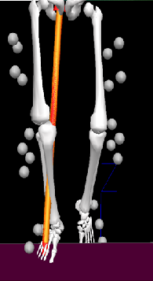
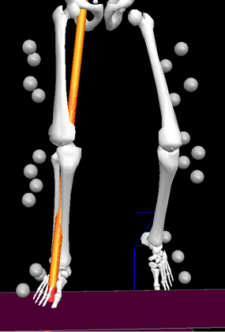
A
B
Figure 1. Illustration of the hypothesized effect of increased step width (B) compared to self-selected step width (A) on frontal plane ground reaction force moment arm to knee joint center. The force vector travels much closer to knee joint center in the medial-lateral direction in the wider step width condition (B) compared to the self-selected step width (A).

Slide 2
Figure 2. Illustration of full marker setup including
anatomical and tracking reflective markers

Slide 3
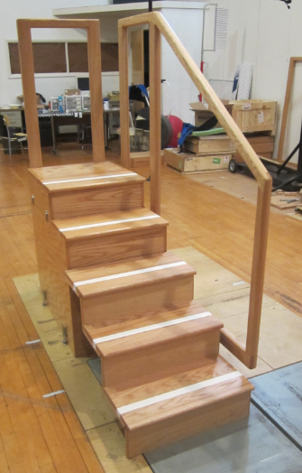
Step of Interest
Figure 3. Illustration of the staircase used in the study.
Variables of interest during the stance phase are analyzed on
the second step (step of interest).

Slide 4
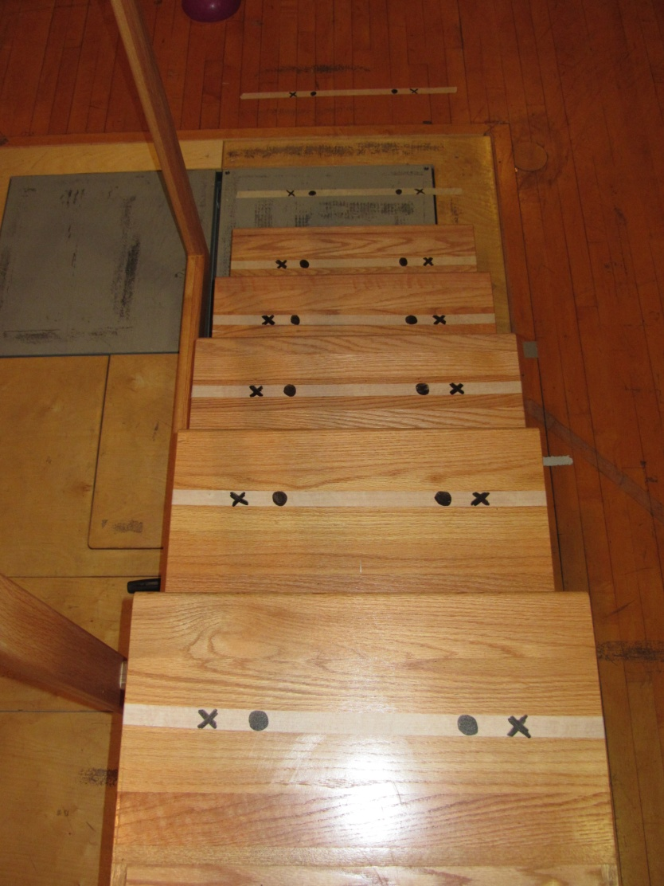
Wide SW
Wider SW
Figure 4. Illustration of the step wide tape with black ink
marks to control step width during the wide and wider step
width conditions.

Slide 5
GRF VARIABLES
LR
Fz_1
Vertical GRF (BW)
0
50
100
A
0
50
100
Medial GRF (BW)
Fx_1
B
Time (%)
Figure 5. Illustration of the vertical (A), and medial (B) GRF
variables from GRF curves of one representative subject.

Slide 6
KNEE ANGLES
0
Ext. (+)
50
100
Flex. (-)
Knee Flex/Ext (deg)
KROM
KADD
Knee Abd/Add (deg)
Add. (+)
0
Abd. (-)
50
100
Time (%)
Figure 6. Illustration of the flexion/extension (A) and
abduction/adduction (B) knee angle variables from
angle curves of one representative subject.

Slide 7
KNEE INTERNAL MOMENTS
KEM
Flex/Ext Moment (Nm/Kg)
Ext. (+)
0
Flex. (-)
50
100
A
0
Add. (+)
50
100
Abd. (-)
Abd/Add Moment (Nm/Kg)
KAM
Time (%)
B
Figure 7. Illustration of the internal flexion/extension (A) and
abduction/adduction (B) knee moment variables from moment
curves of one representative subject.

Slide 8
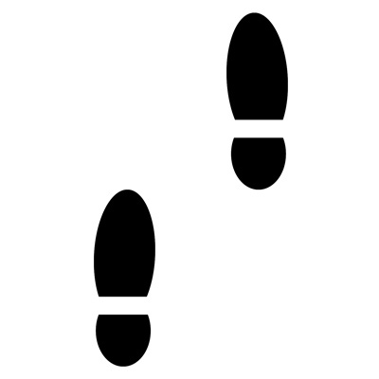
CoG
SW
Figure 8. Illustration of the step width (SW)
variable: medial-lateral distance between
the right and left foot center of gravity (CoG)
location at the instant of lead foot contact.

Slide 9
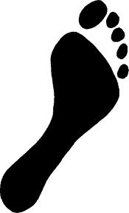
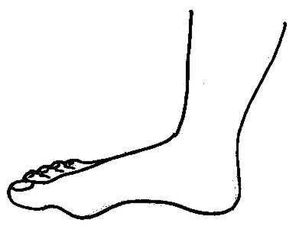
FPA (deg)
FCA (deg)
A
B
Figure 9. Illustration of the foot angle variables. A) Sagittal
plane foot contact angle (FCA) relative to the step surface,
B) Foot progression angle (FPA) at mid-stance.

