Slide 1
UNITY IN THE BLACK COMMUNITY:
From the Past, In the Present, To the Future
Black Issues Conference 2012
Cecilia Dzingira
02/11/12
Notes:
Good Morning: My name is Cecilia Dzingira and I am happy and very honored to be here with you today to present to you the topic on the importance of Unity within our Black community while comparing how things used to be, how they are, and what we can do to better them for the future.

Slide 2
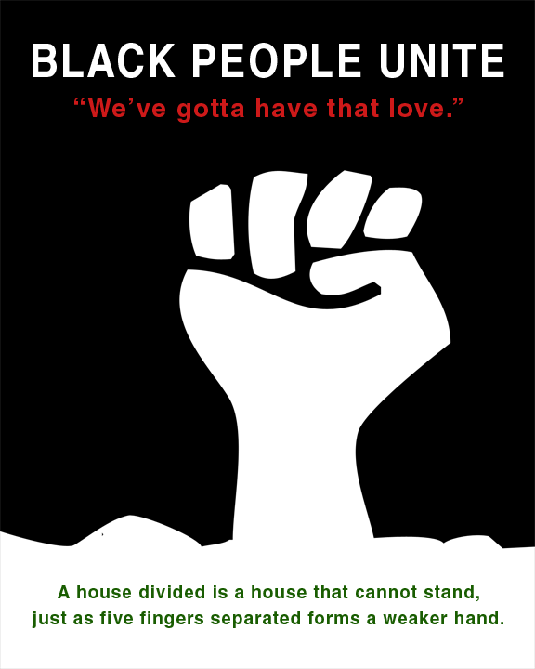
UNITY!!
Notes:
The “Raised Fist” can be dated as far back as early 1920s by a group of Mexicans who printed it for the Assyrian community. It represents solidarity and support. Although introduced by a group of Assyrians, it is most commonly associated with the Black Panther Part for Self-Defense from October of 1966. For those of you who are unaware of these party, it was founded by Huey Newton and Bobby Seal for militant self-defense of minority communities against the U.S. Government. The Raised fist represented unity, strength, defiance, peace, or resistance.

Slide 3
What is Unity?
The state or quality of being ONE.
Oneness.
Being in accord.
Harmony.
Unification.
Constance of purpose action.
Notes:
Would you say, on today, that our black community is in “UNITY”. Please understand that when I say “UNITY in Black Community” I’m not solely speaking on UT’s Black community, I’m speaking on Black communities from your hometown, in other schools, at the work place, and just pure Black empowerment that surrounds us.

Slide 4
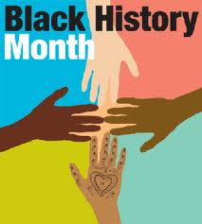
Unity in Schools?
Do you think that there is unity on campus?
Does the African American population have unity amongst themselves on campus?
  Greeks
  Religious Groups
  Organizations
  Jobs
  Academically
Notes:
Do you think that there is Unity on Campus?
Is the Black Population on Campus (students and staff) united?
Why do you think we separate ourselves in groups such as by Greek, Religious Groups, Organizations, etc.
***Create Discussion***

Slide 5
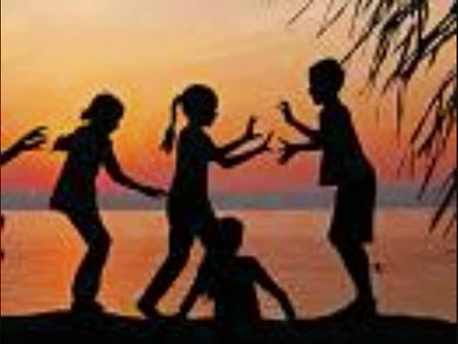
Unity in Schools contd.
Notes:
Are there any comments in regards to the poem?
STOP VIDEO AT 1:12

Slide 6
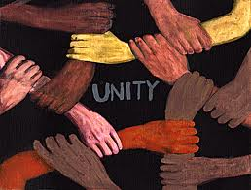
Unity in the Workplace?
Do African-Americans segregate themselves in the workplace?
When in comes to jobs, are all African Americans given the same opportunity as other races?
Do we aim to uplift other people of our kind who are doing better than us?
Notes:
How many of you in here have jobs?
How many have jobs where there is majority African Americans?

Slide 7
Unity in the Communities
School zoning
Transportation
Food:
  Do African Americans solely rely on the assistance of the Government with Food Stamps?
  Do we use them to eat healthier?
Housing:
  Do those who live in richer neighborhoods help those of lower income?
  Are people who are on welfare working towards doing better for themselves?
  What type of ways does living arrangements in communities create social gaps between African Americans?

Slide 8
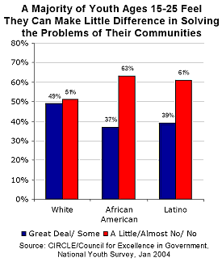
Make a Difference!

Slide 9

How can we foster Unity in the Black Community?
Notes:
While listening to this excerpt, keep in mind all of the questions being asked and think of solutions that may help solve problems as such.
STOP VIDEO AT 1:20

Slide 10
DISCUSSION
Black Child's Pledge
I pledge allegiance to my Black People.
I pledge to develop my mind and body to the greatest extent possible.
I will learn all that I can in order to give my best to my People in their struggle for liberation.
I will keep myself physically fit, building a strong body free from drugs and other substances which weaken me and make me less capable of protecting myself, my family and my Black brothers and sisters.
I will unselfishly share my knowledge and understanding with them in order to bring about change more quickly.
I will discipline myself to direct my energies thoughtfully and constructively rather than wasting them in idle hatred.
I will train myself never to hurt or allow others to harm my Black brothers and sisters for I recognize that we need every Black Man, Woman, and Child to be physically, mentally and psychologically strong.
These principles I pledge to practice daily and to teach them to others in order to unite my People.
The Black Panther, October 26, 1968
by Shirley Williams

Slide 11
ANY QUESTIONS?
THANK YOU. PLEASE DON’T FORGET TO FILL OUT SURVEY! ☺

