Slide 1

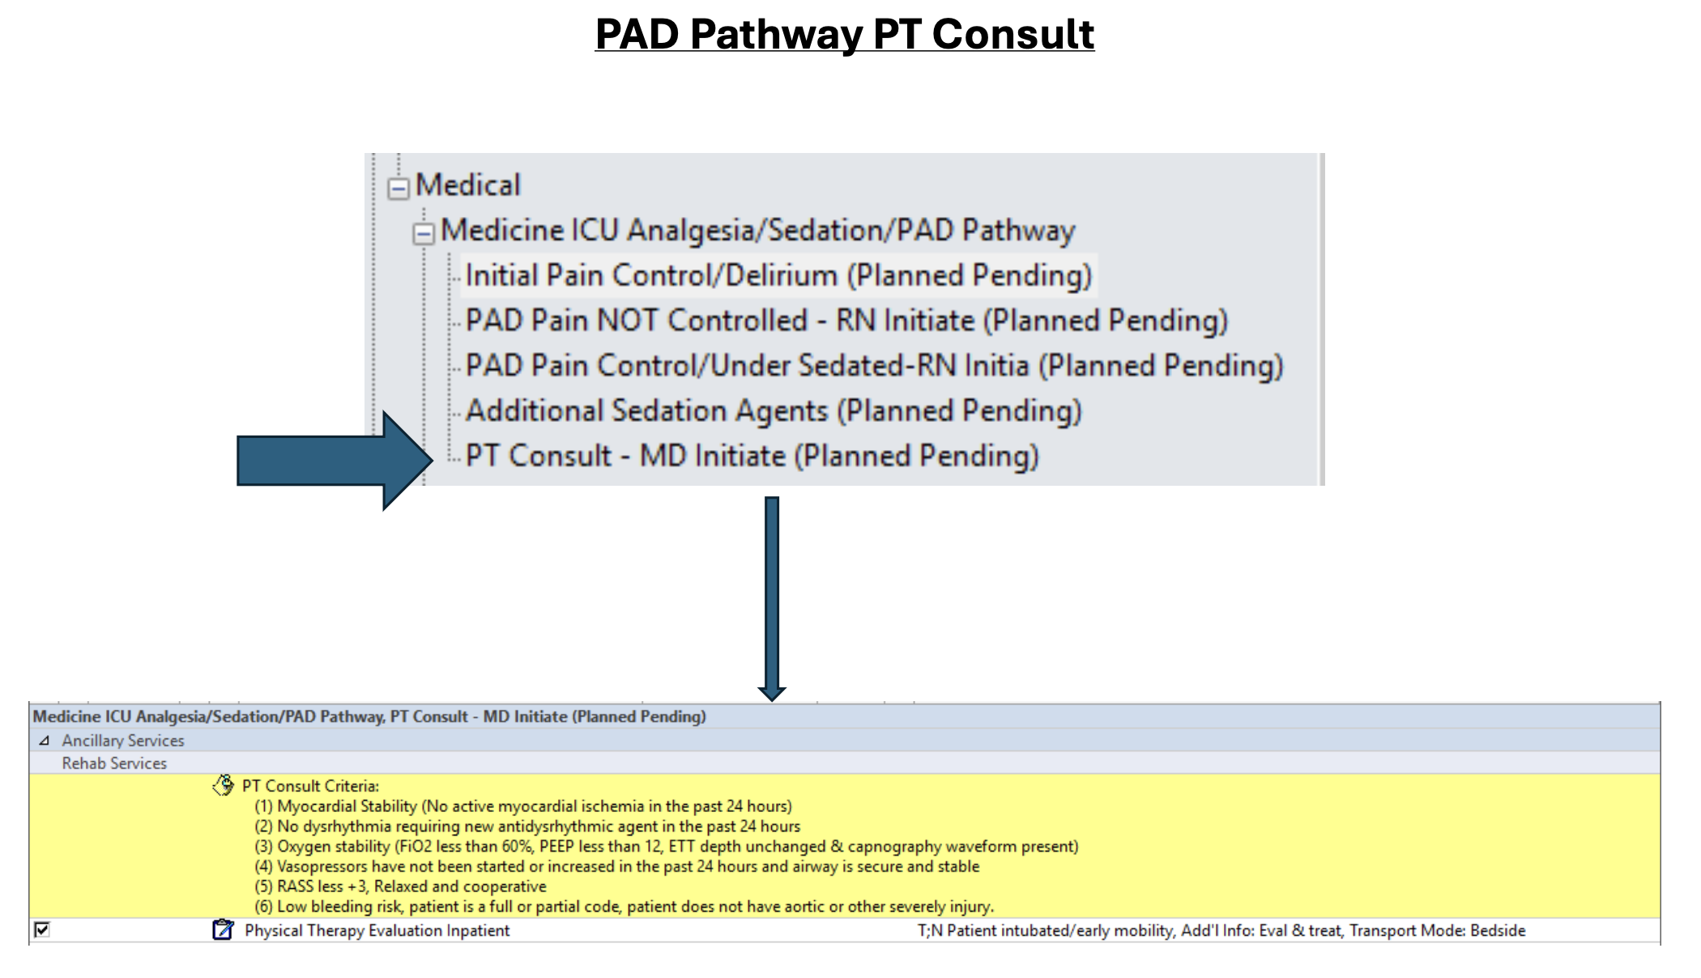
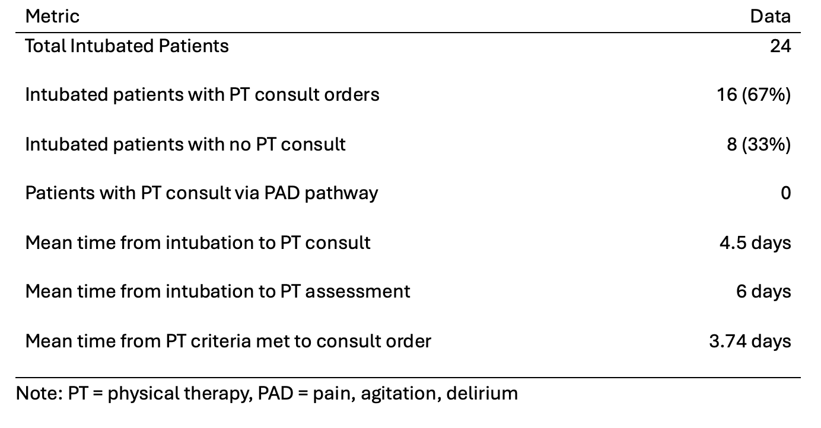
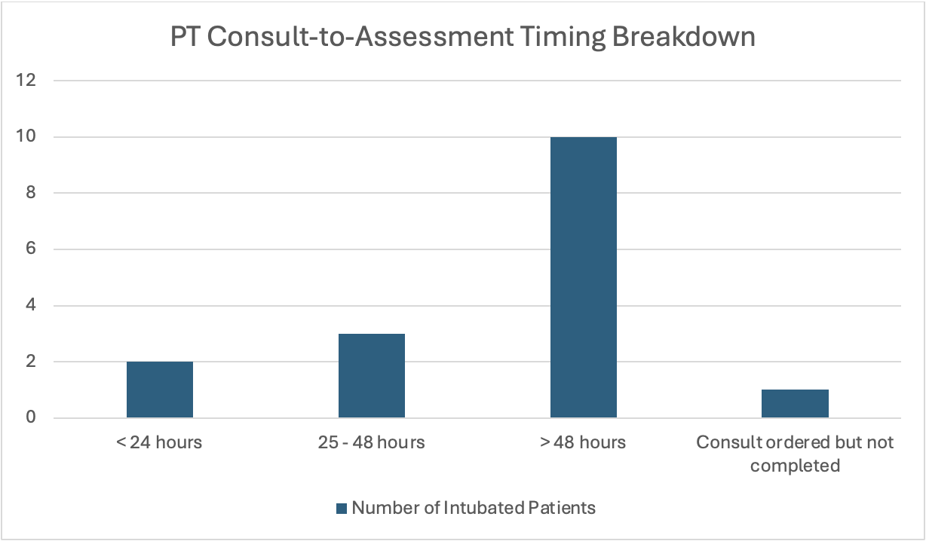
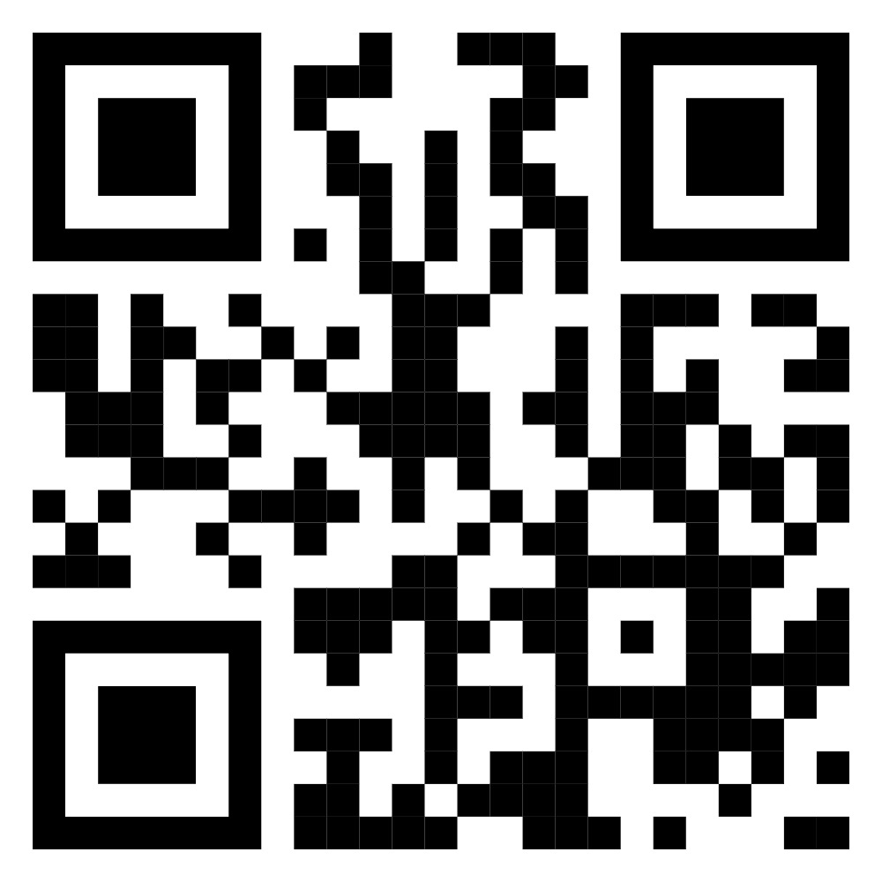

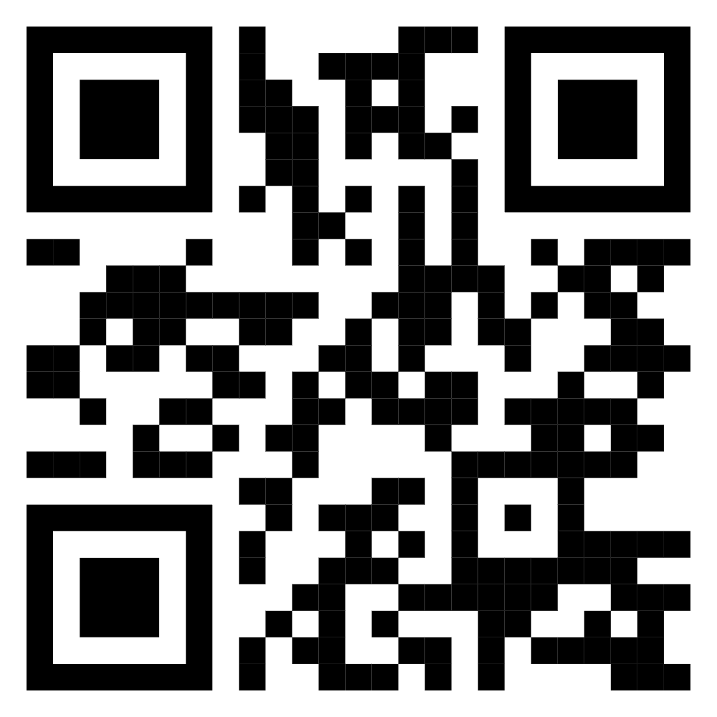
Implementation of a criteria-based physical therapy consultation process did not result in a reduction in time from intubation to PT consult initiation.
Automated Physical Therapy Consultation in ICU Patients: A Quality Improvement Project
Luke Hicks BSN, RN; Luke Dorton BSN, RN; Christian Bayless BSN, RN; Jacob Grubb BSN, RN; Jennifer Patrick DNP, CRNA, CNE; Bradley Milam AG-ACNP; Benjamin Bevill MD
BACKGROUND
INTERVENTIONS
The increased length of time between initial intubation and physical therapy consultation can cause a cascading effect, leading to decreased physical mobility, a modifiable causative factor of prolonged intubation.^{27,28}
Prolonged intubation can lead to muscle atrophy, infection, psychosocial distress, longer stays in the CVICU, increased mortality, hemodynamic compromise, and skin complications.^{11,24,29}
In collaboration with IT, the project team integrated a PT consult order into the existing CVICU PAD pathway.
The PAD pathway is an order set that nurses use following intubation to initiate sedation, analgesia, and vasopressor management.
Initially, it was planned to have the consult order automatically initiate once the patient was intubated; however, due to the PT department’s request, it was changed to a criteria-based consult that had to be manually selected by providers.
Once patients met the criteria, the PT consult could be selected within the pathway.
LOCAL PROBLEM
The project was implemented in a 24-bed cardiovascular intensive care unit (CVICU) at a Southeast U.S. academic medical center.
The primary issue at the project site is the time interval between initial intubation in the CVICU (or arrival at the CVICU while already mechanically ventilated) and the PT consultation.
This project aims to expedite physical therapy consultation by implementing an automatic consult trigger once the endotracheal tube size is documented.
RESULTS
Of 24 intubated patients, 16 (67%) received PT consults, and none received a PT consult via the PAD pathway.
The average time from when a patient met criteria to when a PT consult was ordered was 4.5 days.
The average time from when a patient met criteria to when the PT consult was completed was 6 days.
Only 12.5% of PT consults were completed within 24 hours of ordering.
METHODS
This project utilized the Evidence-Based Practice Improvement Model and the Plan-Do-Study-Act cycles as a framework for continuous improvement.
An existing ICU mobility protocol was adapted specifically for use in the CVICU, providing nursing and physical therapy staff with a standardized, evidence-based framework for early mobility.
Protocol utilization, PT consultation rates, the timing from intubation to consultation and assessment, and the number of patients who did not receive a consultation were measured during this project.
CONCLUSIONS
The biggest hurdle to effective consultation times was the request by the PT department to switch to a criteria-based consultation that was chosen at the provider's discretion, instead of an automated consultation trigger upon documentation of the presence of an endotracheal tube.
Implementing a criteria-based PT consultation did not improve consultation times, as patients experienced significant delays in care, emphasizing a need for a streamlined, automated approach to PT consultation ordering.
Executive Summary
References

