Slide 1
Social media convergence and journalistic adaptation:
Survival of the fittest?
Denae D’Arcy
PhD candidate
University of Tennessee
February 9, 2012

Slide 2

bio
*Master’s Degree, International Journalism, University of Westminster, London, UK
*11 years, television news reporter/anchor
*Appreciates constructive criticism
*ddarcy@utk.edu

Slide 3

The study
Research questions summary:
Which journalists are more likely to adopt social media during the work day?
Measured frequency of posts:
* Twitter
* Facebook
Measured % of work day used

Slide 4

Who cares?
Research gap:
Lack published research examining journalists’ adaptation to social media during workday
Past studies:
Consider broadcast TV news journalists and adaptation to online news duties

Slide 5

Literature
GRANT, A.E., WILKINGSON J.S, eds. Understanding Media Convergence, The State of the Field. New York: Oxford University Press; 2009.
HUANG, J.S., HEIDER, D. “Media Convergence: A Case Study of a Cable News Station.” The International Journal on Media Management. Vol. 9, No. 3, 2007.
LAWSON-BORDERS, G. Media Organizations and Convergence, Case Studies of Media Convergence Pioneers. New Jersey: Lawrence Erlbaum Associates, Inc., Publishers; 2006.
SINGER, J.B., “Strange Bedfellows? The diffusion of convergence in four news organizations.” Journalism Studies, Vol. 5, No. 1, 2004.

Slide 6

method
Online survey, 10 questions
Snowball method
*initial contact with 100 on-air journalists
Pilot study
*25 respondents

Slide 7
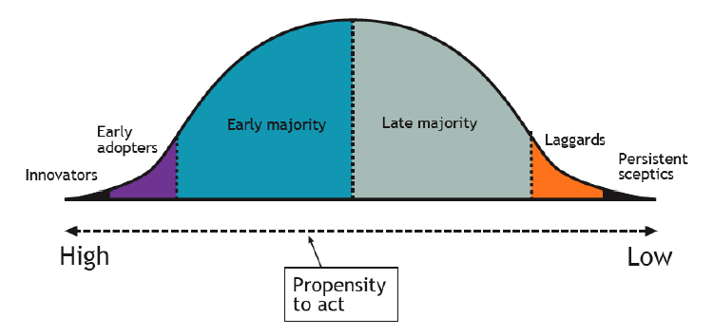
Theory
Rogers’ Diffusion of Innovations

Slide 8
Pilot respondents
Age: 23 – 60
Experience: 2 – 34 years
Education: Bachelor – PhD
Gender: 11 male, 15 female

Slide 9


Pilot Results:
Facebook Users
100%
Twitter
Users
96%

Slide 10
frequency
Facebook
1 – 20 x
daily
Twitter
0 – 20 x
daily

Slide 11

Percentage of day = social media
7. Estimate the percentage of your day spent posting on social media sites.
1% - 35%
(out of an 8 hour, typical day)

Slide 12

Combined Tools used
81% Use desktop computer
69% Use personal cell phone
65% Use laptop computer

Slide 13
A closer look - age
Twitter posts:
(1) > 29, M = 6 times
(2) < 39, M = 4 times
Facebook posts:
(1) > 29, M = 4 times
(2) < 39, M = 3 times
% of use:
(1), M = 11%
(2), M = 10%

Slide 14
A Closer look - Education
Twitter posts:
BA, M = 4 times
MA, M = 20 times
PhD, M = 5 times
Facebook posts:
BA, M = 3 times
MA, M = 5 times
PhD, M = 5 times
% of social media:
BA, M = 5%
MA, M = 25%
PhD, M = 5%

Slide 15
A Closer look - experience
Twitter posts:
> or = 5 years, M = 3
< or = 10 years, M = 4
Facebook posts:
> or = 5 years, M = 2
< or = 10 years, M = 3
% of social media:
> or = 5 years, M = 8%
< or = 10 years, M = 13%

Slide 16

A closer look – gender
% of social media use daily:
female, M= 10%
male, M = 13%

Slide 17

Social media use MOTIVATION
*35% - disseminate information
“I post because I want people to know the stories I am doing and if there is something important to their lives, I want them to know as soon as possible.”
31% - station promotion for TV and web
“To get the word out for web hits and what’s coming up on the air for some eyeballs on the tube.”

Slide 18
Social media use motivation (2)
15% - gather information
“To find quicker leads on a story. Twitter and Facebook are like seven degrees of Kevin Bacon, there’s always someone who knows someone who can add to the story.”

Slide 19
Social media use motivation (3)
12% - employer mandate
“Part of my duties.”
7% - other
“Practice, develop online presence.”

Slide 20
PILOT RESULTS
*Lacks significant finding
Despite age, experience, education journalists tend to readily adopt social media into work duties.
Theory may not fit the trend

Slide 21
Pilot results (2)
Journalists use social media to:
Generate story ideas
Promote station’s platforms
Male on-air journalists spend more time using social media compared to females

Slide 22
Continued research
Why do journalists tend to be early adapters?
At what rate do journalists adopt innovation?
*Addressing questions in main study

Slide 23
Full study sample
*Top 100 markets (3 stations ea)
*TVJobs.com database for emails
*Email link to news directors
*Approx. 7 on-air, each station
*Potential 2,100 respondents
*6% response rate

Slide 24
feedback?
Question?

Slide 25

Contact
Denae D’Arcy:
ddarcy@utk.edu
Communication and Information Science
University of Tennessee Knoxville

