Slide 1




Research Data Services in European Libraries: Current Offerings and Plans for the Future
Carol Tenopir
University of Tennessee
Hanken School of Economics, Helsinki

Slide 2

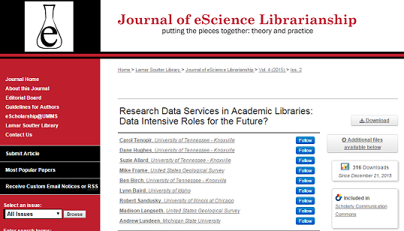
LIBER Survey Builds on Previous DataONE Library Surveys
Library Baseline (2010)
Citations: 72
Follow-up for comparison (2014)
Citations: 5
1,269 downloads
(published Dec 2015)

Slide 3

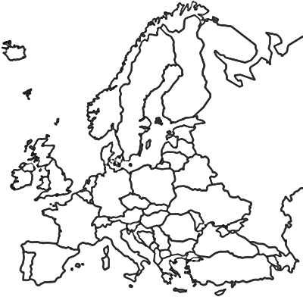
LIBER Survey Responding Libraries
Survey Respondents
LIBER Academic Library Membership
North: 19%
North: 15%
West: 51%
West: 53%
East: 17%
East: 16%
South: 13%
South: 17%
Notes:
n=119; (answered both a demographic & analysis questions) n=109 answered by country
West: 51% North: 19% East: 17% South: 13%
n=333 (LIBER pop)
West: 177 (53.1%) East: 52 (15.6%) North: 49 (14.7%) South: 55 (16.5%)

Slide 4
Key Findings
LIBER academic libraries offer and are planning a range of Research Data Services, but…
…Consultative RDS are most common
…Fewer libraries offer technical RDS
2. There are some regional differences
3. Libraries use a variety of strategies for developing staff skills

Slide 5
LIBER academic libraries offer and are planning a range of Research Data Services

Slide 6
RDS offered by most libraries currently
Consultative
Consultative
Consultative
Consultative
Consultative
Consultative
Notes:
*yes only responses*
Outreach/collaboration with other RDS providers (n=107)
Consulting on data and metadata standards (n=105)
Consulting on data mgt plans (n=107)
Training colleagues on RDS (n=95)
Involved in policy development/planning (n=95)
Discussing RDS with others (n=95)

Slide 7
RDS offered continued
Technical
Consultative
Consultative
Consultative
Technical
Notes:
*Yes only*
ID datasets (n=106)
Direct participation with researchers (n=94)
Creating web guides (n=100)
Providing tech support for finding/citing data (n=101)
Providing ref. support for RDS (n=101)

Slide 8
Currently offered and future plans for consultative-type services
Notes:
Outreach/collaboration with other RDS providers (n=107)
Consulting on data and metadata standards (n=105)
Consulting on data mgt plans (n=107)
Training colleagues on RDS (n=95)
Involved in policy development/planning (n=95)
Discussing RDS with others (n=95)
Creating web guides (n=100)
Provide reference support (n=101)
Direct participation with researchers (n=94)

Slide 9
Currently offered and future plans for technical-type services
Notes:
Providing technical support (n=101)
Preparing data/sets for deposit (n=100)
ID data (n=106)
Create/transform metadata (n=103)
Deaccession of data (n=97)

Slide 10
2) There are some regional differences

Slide 11
Regional differences in consultative RDS availability
Notes:
Crosstab n:
Training colleagues on RDS: (n=95)
Discussing RDS with others (n=95)
Provide support for finding/citing data (n=101)

Slide 12
Regional differences in technical RDS availability
Notes:
ID datasets (n=104)
Prepare data (n=99)
Create/transform meta/data (n=103)

Slide 13
3) Libraries have a variety of strategies for developing staff skills

Slide 14
Have you hired staff for RDS in the last 12 months?
Notes:
n=85

Slide 15
Has your library provided opportunities for library staff to develop skills related to RDS?
Notes:
n=87

Slide 16
Which of the following opportunities has your library provided for library staff to develop skills related to RDS?
Notes:
n=87
Collaboration with others with skills related to RDS (n=8)
In-house staff workshops (n=41)
Support for staff to join working groups related to RDS (n=51)
Support for staff to take courses related to RDS (n=52)
Support for staff to attend conferences/workshops (n=68)

Slide 17
Staff Skills Development
Dramatically increase the workload of some poor individual librarian
Collaborated with another institution to develop a skills-based MOOC
Moved staff from other support unit [ITS]
Strategies
Hired staff for projects (not permanent)
Refocused an existing role

Slide 18
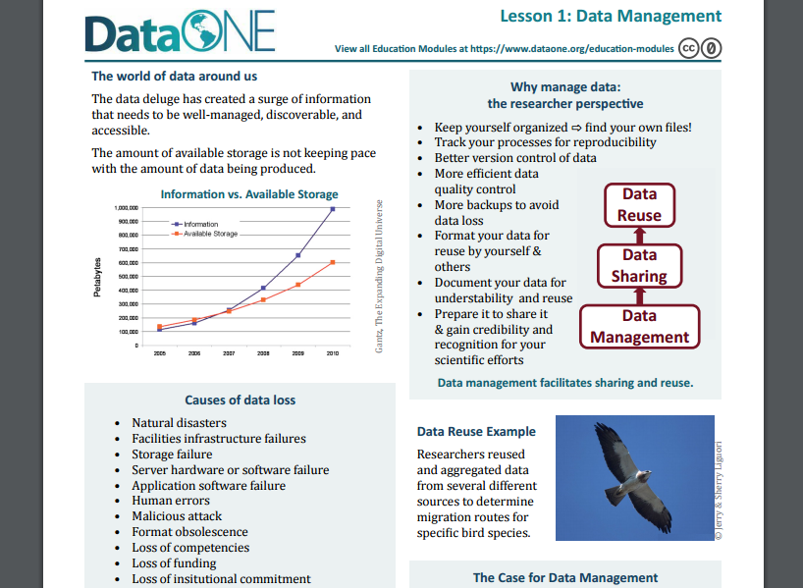
Tools for RDS Education and Assistance
https://www.dataone.org/education-modules

Slide 19
DataONE Education Modules
Why Data Management
Data Sharing
Data Management Planning
Data Entry and Manipulation
Data Quality Control and Assurance
Data Protection and Backups
Metadata
How to Write Quality Metadata
Data Citation
Analysis and Workflows
Legal and Policy Issues

Slide 20
Thank You!
Carol Tenopir-University of Tennessee
Sanna Talja-University of Tampere
Wolfram Horstmann- University of Gottingen
Birgit Schmidt-University of Gottingen
Elina Late-University of Tampere
Lynn Baird- University of Idaho
Robert Sandusky- University of Illinois-Chicago
Suzie Allard-University of Tennessee
Dane Hughes-University of Tennessee
Danielle Pollock-University of Tennessee

