Slide 1
DataONE
Usability & Assessment
External Advisory Board
December 2015

Slide 2
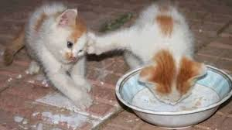
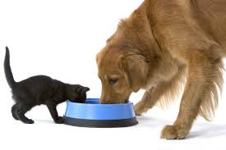

Usability & Assessment Working Group
Understand Stakeholders
Identify Data Sharing Challenges
Monitor Data Sharing Attitudes
DataONE tools UX

Slide 3

Creating a culture of Data Sharing is challenging
Notes:
Scientists face limitations (lack of time & funding, need to publish first, and not having rights to make data public)
Many libraries have no plans to offer RDS
Digital preservation challenges include authenticating, replicating, & formatting data & datasets
In the USGS, there is a lack of awareness on data management training from both their own agency and from authorities like ISO and FGDC;
Outside of an institutional server, most are storing data within their personal domain (PC, desk in office)
; Roughly only one-third of all institution types surveyed provide reference support for finding & citing data & datasets
Many disagree their mission area or program provides training, or the funds to support data management (short or long term); Like scientists, most are storing their data on their personal computer

Slide 4
Challenges of Data Sharing -- Scientists
If all or part of your data are not available to others, why not? (Check all that apply)
2010 n=1329 2014 n=1015
Notes:
Scientists 2010: n=1,329; 2013: n=1,015: Q6, Q14, SPSS Q13b_1-8: If all or part of your data are not available to others, why not? (Check all that apply)

Slide 5
Challenges of Data Sharing -- USGS
Please indicate your awareness of or use/participation in…
Survey N=432
Notes:
USGS n=432; Please indicate your awareness of or use/participation in... Q20, SPSS Q62 (unaware, aware but not used, have used scale)

Slide 6
Challenges of Data Sharing -- Libraries
Which of the following Research Data Services does your library currently offer or plan to offer in the future?
Survey N=128
Notes:
Libraries Follow-Up n=128: Which of the following RDS does your library currently offer or plan to offer in the future? (Consultative services) (Yes/currently offer this service; no but plan to within 12 months; no, but plan to in 13-24 months; no, but plan to in more than 24 months; no, and no plans to do so) *choices were condensed for analysis and grouping purposes*

Slide 7
Challenges of Data Sharing -- Librarians
How frequently do you perform the following digital preservation services on data/data sets or systems?
Survey N=146
Notes:
Librarians n=146: How frequently do you perform the following digital preservation services on data/data sets or systems? (Never, a few times a year, about once a month, about once a week, daily)

Slide 8
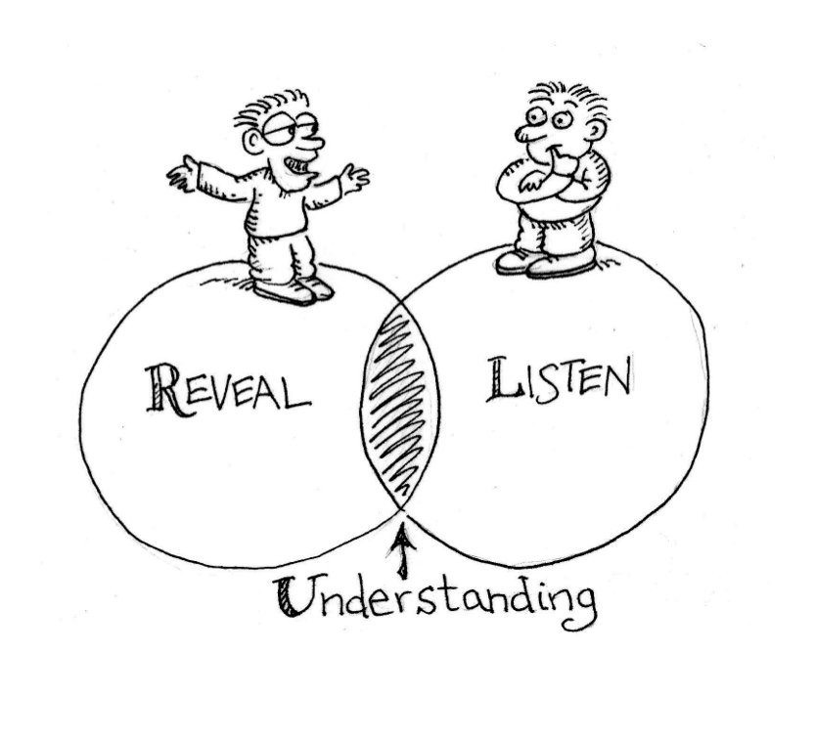
Steps to build a culture of Data Sharing
Notes:
Learn about current practices and attitudes of community members. Identify community needs.
Consult users about their needs when developing effective and easy to use tools & services

Slide 9
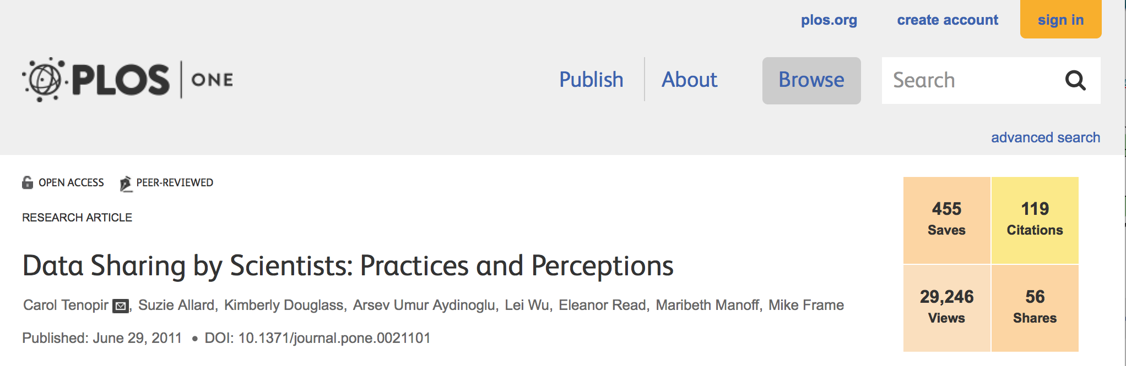
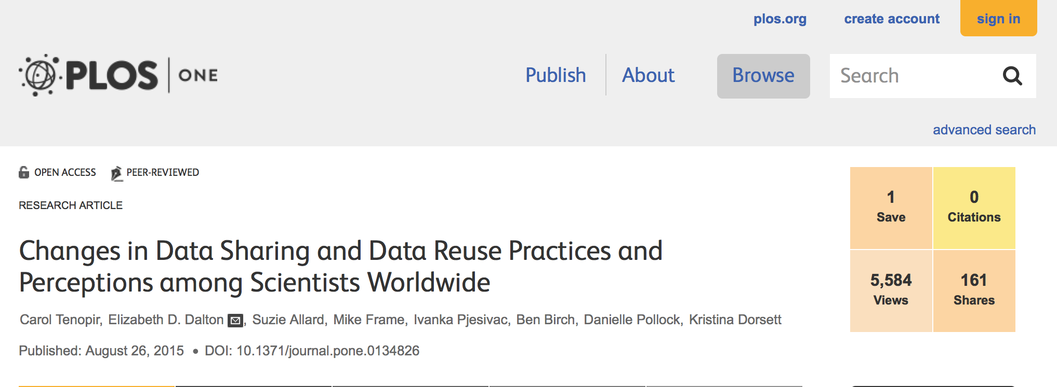
How we are learning about scientists
Scientists Assessments
Record a baseline
2010
Views: 29,484; Citations: 127
(published Jun 2011)
Follow-up for comparison
2014
Views: 5,734 (published Aug 2015)

Slide 10
THE World is Changing….
Scientists tell us

Slide 11
Funding agency DMP requirements have increased
Notes:
Scientists 2010: n=1,329; 2013: n=1,015; Does your primary funding agency require you to have a data management plan?
f=1293 f=857

Slide 12
Interest in data sharing is increasing
Notes:
Use others' datasets if their data were easily accessible (2010 f=1299, 2014 f=629)
Willing to share data across a broad group of researchers (2010 f=1287, 2014 f=617)
It is appropriate to create new datasets from the shared data (2010 f=1297, 2014 f=597)

Slide 13

Use of metadata standards is increasing
Notes:
Scientists metadata standards currently in use 2010: n=1,329; 2014 n=1,015

Slide 14
Conditions for data sharing are relaxing
Notes:
(yes, no, not sure)
Formally cite provider/funder (2010 f=1234, 2014 f=639)
Acknowledge provider/funder (2010 f=1256, 2014 f=646)
Opportunity to collaborate (2010 f=991, 2014 f=409)
Reciprocal sharing agreement (2010 f=880, 2014 f=319)
Reprints of articles (2010 f=860, 2014 f=324)
Complete list of products (2010 f=846, 2014 f=305)

Slide 15
Data sharing challenges are decreasing
2014
Notes:
Scientists top reasons for not making data available (check all that apply)
2010
Insufficient time f=603
Lack of funding f=445
No place to put data f=264
Do not have rights to make data… f=271
Lack of standards f=222
Sponsor does not require f=196
Do not need data f=169
Should not be available f=162
Other reasons for data not available f=164
2014
I need to publish f=299
Insufficient time f=265
I don’t have rights f=179
Lack of funding f=169
Do not need data f=170
Lack of standards f=123
no place to put data f=125
Should not be available f=90
Insufficient skills f=91

Slide 16
Federal Research Agency is unique
Roles (Scientist, Data Manager) and Mission Area were considered
Mission areas include water, natural hazards, etc.
57% agree the data they manage is fully described
52% do not know the process in their center for depositing the data they collect or manage long-term
74% believe their mission area or program would share some of their non-sensitive data in a central repository with no restrictions
54% believed the same for all of their non-sensitive data
Notes:
Respondents totaled to 432, and were also broken down into different types of subsets such as: Scientist, Data Manager, Mission Area, etc.,
Some mission area subsets have been analyzed and reported to respective heads of said mission areas (includes: water, natural hazards, etc.)
While 57% agree the data they manage is fully described, 52% disagree that a process exists in their center or program for depositing the data they collect or manage long-term (n=373)
In regards to sharing data, sentiments are generally favorable, where 74% believe their mission area or program would share some of their non-sensitive data in a central repository with no restrictions, while 54% believed the same for all of their non-sensitive data

Slide 17
To build the best tools….
We watch scientists at work

Slide 18
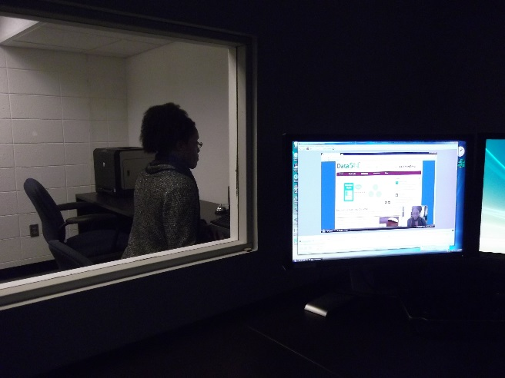
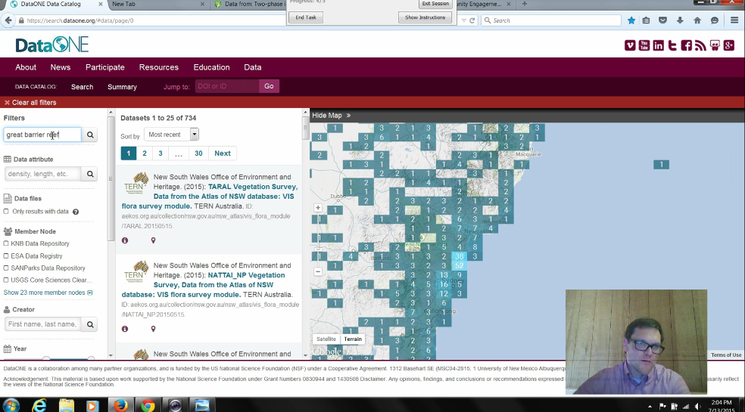
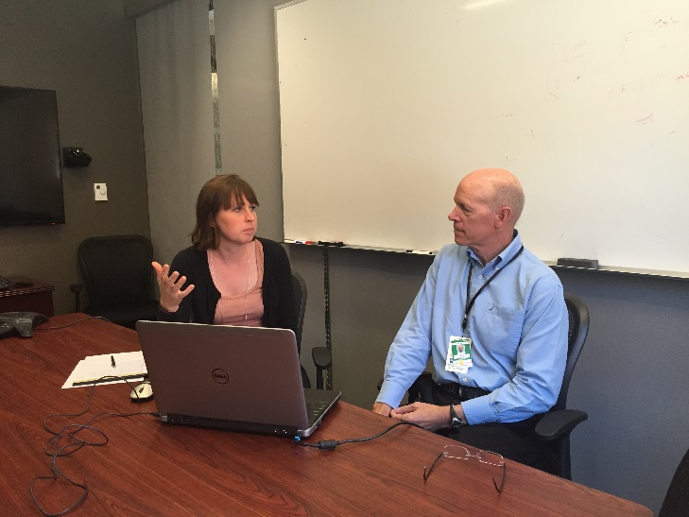
User eXperience Testing
UX includes:
  Heuristic evaluation
  Usability study
  Online Survey
Usability studies include:
  Wireframes, mockups, prototypes
  Live websites
  A/B testing
  Eye-tracking
Testing can be done:
  In the UXL
  In another location
  Remote (online)
UX in the UXL
UX at DUG
UX at ORNL
Notes:
Images of testing in the lab, at ORNL, and at DUG

Slide 19
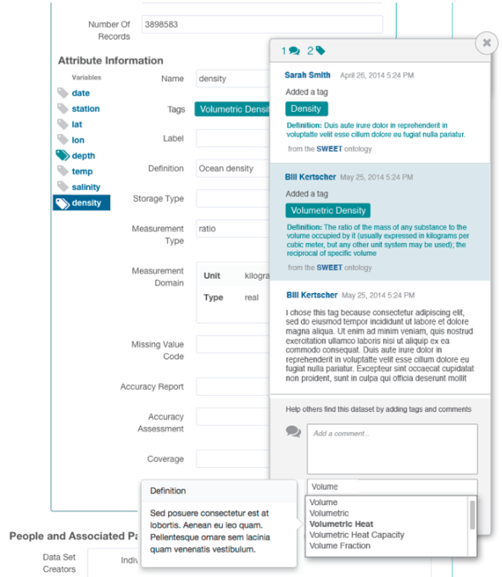
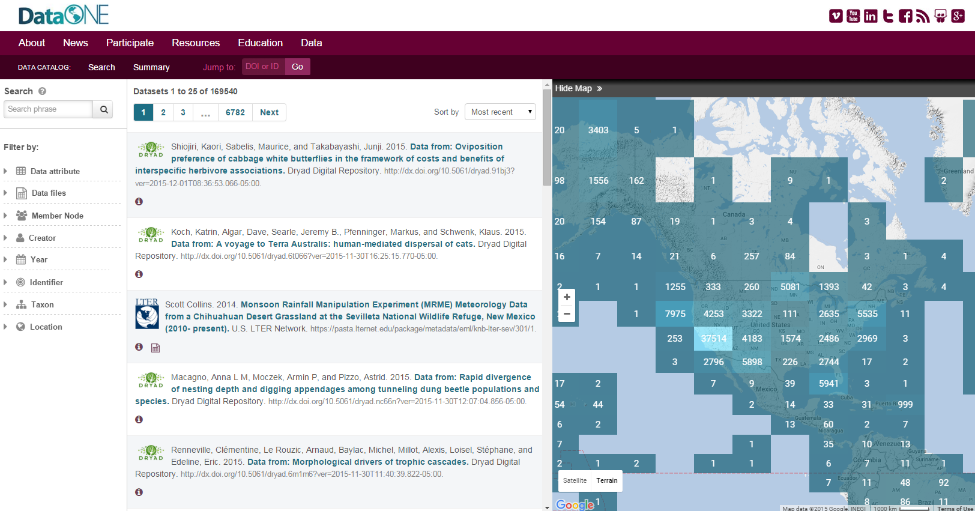
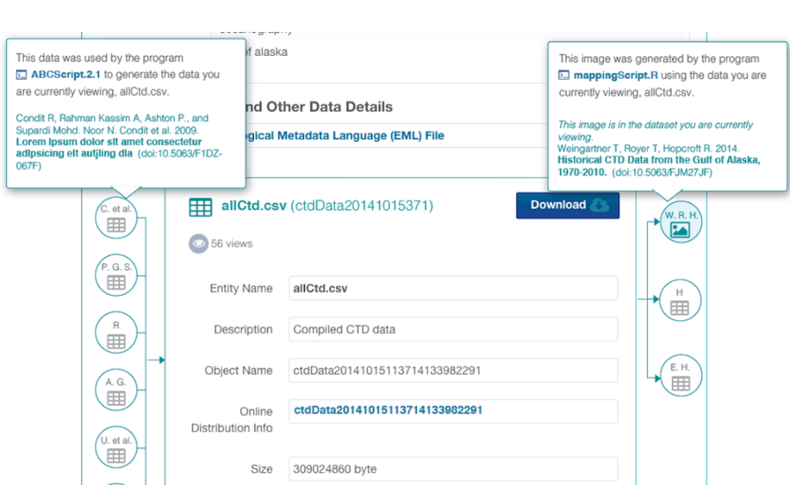
DataONE UX Activities:
Testing completed at UT, ORNL, DUG, AHM, and remotely
Participants include DataONE affiliated scientists, non-DataONE scientists, DUG, Member Node associates, and UT graduate students.
Testing completed using Morae, WebEx, and Qualtrics
Tools tested
  DataONE Search
    Search Interface
    Metadata Interface
    Provenance Display
    Semantics Display
    Login screen
    User profile
  MatLab Toolbox
  DataONE website
Member Node UX for USGS, ARM
Notes:
Images of DataONE search, the prov display in the search metadata results, and the semantics display in the metadata.
DataONE Search was the major piece of DataONE tools for UX. Iterative testing throughout the year. Includes multiple facets of the tool—including search, metadata, user profile, semantics, and provenance. Search was testing heuristically, at U&A WG in Spring Meeting, at DUG 2015, at AHM, and through Webex,and Qualitrics.
MatLab Tool testing at AHM and inspired additional testing of MatLab and the R toolbox (in 2016).

Slide 20
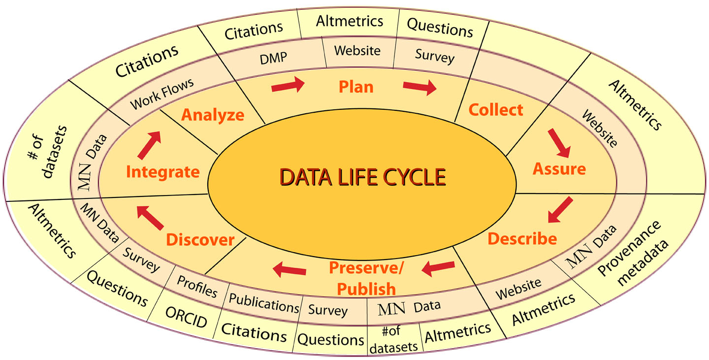
Measuring Impact on researchers and science
DataONE Summer Intern Metric Recommendations
Use the data life cycle to consider impact.
Identify “new” science through tracking integrated datasets from different disciplines.
Increase provenance information to identify integrated datasets .
Examine Data Management Plans for citations and use of integrated datasets
Examine workflows for citations and use of integrated datasets to recognize contributing datasets.
Track the number, and downloads, of integrated datasets.
Identify users of MN datasets - create an opt-in profile of researchers using ORCID's to allow analysis about data use (educational, research, hypothesis testing etc.)

Slide 21
Targets for education
Many scientists who teach would find data management courses or seminars on the topic useful.
Areas of interest: the data lifecycle, workflow and meta-analysis.
9% feel they are covering data management thoroughly, and 35% believe they should add more content to their data management topics.
Notes:
Many scientists who teach data management do not feel it is their area of expertise. More courses or seminars on the topic would be useful to these educators.
Those who teach data management are teaching in graduate courses or outside courses the most. Areas for more exposure: the data lifecycle, workflow and meta-analysis.
Only 9% feel they are covering data management thoroughly, and 35% believe they should add more content to their data management topics. Only 2% do not believe they teach data management sufficiently, and have no plans to add more content (n=132)

Slide 22

Inspirational
UT, ORNL UK, RFC
Comments?
Questions?
Image: public domain available at http://commons.wikimedia.org/wiki/File:Polarlicht_2.jpg

