Slide 1


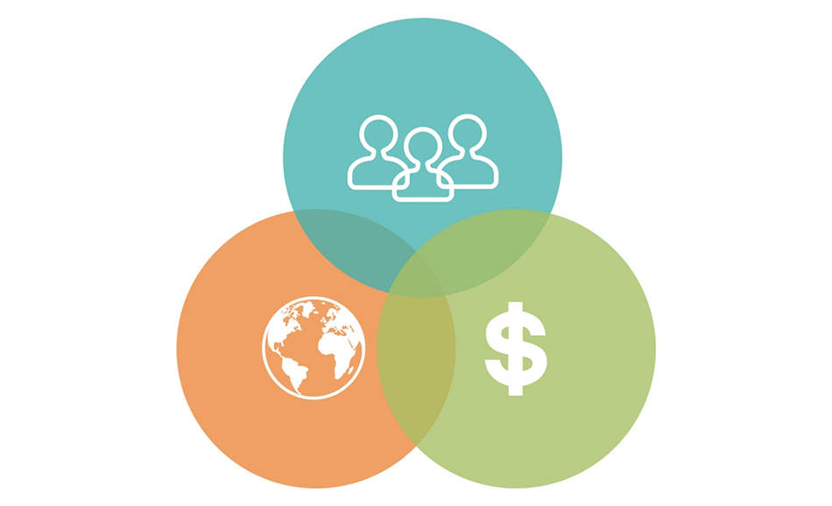
Education’s Role in Socially Sustainable Sourcing Methods
Author: Emily Lorraine Toye
Advisor: Dr. John Bell
University of Tennessee
Abstract
Methodology
Conclusion
From blood diamonds sparking a war in West Africa to Foxconn building a suicide net, any inhumane act in a supply chain poses a risk to companies, despite how upstream the scandal occurs. Consumers are becoming increasingly aware of the supply chains of the companies from which they purchase, as information is becoming more and more accessible. While companies may claim to be not responsible for the actions of tier two and three suppliers, consumers associate the company with the scandal regardless. This study explores how companies are ensuring their upstream supply chains are socially responsible.
-Qualitative Research Method: Collected Data through interviews with subject matter experts and company representatives
-Five interviews with experts in supply chain sustainability
Faculty or doctorate students at the University of Tennessee
Purpose: gather insights that are not biased towards any particular company
-Three interviews with company representatives
Procurement or sustainability professionals
Purpose: gather insights from individuals who are currently working in the field
-Data Evaluation: Identified common themes within transcribed interviews
The main incentive behind social sustainability programs is economic performance.
Companies do not have sustainability programs beyond tier 1 suppliers.
Companies are using education as an approach to sustainable sourcing.
Consumers will incentivize companies to improve sustainability programs in the future.
.
Contacts
Emily Toye:
etoye@vols.utk.edu
Dr. John Bell:
bell@utk.edu
Background
Sourcing is a function of supply chain in which the need for sustainability has become evident in the past decade due to customer visibility and globalization.
Consumers now have increased visibility of supply chains due to readily available information on the world wide web and social media. When a supplier is involved in a scandal, the company will be associated with the scandal, regardless of what tier the supplier falls under.
Globalization is another factor impacting sustainability. Companies are seeking lower labor and materials costs in developing countries to improve their bottom lines. In other cases, a raw material is scarce and can only be found in certain regions. Globalization leads to an increase in risk. Suppliers can be more difficult to monitor and values may not align.
McCormick’s social sustainability strategy involves the use of education. McCormick is improving access to education by sponsoring “village adoption” programs in the regions from which they source.
Acknowledgements
Results
Thank you to the following for the support throughout this research process:
My advisor Dr. John Bell
The Global Leadership Scholars Program
The Haslam College of Business faculty and peers
Key Theme | Insight | Participant
Economic Performance Incentive | The goal of investing in long-term social projects is to reap economic benefits in the future. Companies are ultimately measured by their economic performance. | 1 | 2 | 3 | 4 | 5 | 6 | 7 | 8 | Count
 |  | x | x |  | x | x |  |  | x | 5
Companies do not have sustainability programs beyond tier 1 suppliers | Companies must focus their efforts on themselves and tier 1 suppliers before delving into their upstream supply chain. | x | x | x | x | x | x | x | x | 8
Companies are using education as an approach to sustainable sourcing | Companies work directly with farmers to educate them how to operate sustainably. | x | x | x | x | x |  | x | x | 7
 | Companies invest in education programs in communities in which they source from and operate in.
Consumers will incentivize companies to improve sustainability programs in the future | Consumers are becoming increasingly aware of business practices and are making more educated decisions. Sustainability could possibly become an order winner. | x | x | x |  | x |  |  | x | 5
Bibliography
Bals and Tate. “Achieving Shared Triple Bottom Line (TBL) Value Creation: Toward a Social Resource-Based View (SRBV) of the Firm.” Journal of Business Ethics. Oct2018, Vol. 152 Issue 3, p803-826. UTK Online Library. https://web-b-ebscohost-com.proxy.lib.utk.edu/ehost/detail/detail?vid=5&sid=43cee0e4-2a21-45cb-884b-c1ee277e387d%40pdc-v-sessmgr04&bdata=JnNjb3BlPXNpdGU%3d#AN=132697357&db=bth. Accessed 6 September 2019.
Epstein, Marc J., and Adriana Rejc. Making Sustainability Work: Best Practices in Managing and Measuring Corporate Social, Environmental and Economic Impacts. Taylor and Francis, 2017. https://ebookcentral-proquest-com.proxy.lib.utk.edu/lib/utk/reader.action?docID=1407850&ppg=98. Accessed 16 November 2019.
“Human Rights and Supply Chain.” McCormick: Purpose-Led Performance Report, 2017, p.widencdn.net/svjpy4/PLP_2017_Report_US_English. Accessed 16 November 2019.
Johnson, Eric. “Blood Diamonds: The Conflict in Sierra Leone .” Blood Diamonds, 2002, web.stanford.edu/class/e297a/Conflict%20in%20Sierra%20Leone.htm. Accessed 17 November 2019.
Research Objective
This research study explores how companies are approaching socially sustainable sourcing through the use of education.

