Slide 1




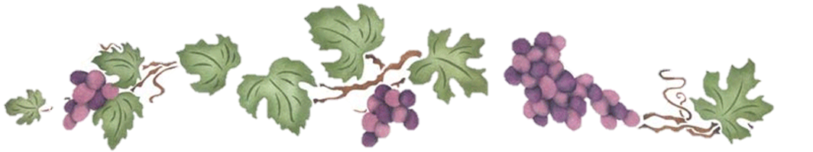





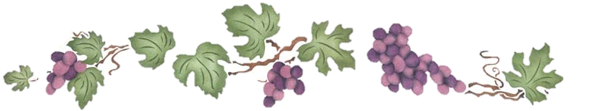

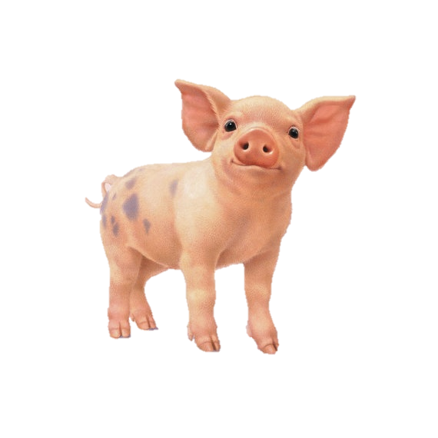

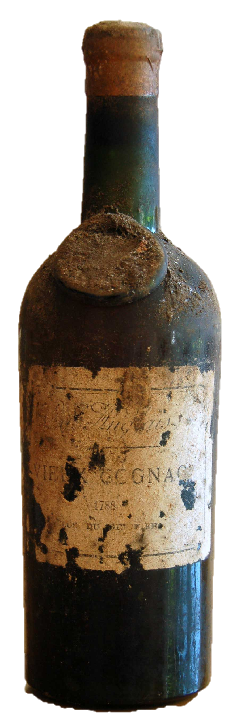

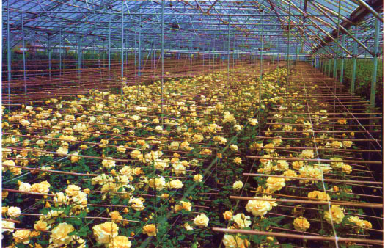

Women in Agriculture: A Qualitative Study Examining How Women Have Sustained Their Leadership Roles in Agriculture in Australia
Amanda Dean, Undergraduate
Dr. Carrie Stephens, Faculty Advisor
THE UNIVERSITY of TENNESSEE
INTRODUCTION
Women are the minority in production agriculture and their leadership in agricultural industries is rarely explored. Therefore, the leadership development of five prominent agriculture leaders in Australia was chosen to be explored for this study. Connections were drawn between each case study, emphasizing the central research question of “How have women in agriculture sustained their leadership role in a male-dominated field?” Impacting their styles of leadership within farming and other agribusiness trades were the shared themes of their childhood dynamics, their individual support systems, and their current home life. This study used a constructivist paradigm, as reflecting upon the subjects’ past cultural experiences was crucial in understanding their current positions in life and leadership. Each story is unique however, this analytical study aims to recognize successful women in agricultural leadership roles traditionally held by men.
CONCLUSIONS
All subjects recognized the importance of self-development and the value of support from others necessary to achieve it. Now that the women studied have achieved success in a field dominated by men, they are now eager to share their knowledge and present others with similar opportunities. Each emphasized notions that one cannot “take” people along, but can only inspire and encourage, providing others with choices. One woman stated, “We support other women so they are encouraged to put their hands up for those opportunities so they can contribute sooner.” Along their journeys, they have faced personal struggles, both within the industries they lead and with finding a balance at home in their families. Their primary objective is to engage with their own industry and provide opportunity and support to other women.
PURPOSE AND OBJECTIVES
The purpose of this study is to explore the lives of women in Australian agriculture in an attempt to conceptualize the leadership styles they have developed as a result of their positions in a male dominated field, as well as their upbringing and life experiences.
- Explore personal journeys of five women in agriculture
- Identify leadership styles of selected women
- Recognize impact their personal journeys have had in developing their
leadership styles and sustaining their roles as leaders in a male-dominated field
Objectives :
METHODS
Using a phenomenological approach to this research, open-ended questions were posed during in-depth interviews with each candidate, whose identities are kept anonymous. Evaluating the objective experiences of the women provided the necessary insight to better understand the formation of their unique leadership style and their ability to sustain these roles within their respective agricultural industries. Further research of associated interpretations contributed to the conceptualization of the individual data. Responses given that related to their experiences in agriculture and personal struggles were then examined, cross-referenced by coding, and compiled into an analytical study.
RESULTS
The subjects represented a broad range of industries within Australian agriculture. The findings from this study emphasize that people, including and especially that of their leadership development, are ultimately generated by their human experiences. Exploring the personal journeys of five of Australia’s leading women indicated that simply having a female presence within the industry itself promotes a positive impact for other women who now have opportunities to grow in a male-dominated field. By examining
Rose Grower
Citrus
Producer
Pig
Farmer
Viticulturist
Wine Maker
Primary Overarching Theme
Leading By Example/ Presenting Others with Opportunity
Involved in Larger Community/ Industry
Desire to “foster” others’ abilities/ potential
Codes Applied to Qualitative Research
Self-Perception and Motivation
Leading by Example
Leadership
Support from Family
Family in Agriculture
Supportive Parents
Involved in Agriculture
Growing Up
Industry Struggles
Personal Turmoil
Sexism
Hardship
Restrictive Parents
Dynamics with Children
Outreach to Women in Industry
Family Dynamics Now
individual experiences throughout childhood, the opportunities presented to, or withheld from, them throughout their career, and their perception of their own leadership styles at home and in the office, an understanding of the environment each has constructed for herself is provided. This study found that leadership was generally promoted as a trait which must be carefully cultivated, but may be met with additional resistance if one is a woman. As expressed by one subject, “If you’re a female in the industry, you may have to work twice as hard to be thought of as half as good.”
Sub-codes

