Slide 1


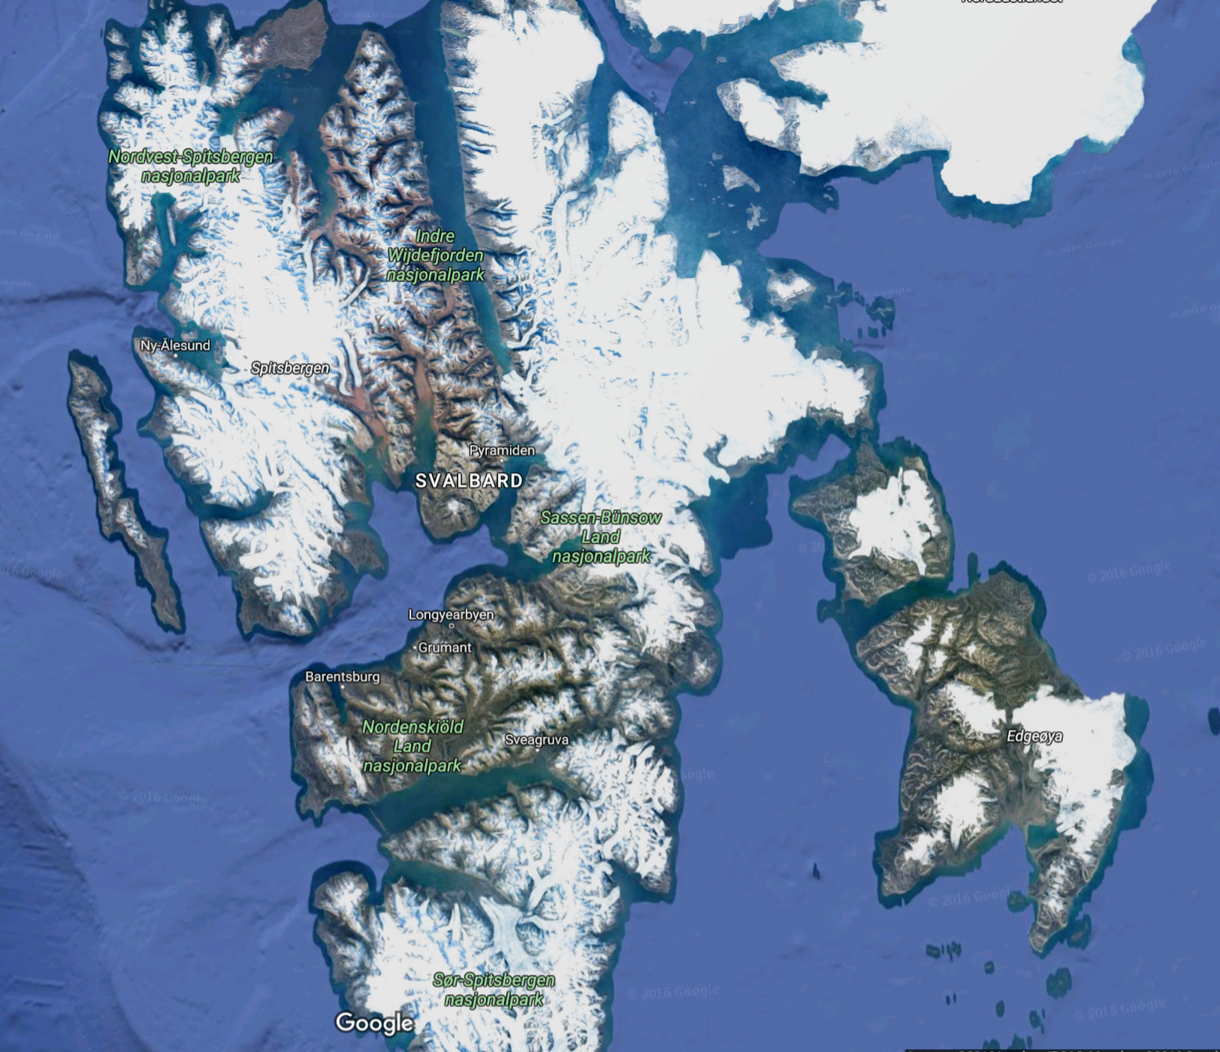
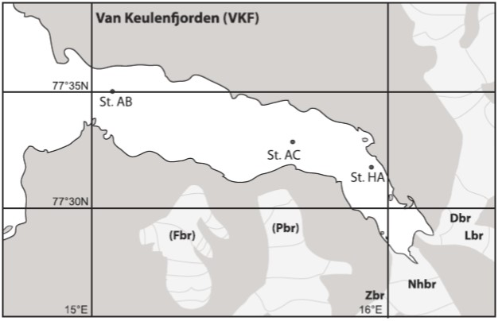
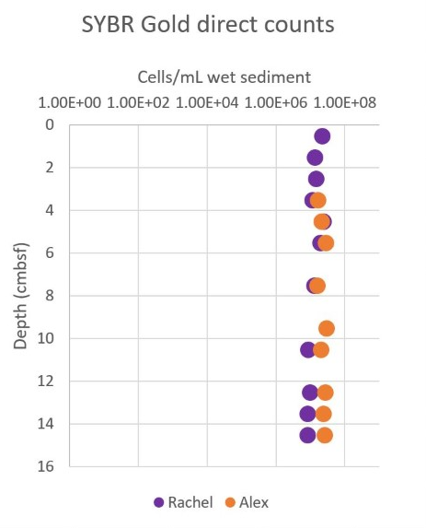
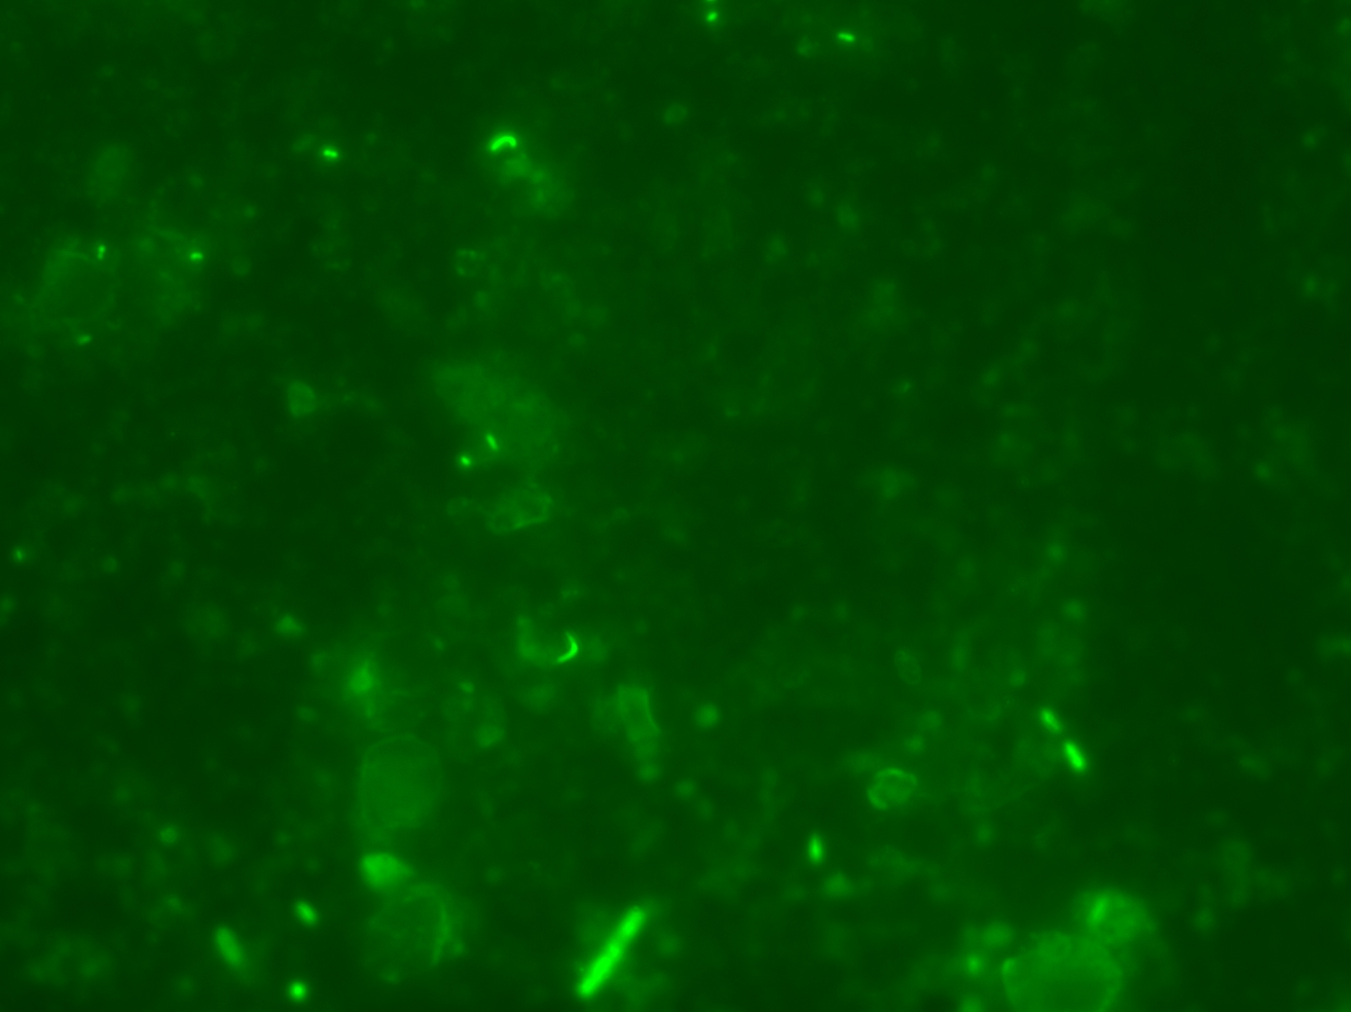
Quantatative analysis of microbial abundance within Arctic fjord sediments assessed through direct counting
Rachel Winstead, Alex Swystun, Brandy Barber, Jacob Lejeune, Joy Buongiorno, Karen Lloyd
University of Tennessee
Abstract
Adapted Methods
Microbes found in the marine sediments are responsible for the production of nearly half of the carbon dioxide found in the atmosphere (Arrigo, 2005). The fjords of Svalbard (79°N) are not considered typical marine sediments because high iron content influences unique subsurface redox chemistry. Radiotracer studies have shown that these sediments contain active bacterial sulfate-reducing communities (Finke et al., 2016). In addition to bacteria, archaeal cells within these sediments have been in aggregates encompassed by sulfate-reducing bacteria (Ravenschlag et al., 2001). These anaerobic organisms participate in mediating environmental biogeochemical cycles, including the oxidation of methane (Ravenschlag et al., 2001) and iron reduction (Vandieken et al., 2006). These observations have led to the understanding of the important role that these microbes play in global nutrient cycling and have led to recent interest in how these communities will respond to glacial retreat associated with climate change (Arrigo, 2005). However, the abundance of microbes across the fjords in Svalbard is relatively unknown. Here, we show the abundance of in sediments from two virtually unstudied fjords, Van Keulenfjorden and Kongsfjorden. We found a general trend of lower microbial abundance after around 10 cm in depth. For relative abundance, we saw numbers around 10^7 cells per ml in Van Keulenfjorden, which is slightly lower than counts of 16S copy numbers acquired through quantitative PCR (qPCR). Our results demonstrate that there are varying levels of microbial abundance in the fjord sediments of Svalbard. Moving forward, this research could help contribute to a better understanding of the effect that these microbes have on nutrient cycling at both a local and global level by coupling abundance data with functional analyses. Furthermore, we hope that this research will enhance the ability of predicting the effects that climate change and glacial runoff have on these microbial communities and carbon cycling in the Arctic Circle.
Undiluted x 3
Fig. 4 Adapted Methods Diagram. Six samples of generic test sediment were collected. Three of the samples were washed using the methods previously outlined and the other three samples were left in the paraformaldehyde to determine the difference (if any) that resulted from washing the samples (“Spin” and “No Spin” samples). These experiments will be conducted using various dilutions of the sample- undiluted, 1:10, 1:20, and 1:40.
Spin
1:10 x 3
1:20 x 3
1:40 x 3
No Spin
Undiluted x 3
1:10 x 3
1:20 x 3
Fig. 1: Field sites included in this study. Svalbard is an archipelago containing numerous fjords shaped by glaciers. Gold star denotes Van Keulenfjorden, the fjord that is the subject of this study (left). Samples were taken along a transect within Van Keulenfjorden (right) (Wehrmann et al., 2014).
1:40 x 3
ADAPTED RESULTS AND DISCUSSION
Preliminary Results
The first experiment from the undiluted samples showed that the undiluted samples contained too many cells and other background materials to be effectively mounted or counted via a microscope. The next experiment to be conducted will be using a 1:10 dilution which is expected to contain a sufficient number of cells based on these previous experiments (approximately 30 cells per field of view). We will continue to test various dilutions of the samples (including 1:20 and 1:40) to better determine the difference in these methods.
A future experiment will be conducted to determine if the sonication of the samples is having an effect on the counting of the cells- perhaps the cells are being lysed via the sonication. Once it is determined which method- "Spin" or No Spin"- results in the highest number of countable cells, a similar test will be conducted with three sonicated samples and three unsonicated samples.
Fig. 2 SYBR Gold Direct Counts. Counts for AB.1 samples taken from Van Keulenfjorden. Cells per ml wet sediment around 10^7 consistently for both direct count data. The general trend of Rachel's count went down for the deeper samples while Alex's counts showed no general trend.
Objective
The objective of this study is to determine microbial abundance in the sediments of Svarlbard fjords with the intent to enhance global carbon cycling models. The trajectory of carbon dynamics in the Arctic is hard to predict with climate warming, and so we take the first steps to uncovering the effect that these microbes have on cycling of nutrients at both the local and global scale.
Future Work
If our hypothesis is correct, and cell loss can be traced to previously used methods, a more accurate estimate of microbial biomass in these sediments can be attained. However, should the adapted methods not alleviate cell number discrepancies between this data and the data found in previous studies, further study will be needed to determine the cause of these differences. Such a large difference in cell abundance between fjords may reveal environmental variances not before realized in these fjords responsible for microbial abundance.
This work will better our understanding of how microbial communities are shaped by their Arctic sediment environment. Ultimately, the data produced from our adapted method experiments will aid us in estimating microbial biomass living in Arctic sediment, which is the first step to understanding how microbial communities may respond to climate warming and glacial retreat.
Methods
Samples were collected on site (Fig. 1) and fixed with paraformaldehyde, then washed with PBS and centrifuged x 3000g for 5 minutes three times. They were then stored in PBS/EtOH in a –20°C freezer. Samples were then diluted to a 1:10 dilution (to ensure the quantification limit was reached) in PBS and sonicated for 40 seconds. In preparation for staining, 20 ul of the diluted sample were combined with 5 ml of PBS and vortexed. Then, the samples were filtered using a vacuum filtration system, absorbant pads, and 0.2 um filters. The samples were then stained using SYBR Gold stain for 7 minutes. The filters were then washed with PBS for 5 seconds. Following this, the samples were mounted onto microscope slides and Vectashield was used to place the coverslips on the filters. The slides were then viewed using either an FITC or DE FGE light filter. The cells were counted using direct counting methods at 100x and then converted to cells/ml by accounting for filter size, dilution, and amount of sediment placed on filter.
Two student researchers counted the same samples to test reproducibility and user bias.
Fig. 3: Photo of cells. Cell morphology was diverse, with cocci, baccili, and some instances of vibrio-shaped cells.
2 um
Preliminary findings
REFERENCES
Our preliminary findings are in contrast to previous studies conducted in a nearby fjord, which shows as many as 10^9 cells in sediments (Ravenschlag et al., 2001). The cause for this discrepancy could be due to a number of factors, including geography and relatively different glacial cover. However, it is more likely that washing steps introduced during sample preparation caused decreased yield. To test the hypothesis that wash and spin steps result in underreporting of cells, we designed a new protocol.
Arrigo, Kevin R. "Marine Microorganisms and Global Nutrient Cycles." Nature 437.7057 (2005): 349-55. 15 Sept. 2005. Web.
Katrin Ravenschlag, Kerstin Sahm, and Rudolf Amann. Appl. Environ. Microbiology. January 2001 67:1 387-395.
Niko Finke, Verona Vandieken, Bo Barker Jørgensen; Acetate, lactate, propionate, and isobutyrate as electron donors for iron and sulfate reduction in Arctic marine sediments, Svalbard. FEMS Microbiol Ecol 2007; 59 (1): 10-22.
Wehrmann, Laura M., et al. "Iron and manganese speciation and cycling in glacially influenced high-latitude fjord sediments (West Spitsbergen, Svalbard): Evidence for a benthic recycling-transport mechanism." Geochimica et Cosmochimica Acta 141 (2014): 628-655.

