Slide 1


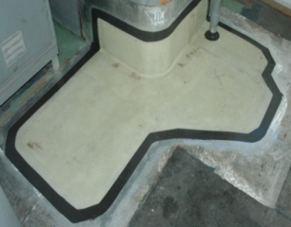
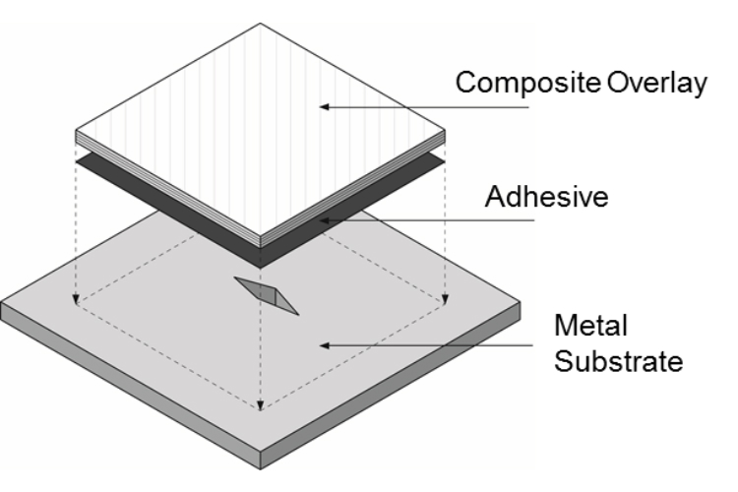
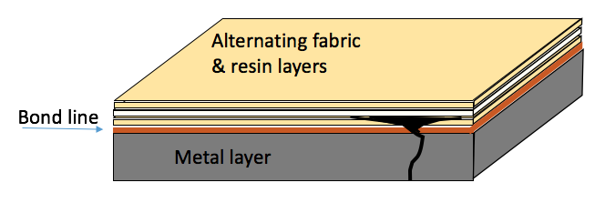
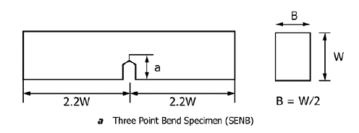
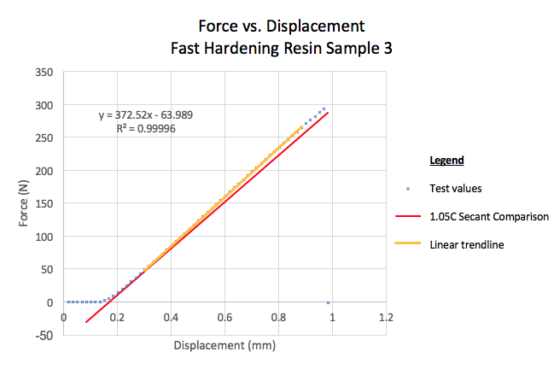
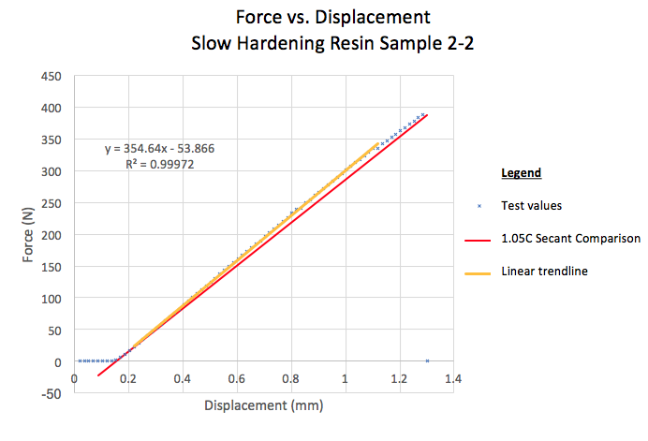
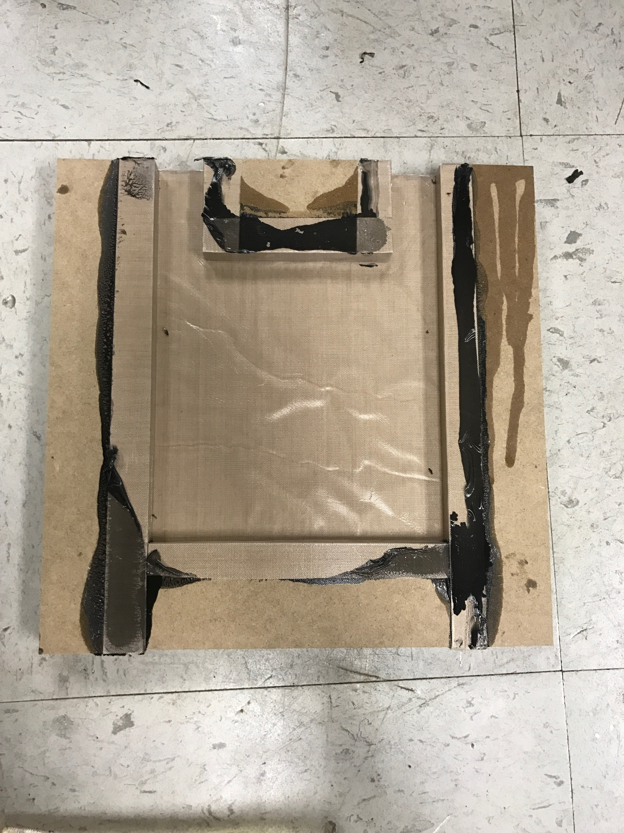
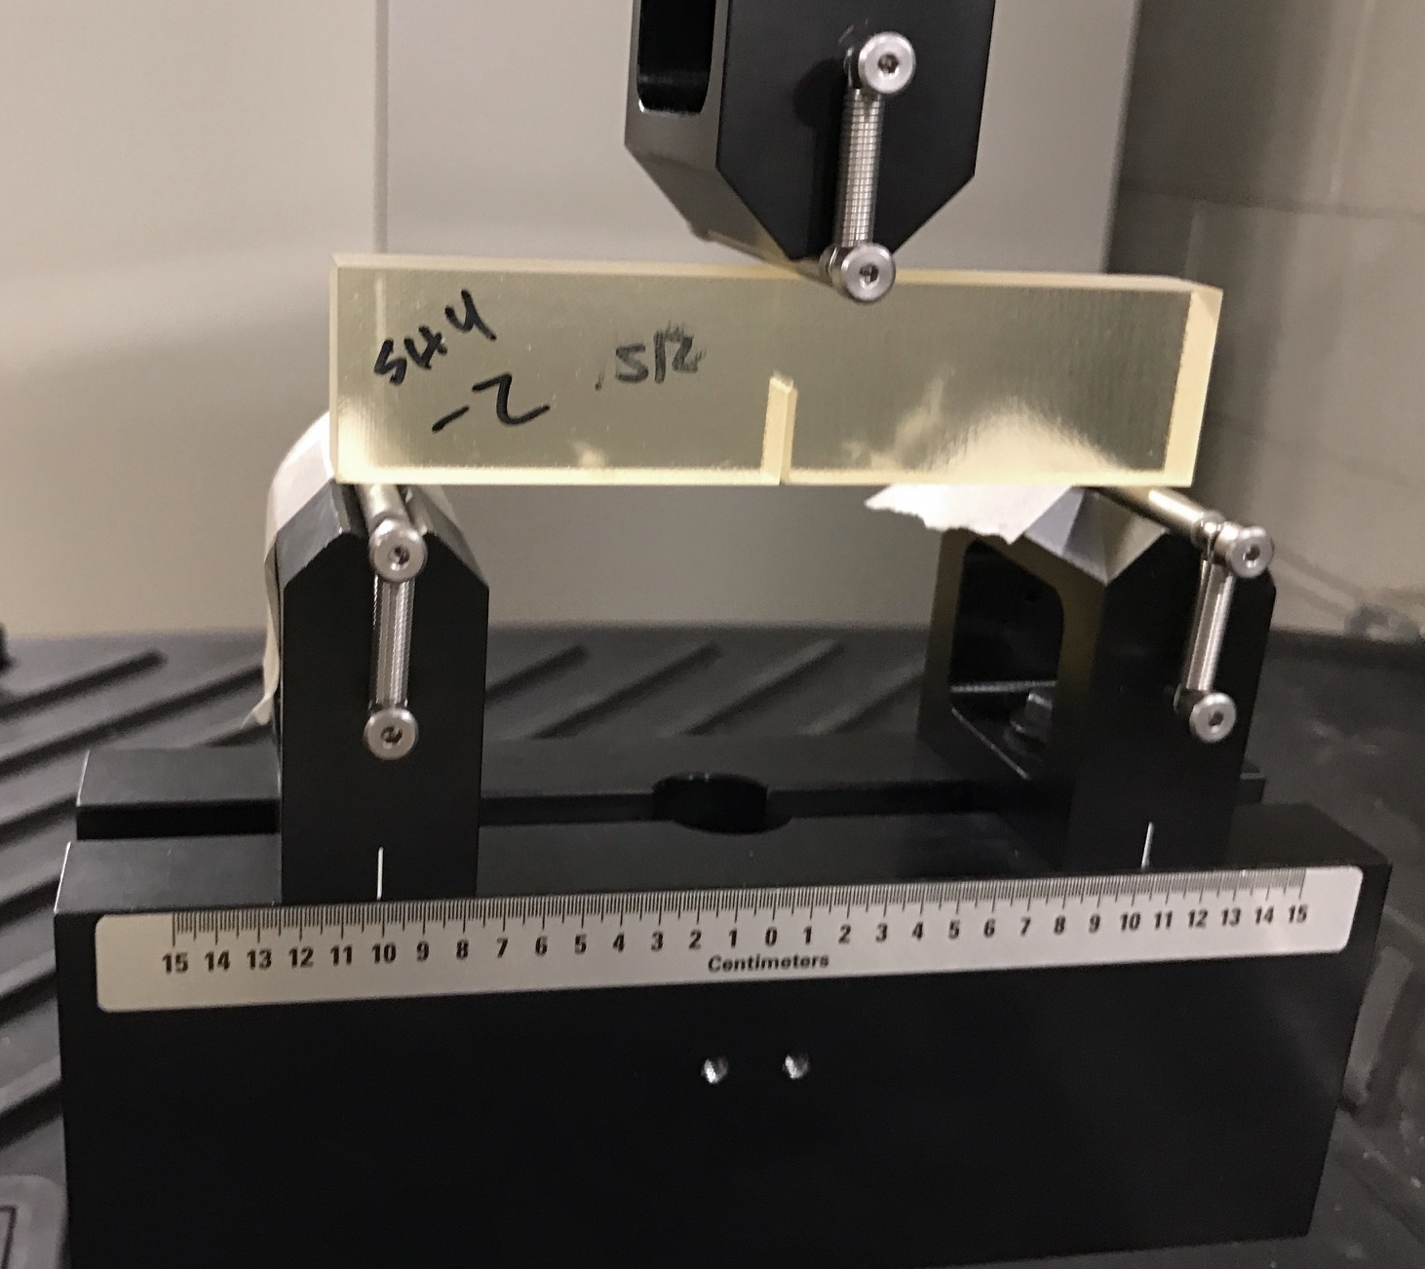
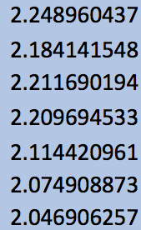
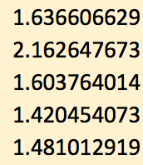
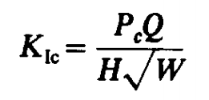
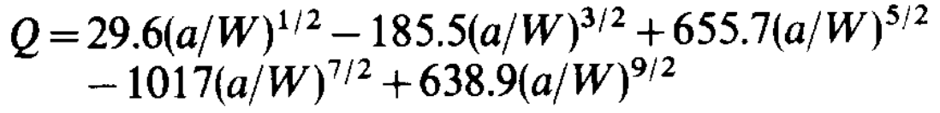
Mode I Fracture Behavior of Bisphenol-A Epoxy Resins
Gillian McGlothin
Mentors: Dr. Stephanie TerMaath, Dr. Jason Clement, Nathan Phelps, Bozhi Heng
Composite Patch Applications
Research Motivation
Technical Approach
Composite patches are used within many industries (including aerospace, automotive, and marine) for the purpose of repairing and reinforcing structures.
Restore load carrying capacity and prevent damage propagation
Cost efficient repair option for large structural components
Easily installed even on structures with complex geometries
Resistant to corrosion, which makes them ideal for use in many environments
70 patches are currently installed on 12 Navy ships to reinforce and repair hulls
Prior work has shown that the composite patches don’t fail at the bond line between the metal and epoxy, but rather the crack grows up into the resin layer causing failure in the epoxy itself.
  By studying the fracture behavior of the epoxy resin, we can improve the physics based model we have developed of the patched structure as a whole.
  3-point bend testing is an effective method to characterize the fracture behavior and crack growth properties of the resin.
  By utilizing the total force versus crack displacement data gathered from the testing, we will be able to characterize the fracture behavior and calculate the fracture toughness.
Calculate proper dimension of resin samples for testing according to ASTM standards (American Society for Testing and Materials).
Develop molding method to efficiently produce samples, with minimal air voids and maximized usable material in each mold.
Perform a 3-point bend test to observe the fracture behaviors of Bisphenol-A epoxy resin.
Analyze data for characteristic material properties of the BPA epoxy.
(5) Compare the resin properties when manufactured with slow and fast curing hardeners.
Photo courtesy of the US Navy
Molding and Testing Methods
Three Point Bend Testing Data
We created a mold out of medium density fiberboard pieces covered in Teflon and held together by an RTV Silicone to provide a strong seal.
  The Teflon covering allowed for easy disassembly and removal of the epoxy resin slabs as well as quick reassembly for further molding.
  The vertical, two hole design allowed for the resin to be poured into one hole and trapped air to easily rise into the crevice contaminating only the edge of the resin samples
The 3-point bend test allowed us to easily gather load force versus displacement data without special fixtures or attachments.
Epoxy resin
Trapped air bubbles
Fracture Toughness Comparison
Conclusions
Fracture toughness is the ability of a material containing a crack to resist fracture. This fracture toughness was calculated using the left formula below (where Pc is the maximum load on the sample, Q is a geometry factor given by the right equation below, H is the thickness, and W is the width).
The Pc value was determined by interpolating the force versus displacement testing data and utilizing a linear best fit line to find the maximum force along the trend line.
The fracture toughness values were then compared for the slow versus the fast hardening resins.
Fast hardener
KIC values
Slow hardener KIC values
We previously knew that the composite patches tended to fail through the resin layer adjacent to the metal and then propagate beneath the first fabric layer.
From the 3-point bend test data, we can see that the slow hardening resin performed better than the fast hardening resin (based on the maximum load applied and the fracture toughness values).
  On average, the slow hardening resin had a fracture toughness 29.79% greater than the fast hardening resin.
We now know that varying the resin used in the patch can alter the fracture toughness and consequently the overall strength of the patch.
This data will be used to modify a detailed 3D computational model of the patch enabling improved predications of patched structural performance.
Gillian McGlothin acknowledges the support of the Research and Instructional Strategies for Engineering Retention (RISER) at the University of Tennessee, Knoxville.

