Slide 1



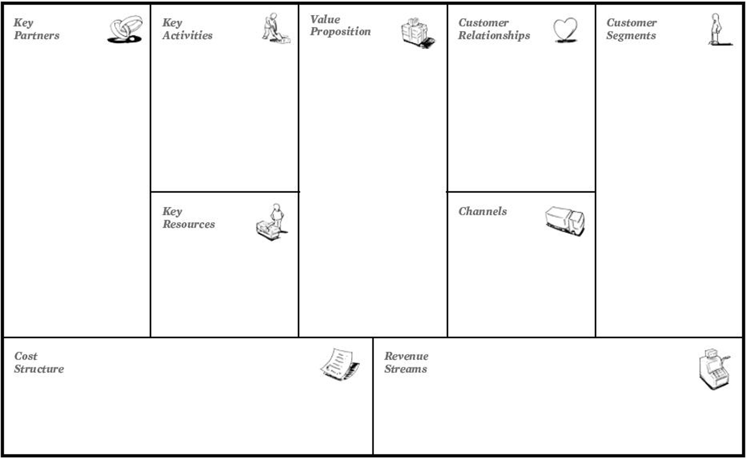
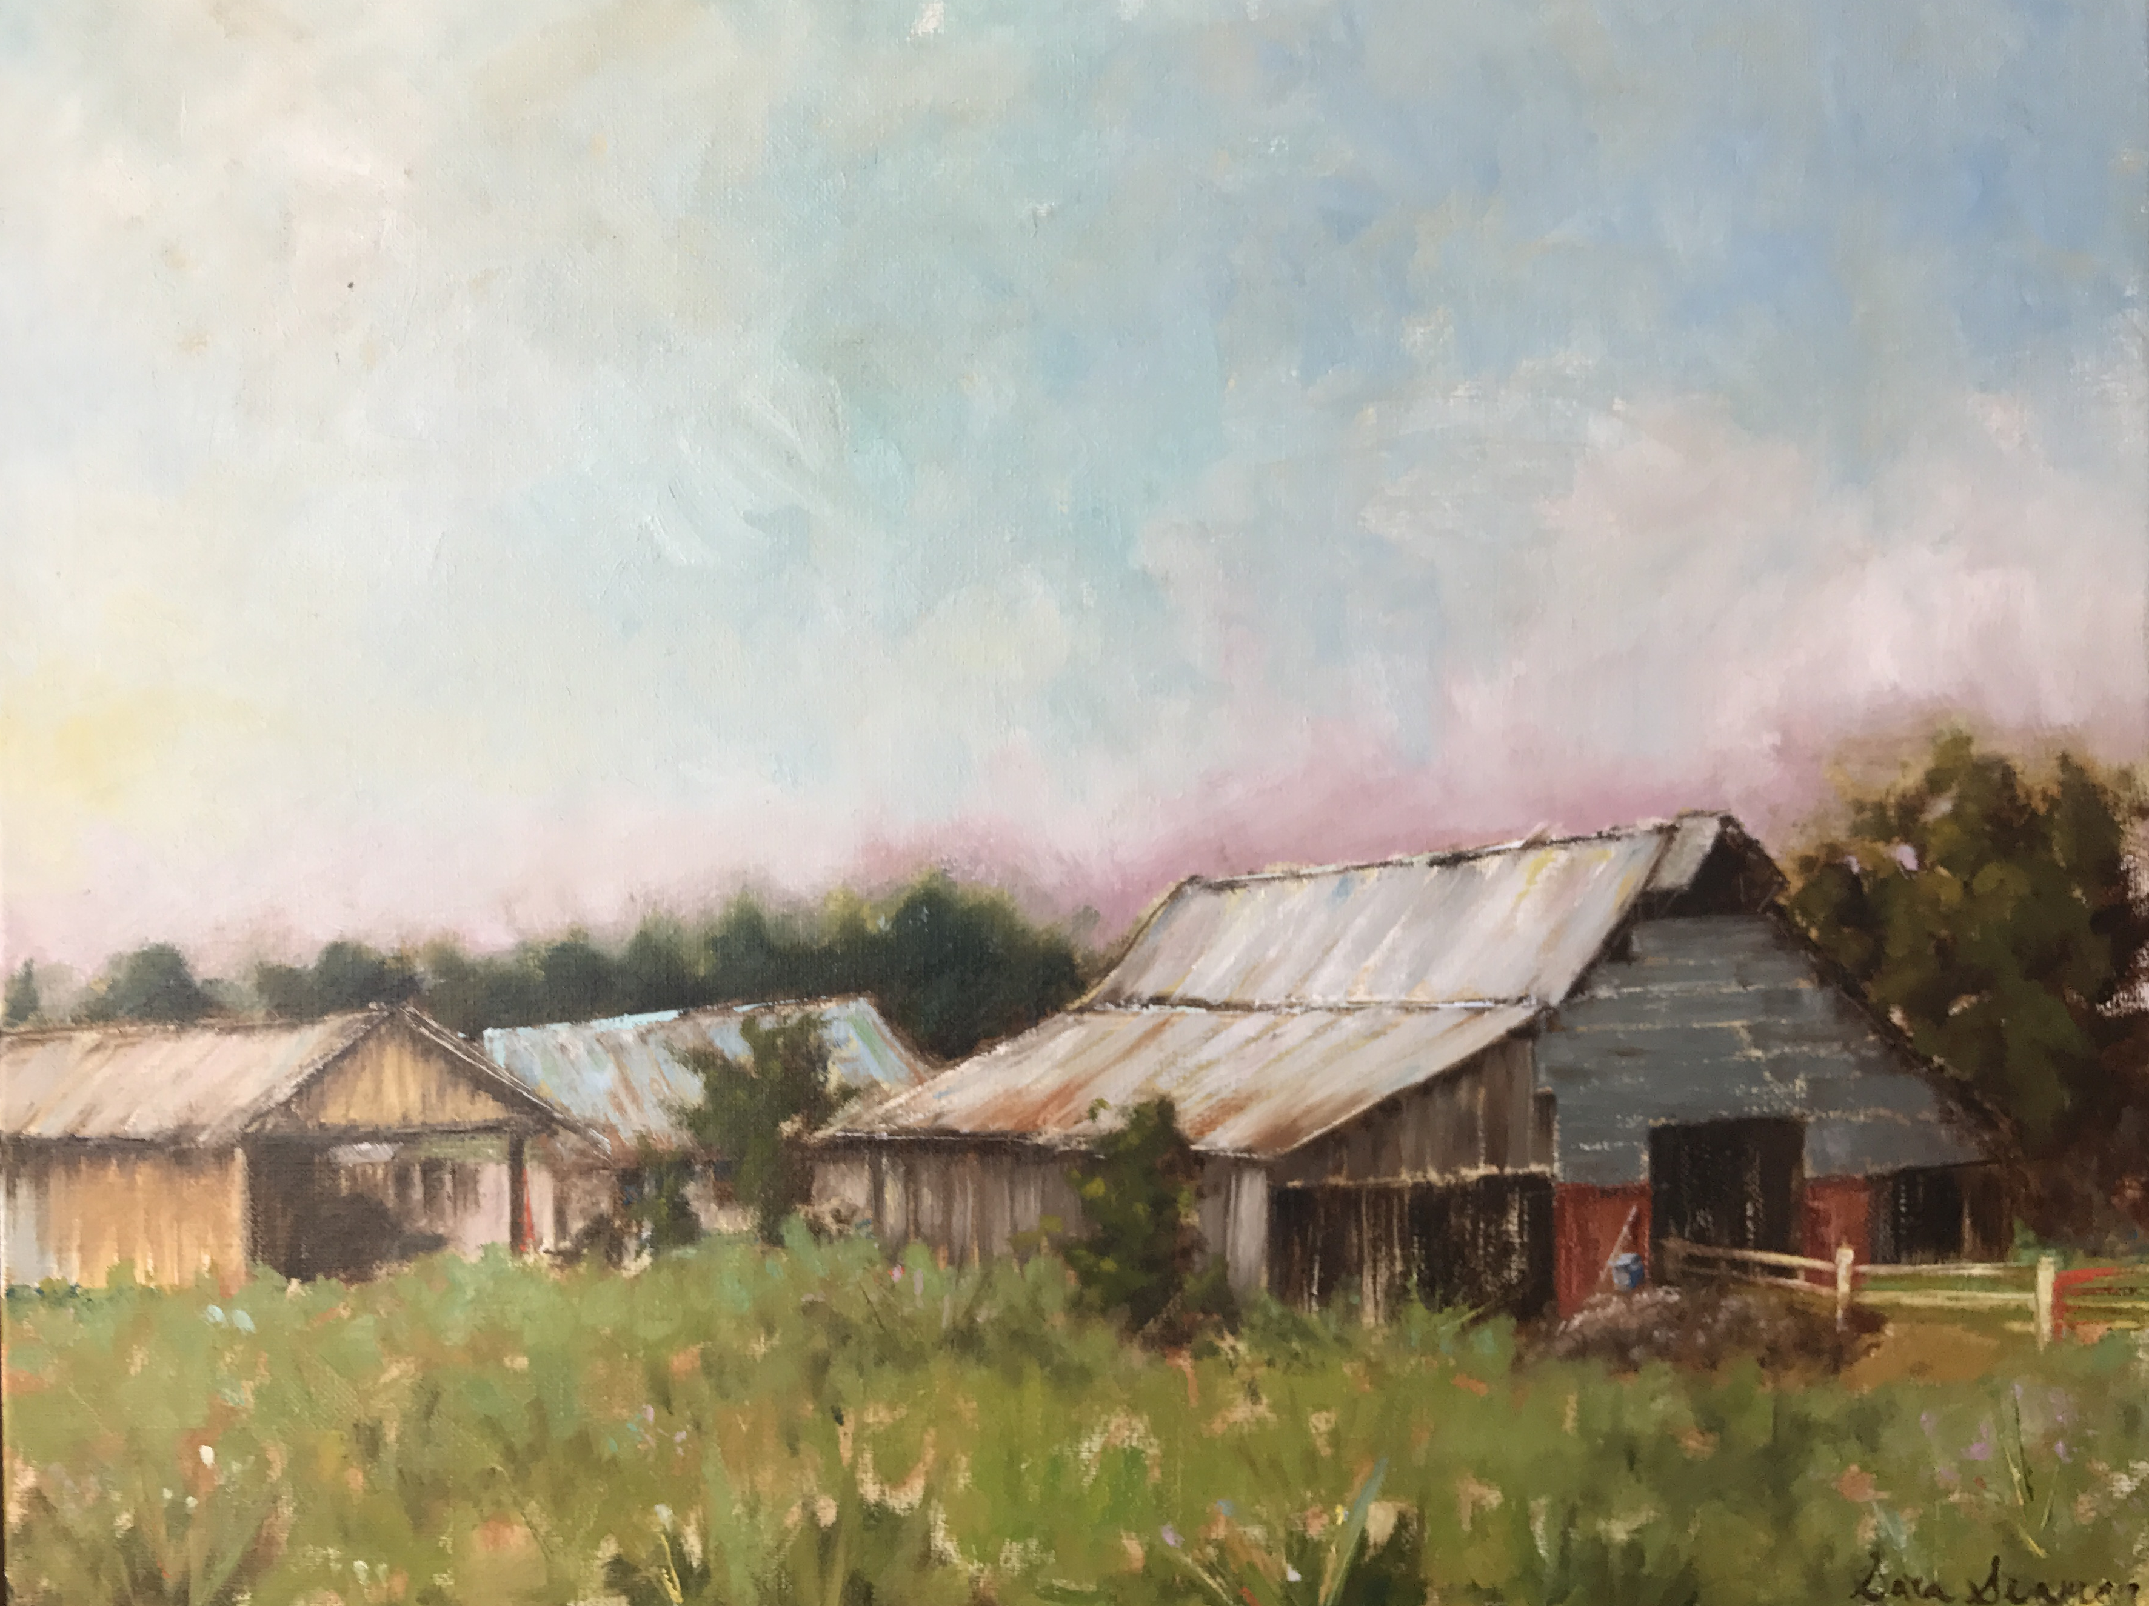
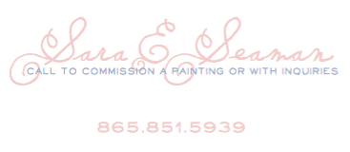
Sara Liza: a Pant Suit and a Paint Brush
By: Sara Seaman
Advisor: Lynn Youngs
Haslam College of Business at the University of Tennessee
BACKGROUND & RESEARCH
THE BLUEPRINT: a foundation for my business
OPERATIONS: Moving out of my dining room
Sara Liza is a company inspired by my passion for painting and impacting others. It breaks the business plan mold by creating a need through an emotional interaction between consumers and art - rather than finding a need and filling it.
Vision: As a budding artist, it is necessary for me to gain awareness and financially support myself through accepting commissions and selling prints; however, I will eventually only sell originals to allow myself full creative freedom and maximize the value of my work.
Business Model Canvas
Graphic Designer
Investors
Galleries
Third Parties
Monthly Newsletter
Website & Social Media Communications
Product Research, Development, and Creation
Emotional Connection
Customization
Status
Design
Price
Personal Assistance
Dedicated Personal Assistance
Original Art Enthusiasts
Commissioners
Print Buyers
Vol Fans
Research Methods
Interviews: I conducted 20 interviews with artists, original art collectors and people from the general population to inform my decision on customer segments and what values to deliver.
Admired Artists Study: I selected 5 artists based on how I admire them for their styles and career paths. These artists influenced my decisions on my style, career path and go-to-market strategies.
FINANCIAL SNAPSHOT: Price changes drive financial success
Studio
Sales Force
Word of Mouth
Social Media
Galleries
Website
Studio Rent
Website
Employee Salaries
Painting Materials and Supplies
Commissioned Pieces
Originals
Smokey Prints
CAREER TIMELINE: Skill matters
Master
MY WORK: Impressionism meets reality
Costs peak due to initial investment in materials that do not require repurchase. Revenue appears to peak between Y4 and Y5 – this is because time limits my production capacity; however, as demand rises, the growth in my revenue comes from my ability to raise prices each January.
While the two styles represented in my works here - realism to the left and impressionism to the right - are opposites, I will marry the technique of Smokey with the color and freedom of the farm scene for future collections. This combination is unique and will set me apart as an artist.
I plan to continually develop and improve my products through workshops and formal classes.
CONTACT
Novice
My go-to-market strategy changes over time as my skills progress from novice to master painter level.

