Slide 1
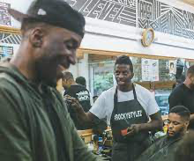
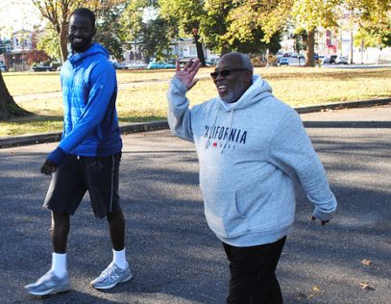
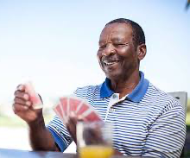

Are you a Black man who has an opinion on health?
Researchers from the University of Tennessee, Knoxville, are studying the attitudes and perceptions of Black men towards physical activity and want to hear from you!
Participation includes completion of a 15-minute survey. The first 400 men who complete surveys will be compensated for their time.
**BEING A REGULAR EXERCISER IS NOT A REQUIREMENT**
PLEASE DIRECT QUESTIONS TO:
ALVIN MORTON
AMORTO16@VOLS.UTK.EDU
IF YOU ARE READY TO PARTICIPATE, PLEASE CLICK THE LINK BELOW

