Slide 1
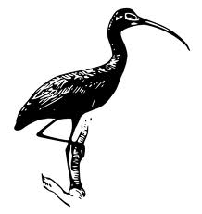

Understanding the Data Management Needs and Data Sharing Challenges of Environmental Scientists
Carol Tenopir,
Suzie Allard, and Miriam Davis
University of Tennessee
EIM Conference
Wednesday, September 28, 2011
IBIS

Slide 2

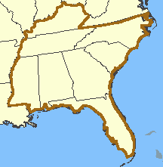
Data Observation Network for Earth (DataONE)
International
NSF
Multi-disciplinary
Increasing Biological Information Sources (IBIS)
Southeast US
USGS
Dual disciplinary (Env. & Info. Sci.)
IBIS
Both use assessments to gain insights into scientists’ data and information practices and needs.

Slide 3
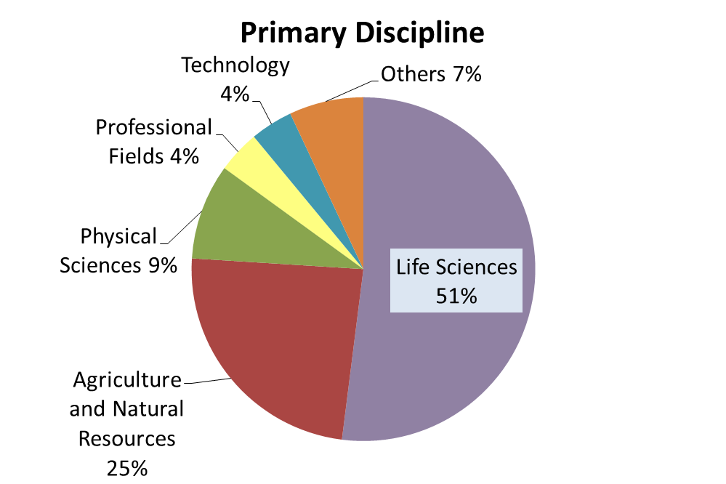
Surveys of Scientists
IBIS
Primary Discipline
n=1317
n=428
Notes:
A quarter of the IBIS respondents were in government and 12% of DataONE respondents.

Slide 4

Lessons Learned
+
IBIS

Slide 5
Many scientists are interested in sharing data, but there are barriers and with conditions.

Slide 6
Interest in Data Sharing

Slide 7
Gap Between Willingness to Share and Accessibility

Slide 8
Conditions for Data Sharing

Slide 9
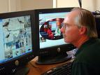

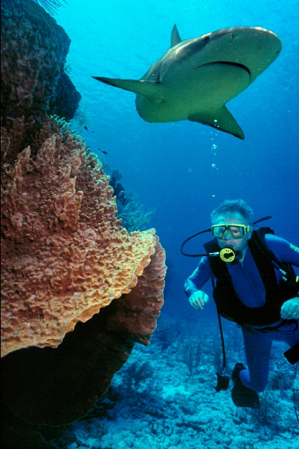
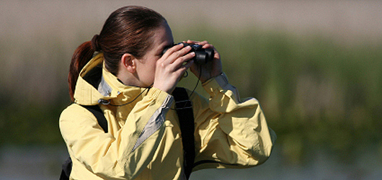
Concerns about sharing
IBIS
“We are torn between putting it out there for everyone and worry about suffering the risk of something bad happening with it. Saddest thing would be if the data loses its use, where it isn’t shared.”
“Is there a mechanism by which we can know when our data is being used? Knowing how valuable we are to the general public comes from the use of our data.”
“If someone were to ask about rare or endangered plants, I would limit that information to appropriate people: natural heritage, universities and federal agencies.”
“We want to make sure that those of us who have been involved in gathering the data get appropriate recognition for it.”

Slide 10
Reasons for Not Making Data
Electronically Available

Slide 11
2. There are different needs, attitudes, and practices between scientists who work in government agencies and those who work in academia.

Slide 12
Satisfaction with Ability to Engage in Data Management Activities
 | % Government | % Academic
Satisfied with the process for cataloging/describing my data | 47.5 | 61.5
Satisfied with the tools for preparing my documentation | 33.7 | 45.6
Managing data during the life of the project | 52.4 | 39.6
Storing data beyond the life of the project | 53.3 | 34.6

Slide 13

The View from Government & Academic
IBIS
“I don’t have the authority to make decisions about data sharing. “
“Our data sharing policy makes it difficult for us to withhold parts of the datasets we receive. As a result, some data contributors only share sub-sets of their data.”
“I don’t have anything I’m keeping private. I’m willing to put it all out there.”
“If other people are using my data then I somehow need to report that. I need to know how it’s being used and if any publications result.”
Notes:
Academic respondents are more likely to have sole responsibility for approving access to some or all of their datasets.
Academic 83%, Government 63%

Slide 14
3. There are many ways data management can be assisted.

Slide 15
Data Life Cycle
Assure
Preserve
Discover
Integrate
Analyze
Collect
Describe
Deposit
Assessment

Slide 16
Importance of Information Tools
IBIS
Notes:
How important is each tool listed below for doing your biodiversity work?

Slide 17
Metadata Standards Currently Used

Slide 18
My organization provides…
 | % Government | % Academic
Training on best practices | 23 | 21
Funds for data management long-term | 27 | 20
Funds for data management short-term | 34 | 29
Tools and technical support for data management long-term | 39 | 34
Tools and technical support for data management short-term | 48 | 43

Slide 19
Looking for Assistance
“Manpower. We need more people to handle these sorts of things.”
IBIS
“Maximum utility of the data would require geo-referencing of the data. We would need help geo-referencing the part of the collection that isn’t geo-referenced.”
“It is cumbersome to put those data sets together, but only because it is important. If there were ways to automate some of that information collection out of the data sets, it would help.”

Slide 20
Questions?
Carol Tenopir
ctenopir@utk.edu
Suzie Allard
sallard@utk.edu
Miriam Davis
miriams@utk.edu

