Slide 1
SocioCultural
Highlights
EAB
Suzie Allard,
Maribeth Manoff & Kimberly Douglass
(with additional support from Carol Tenopir, Bob Sandusky, & the SC Working Group)

Slide 2
Outline
Summary of SC activities
  Stakeholder Network & Matrix
  Stages of the Data Lifecycle
  Working Group
  Next Steps

Slide 3
SCWG mission
“This working group will research the social and cultural context of the scientific data lifecycle to devise strategies that maximize the impact of DataONE.”

Slide 4
Data Stewardship
Data deposition/ acquisition/ ingest
Data curation and metadata management
Data protection
Data discovery, access, use, and dissemination
Data interoperability, standards, and integration
Data evaluation, analysis, and visualization
Stages
of the Data LifeCycle

Slide 5
Stakeholder
Network
Administration
Research Faculty
Students
Teaching Faculty
Scientists
Academia
Non-profit
Govt
Community
Libraries/Librarians
Publishers
Private
Industry
Libraries
Professional Societies
Citizen-scientists
Citizen-activists
Foundations
Libraries
Librarians
Social Svcs
K-12 Teachers
Librarians
Think Tank - Advocacy
Informal Educators
Curriculum Builders
Policymakers
Local
Federal
Policymakers
State
Administrators
Advisory Committee
Decision Makers
Judiciary
Policymakers
Administrators
Advisory Committee
Decision Makers
Administrators
Advisory Committee
Decision Makers`
Libraries/Librarians
Libraries/Librarians
Libraries/Librarians

Slide 6
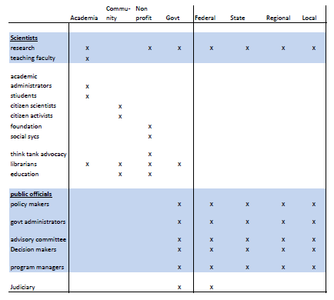
Example Profile:
Government housed researcher
Data intensive environment
Data producer/contributor
Data user
What s/he wants from us: system that improves how they work
What can we supply they don’t know about: toolkit, work flows
What motivates us: facilitating science
Contacts:

Slide 7

Questions for each Profile
What kinds of questions are our stakeholders addressing?
What kinds of information can we supply they don’t know is useful?
What are our motivations for being involved with them?
Who are our contacts inside these stakeholder groups?

Slide 8
SC WG Members
Co-Chair: Suzie Allard, University of Tennessee
Co-Chair: Maribeth Manoff, University of Tennessee
Lynn Baird, University of Idaho
Geoff Bilder, CrossRef
Ahrash Bissell, ccLearn
Kevin Crowston, Syracuse University
Charles Humphrey, University of Alberta
Heather Joseph, SPARC
Elena Karasti, University of Oulu
Theresa Pardo, University of SUNY
Scott Tomlinson, Canadian International Polar Year

Slide 9
WG Accomplishments
Revised draft charter. Approved final draft.
Developed action plan: specific deliverables through Y2Q4 particular attention to materials for DIUG; general planning beyond
Aligned specific deliverables with SCWG mission & D1
Assigned responsibility for 19 action items
Created opportunities to collaborate with other WGs
Formalized on-going communication: monthly e-meetings – updates/methodologies
Worked on calendaring

Slide 10
SCWG Next Steps
Data life cycle (based on VDC work) (Y1/Q4)
Research life cycle (Y2/Q1)
Stakeholder network by function (Y2/Q1)
Data citation white paper (Y2/Q1)
Public officials grant proposal (Y2/Q1)
Relationship between data & research life cycle – for DIUG (Y2/Q2)
Stewardship principles – for DIUG (Y2/Q2) Personas(w/U&A?) (Y2/Q2)
Quick success stories (data sharing) –for DIUG(Y2/Q2)
Data citation recommendations – for DIUG (Y2/Q2),
Stakeholder life-cycle matrix (Y2/Q3),
Lit Review (data sharing, data re-use) (Y2/Q3),
Environmental scan – journals (& professional societies) (Y2/Q3),
Intervention paper (Y2/Q3),
Meaning of data, Barriers 1-pager (Y2/Q4)
Environmental scan – Institutional policy (Y2/Q4)
Infinity & Beyond: International-national policies
socio-cultural symposium…

