Slide 1
U&A WG 2016-09
Carol Tenopir, Mike Frame, Lynn Baird, Rachel Volentine, Rachael Hu, Lisa Zolly, Bruce Grant, Kevin Crowston, Allison Specht, An Yan, Bob Sandusky, Suzie Allard, Danielle Pollock

Slide 2

UX activities to inform 36-month deliverables:
Aligned activities with S&G and CI
Drafted UX strategic plan
Developed value questions for UX testing:
  How do you see this [tool] helping you with your work (i.e. research, library support, etc.)?
  If you are interested in participating in a follow-up study when the product goes live (or for a follow-up interview) please provide your name and e-mail: ___________

Slide 3
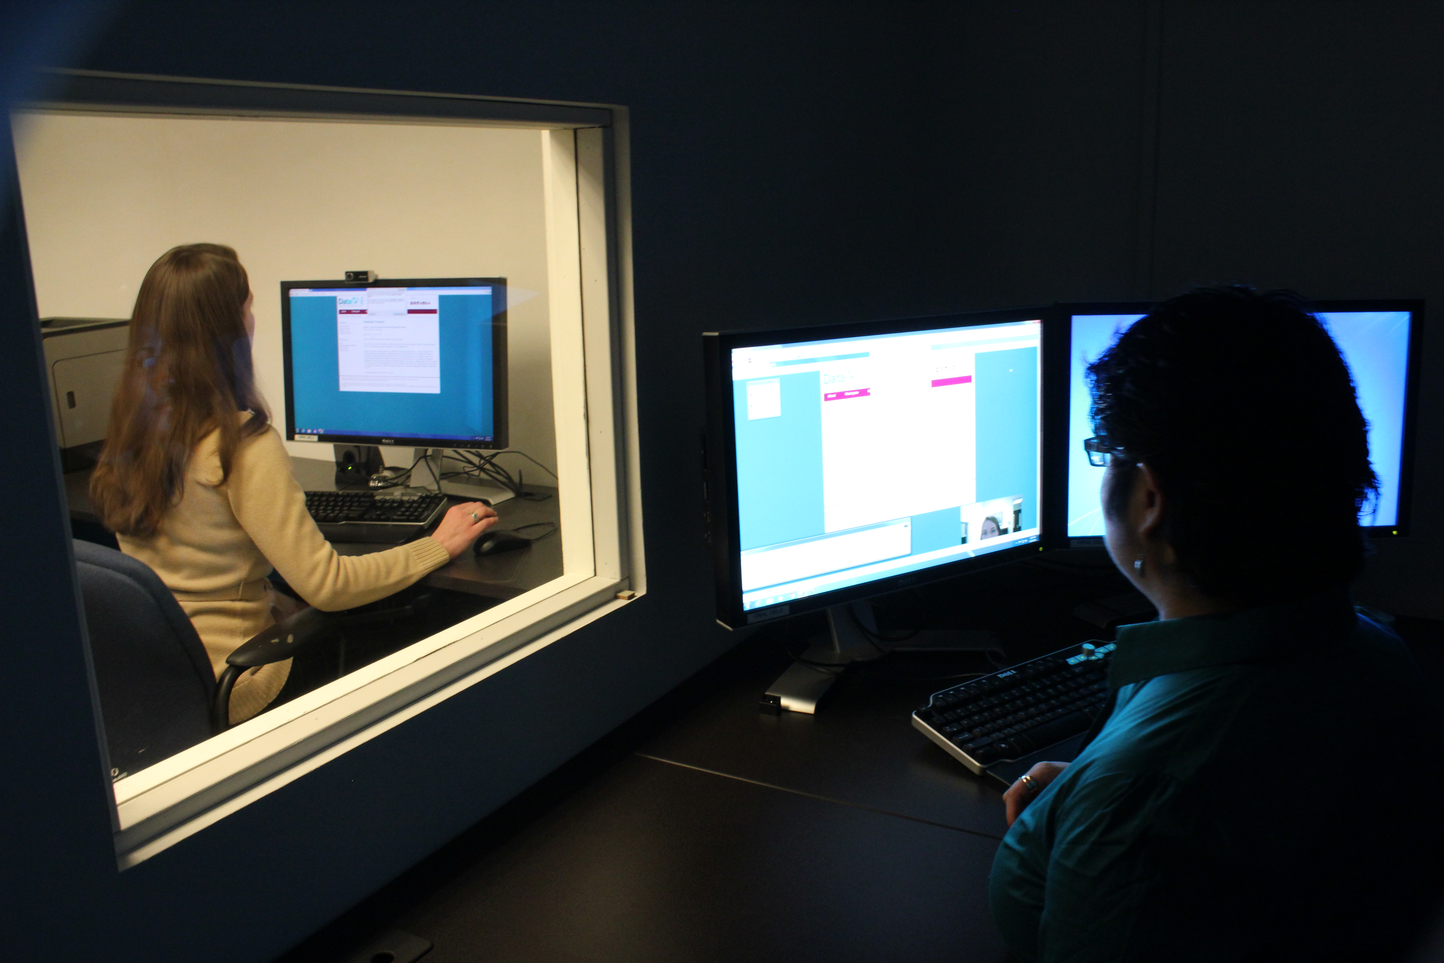
UX Strategic Plan
Goal: Gather meaningful metrics and impact stories to demonstrate the value and effect of DataONE’s tools and services.
Establish usability test plan
Develop impact stories based on data sources
Investigate accessibility testing (ADA 508)
Integrate with other DataONE operational areas

Slide 4

Assessment deliverables for month 36
1. Finishing up general assessments
Scientists #3 (a.k.a. FU#2); distribute, analyze, write draft
Libraries #3 (European academic libraries) accepted for publication
Data reuse paper
2. Transition to focused assessment
Assess impact of DataONE tools and services on practices of librarians
Plan strategies to assess impact of DataONE on other stakeholders
Emerging communities: environmental health

Slide 5
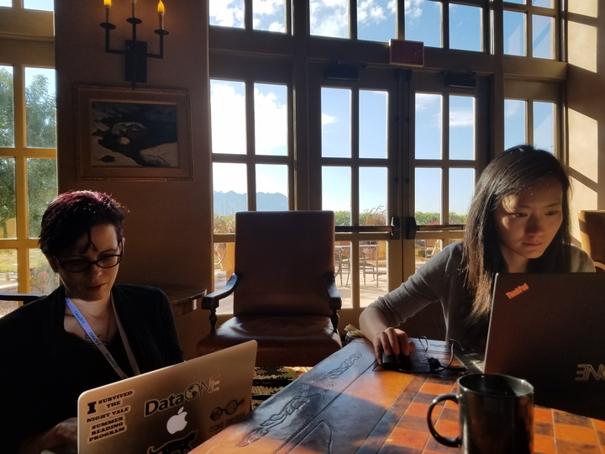
New and Emerging Communities: Studying Environmental Health
Satisfies requirement to use alternative methods to examine a new and emerging community
12-month deliverables:
  Multiple research papers
  White paper that informs DataONE S&G
AHM accomplishments:
  Developed initial code book
  Developed research plans
  Brainstorm for future emerging communities

Slide 6
