Slide 1

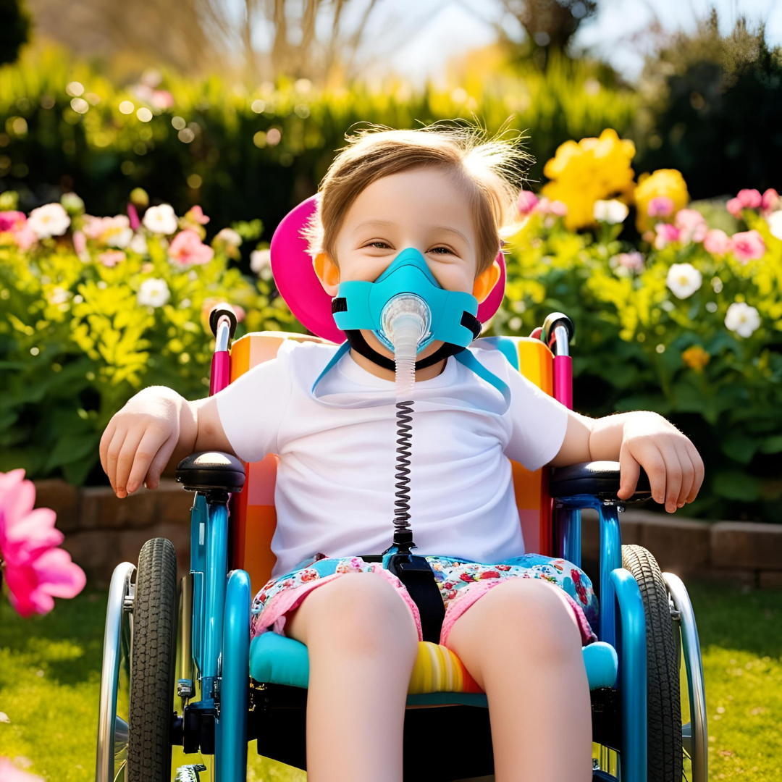
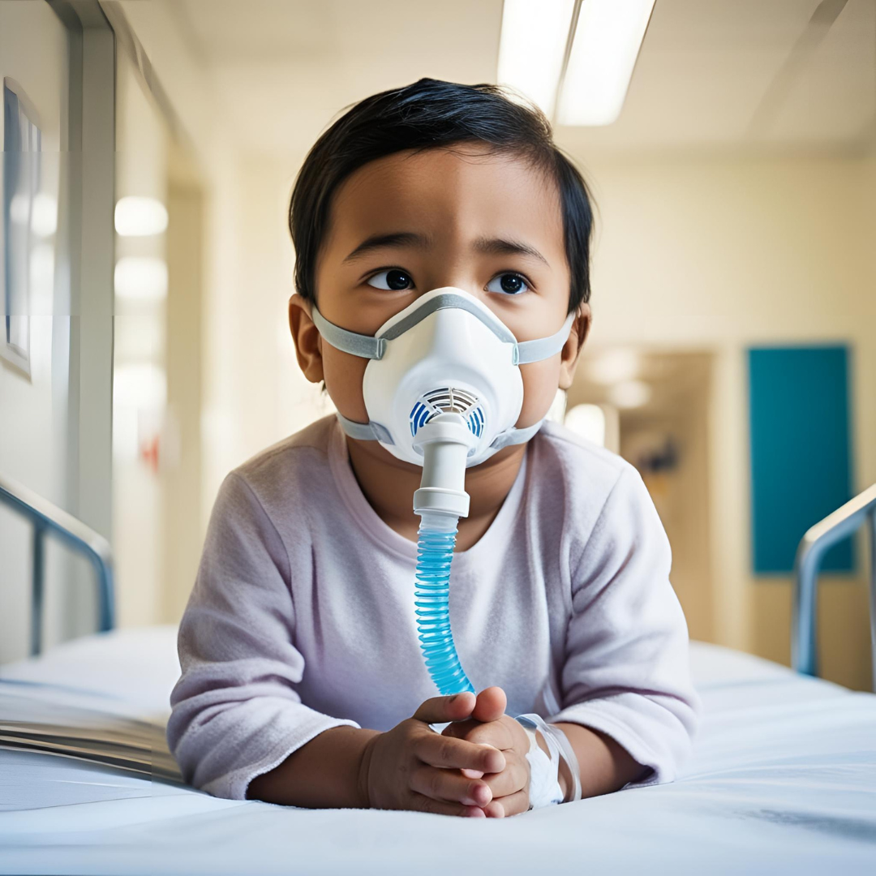
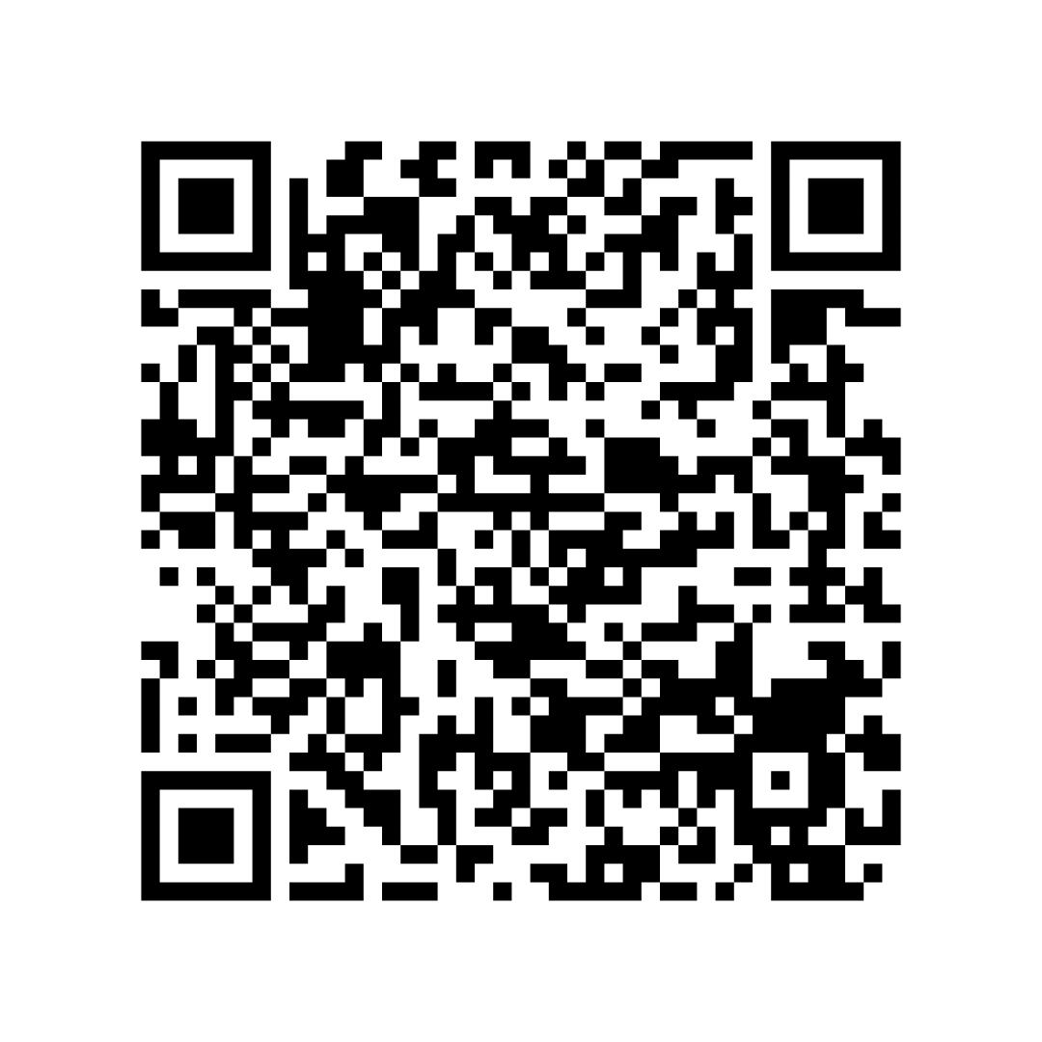

Qualitative description will allow a patient-centered exploration of barriers to NIV usage
Understanding Barriers to Using Noninvasive Ventilation Through the Experiences of Caregivers of Pediatric Patients with Neuromuscular Disorders
Regan Bergan, SN
Mentor: Noel Arring, DNP, PhD, RN
Advisor: Kathleen Thompson, PhD, RN
PICO
EXPLORATION OF METHODS
How do caregivers of pediatric patients diagnosed with a neuromuscular disorder perceive barriers to the use of noninvasive ventilation as respiratory support?
The methods which could be used to explore this issue include a quantitative approach, a phenomenological approach, or a qualitative descriptive approach.
BACKGROUND
Quantitative | Qualitative
 | Qualitative Description | Phenomenology
Deals with numerical information⁶. May illustrate effectiveness of various treatments using lung capacity or oxygen saturation levels. May show adherence rates. May show barriers are present, not what they are. | Deals with specific experiences of participants^{18,23}. Guided data collection allows researchers to look at a specific experience or specific element of an experience²³. | Deals with the lived experience surrounding a particular phenomenon²⁶. Less guided questions: “tell me about your experience with…” No preconceived goals for data collected¹³. May not explain barriers.
Children with neuromuscular disorders (NMD) often have weakened respiratory muscles as a result of their condition.
Noninvasive ventilation (NIV) is often used to give these children respiratory support^{1,9}.
With NIV, oxygen is being pushed into the lungs and can be adjusted as needed for each client⁷. The form of supplemental oxygen used is dependent on each child’s needs.
The NMDs frequently discussed in literature related to NIV or Duchenne Muscular Dystrophy (DMD)²⁰ and Spinal Muscular Atrophy (SMA)^{2,24} .
Children with these conditions do not often reach adulthood due to complications from their disorders^{20,24}.
Common complaints among adults with NIV include:
  Skin breakdown^{5,15}
  Dried mucous membranes¹⁵
  Air leakage¹⁵
  Claustrophobia^{5,15}
  Difficulty with communication³
There is a gap in the research surrounding barriers to use in children
Due to the nature of NMDs and the ages of the children with these conditions using NIV, communication is often difficult especially with strangers who are not attuned to each child’s communication style.
The caregivers of these children are with them everyday and have become experts with their child’s habits and feelings surrounding their NIV usage. As a result, caregivers are a reliable source of information regarding their child’s NIV use.
CONCLUSION
Images created by Canva Magic Media
These approaches all have merit, but not all of them are appropriate for what we want to understand. We want to learn about the experiences of the caregivers of these children with a focus on understanding the specific barriers to effective use and regimen adherence.
A qualitative descriptive approach is the most appropriate method of research to understand barriers to NIV regimen adherence for children with neuromuscular disorders through the lens of their caregivers.

